Slide 1
DSTA 5301 Final
Willis Banks
2023.12.09

Slide 2
Background
The data shown here comes from the publicly available NYPD shooting incident data set
This data is published yearly and provides information regarding shooting incidents to which the NYPD responded going back as far as 2006

Slide 3
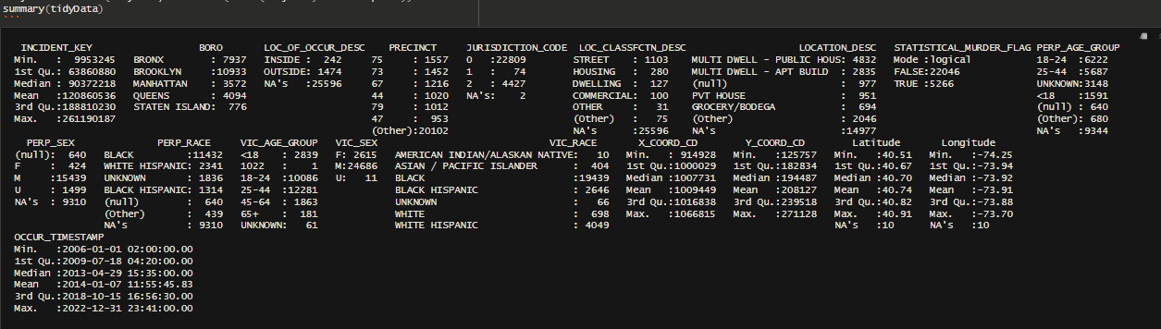
Data Cleaning
Prior to any exploration or analysis, the data was cleaned to a computer processable state
  Dates and times were cast as datetime values instead of strings
  Descriptive encodings, such as a person’s gender, were cast as categorical variables

Slide 4
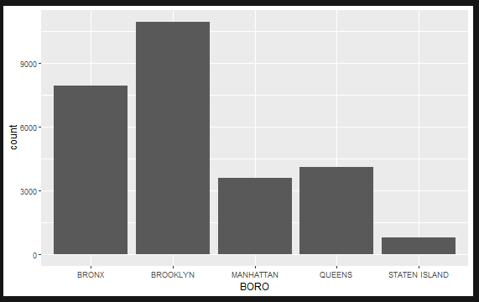
Data Exploration
To get started, a quick histogram of the number of events on a per-borough basis was created.
At a glance, one could assume Brooklyn and The Bronx to be the most dangerous.
  It is extremely important to remember that these values are not adjusted to population and can be very misleading.

Slide 5
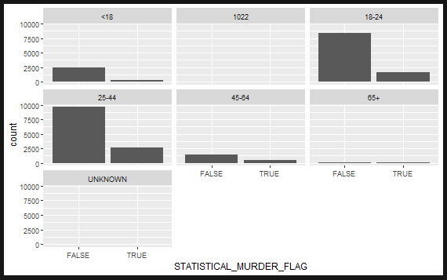
Data Exploration
Next, a review of the distribution of events across age groups
The plots to the right display each age group with a bar for the number of incidents in which the victim survived vs ones where they did not
These plots have the y-axis linked and so can be difficult to interpret when comparing across groups
One thing shown, which is intuitive, is that 18-44 age groups are most likely to be involved in an incident
  This is likely due to both the proportion of the population they take up
  Another possible factor would be the likely hood of these age groups to participate in riskier behavior

Slide 6
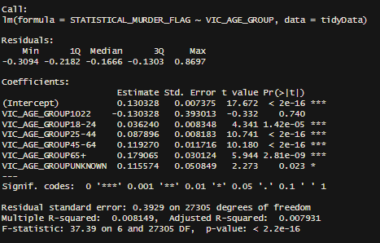
Simple Model
To experiment with the data, a simple model was generated
This model fits the statistical murder flag (whether or not a given event was fatal) to the victim’s age group
  One would expect the very young (who are not represented here) or the elderly to be more likely to succumb to their injuries
The model shows that every age group is relevant (p-value < 5%) with the execption of group 1022, which is likely to be erroneous

Slide 7
Biases
A likely significant source of bias in the data is the reporting methods themselves
  Given the scale of the data, any systemic biases will be reflected in the data
  This can be due to areas being over/underrepresented for example
A notable flaw in the aggregate of the data is that the populations of the assorted groupings was not readily available
  The histogram of number of events by borough in particular was very sensitive to populations and a poor visualization
Given the simple, exploratory nature of the review and modeling, no personal biases were present in the analysis

