Slide 1
DTSA 5509 Final Presentation
Willis Banks
2023.12.09

Slide 2
Background
The police of New York City have a publicly published dataset describing shooting incidents beginning in 2006 and updated every calendar year. In this data set one can find information on the victim, perpetrator when available, time, place, and a few other pieces of information.
  One piece of information in this data set is the STATISTICAL_MURDER_FLAG. This boolean variable describes if the shooting resulted in a fatality.
This analysis will be concerned with if a model can accurately assert if a given event will be fatal based on the other parameters.
  Such a model would be a place to start to discover factors about incidents that could be controlled and possibly advise the public on ways to reduce the number of deaths caused by shootings in New York.

Slide 3
Approach
The focus of the project is to attempt to find a model that does better than guessing.
  Should such a model be found, future work would be focused on tuning and upgrading the model to do so with greater efficacy.
For this project several classifiers with different sets of hyperparameters will be reviewed to determine which ones, if any produce a model that is superior to guesswork.

Slide 4
Data Ingestion
The data set is downloaded directly from the City of New York as a CSV and loaded using pandas and contain the following fields
Parameter | Type | Description
INCIDENT_KEY | int | Unique identifier
OCCUR_(DATE/TIME) | string | Time of event
LOC_OF_OCCUR_DESC | string | Description of location in which the event occurred
PRECINCT | int | Precinct in which the event occurred
JURISDICTION | float | Jurisdiction under which the event occurred
BORO | string | The borough in which the event occurred
LOCATION_DESC | string | General description of the type of location in which the event occurred
LOCATION_DESC | string | Description of location
Parameter | Type | Description
PERP_(AGE_GROUP/SEX/RACE) | string | Information regarding the perpetrator
VIC_(AGE_GROUP/SEX/RACE) | string | Information regarding the victim
(X/Y)_COORD_CD | float | Location variable
Latitude/Longitude | float | Location variable
Lon_Lat | string | String representation of latitude and longitude
STATISTICAL_MURDER_FLAG | bool | Indicator if the shooting resulted in a fatality

Slide 5
Data Exploration
Most parameters are intuitively named and need no special description
The following is a clarification of the less obvious names
  Jurisdiction: Describes the jurisdiction in which the event occurred. This may be traffic, patrol, or residential for this data set, encoded as integers
  (X/Y)_COORD_CD: These values refer to the midblock x/y coordinates of the New York State Plane Coordinate System, Long Island Zone. Functionally, they serve as a location variable.

Slide 6
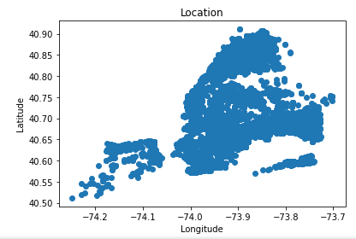
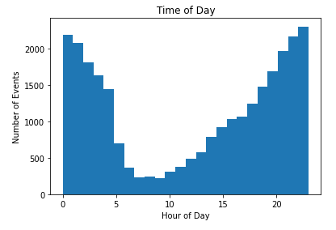
Data Exploration
Scatter plot of event locations.
Unsurprisingly, appears in the shape of NYC
Histogram of event times.
As one would expect, most occur after nightfall

Slide 7
Data Cleaning
Prior to any modeling the following was done to clean the data
Recast occurrence date and time to ordered categorical variables
  Date and time were converted to an integer representation
Generated rotated date and time
  To capture the cyclical aspect of the date and time, each was rotated by half the range
  All values had half the range subtracted, and any value under the original minimum had the full range added to it, so that noon and July became the new minimums.
  This is acknowledged as being most likely to be a sub-optimal choice and several alternate options exist to capture this data.

Slide 8
Data Cleaning
Categorical variables were cast into a series of dummy variables
  Borough, victim descriptions, jurisdiction codes were all so cast
  The original variables were then dropped
Dropped problem columns
  Many location descriptions and perpetrator information were filled with null values
  Redundant location variables were removed
    Only latitude and longitude were used
  Incident key is a clerical item to uniquely identify events and cannot help the analysis
Dropped any rows that had null values
  Only latitude and longitude, after dropping columns above, lacked entries for 10 rows

Slide 9
Modeling
For this analysis, three models were chosen to explore
  Logistic regression
  Forest of Random Trees
  AdaBoost
The GridSearchCV object was used to automate hyperparameter tuning
The benchmark to deem a model worth investigating is if the model can predict values better than guessing
  For this data, 80.7% of shootings were non-fatal
  If the model is guessing non-fatal for every entry, we should expect it to be that level of accurate. Anything above that point is worth examining.

Slide 10
Logistic Regression
For this model, the specific tunings for all models are:
  Penalty: L1 and L2 (or ‘elasticnet’) regularization
  Solver: ‘saga’
    So chosen as the only solver natively available to use elasticnet
Grid search automated fitting for the following:
  L1_ratio: Controls how much L1 and L2 regularization, as a ratio between them, to apply
    [0, .1, .5, .8, 1]
  C: Controls how stringently to apply the regularization.
    [.1, 1, 10, 100]

Slide 11
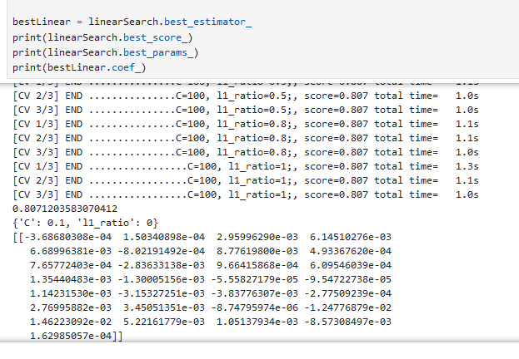
Logistic Regression
After fitting the model, the best fit was found to be
  C = .1, L1_ratio = 0
  Accuracy = 80.7%^
Given the model accuracy of the best fit, logistic regression does not work for this data

Slide 12
Forest of Random Trees
For this model, the following was held for all iterations
  Number of estimators = 100
  Criterion: Gini
  Max_Features: sqrt
The following was iterated through using grid search
  Max depth: [None, 1, 5, 10]
  Min leaf samples: [1, 5, 10]
  ccp_alpha: [0, .001, .01, .1, 1]

Slide 13
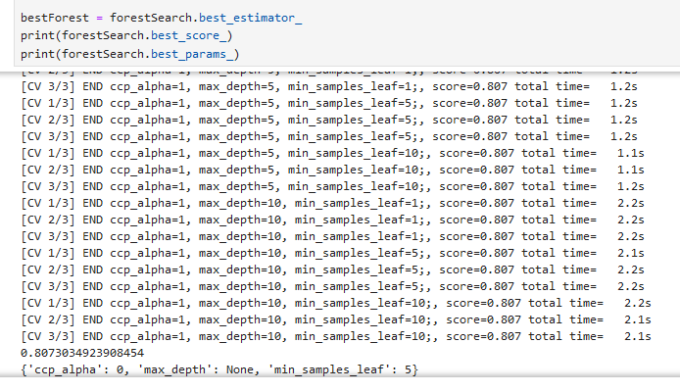
Forest of Random Trees
The best fit was found to be:
  ccp_alpha = 0, max_depth = None, min_samples_leaf = 5
As with logistic regression, the best fit had an accuracy of 80.7%, indicating no model worked
While not shown to the right, many models did do worse than 80.7%

Slide 14
AdaBoost
The AdaBoost model was left at default values aside from the grid searched parameters
Grid search was used for the following:
  Number of estimators: [10, 25, 50, 100]
  Learning rate: [.01, .1, 1, 10, 100]

Slide 15
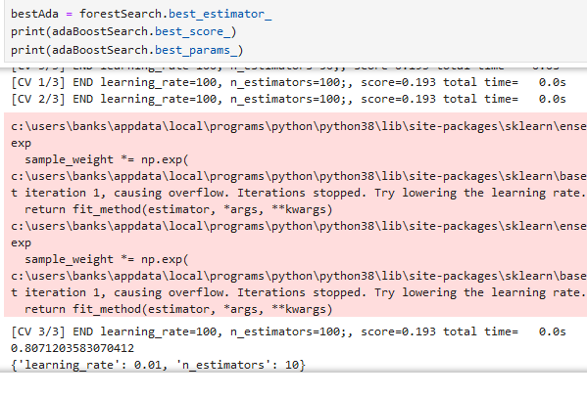
AdaBoost
The best model was found to be:
  Learning rate = .01, Number of estimators = 10
The best accuracy was 80.7%, also failing to surpass guessing
Notably, this model did very poorly on the high-estimator iterations

Slide 16
Conclusions
Unfortunately, no model with any set of parameters as defined above managed to do better than guessing. These models could have failed for a number of reasons. In no particular order and non-exhaustively:
  Insufficient data. Both in number of data points as well as the kind of data collected.
  A useful model may be a different one. A support vector machine may have been capable where these were not.
  The parameter ranges were too narrow. Additional parameters to tune, wider ranges, and more thoroughly explored ranges are all options to examining the existing models
  The odds of fatality are truly random and these factors have no impact on it at all

Slide 17
Future Steps
Proposed options for the next step of the analysis in order of expected likelyhood of increased efficacy:
  Gather better data.
    This is the avenue I would expect to yield the best results. Data on how many shots, location of injury if any, etc would likely better inform a model. Ultimately, this question is more of biology than crime and gathering more relevant data I would expect to yield better results.
  Attempt different models.
    As stated above, SVC may be capable of achieving something that the models created cannot. Some combination of hyperparameters may generate useful results. Exploring alternates is a worthwhile endeavor.
  Gather more data.
    Given that these are human lives as data, this is the most unpalatable option. Ideally, the existing data set would be capable of informing behavior in such a way that future data points would be reduced.
  Review the use case for such a model
    This particular question may not have significant use, even if a model were to beat the guess rate. There may be better avenues to determine this answer than machine learning techniques.

