Slide 1
DTSA 5510 Final
Willis Banks

Slide 2
Introduction
This analysis will step through using a K-means clustering algorithm to map personality traits onto the drug usage habits of respondents of a data set
For this, the Drug Consumption Classification Dataset from Kaggle is used
This dataset describes demographic information, personality traits and substance usage responses of 1885 respondents.
For the sake of this analysis, the provided education level, country, and ethnicity values are not used
  These values together indicate socioeconomic status, but in such a way that significant effort would be required to standardize them in a useful way
Project GitHub Link

Slide 3
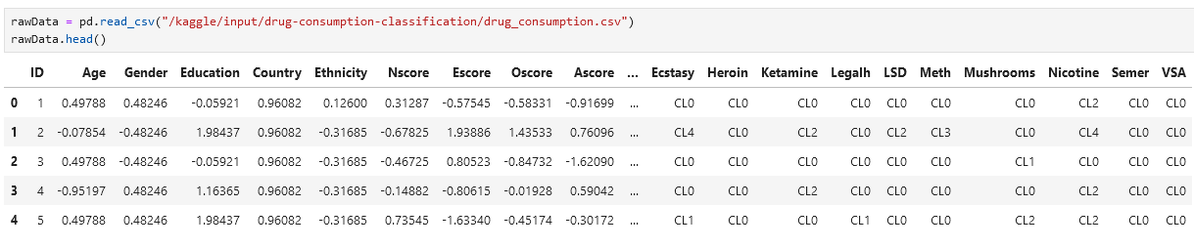
Database Exploration
Below is a snip of the raw dataset
The demographic data as well as the personality traits are pre-normalized numeric values
  Likely due to the processing done prior to downloading the data, the dataset contained no duplicate rows or null values
The substance usage columns are strings indicating the last time a respondent used a given substance

Slide 4
Personality Traits and Substances
Personality Traits
Substances
Neuroticism
Extraversion
Openness
Agreeableness
Conscientiousness
Impulsiveness
Sensation Seeking
Alcohol | Amphetamines | Amyl Nitrate
Bezodiazepine | Cannabis | Chocolate
Cocaine | Caffeine | Crack
Ecstasy | Heroin | Ketamine
Legal Highs | LSD | Methadone
Mushrooms | Nicotine | Volatile Substances (Sniffing Glue)

Slide 5
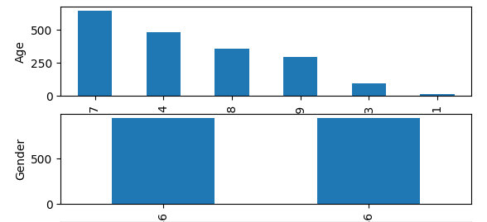
Database Exploration
Ages are binned, not literal values and after normalization, are not directly representative of respondent age
  The values are ordinal with the smallest indicating the earliest age group, and so are left it its current form
Gender is similarly normalized and non-representative
The histograms shown indicate an even distribution of genders as well as a reasonable distribution of respondents, with the final group (65+) taking about 5% of the data

Slide 6
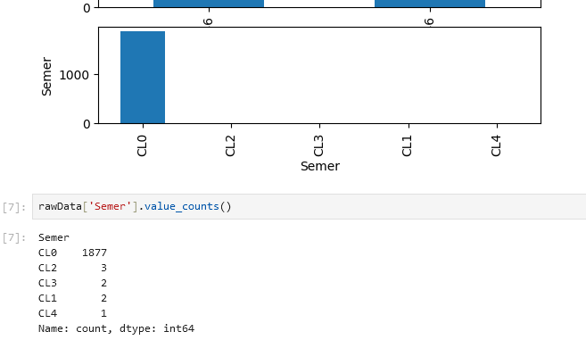
Semeron
Semeron is a ficticious substance used to weed out over-responders
  Reasons for claiming to have used this fictional substance range from a mistake to performative answering
Given that only 8 respondents (0.4% of the total data) answered that they have ever used this substance, these rows have been removed from the data set

Slide 7
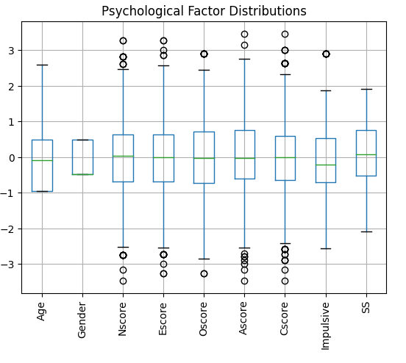
Psychological Factors
The factors used in this analysis were split off and reviewed
The box plot to the right shows that the means of the raw data are not always zero, but close to it
With the exception of gender, most factors range from -2.5:2.5, not counting the outliers

Slide 8
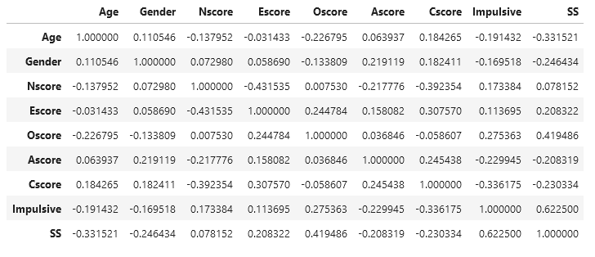
Psychological Factors
Correlation between all the psychological factor was also obtained
The only correlation that was high enough to consider adjusting the data was between impulsivity and sensation seeking
It was determined the loss of variance from reducing these in some way was not worth the effort to do so nor the amount of information lost

Slide 9
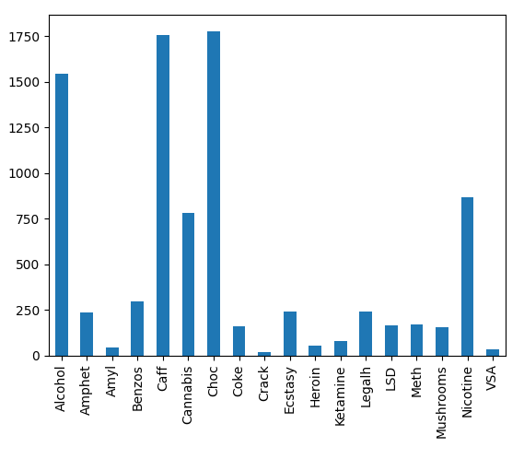
Active Substance Users
The chart to the right is a count of everyone that is deemed an ‘active user’ of a substance
  So defined as an individual who as used a given substance within the past month
The widely legal substances (alcohol, caffine, chocolate, nicotine) predictably have the most active users
  Cannabis, having mixed legality in many parts of the world, also has a notable portion of users

Slide 10
K-Means Cluster Model
For this analysis, the k-means clustering model is used
  The algorithm initializes the initial kernels to be a random point within the data set
  Each run of the algorithm is performed 20 times to determine the ‘best’ cluster based on inertia
Number of clusters, the only hyperparameter for k-means, was determined experimentally using silhouette score, Calinski-Harabasz index and Davies-Bouldin index

Slide 11
Clustering Metrics
The three clustering metrics were so chosen because they do not require ground truth to evaluate
Silhouette score judges a clustering by how much they overlap, ranging from -1 to 1, with the least overlap at 1
Calinski-Harabasz scores a clustering by how tightly clustered they are, optimizing on a maxima
Davies-Bouldin scores a clustering by how well separated the clusters are, similar but distinct from silhouette score
  This metric optimizes on a minima

Slide 12
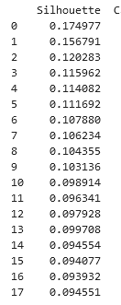
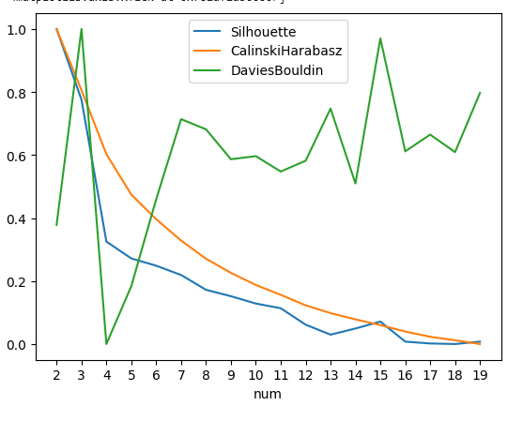
Cluster Number Evaluation
To show the three metrics side by side, each was normalized to range from 0 to 1
  Additionally, the Davies-Bouldin index was inverted so that the apparent maxima relates to a minima of the data, thus a potentially useful clustering
  The unmodified silhouette score was reviewed to confirm it wasn’t significantly negative
Only the Davies-Bouldin index indicates a particular cluster as being potentially useful, 3 and 7
  For this analysis, 7 was chosen for review
  3 clusters, in my experience tends to often be ‘optimal’, when it’s more to do with how few clusters there are more than actual optimality

Slide 13
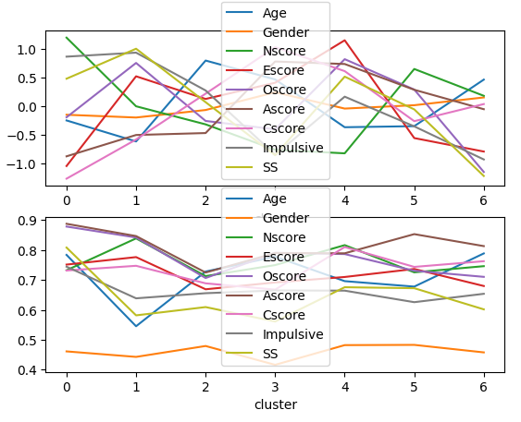
Clustering Results
The plots to the right show the means and standard deviations of each of the clusters
Gender has significantly lower standard deviation, which is to be expected given that it ranged lower than all the other factors
  The cluster number evaluation was run without gender and still yielded 7 as a potentially useful cluster set
The specific meaning of any given cluster is interesting, but out of scope for this presentation

Slide 14
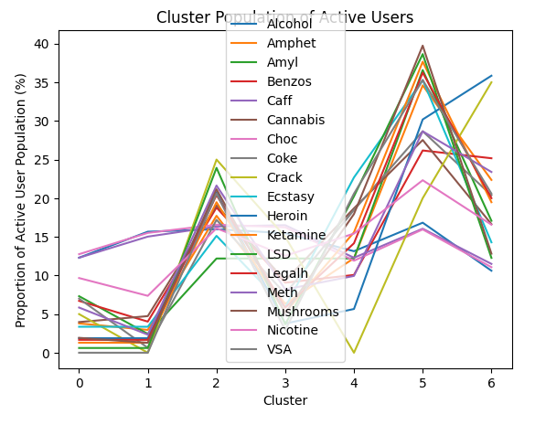
Mapping Cluster to Substance Use
The results of the clustering were applied to the active substance use data previously generated
The plot here shows the proportion of active users of any given substance that belong to a given cluster
Three items of particular note

Slide 15
Mapping Cluster to Substance Use
The four widely legal substances (alcohol, caffeine, chocolate, nicotine) were generally stable across the clusters
  Contrast the other substances which trended together, indicating that the personality clusters don’t predict which substance a given cluster will use
  Nicotine somewhat split the difference between the two trends
Alcohol Caffeine Chocolate
Nicotine

Slide 16
Mapping Cluster to Substance Use
Clusters 0 and 1 show low proportions of active users
This would point at these personality clusters being less prone to substance use
Cluster 1 will be further examined in a few slides

Slide 17
Mapping Cluster to Substance Use
Cluster 5 shows very high proportions of substance use
This indicates that this personality cluster is prone to general substance uses

Slide 18
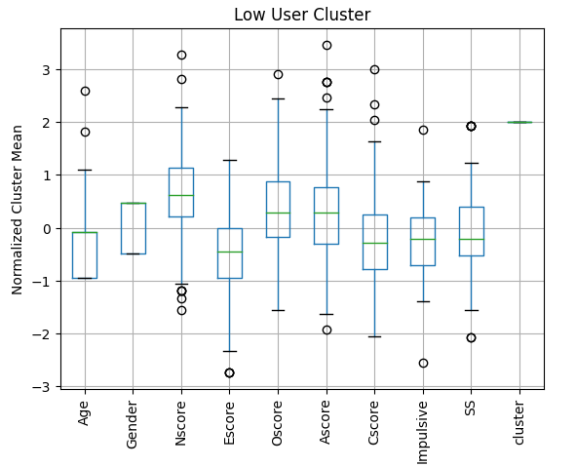
Low Substance Use Cluster
A box plot was generated using only the results of cluster 1 to examine what personality traits comprise it
It shows higher neuroticism and lower extraversion as the most notable features
  i.e. The first through third quartiles were above or below average
Intuitively and speculatively, it would make sense that an anxious individual with fewer social connections would have less ability or desire to use substances

Slide 19
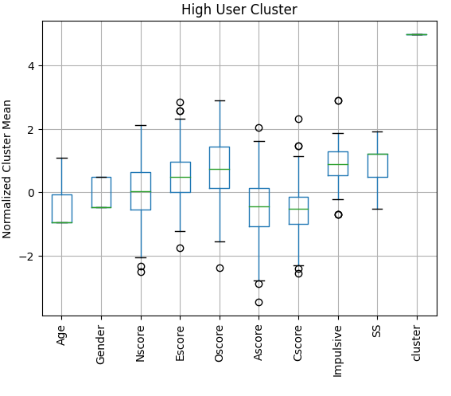
High Substance Use Cluster
As with the previous slide, the high usage cluster was box plotted for examination
The results show higher extraversion, openness, impulsivity, and sensation seeking
  Also shows lower agreeableness and conscientiousness
Notably, neuroticism averaged out to zero for this cluster

Slide 20
Conclusion
The analysis indicates that there are personality clusters that could indicate higher or lower propensity for substance use
  With the aid of a subject matter expert to guide further analysis, such data could help with the treatment and prevention of substance abuse
The clusters could be better improved in several ways
  Factoring the legality of mixed legality substances (e.g. cannabis) per country
  Utilizing the education, country, and ethnicity fields in a useful way
Project GitHub link

