Slide 1
Package Nomenclature
<cc><UT><VS><pack><duration>
INWMPVDIYDPFY
IN – India
WM – Wikitek Mechanik
PV - Pass Vehicles
DIYDP – Diagnostics Pack
FY – Full Year
INRMPVOSFY – In current scope
miBud
Used by the service users
wikitek1
One app for various User types, vehicle segments, packages
Used by service providers
Country | User Type (UT) | Vehicle Segment (VS) | Packages(pack) | Duration
IN - India | Wikitek Mechanik (WM) | 2W – 2 wheeler | Diagnostics Pack (DIYDP) | FY – Full Year
 | Mobitek Mechanik (MM) | 3W – Auto Rick | Operations Pack (OP) | HY – Half Year
 | RSAngel Mechanik (RM) | PV – Passenger Vehicles | Assisted Diagnostic Pack (ADP) | QY – Quarter Year
 |  | CV – Commercial Vehicles

Slide 2
miBud

Slide 3
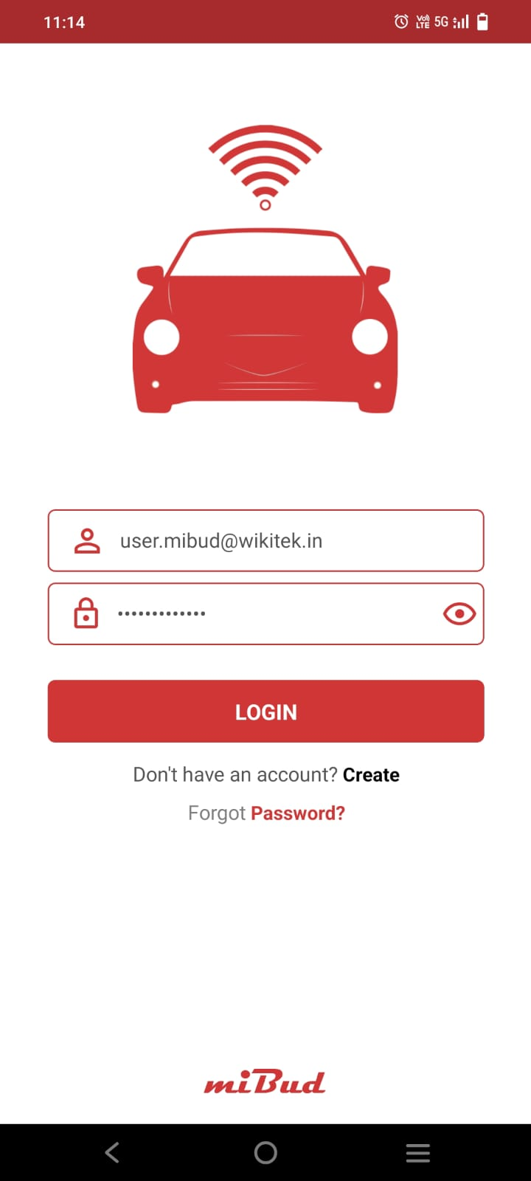
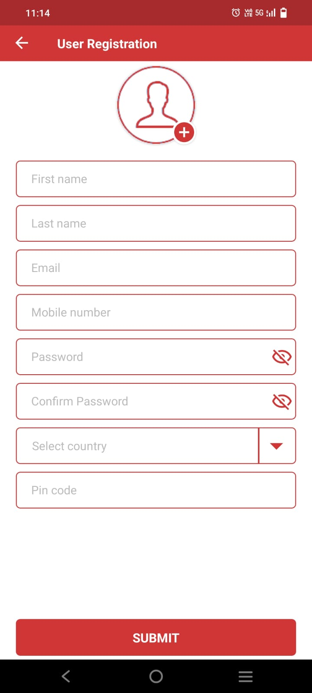
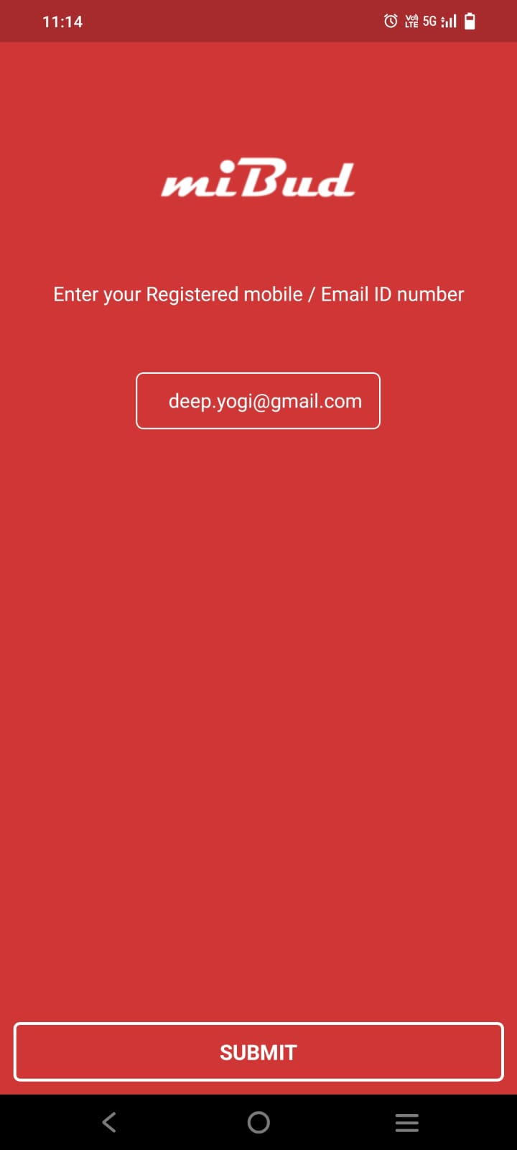
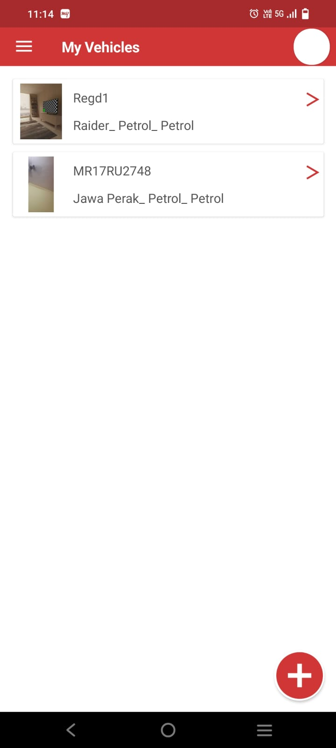
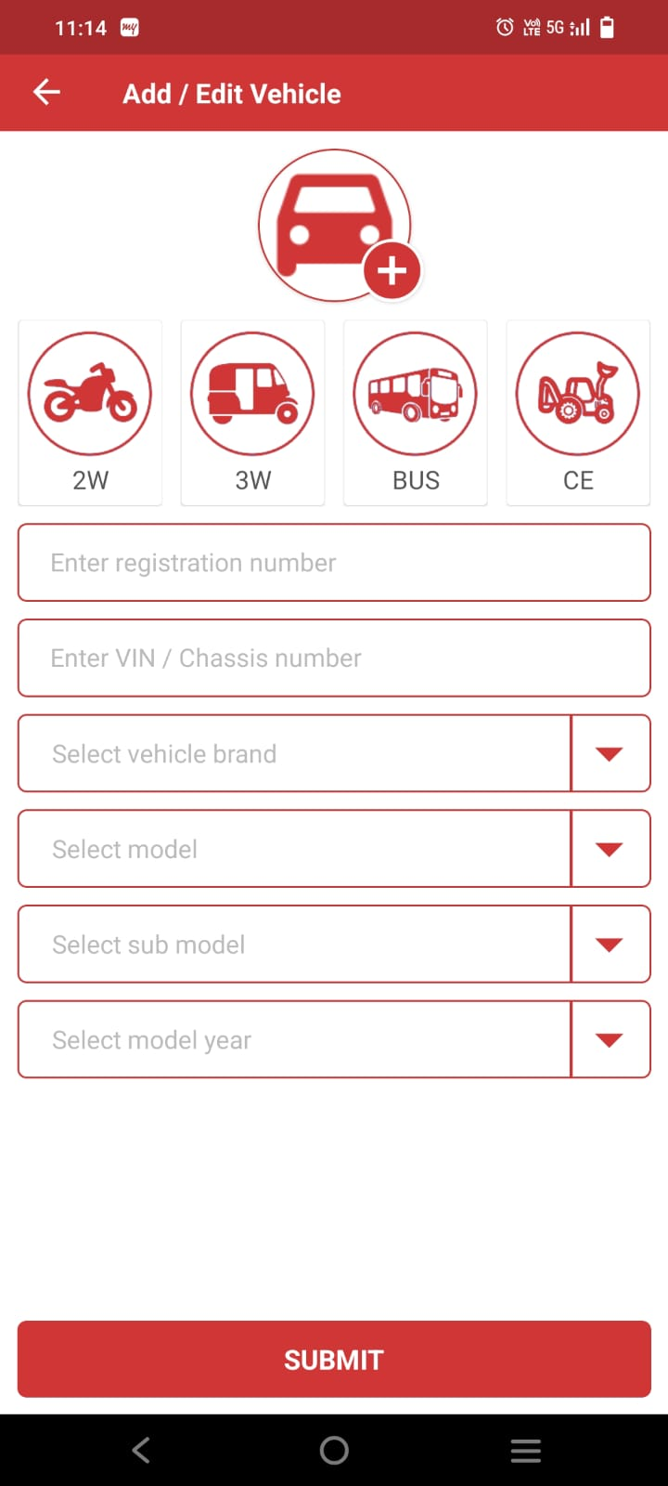
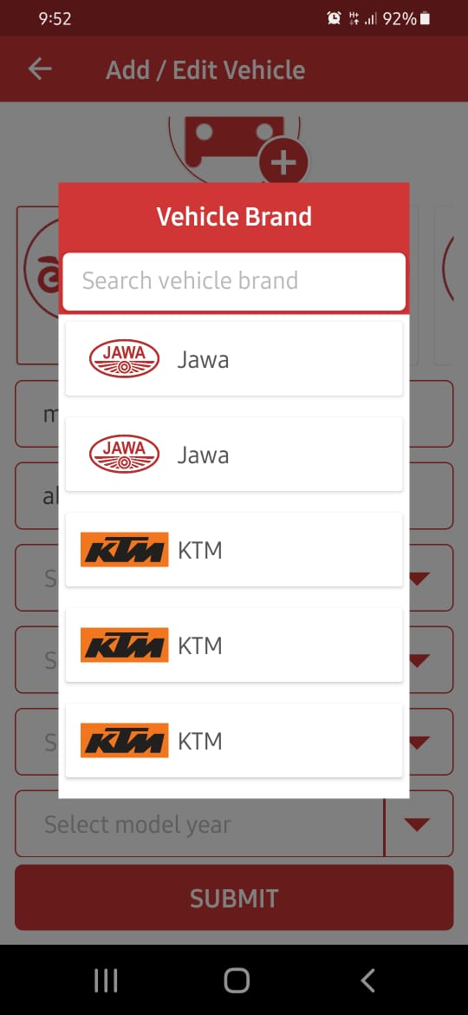
Provide login by otp also as an option. Instead of forgot password, put OTP Login. This way, he can login and later change his password inside
Use only mobile number. No email required. Until otp authentication happens, don’t approve the user. Until user is approved, he cannot login
This screen will not be there as we will not have forgot password option
Remove the circle on top right.
Remove the > symbol, once vehicle is crated, it cannot be edited / changed
when new vehicle is created, have blank page and say Add vehicle.
We shud have brands shown only once. Same with model, submodel, modelyear

Slide 4
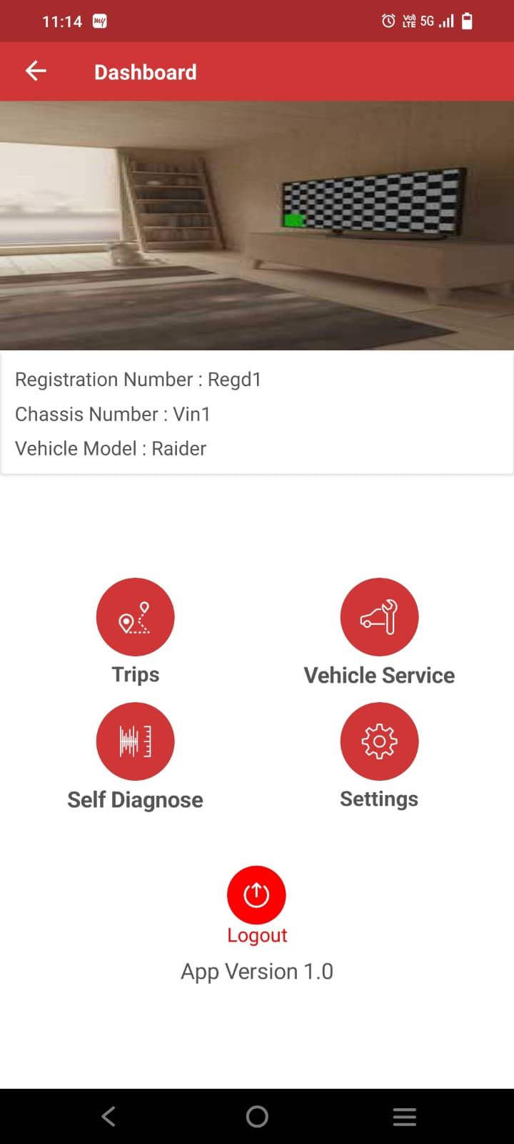
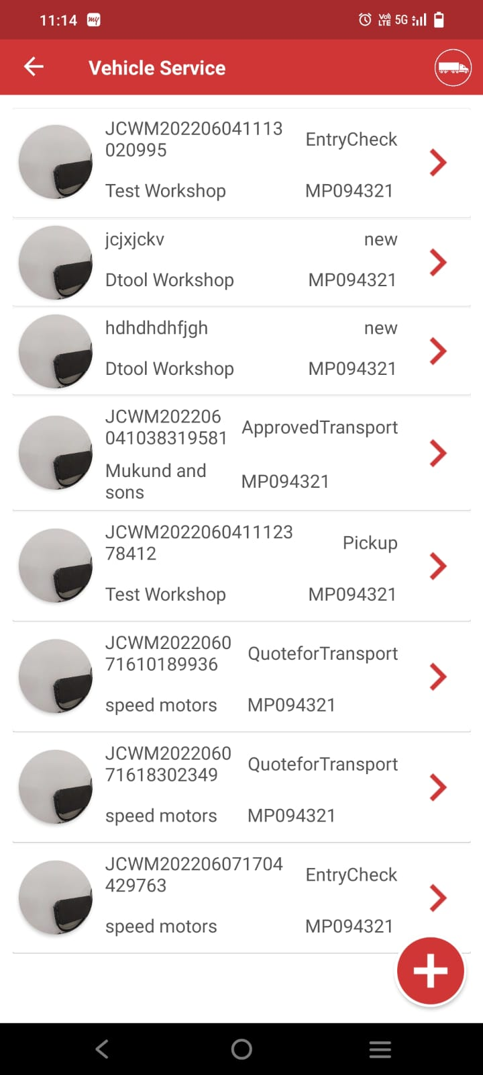
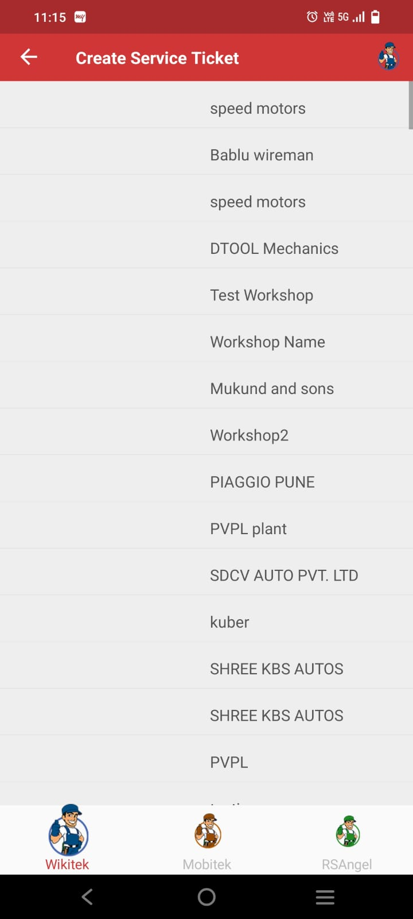
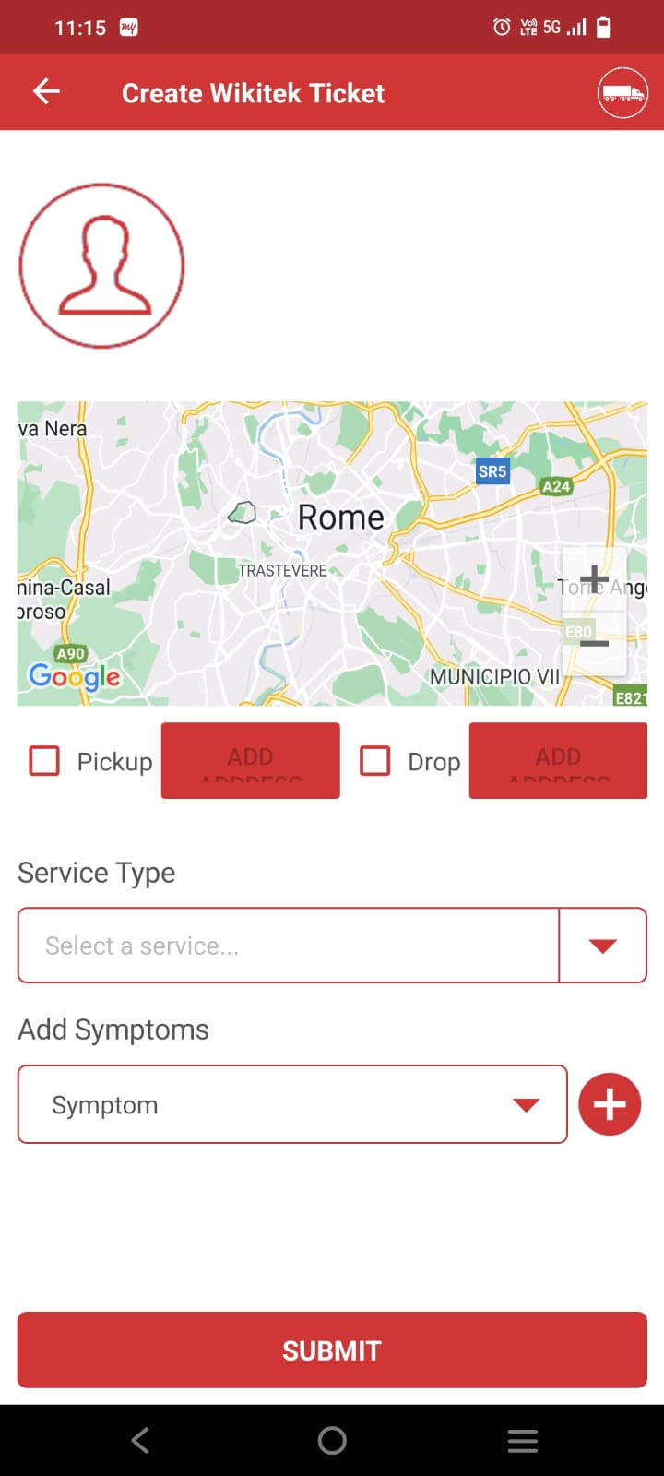
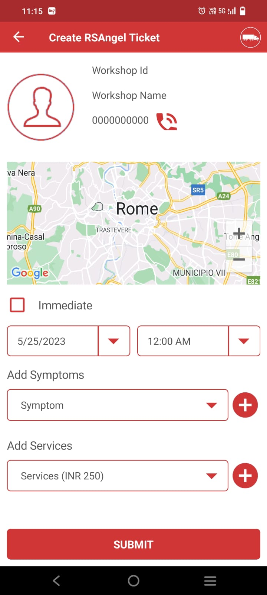
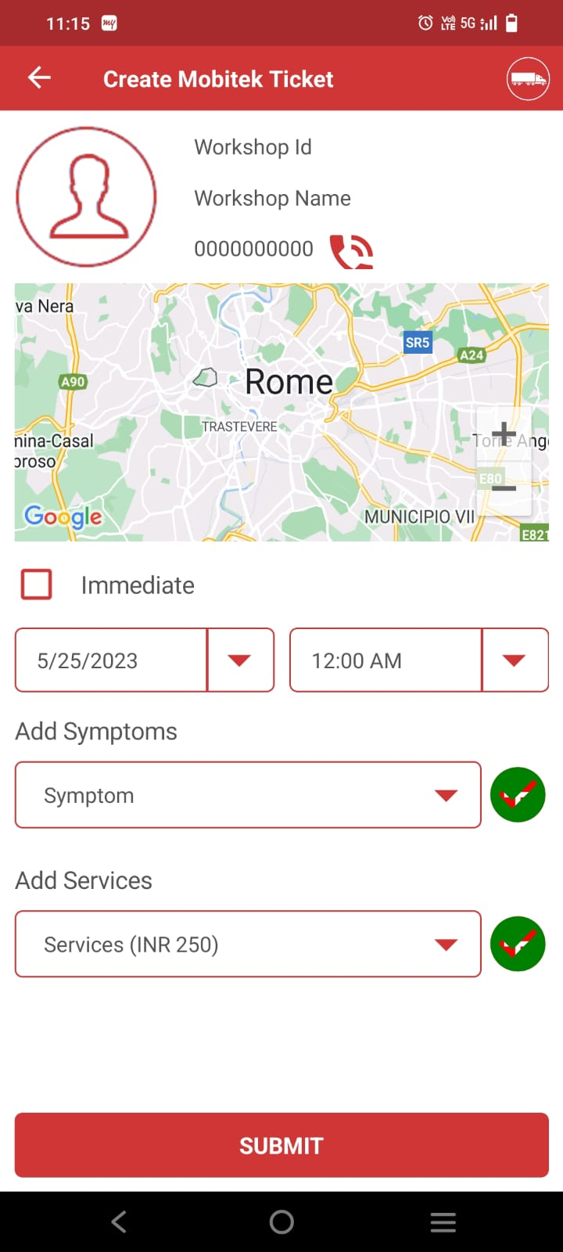
Remove Trips. Settings and logout from here. First line would have Wikitek Mechanik, Mobitek Mechanik, RSAngel Mechanik
Second line would have Self Diagnose
Based on which one is selected, show only those service ticket (by user type)
Based on which user type is selected, show appropriate pic on top right. Remove the link from that. Show only those user types on map. Below remove the 3 icons. And have book nearest, and book selected only. Once this is clicked, display next service detail page
Based on which user type is selected, show appropriate pic on top right. Remove the link from that. Show only those user types on map. Below remove the 3 icons. And have book nearest, and book selected only. If picture not attached, show workshop icon here. Map should show route from current to workshop. If pickup / drop enabled, add date and time. Select one service type and one or more symptoms
In case on mobitek / rsangel, only service date and time would be shown.
Workshop ID
Workshop Name
Address:
This will book the service ticket

Slide 5
wikitek1

