Slide 1
Integration / Middleware
Introduction to MuleSoft
Different components in MuleSoft
Runtime Plane - MuleSoft Runtime
Control Plane – MuleSoft AnyPoint Platform
Design Center
Mule application
API Specification
Exchange
RunTime Manager
API Manager
Access Management
Any Point Monitoring
MuleSoft AnyPoint Studio
https://www.youtube.com/c/TechLightning

Slide 2
Integration / Middleware
Middleware is a software that links two separate applications or is commonly used to illustrate different products that function as a glue between two separate applications.
Application Integration (A2A): Integrates various company-managed applications together, including cloud-based and remote systems
B2B Integration: Integrates customer, provider and various alternative partner interfaces with various data resources and company-managed applications
Cloud Integration: Integrates with and also between the cloud services, cloud-based applications (SaaS), private clouds, trade hubs and other typical cloud resources through Web services and standard B2B communication strategies (FTP, AS2, etc.)
https://www.youtube.com/c/TechLightning

Slide 3
Introduction to MuleSoft
Design and build APIs and integrations at lightning speed
Build APIs and integrations faster using reusable assets with clicks or code — whether it is through a web interface or a desktop IDE.
Mule, the runtime engine of Anypoint Platform, is a lightweight Java-based enterprise service bus (ESB) and integration platform that allows developers to connect applications together quickly and easily, enabling them to exchange data. It enables easy integration of existing systems, regardless of the different technologies that the applications use, including JMS, Web Services, JDBC, HTTP, and more. The ESB can be deployed anywhere, can integrate and orchestrate events in real time or in batch, and has universal connectivity.
Key advantages
Message routing — route, filter, aggregate, and re-sequence messages based on content and rules
Data transformation — exchange data across varying formats and transport protocols
Service creation and hosting — expose and host reusable services, using the ESB as a lightweight service container
https://www.youtube.com/c/TechLightning

Slide 4
What are the different components in MuleSoft
Runtime Plane - Mule Runtime
Mule runtime is the engine for connecting application, data ,devices.
Control Plane – AnyPoint.mulesoft.com – Any Point platform
https://www.youtube.com/c/TechLightning

Slide 5
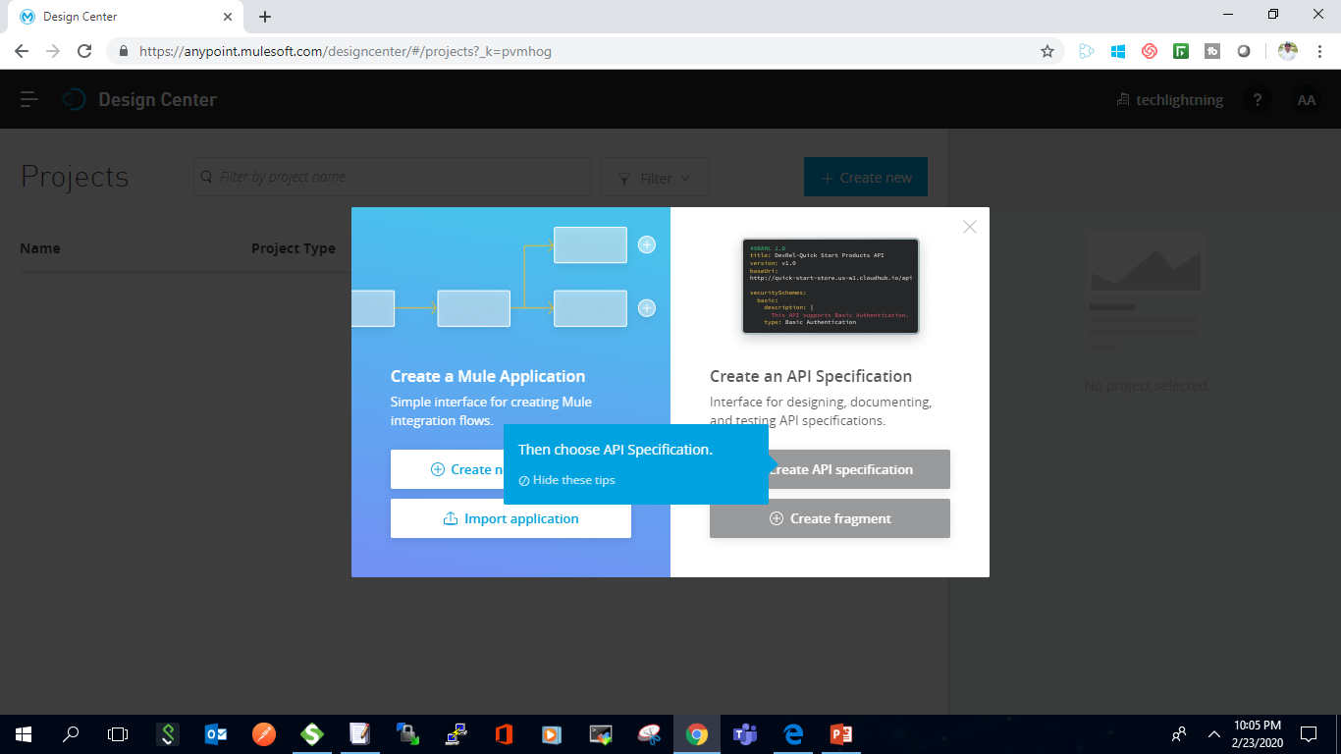
Design Center
A Design center is the development environment for a Mule application as well as for our API specification. In Design Center, we can create API's with the help of RAML (RESTful API Modeling Language), a YAML based language, and simple Mule Applications in the flow designer component.
https://www.youtube.com/c/TechLightning

Slide 6
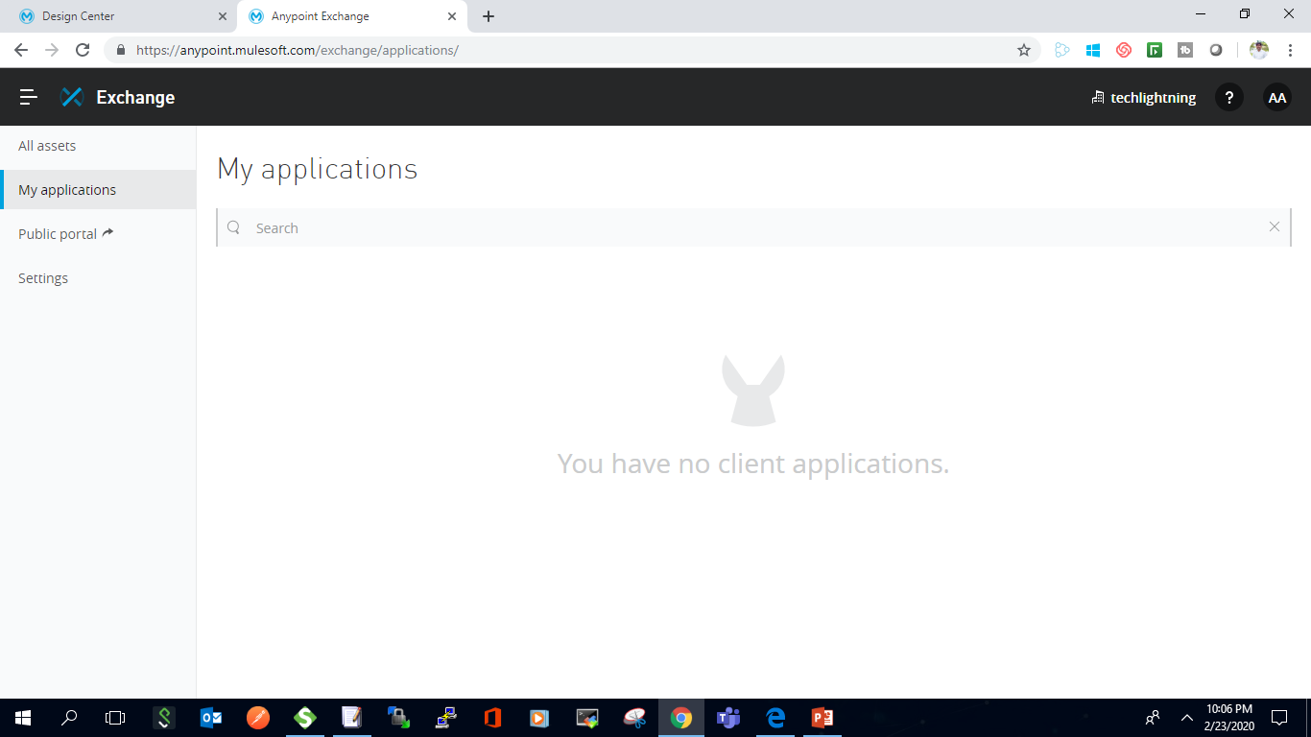
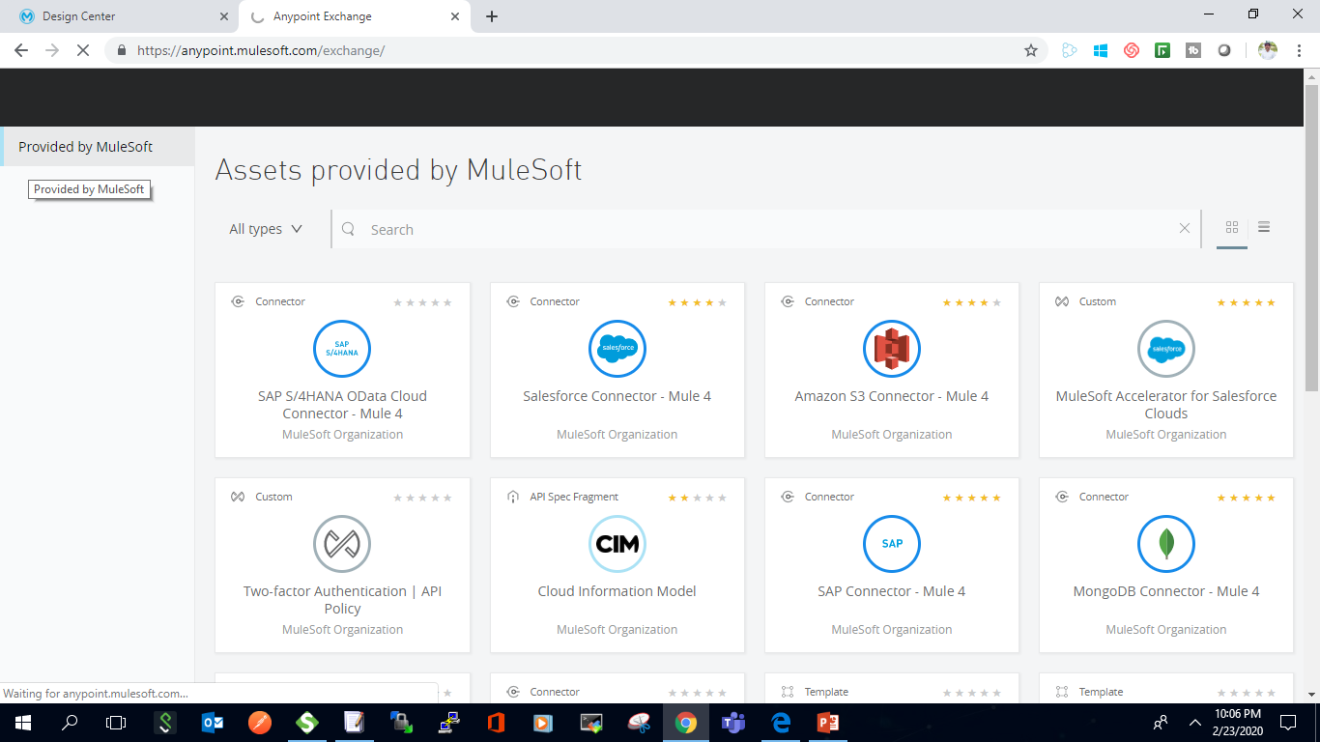
AnyPoint Exchange
Anypoint Exchange. The marketplace for connectors, templates, examples, and APIs. Discover and use prebuilt assets from the MuleSoft ecosystem, or use Exchange to save, share, and reuse internal best practices.
https://www.youtube.com/c/TechLightning

Slide 7
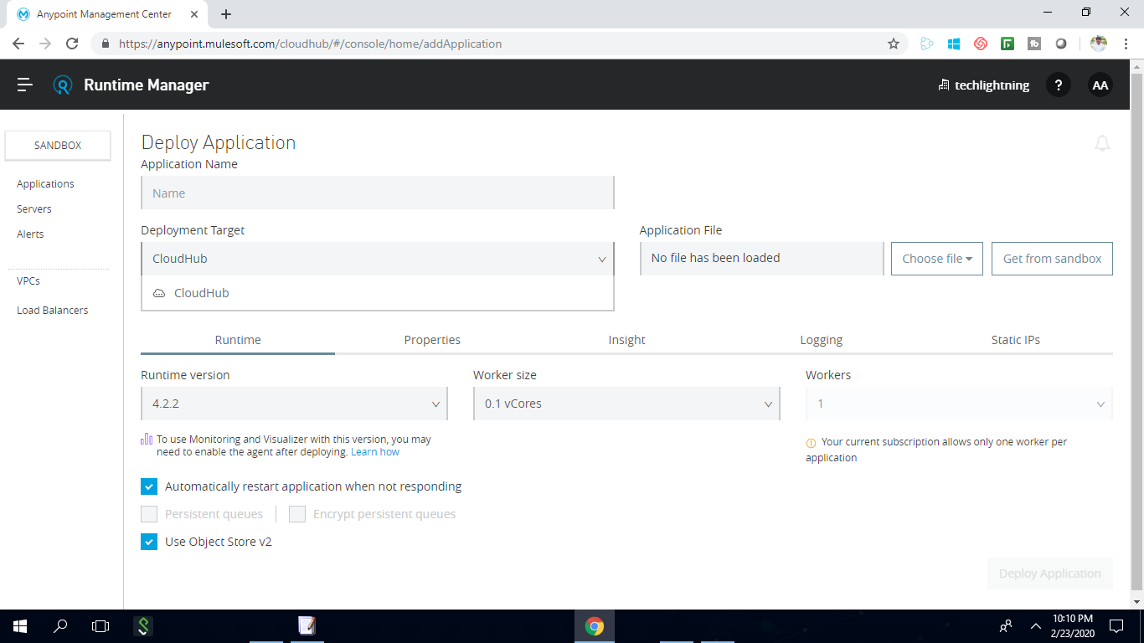
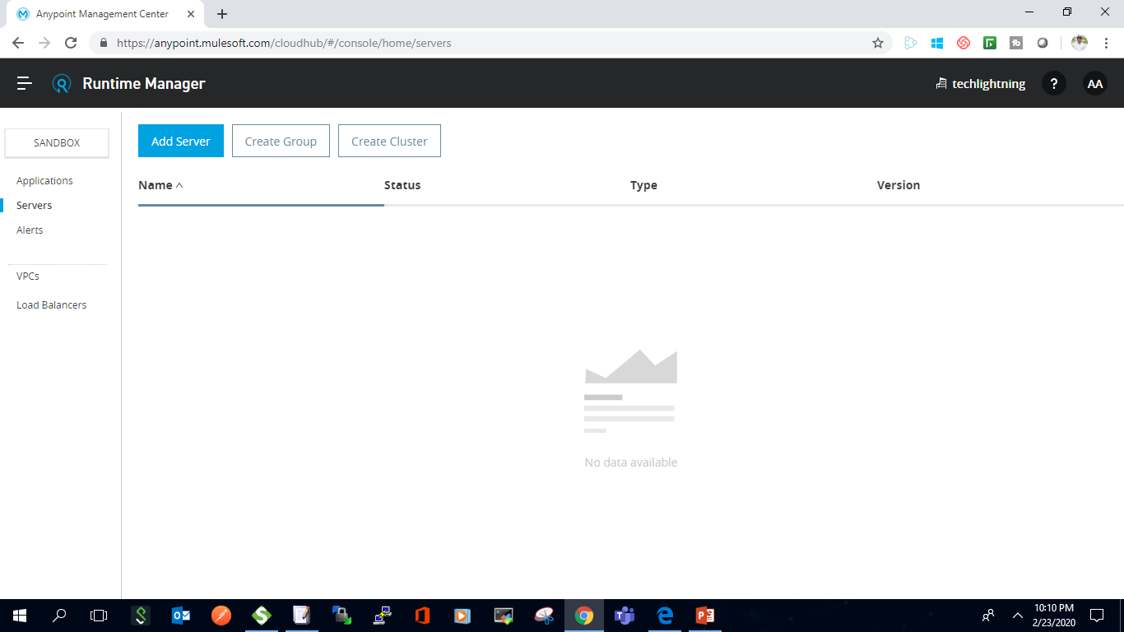
Runtime Manager
Use Runtime Manager to deploy and manage all of your Mule applications from one central location, whether your apps are running in the cloud, on-premises, or on Runtime Fabric.
https://www.youtube.com/c/TechLightning

Slide 8
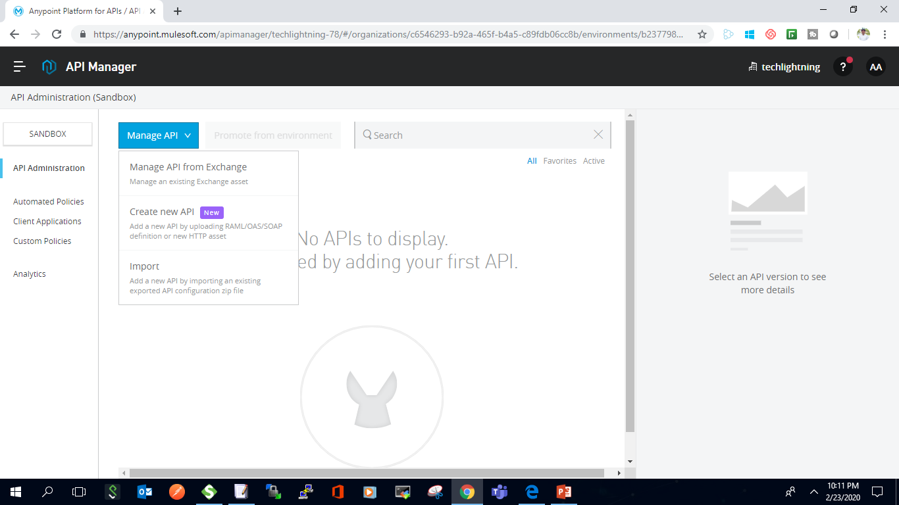
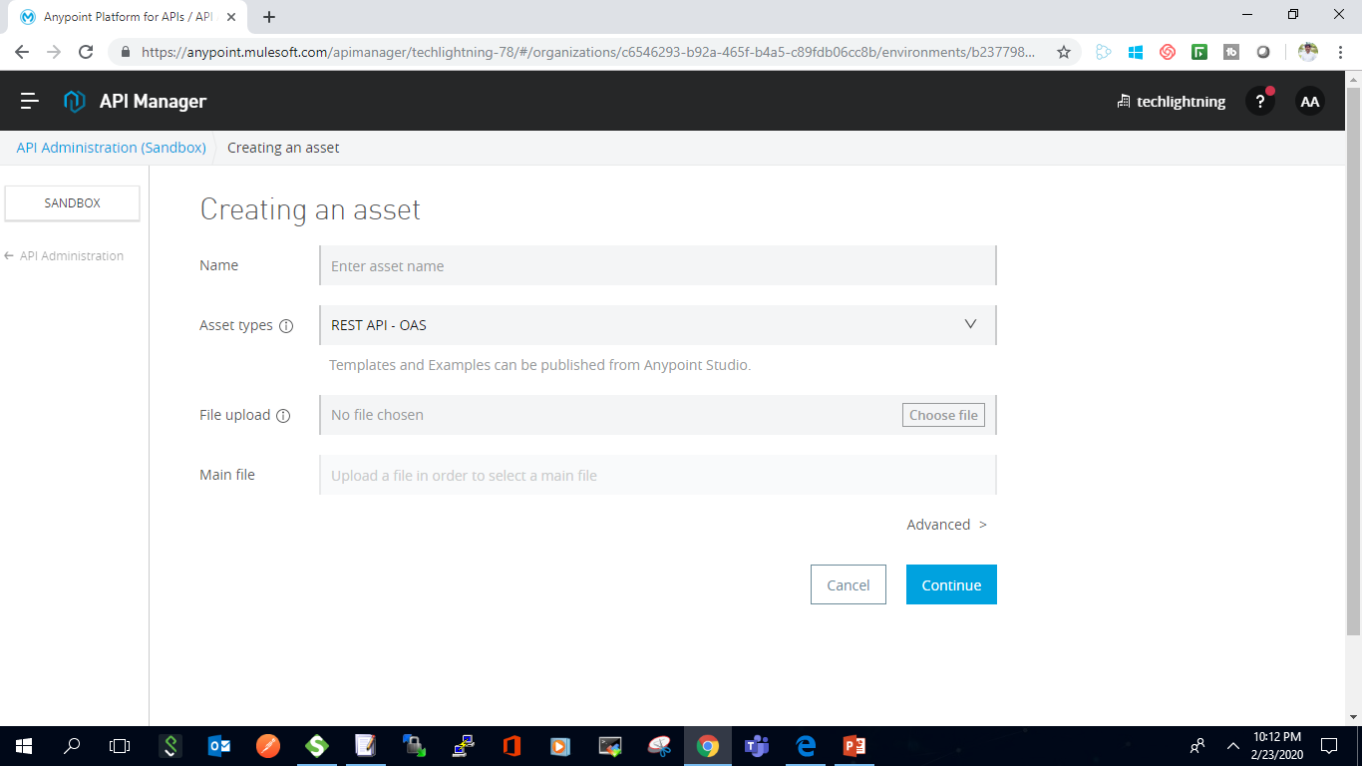
API Manager
Secure APIs with policies, manage client access, group APIs as products, and monitor and analyze traffic. No matter where your APIs and micro services are hosted and which technologies they run on, you can manage them all from one place.
https://www.youtube.com/c/TechLightning

Slide 9
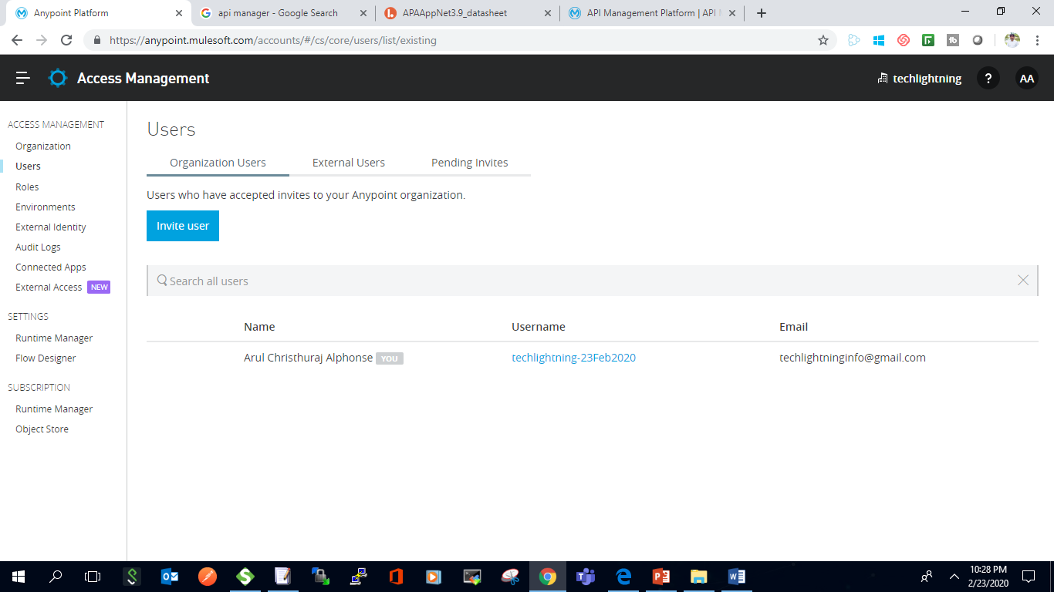
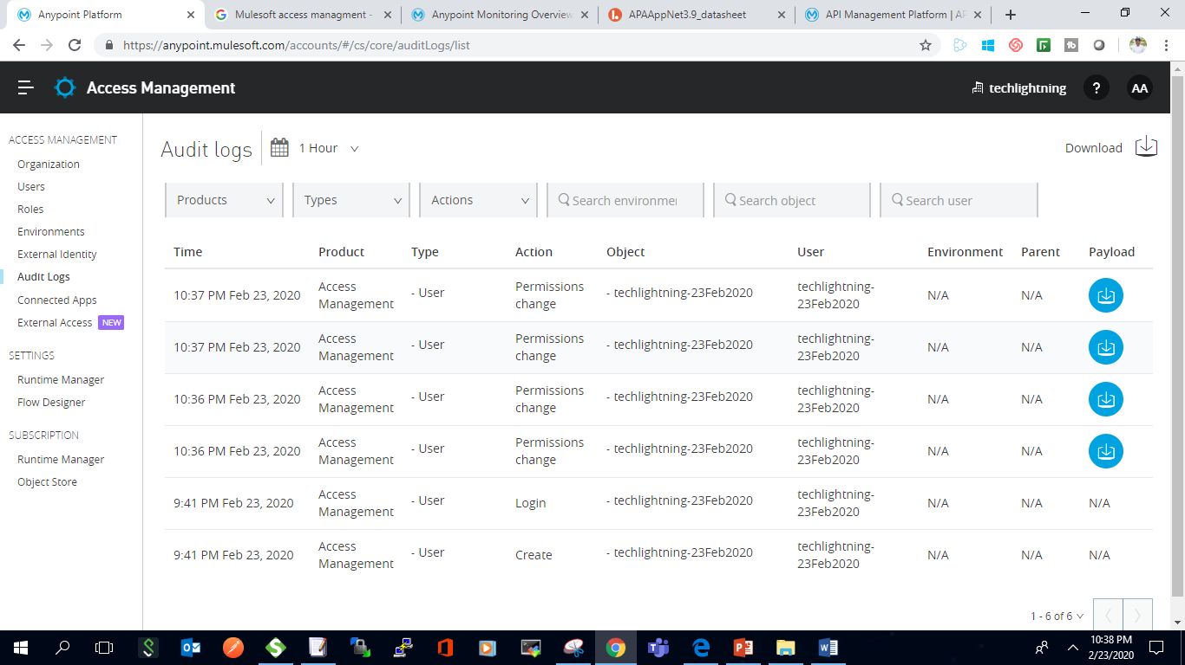
Access Management
Use Anypoint Access Management to create your Anypoint Platform account or configure federated External Identity.
Additionally, you can configure access and permissions within your Organization and, based on your access level, manage the Usersand Roles
https://www.youtube.com/c/TechLightning

Slide 10
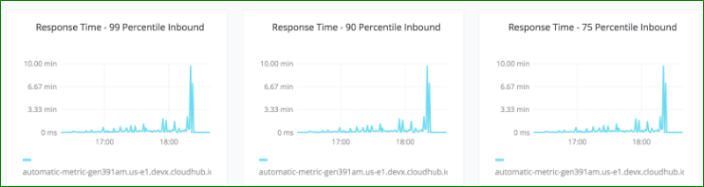
Any Point Monitoring
As part of Anypoint Platform, Anypoint Monitoring provides visibility into integrations across your app network. The monitoring tools provide feedback from Mule flows and components in your app network.
https://www.youtube.com/c/TechLightning

Slide 11
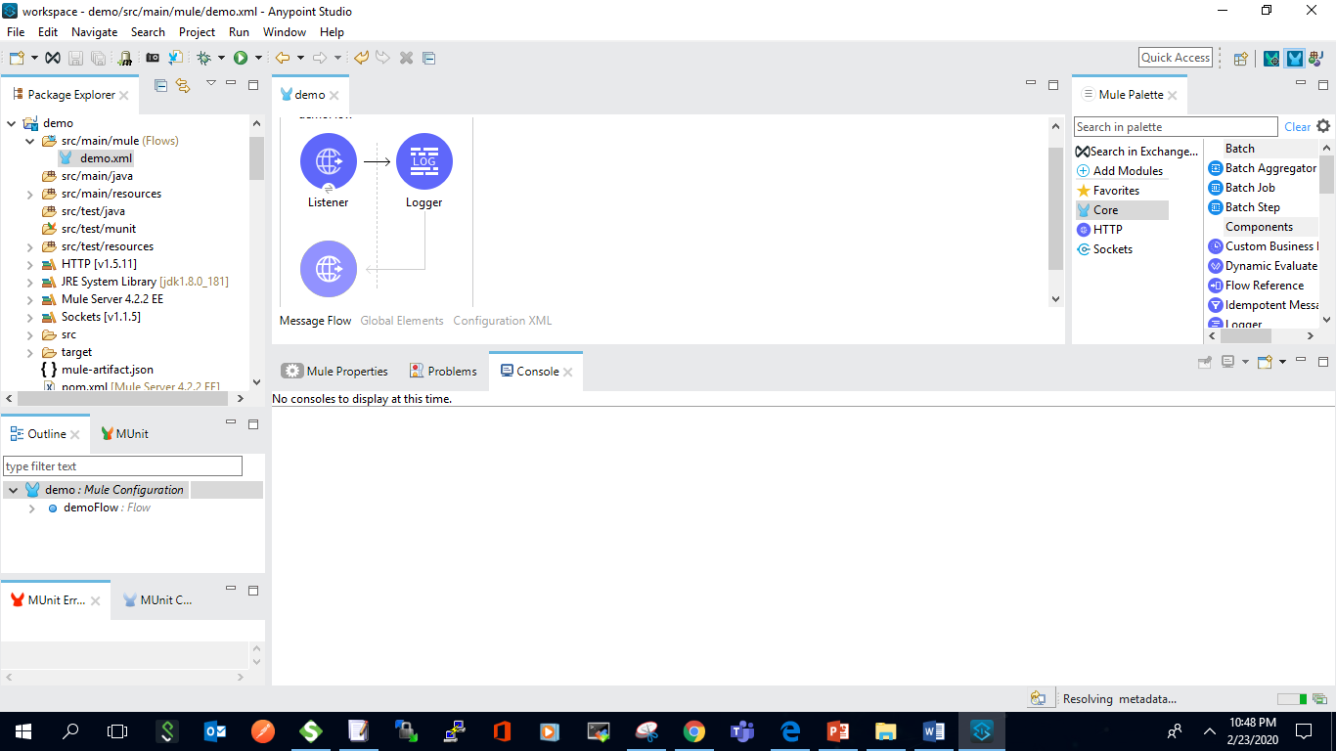
Any Point Studio
Connect data to apps or build APIs graphically on your laptop / desktop.
One-click access to a rich library of prebuilt, out-of-the-box connectors and templates
Access, query, and transform data with the powerful DataWeave language
Deploy applications on-premise or to the cloud
Test applications with the Mule runtime embedded in Studio
https://www.youtube.com/c/TechLightning

Slide 12
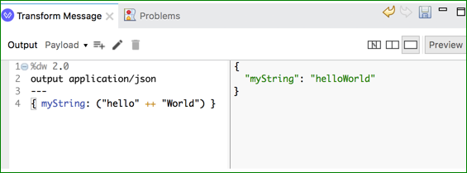
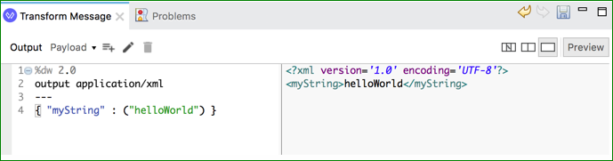
DataWeave
DataWeave is the MuleSoft expression language for accessing and transforming data that travels through a Mule app. DataWeave is tightly integrated with the Mule runtime engine, which runs the scripts and expressions in your Mule app.
https://www.youtube.com/c/TechLightning

Slide 13
Important Links
https://docs.mulesoft.com/
https://anypoint.mulesoft.com/login/ -- anypoint platform
https://www.mulesoft.com/lp/dl/studio - studio download
https://help.mulesoft.com/s/forum

