Slide 1
RMI
Advisor: Madjid S. Mousavi
PRESENTED BY : SHIVAM PATEL(10422123)
MANIDEEP REDDY (10431192)

Slide 2
INDEX
PROBLEM
DESIGN
SERVER
CLIENT

Slide 3
PROBLEM
Implement the Server and Client Programs to Demonstrate the RMI Functionality by Student Query Example
Server – Store the student information and provide method to query for first name and Server returns Full name
Client – Query for the First name and Display the received Information

Slide 4

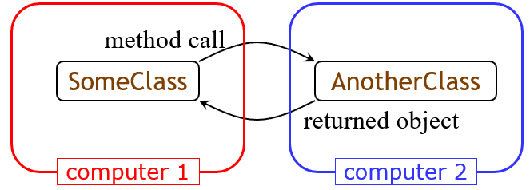
RMI:Remote Method Invocation
If the network is the computer, we ought to be able to put the two classes on different computers- RMI is one technology that makes this possible.
RMI is purely Java-specific
Java to Java communications only

Slide 5
TERMINOLOGY
A remote object is an object on another computer
The client object is the object making the request (sending a message to the other object)
The server object is the object receiving the request
As usual, “client” and “server” can easily trade roles (each can make requests of the other)
The rmiregistry is a special server that looks up objects by name
Hopefully, the name is unique!
rmic is a special compiler for creating stub (client) and skeleton (server) classes

Slide 6
PROCESSES
For RMI, you need to be running three processes
The Client
The Server
The Object Registry, rmiregistry, which is like a DNS service for objects

Slide 7



DESIGN
CLIENT
REGISTRY
Hello stub =(Hello registry.lookup(name:“Hello”);
Registry.bind(name:“Hello”,stub)
Return StudentQuery Stub
SERVER
Stub.getName(“First Name”)
Returns List<Student>
DATABASE
Database:cpe_545

Slide 8
SERVER
Server creates the List to Store Student Information.
First Name
Last Name
ID
Takes the input from User and Store Information.
Creates Server Object and bind it to the Registry.
Handle the Method Invocation for stub.getName(name).

Slide 9
STEPS TO RUN SERVER SIDE
Compile
Compile the Source Code
Javac *.java
Run the Server
Start rmiregistry
Start
Run
java -cp .;postgresql-42.1.4.jar -Djava.security.policy=Client.policy Server

Slide 10
STEPS TO RUN CLIENT SIDE
Compile
Compile the Source Code
Javac *.java
Run
Run the Client
Java -Djava.security.policy=Client.policy Client

Slide 11
Thank You

