Slide 1
Credit card fraud detection

Slide 2
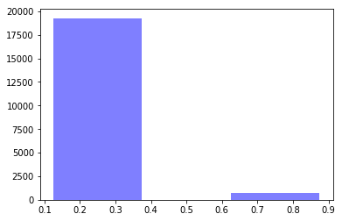
How much fraud is in this dataset?
Applied the Exploratory data analysis and found that around 3.68% of fraud in the dataset.

Slide 3
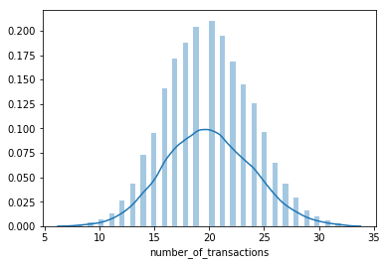
What are the other variables distributed?
Along with the target variable(is_fraud) other variables like number_of transactions, site_visits_A, site_visits_B, dist_latest_transaction_address_km are used.
dist_latest_transaction_address_km is normally distributed.

Slide 4
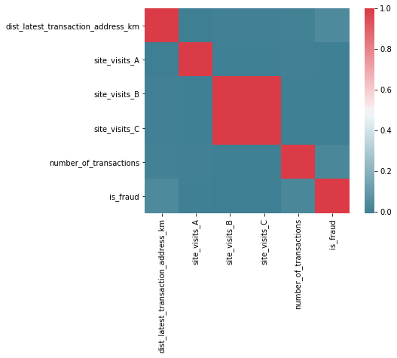
How well can we explain the present fraud using these variables?
The present fraud is explained by the independent variables using correlation check.

Slide 5
From the chart in previous slide it can be observed that site_visits_B and site_visits_C contains almost the same information to predict the target.

Slide 6
What kind of model would you use to predict incidences of this fraud phenomenon and why would you use that kind of model over all others?
Apart from correctly predicting the target values it is important to reduce the false negative rate.
I prefer Xgboost to other models based on the accuracy and error metrics obtained.
Moreover, Xgboost is a tuning parameter technique it improves the performance of the model.

Slide 7
Implement the model you suggest above, what are its performance characteristics?
Performance metrics :
Accuracy = 96.5%
AUC = 0.5
FN = 459

