Slide 1



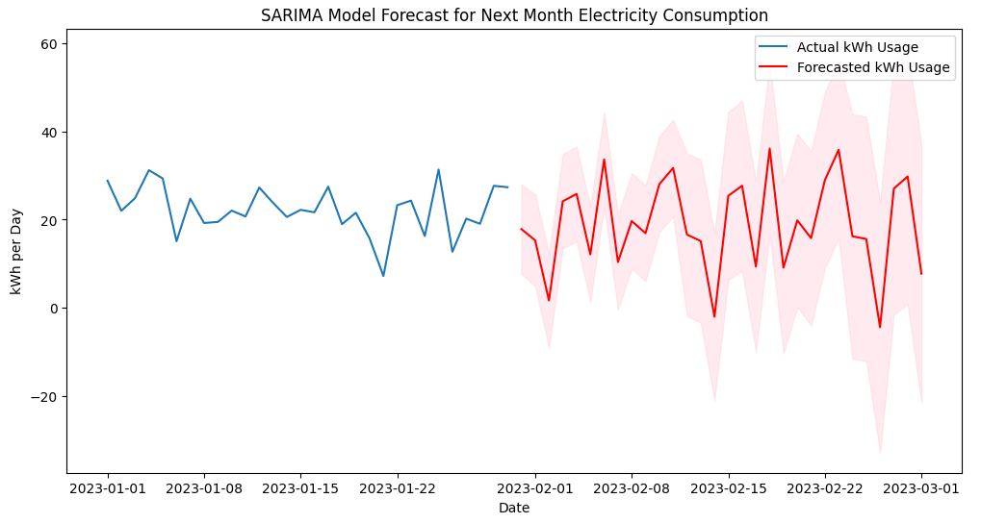
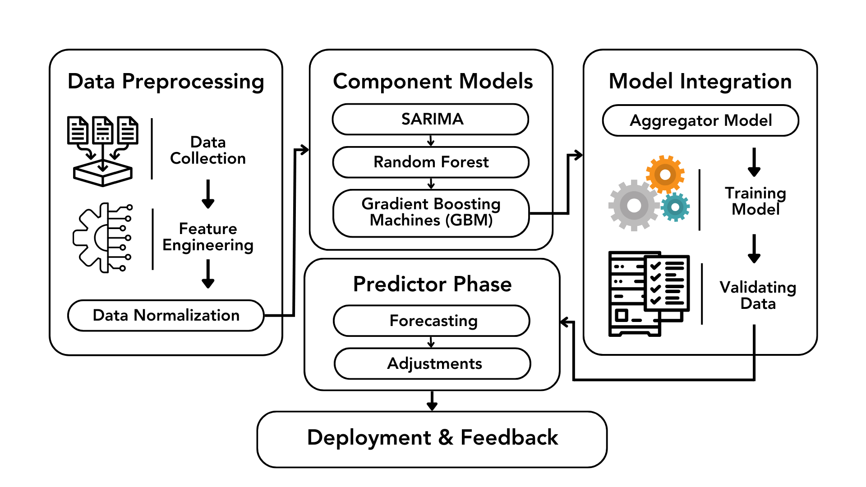
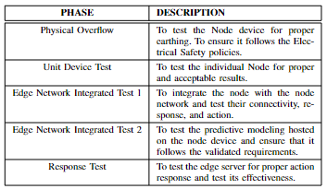
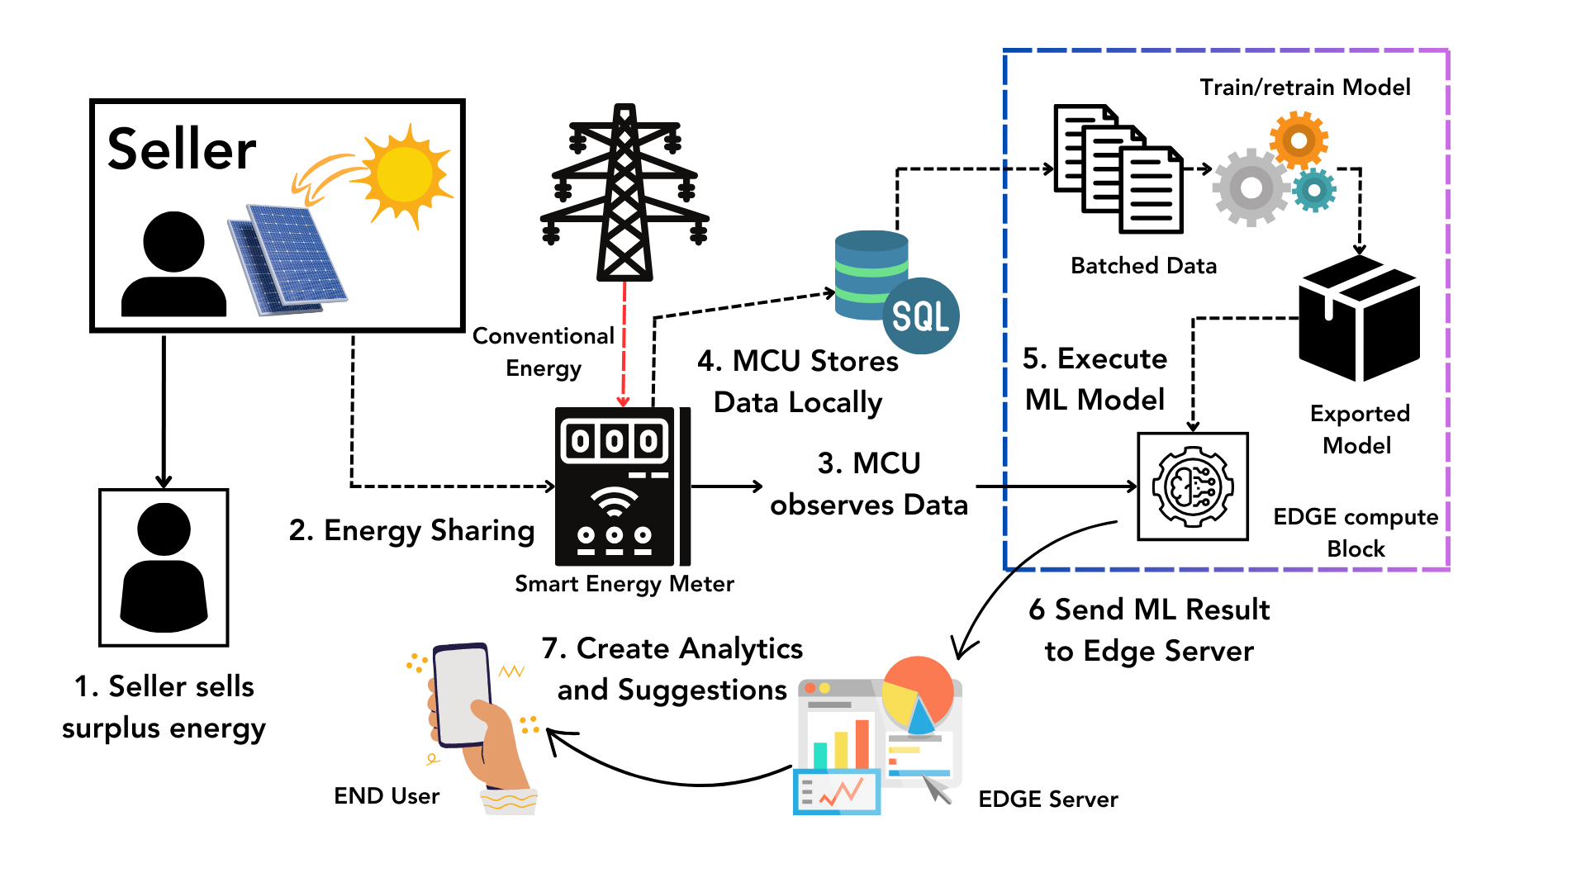
Envisioning S.E.M's by Inducting Edge Computing and Predictive Modelling for Achieving Net Zero Goals
Department of Computer Science and Engineering Batch: (2020-2024)
School of Computing
1156CS701-MAJOR PROJECT
INTERNSHIP THROUGH ABROD/ National Ilan University
WINTER SEMESTER 2023-2024
ABSTRACT
INTRODUCTION
RESULTS
STANDARDS AND POLICIES
With the abrupt realization of the requirement for sustainability and sustainable processes, there is an acute increase in awareness of how resource generation and consumption are being conducted. In the modern world, new ideas and solutions are heavily dependent on computation, power, and energy. Electrical energy is one of the fundamental and foundational aspects upon which all these innovations are realized. The rising apprehension of applying sustainable practices to action has called for solutions to improve and achieve a set of ‘net zero goals’. In response to the growing demand for electricity in the 21st century, a strategic approach is essential for effective energy conservation. This research outlines an implementation of a smart energy meter, built from the ground up, inducted into an edge network, and uses predictive modeling to complete a set of a tripartite eco-system. The design of an individual edge is designed and depicted, along with its performance as a part of an edge node in a multi-nodal network. This initiative aims to utilize modern predictive approaches to map consumption and take precautionary and insightful actions that curb excessive utilization and waste of electricity. The project envisions a future where IoT’s real-time monitoring and edge intelligence’s rapid data processing contribute to achieving net zero goals.
This research demonstrated remarkable outcomes by deploying the proposed smart energy meter system that incorporates an ensemble machine learning model within an intelligent edge network. It showed improvable portions that could have performed better. The emphasis on real-time data processing stands out, enabling timely and informed decision-making that curtails unnecessary energy use and waste, showcasing thesystem’s potential to foster sustainable energy consumption
practices. The architecture of the proposed solution is meticulously designed, encompassing the deployment of node devices, the establishment of an intelligent edge network powered by node data, and the development of a user-friendly interface for edge control. It is backed by the fact that node-based systematic architecture allows a collaborative yet impactful result while reducing any possible miscalculations. This multi-faceted approach provides a holistic enhancement of
an energy management process. Impressively, the system’s testing phase revealed an 83.5% accuracy in forecastingelectricity consumption.
Click here to insert your Discussion text. Type it in or copy and paste from your Word document or other source.
This text box will automatically re-size to your text. To turn off that feature, right click inside this box and go to Format Shape, Text Box, Autofit, and select the “Do Not Autofit” radio button.
To change the background color of any text box, click once on the box so it is outlined with a dashed border. Then select Shape Fill from the Drawing Tools, Format tab on the ribbon bar above. It’s the one with the ‘paint can’ icon.
In response to the escalating demand for sustainability and eco-conscious practices, heightened awareness of the intricacies surrounding resource generation and consumption has emerged. The aftermath of the COVID-19 pandemic has spurred numerous innovations, discoveries, and developmental breakthroughs, heavily reliant on computation, power, and energy. Electrical energy stands as a fundamental cornerstone amid these pillars, crucial for groundbreaking advancements. The quest for implementing sustainable practices into action has driven a compelling search for solutions to enhance and actualize 'net zero goals'. This concern encompasses multifaceted factors, with energy generation and consumption at its core. From 2010 to 2019, the average energy production trend exhibited a positive growth rate of 2.5% annually, with global power generation in 2022 increasing by approximately 2.3%. However, despite this growth, only 20.4% of energy is prone to electrification, while the majority still relies on fossil fuels. As of 2021, there are reportedly about 2.3 billion residences worldwide, a number expected to exponentially grow by 2024, underscoring the significant impact potential of proposed energy solutions.
This initiative envisions a future where real-time monitoring through the Internet of Things (IoT) and rapid data processing via edge intelligence collectively contribute to achieving net zero goals. Our work not only addresses current challenges but also envisions a sustainable energy landscape for future generations. In the ever-evolving energy systems landscape, a thorough exploration of technical intricacies surrounding sustainable energy solutions is imperative.
Table 1. Testing framework used for validating the system..
Figure 1. Sarima Model Prediction
Figure 2. Predictor, ML Model
CONCLUSIONS
METHODOLOGIES
This research, which integrated an intelligent edge network with an ensemble machine learning model in smart energy meters, has successfully met its set requirements, focusing on achieving net zero goals. The efficient data management facilitated by the Node Device, utilizing ESP32 microcontroller and multiple sensors, laid a robust foundation for accurate energy consumption analysis. The advanced predictive analytics, combining SARIMA, Random Forest, and GBM algorithms within the Raspberry Pi 4 Model B, performed above par with 83.5\% accuracy in forecasting electricity consumption, enabling informed and sustainable energy usage decisions. The user-friendly mobile app enhanced user engagement and awareness, fostering sustainable energy behaviors.
The Node Device is the cornerstone of the proposed smart energy meter system. Though it is simple in the sense of a single unit, when it is joined with many such nodes, it groups into a very big and complex network that provides an exceptional outcome. It encompasses the following key components:
There are three methodologies we are using
MODULE 1: Node Device Establishment
MODULE 2: Intelligent Edge Network Supported by Node Data
MODULE 3: User Interface for Edge Control
TEAM MEMBER DETAILS
ACKNOWLEDGEMENT
TEAM MEMBER DETAILS
Project Supervisor Name/Designation : Dr. G.DHANABALAN M.E.,Ph.D.,
Project supervisor Contact No : 9894955190
Project supervisor Mail ID : gdhanabalan@veltech.edu.in
<Student 1. 17713/Sripathi Manideep Reddy>
<Student 1. 6305959473>
<Student 1. Vtu17713@veltech.edu.in>
Chart 1. Architecture Diagram

