Slide 1
Real Time Facial Recognition using OpenCV and Python
Presented By:
Mani Deep Charugundla
Satish Pallabothula
Sravani Ganipisetti

Slide 2
Agenda
Introduction
Goals
Software Analysis
Approach
Libraries used
Deliverables
Implementation
Results
Live Demo

Slide 3
Introduction
Implementation of face detection and Recognition by simply using laptop’s Webcam.
Real Time face detection using Face Detection algorithm to visualize human faces in Digital image.
We are using video feed from a webcam which are sequence of frames of still images being updated one after the other to recognize and predict faces.

Slide 4
Primary goals

Slide 5
Goals
To train the image dataset and store them with proper faceID.
Passing the frames captured by webcam one by one to detect faces.
Depending upon the confidence level, determine whether to label the predicted face or not.
Validating the test results with multiple test cases.
Improving the training data with larger data sets of images.

Slide 6
Software Analysis
Anaconda IDE
Python
Open CV libraries

Slide 7
Approach
Creating Dataset
Training Data set
Predicting Faces in Real time

Slide 8
LIBRARIES USED:
NumPy
OpenCV
CV2
Tensorflow
Imutils
Pandas

Slide 9
DELIVERABLES
We will deploy a convolution neural network to recognize face. After that we use the dataset into a model. Finally, we associate each facial with or without mask.
Sample output Images.
Git Hub repository with all documentation and code.
YouTube link which demonstrates our work.

Slide 10
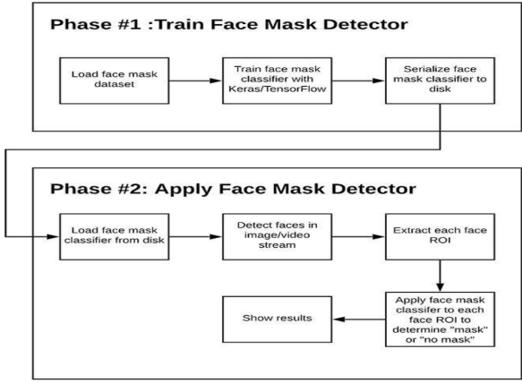
Implementation

Slide 11
CNN
CONVOLUTIONAL NEURAL NETWORKS
Convolutional Neural Network are based on the following principles:
Local receptive fields.
Shared weights.
Pooling.

Slide 12
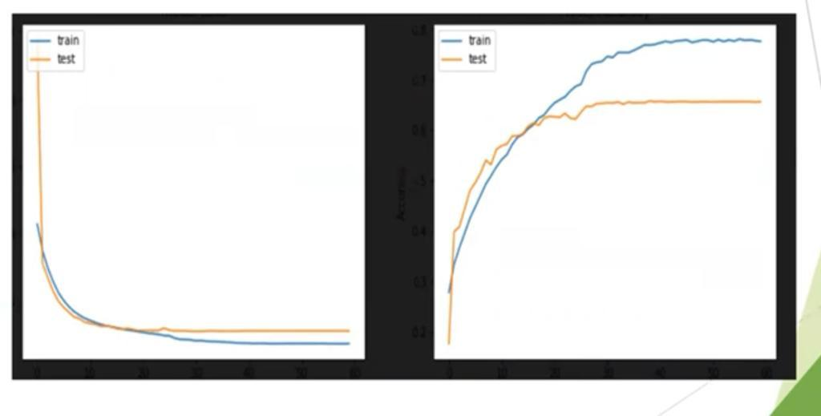
LOSS AND ACCURACY PLOT

Slide 13
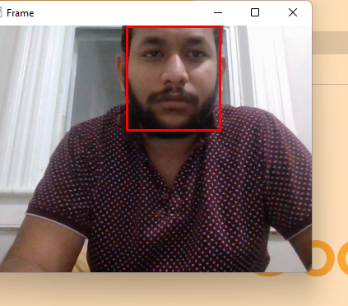
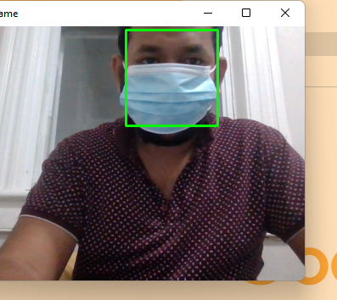
RESULTS
Without Mask
With Mask

Slide 14
Thank you

