Slide 1
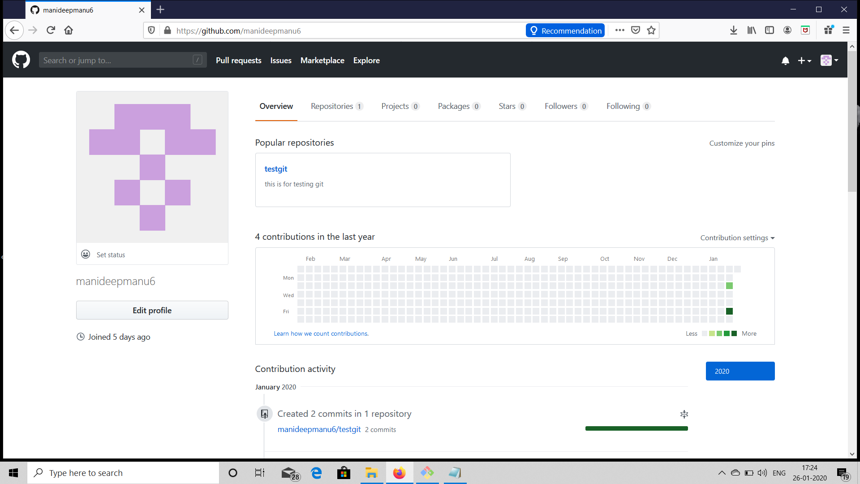
GITHUB ACCOUNT PROFILE
Step1: created the github account and profile of my github account.

Slide 2
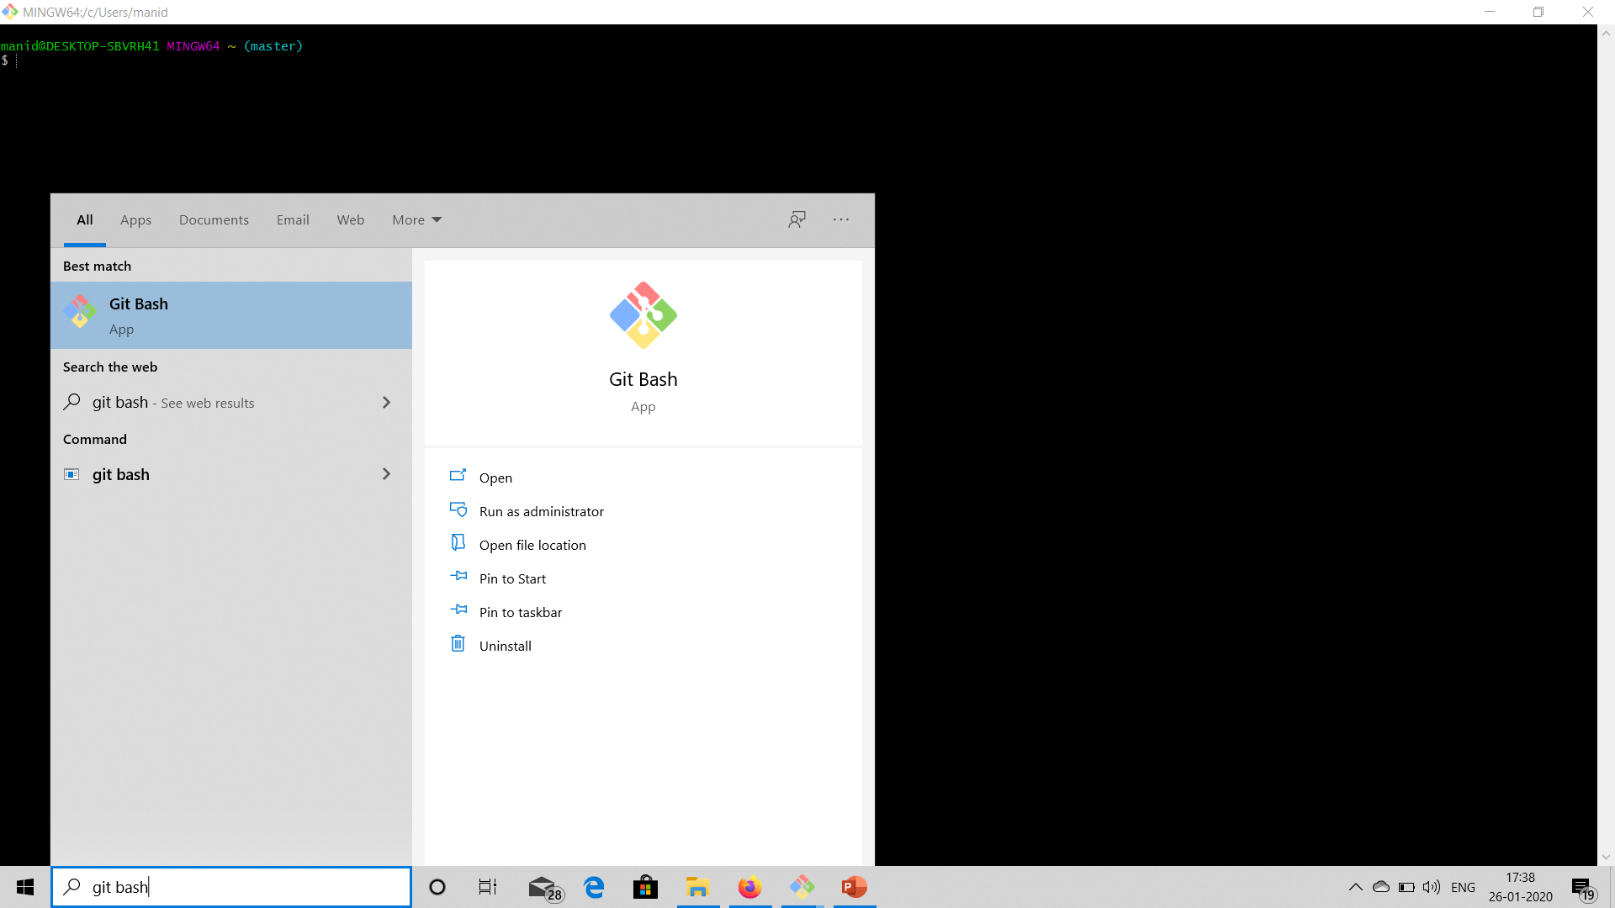
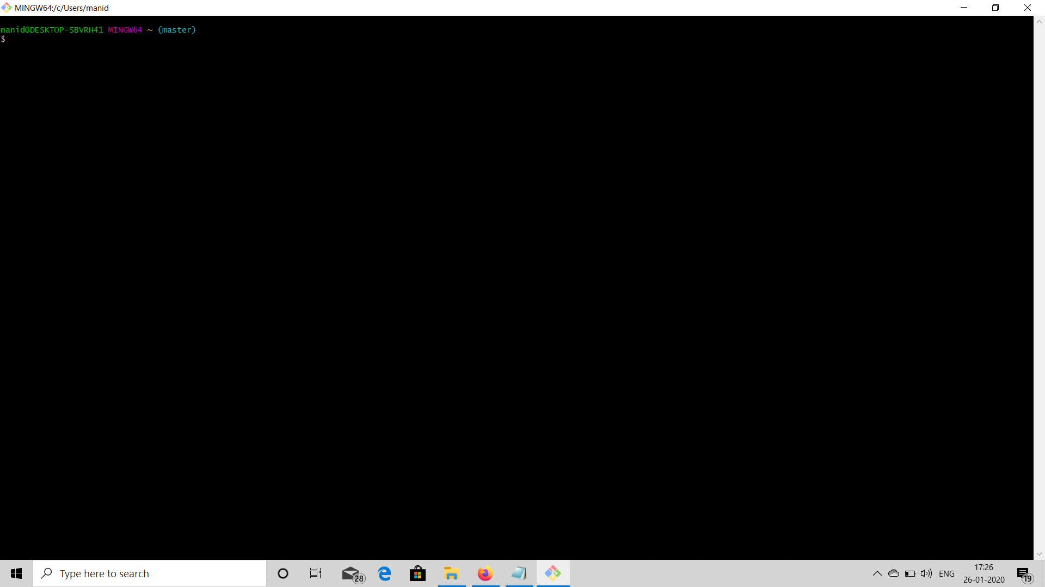
Step 2:Installed git in my personal computer

Slide 3
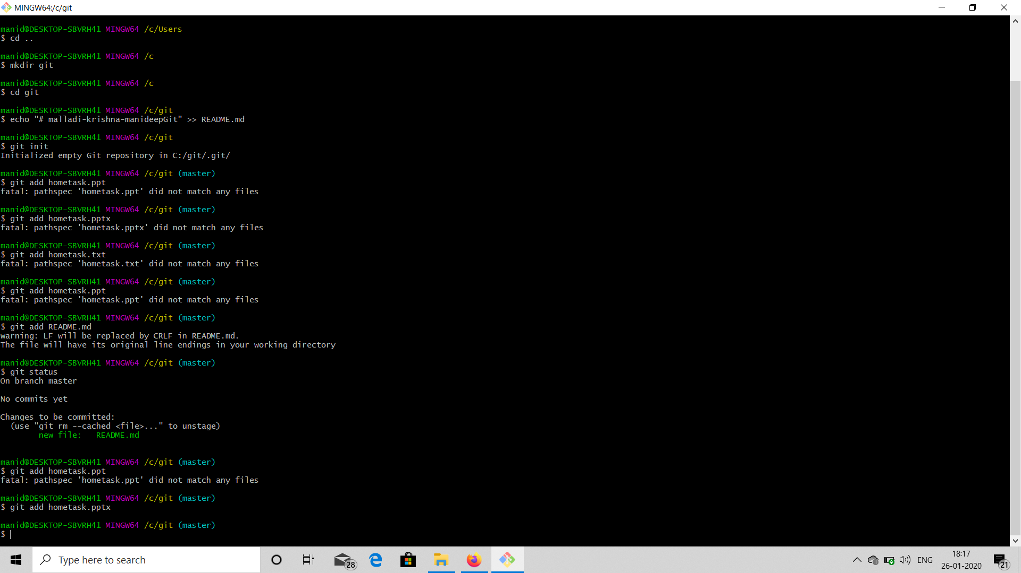
Step3: creating a repository using git commands and adding file to git

Slide 4
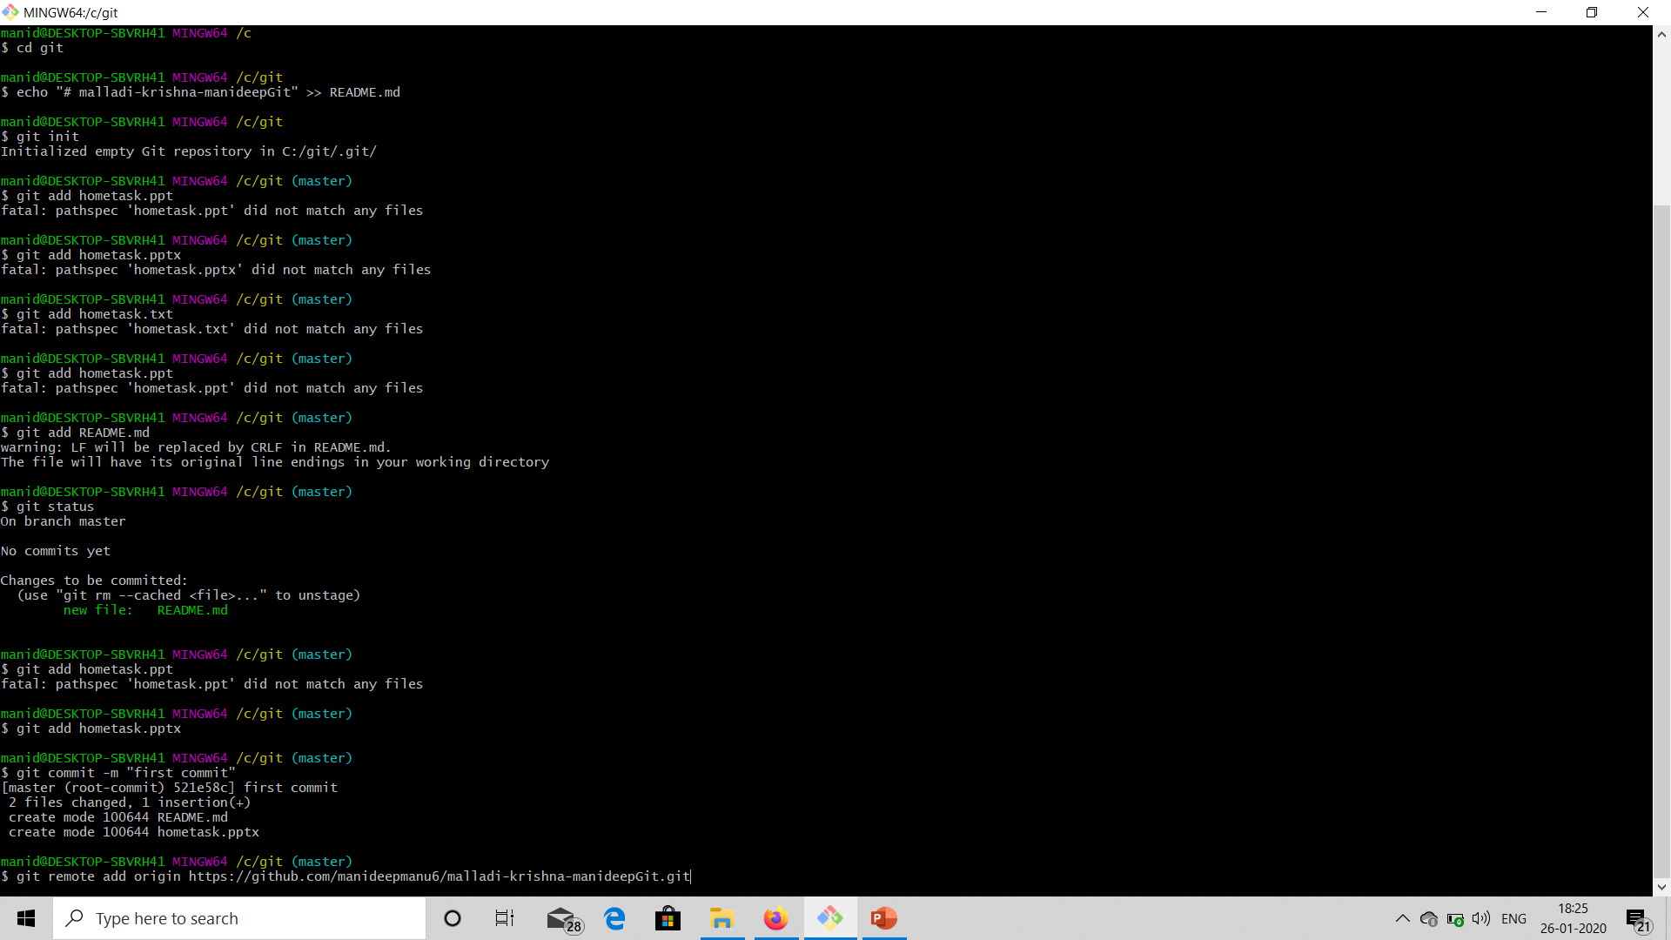
Step3:giving the path where to push the changes and commit the files

Slide 5
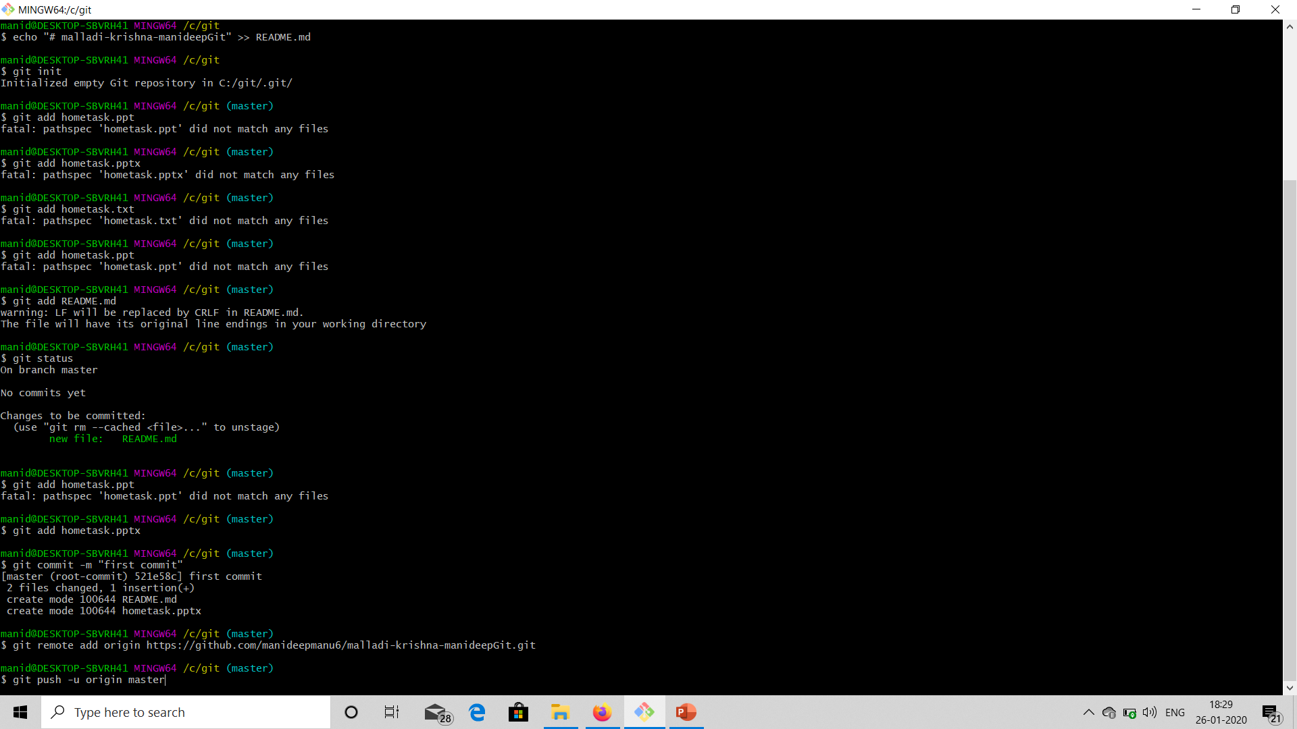
Step5:Pushing the file from origin to master

