Slide 1

Customer Behavior Analysis using Python, MySQL, and Power BI
Manideep Reddy | End-to-End Data Analytics Project
Python • MySQL • Power BI

Slide 2




Problem Statement
Understanding customer behavior to drive business growth through data-driven insights
Shopping Behavior
Spending Patterns
Understand how customers shop and what influences their purchase decisions
Identify trends in spending across different customer segments and product categories
Product Performance
Subscription Behavior
Analyze which products and categories drive the most revenue and customer engagement
Study how subscription status affects customer spending and retention patterns

Slide 3
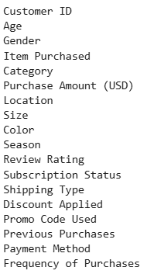
Dataset Overview
3,900 Rows • 18 Columns
A comprehensive dataset requiring cleaning and preparation before analysis
Data Categories
Customer demographics (Age, Gender, Location)
Purchase details (Item, Category, Amount)
Behavior data (Discounts, Shipping, Previous Purchases)

Slide 4
Data Cleaning & Processing
Python pandas workflow
01
02
Load & Explore
Check Missing Values
Loaded dataset using pandas and explored structure with df.info() and df.describe()
Identified and assessed missing data points throughout the dataset
03
04
Fill Missing Data
Rename Columns
Applied appropriate imputation methods to handle missing values in review_rating
Standardized column names for consistency and readability
05
06
Create Features
Prepare for Database
Built new analytical features including age_group and purchase_frequency_days
Finalized cleaned dataset ready for MySQL integration and SQL analysis

Slide 5




Database Integration
MySQL workflow
Created Database
Python Connection
Designed MySQL database schema optimized for analytical queries
Connected Python to MySQL using SQLAlchemy for seamless data transfer
Store Data
SQL Queries
Loaded cleaned dataset into MySQL table for efficient querying
Executed analytical queries to answer business questions

Slide 6






SQL Business Analysis
Key insights extracted through targeted SQL queries
Revenue by Gender
Discount Analysis
Segmented revenue performance across different gender groups
Identified high-spending customers who use discounts effectively
Product Ratings
Shipping Comparison
Determined top-rated products driving customer satisfaction
Analyzed impact of different shipping types on purchase behavior
Subscription Impact
Age Segmentation
Compared spending patterns between subscribers and non-subscribers
Grouped customers by age to identify high-value segments

Slide 7
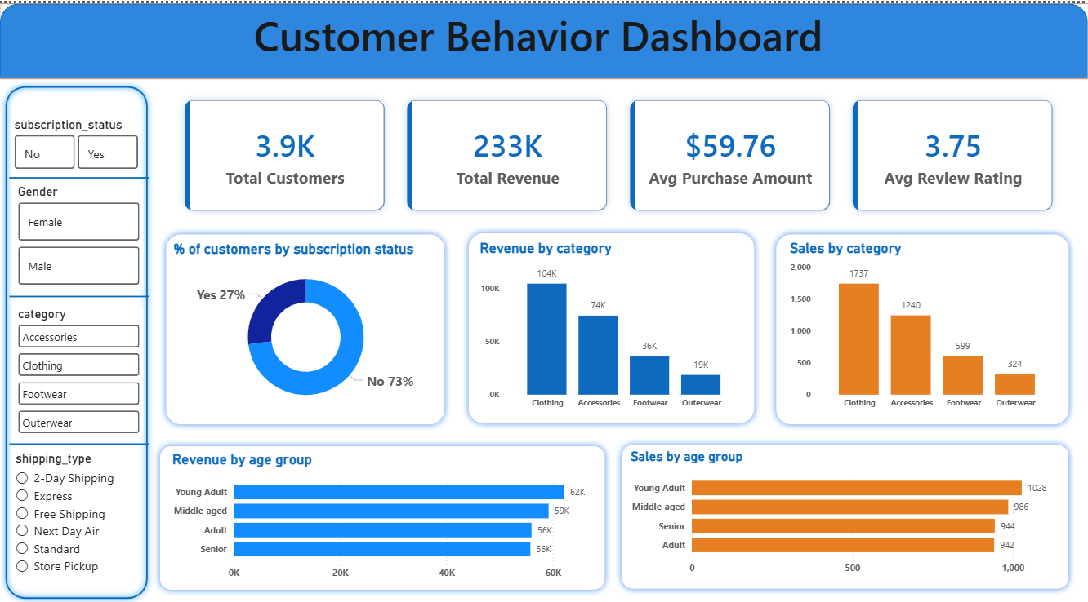
Power BI Dashboard
Key Performance Indicators
Total Customers
Total Revenue
Average Purchase Amount
Average Review Rating
Visualizations
Revenue by Category
Sales by Category
Revenue by Age Group
Sales by Age Group
Interactive Filtering
Users can dynamically filter data by gender, category, subscription status, and shipping type for real-time insights

Slide 8
Key Insights & Recommendations
Insight: Top Category
Insight: High-Value Segment
Clothing category generates the highest revenue and drives the most customer purchases
Young Adult customers contribute the most revenue and have the highest purchase frequency
Insight: Subscription Gap
Insight: Discount Influence
Most customers are non-subscribers, representing a significant growth opportunity
Discounts significantly influence customer purchasing decisions and increase conversion rates
Business Recommendations
Increase subscription adoption through exclusive benefits and incentives
Implement loyalty programs specifically designed for repeat customers
Promote high-performing product categories through targeted marketing campaigns
Optimize discount strategies based on customer segmentation data
Target high-value customer segments with personalized marketing campaigns

