Slide 1
Sonifying the Heart
MUSIC WORKSHOP · MID-SEMESTER EVALUATION
Turning a heartbeat into music — and reading the emotion back out
Chervith Reddy
Manidhar Sukasi
Sathwik Reddy
2024101076
2023101067
2024121002
ECG data & heartbeats
Music & integration
Emotion & evaluation
ECG data → Heartbeats → Music → Emotion
Notes:
Mid-semester evaluation. We turn a real ECG recording into music, then read the emotional character of that music. Four stages, and the whole thing is one notebook.

Slide 2
The question we started from
A heart does not beat like a metronome.
The gap between one beat and the next shifts constantly, and the same nervous system that steers those shifts also shapes how we feel.
Why music, and not a number?
The ear is far better than the eye at hearing timing. We notice a broken rhythm instantly, without counting. An arrhythmia is a timing disorder — so sound is the natural medium for it.
So we asked:
Can a heartbeat be turned into music that is honest to the rhythm?
Can a listener hear the difference between a steady heart and an irregular one?
This already happens in hospitals
Does the emotion of that music tell us anything about the person?
Cardiac monitors beep. Pulse oximeters change pitch. Anaesthetists listen while their eyes are elsewhere.
Our question: if we are turning the heart into sound anyway, what happens when it becomes music?
Notes:
Frame the problem. Note we are NOT claiming to detect disease - algorithms already do that better.

Slide 3
Existing research we build on
Sonifying the body is an old idea. Reading emotion from music is a large, active field. Our contribution is joining them.
Sonifying physiology
Music and emotion
Lucier, Music for Solo Performer (1965) — first work to make sound from body signals
Russell (1980), A circumplex model of affect — the valence/arousal plane we use
cambridge.org/core/journals/organised-sound
Journal of Personality & Social Psychology
Scale-Free Music of the Brain, PLOS ONE — sleep stages become audibly different music
Gabrielsson & Lindström (2010) — which musical features carry which emotions
journals.plos.org/plosone (pone.0005915)
Handbook of Music and Emotion, OUP
Models we cross-check against
Where the data comes from
Essentia (Bogdanov et al., ISMIR 2013) — pretrained mood and valence/arousal models
Goldberger et al. (2000), PhysioNet — the open archive our recordings come from
essentia.upf.edu
doi.org/10.1161/01.CIR.101.23.e215
music2emo (Kang & Herremans, 2025) — unified music emotion recognition
Moody & Mark — the MIT-BIH databases, and AF detection from R-R intervals
arxiv.org/abs/2502.03979
physionet.org
Notes:
Full citations with DOIs are in README section 11.6 and project_description section 18.

Slide 4
Available datasets
All open, all from PhysioNet or public research archives.
WHAT WE USE NOW
WHAT WE WOULD NEED TO VALIDATE EMOTION
MIT-BIH Atrial Fibrillation
WESAD
15 people
chest ECG, with stress / amusement / neutral conditions and self-report questionnaires
25 long recordings of adults with AF. Most contain both a healthy rhythm and an irregular one, so we hear the same person in both states. Expert-labelled, 250 Hz.
DREAMER
23 people
ECG and EEG while watching 18 film clips, each rated by the viewer
MIT-BIH Arrhythmia
48 half-hour excerpts from 47 people, with beat annotations checked by two or more cardiologists. Adds two more recordings with both rhythms.
AMIGOS
40 people
ECG, EEG and skin response, with self-rated valence, arousal and liking
All three pair physiology with what the person actually reported feeling — which is exactly what ours lack.
The limitation: these are cardiology archives from 1975–1983. They contain no emotion data at all — so our emotion claim cannot be tested on them.
Notes:
Key point: our current data can show the music separates the rhythms, but can never show it matches a feeling.

Slide 5
Our approach — four stages
Each stage is a plain, stated rule. Nothing is learned from data, so every musical decision can be explained and defended.
1
ECG data
2
Heartbeats
3
Music
4
Emotion
A real recording, streamed from PhysioNet.
Any ECG file works — no annotations needed.
→
Find each beat, measure the gap to the next.
That gap, and how it changes, is the whole input.
→
One heartbeat becomes one note.
Strings and a lub-dub pulse follow the same rhythm.
→
Place the music on the valence–arousal plane.
Two pretrained models give second opinions.
The one rule that matters
Every heartbeat becomes exactly one note. It starts at the beat, and lasts as long as the gap to the next one — so the rhythm of the music is the rhythm of the heart. Its pitch follows whether the beat came early or late.
While the beat stays close to schedule the melody uses a five-note scale that cannot sound wrong. Once it drifts past 12%, the melody leaves that scale and the chords sour. A steady heart is incapable of sounding tense.
Notes:
Emphasise: the dissonance only ever comes from real irregularity, never from our choice of notes.

Slide 6
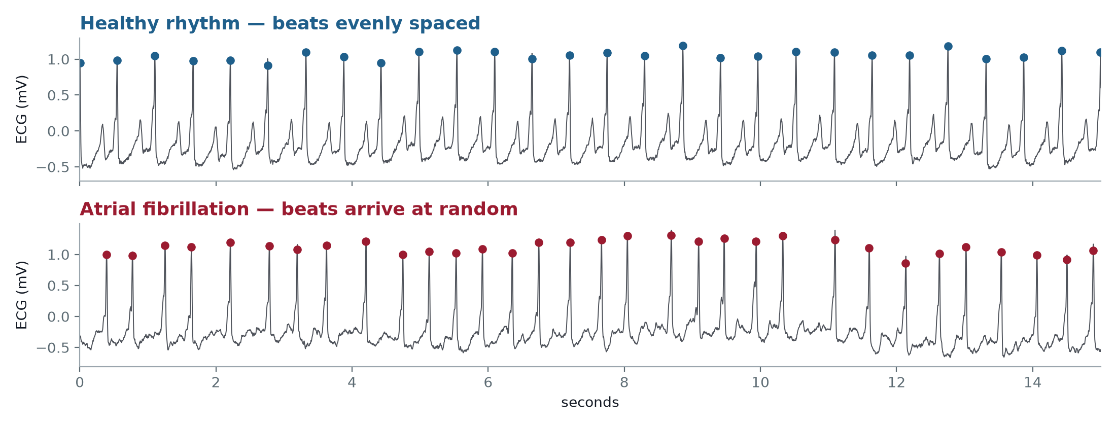
What the heart gives us
The same person, 30 seconds apart. Each dot is one heartbeat — and the spacing is the only thing our music is built from.
MIT-BIH record 04043 — the upper trace is this patient's healthy rhythm, the lower one is the same patient in atrial fibrillation
Notes:
Point at the even spacing above versus the ragged spacing below. That is the entire signal.

Slide 7
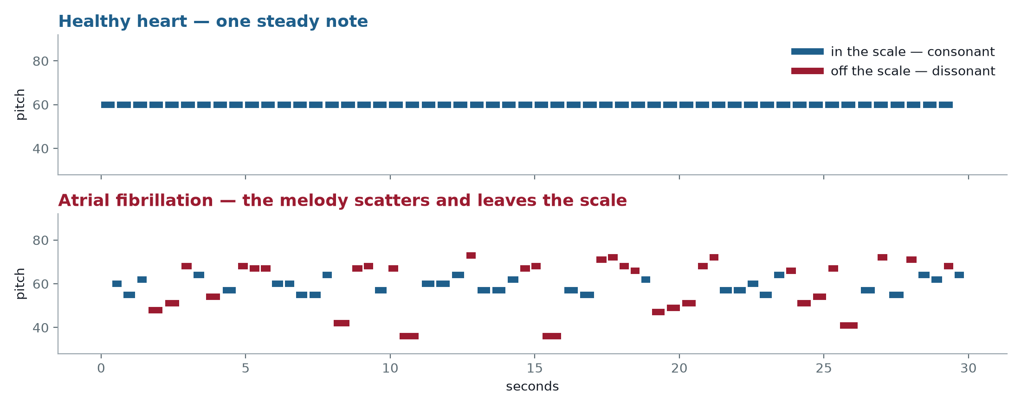
What comes out
The same two clips, turned into melody. Nothing was tuned per-clip — one rule produced both.
A healthy heart holds one note. An irregular heart scatters across three octaves, and half its notes fall outside the scale.
Notes:
If there is sound in the room, play 30 seconds of each here. It lands far better than the picture.

Slide 8
What we have produced so far
14
6
3
100%
pieces of music
from 7 recordings
patients, each heard
in both rhythms
emotion models
compared
of results reproduced
by a clean rebuild
The music
The figures
Melody, string harmony and a heartbeat pulse, as MIDI and audio, for every clip.
A score plot per piece showing the ECG, the timing, and the generated music on one time axis.
The code
The documentation
One self-contained notebook — every stage, explained, runs top to bottom in four minutes.
Full write-up, dated progress log, and a plan stating what is proven and what is not.
Notes:
All of it is on GitHub and reproducible from the notebook.

Slide 9
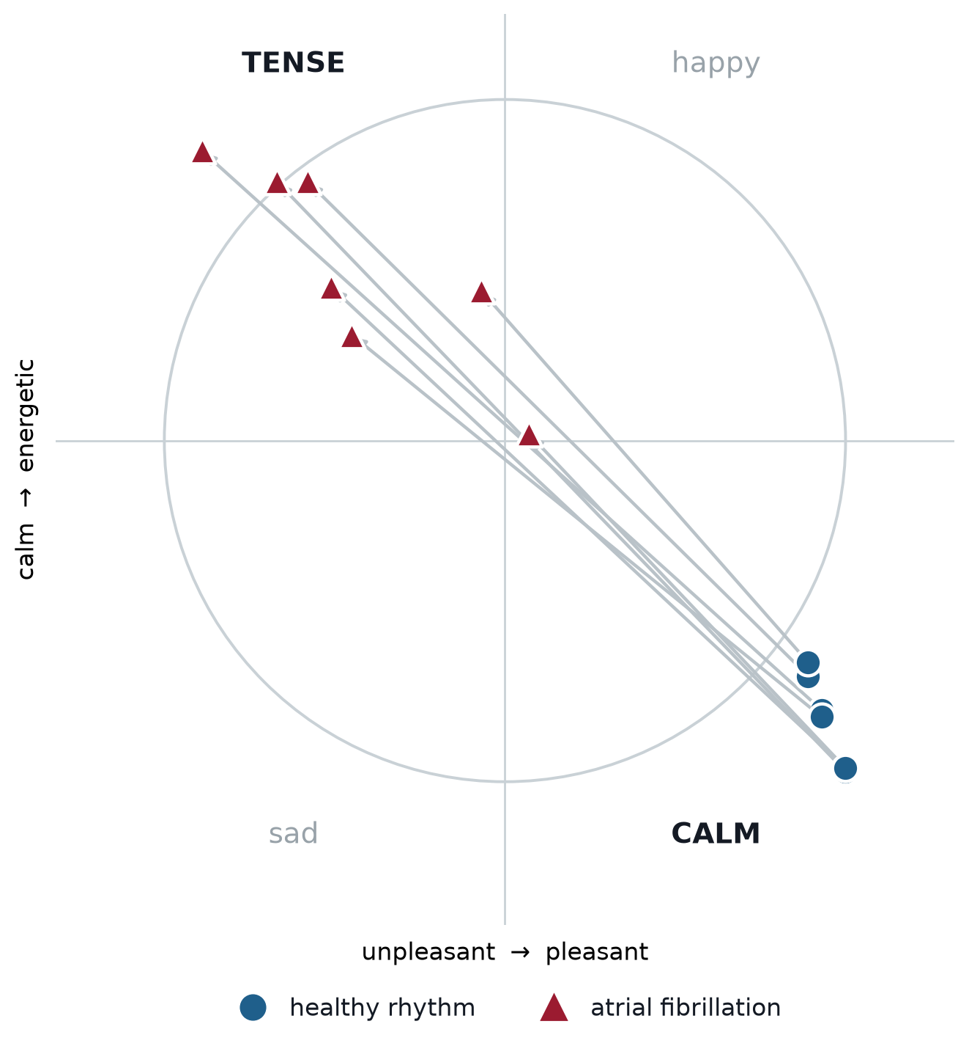
The result, in one picture
Every arrow runs from a patient's healthy rhythm to their own irregular rhythm.
All 7 healthy rhythms land in the calm quadrant.
6 of 7 irregular rhythms land in the tense quadrant.
Every arrow points the same way — less pleasant, more agitated. 7 out of 7, on both axes.
The one exception is a genuinely mild case, and it sits at the centre rather than being forced to a side.
The music reports a degree, not a verdict.
Notes:
Stress that nothing here is a diagnosis. The system reflects the rhythm it is given.

Slide 10
The finding we did not expect
One recording is labelled “normal” in the database. Our music disagreed — and the music was right.
What the database says
What our pipeline said
Who was right
This stretch of record 219 is labelled a normal rhythm, and was used for decades as a normal example.
Every stage flagged it independently. The melody, the harmony and both pretrained models all called the “normal” clip the more disturbed of the two.
The annotations show 133 blocked atrial beats — a genuine irregularity the label never captured. We excluded the record, and kept the finding.
Why this matters for the project
We are not claiming to detect disease — existing algorithms do that better. The claim is narrower and more interesting: the music is an instrument for noticing things about a rhythm that a label does not carry.
Notes:
This is the strongest result we have. It is also the clip we hid inside the listening study as a control.

Slide 11
What we are doing right now
Everything above is a measurement on our own output. No human has yet been asked whether any of it is audible.
A blind listening study — built and ready
Every outcome is useful
16 clips, 30 seconds each, in random order — nobody is told what they are hearing.
They track our model
→ the translation works
Four questions per clip: how pleasant, how energetic, which word fits, how steady the rhythm felt.
They hear the rhythm, not the emotion
Plain piano throughout, so no instrument can give the answer away.
→ we learn exactly where it breaks
Two clips are the disputed record 219, hidden as a control.
They hear nothing
→ an honest negative result
This is the step that turns “we built a translation” into “we built a translation and tested it.”
All that is missing is listeners. We would like to run it with the class.
Notes:
Ask here whether we can use class time for this.

Slide 12
What we can still do in this course
Ordered by what each gives us for the effort it costs.
Run the listening study
NEXT
Tune the music by ear
One class session. Finishes the half of the project that is about music reaching a listener.
Every threshold so far is justified by what it measures, not how it sounds. For a music course, that is the gap worth closing.
Widen the evidence
Finish the cross-check
We use 5 recordings; about 21 are usable. Nearly free, and roughly triples the evidence base.
Re-run the two pretrained models so the whole results section is independently verified.
A mapping for healthy hearts
A live demo
Calm breathing raises variability, which our rule would misread as tension. Breathing sits at a distinct rate, so it can be separated.
Drop in any ECG file and play the result. The code already does this.
Notes:
The first two are the ones that most suit a music course.

Slide 13
Where we stand
We built a complete, transparent system that turns a heartbeat into music, where every decision is stated and testable. Along the way it caught a mislabelled recording in a database used for decades.
What nobody in this area usually checks — whether a listener can actually hear what the mapping encodes — is what we are testing next.
Thank you — questions welcome
Notes:
Close by asking: can we use class time for the listening study, and does the music need to be good or only different?

