Slide 1
Google Tasks API Integration
This video shows how to setup Google Tasks Integration app on Zepp OS Smart watch

Slide 2
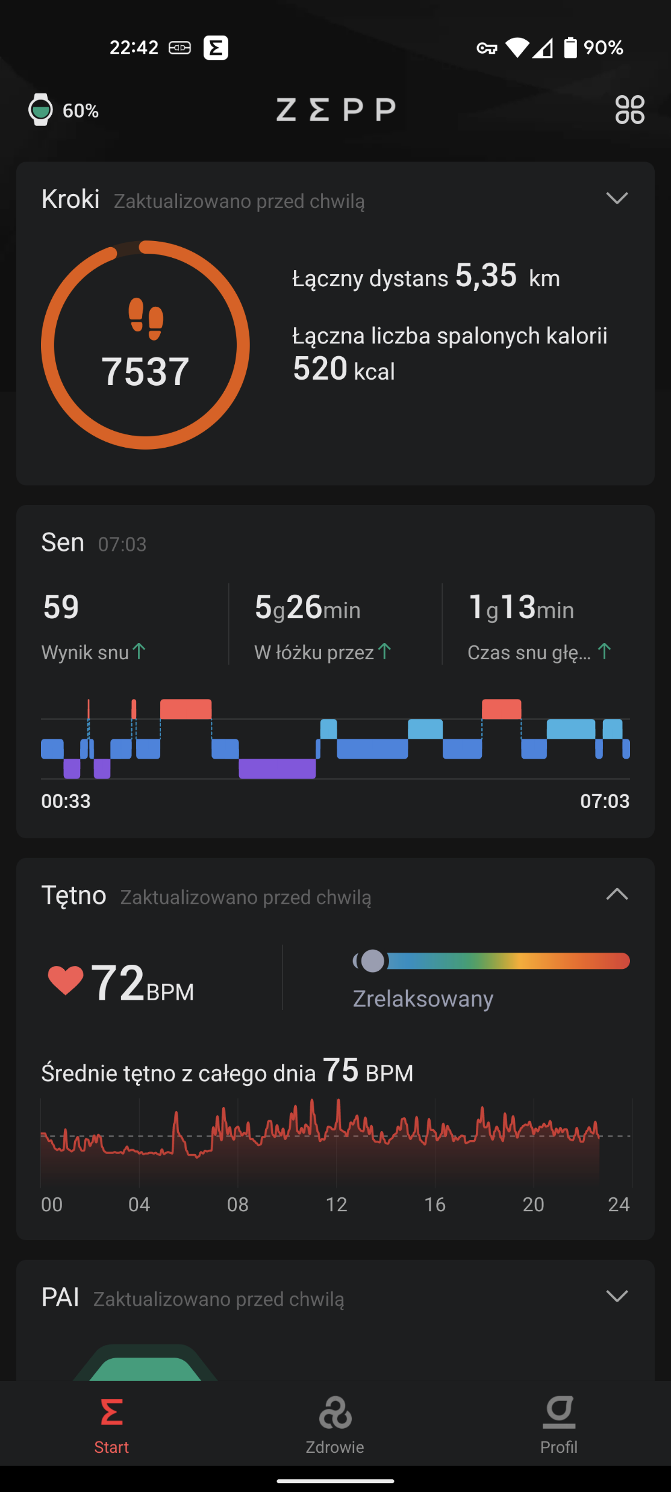
Click on profile to go to apps

Slide 3
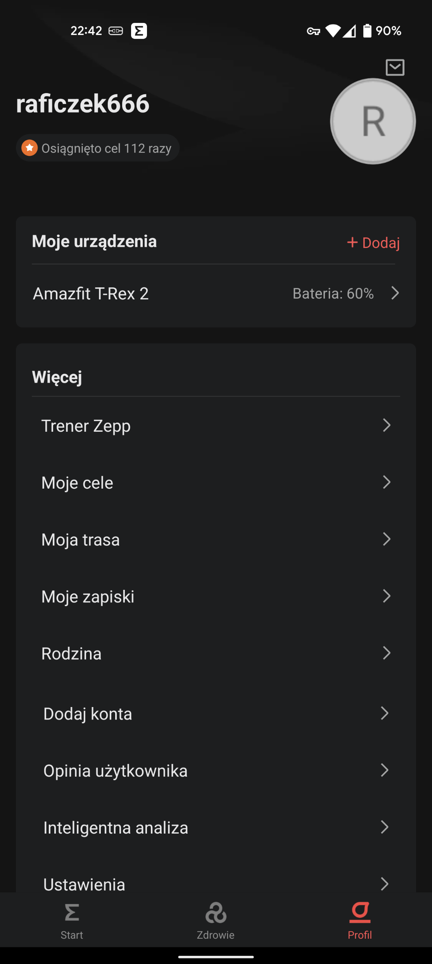
Choose your smartwatch

Slide 4
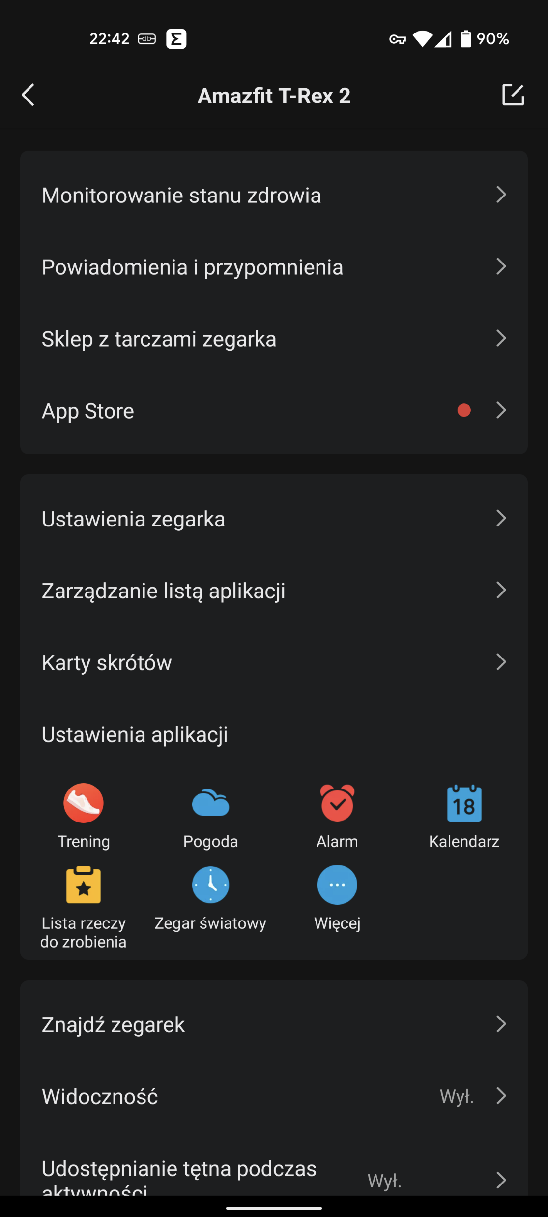
Go to app store

Slide 5
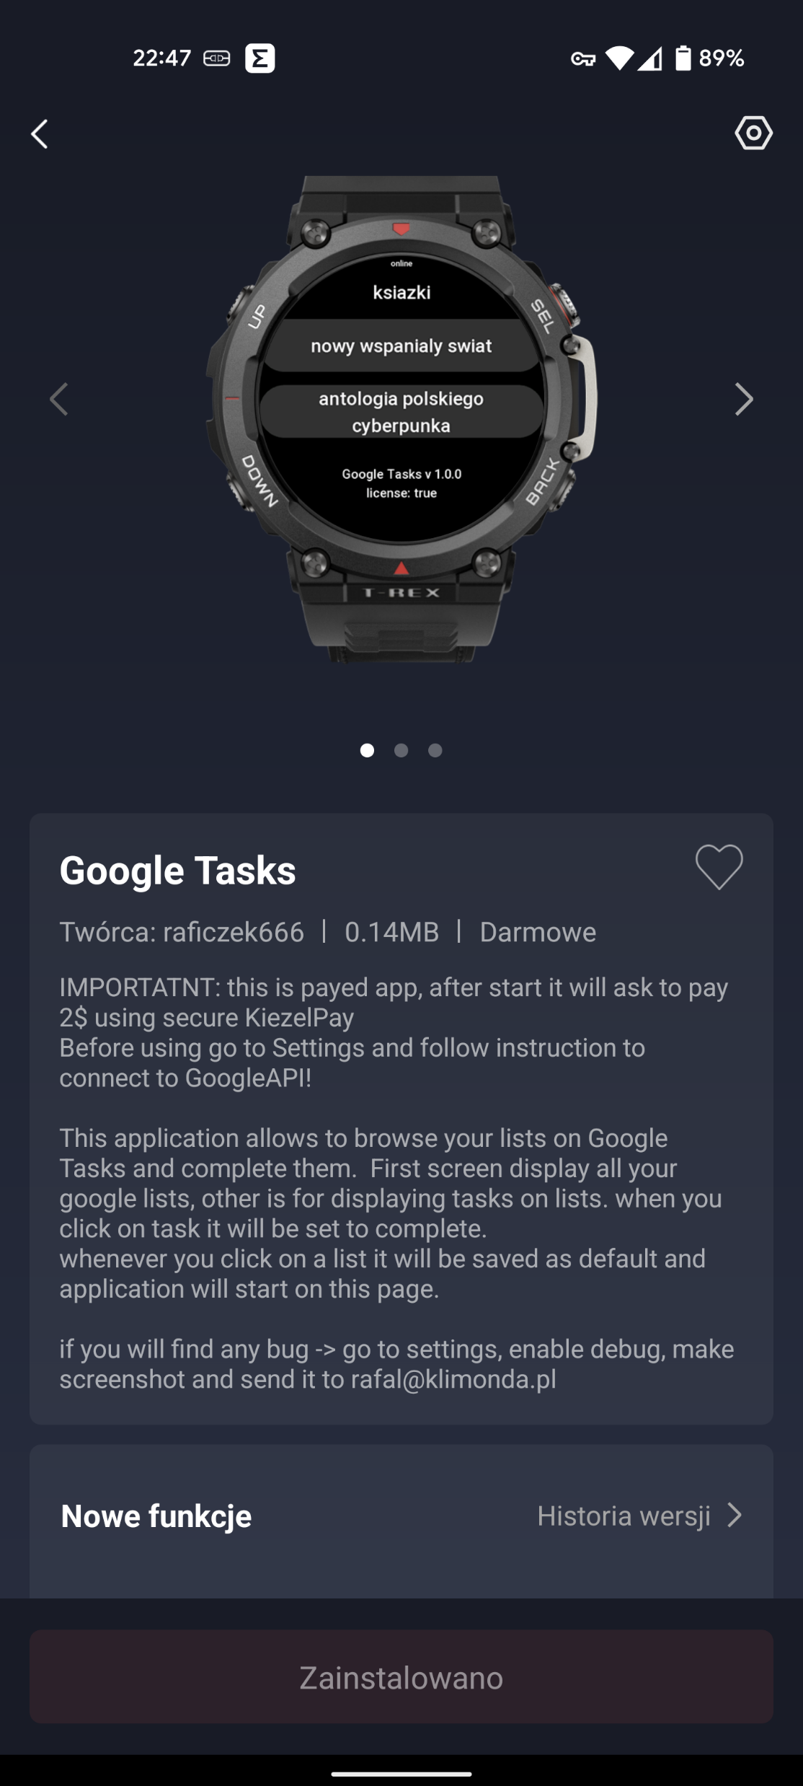
Go to application settings

Slide 6
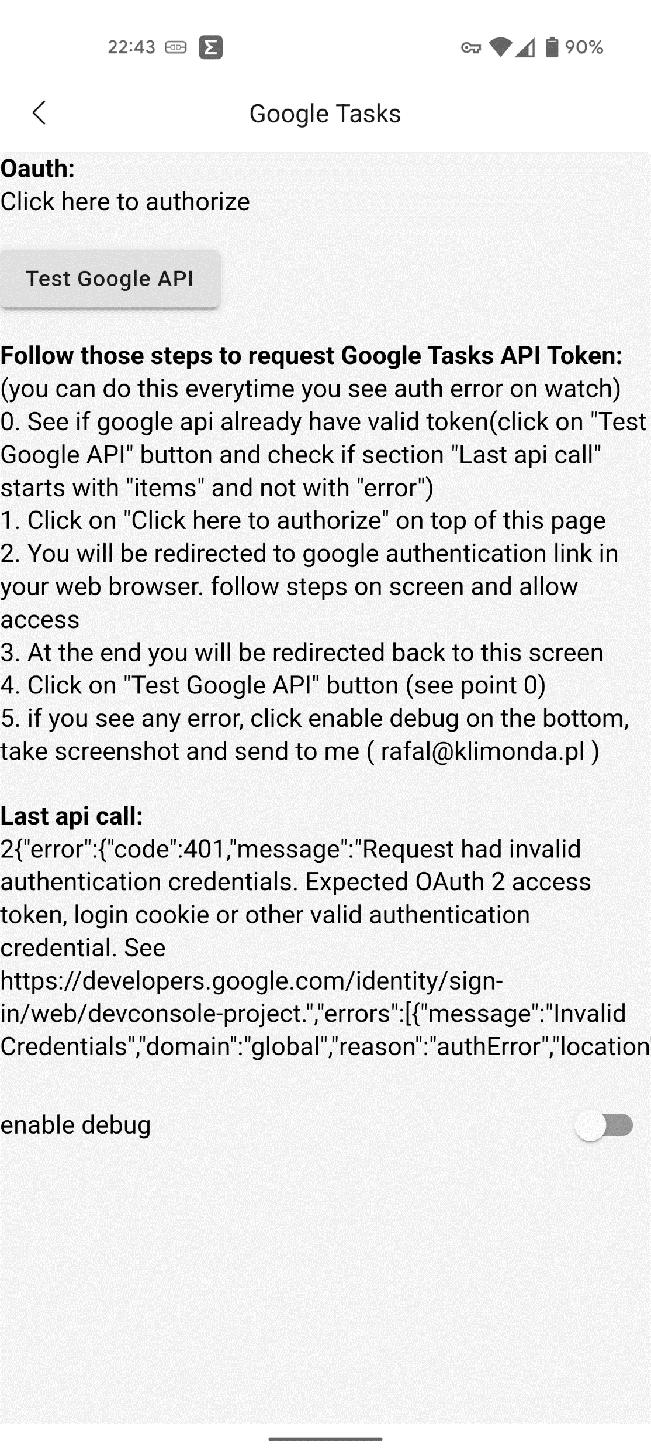
Click on this buton to open web browser on phone and allow application usage of Google Tasks API
If you see code:401 or 403 it means that you havent initialized application or your token expired/revoked

Slide 7
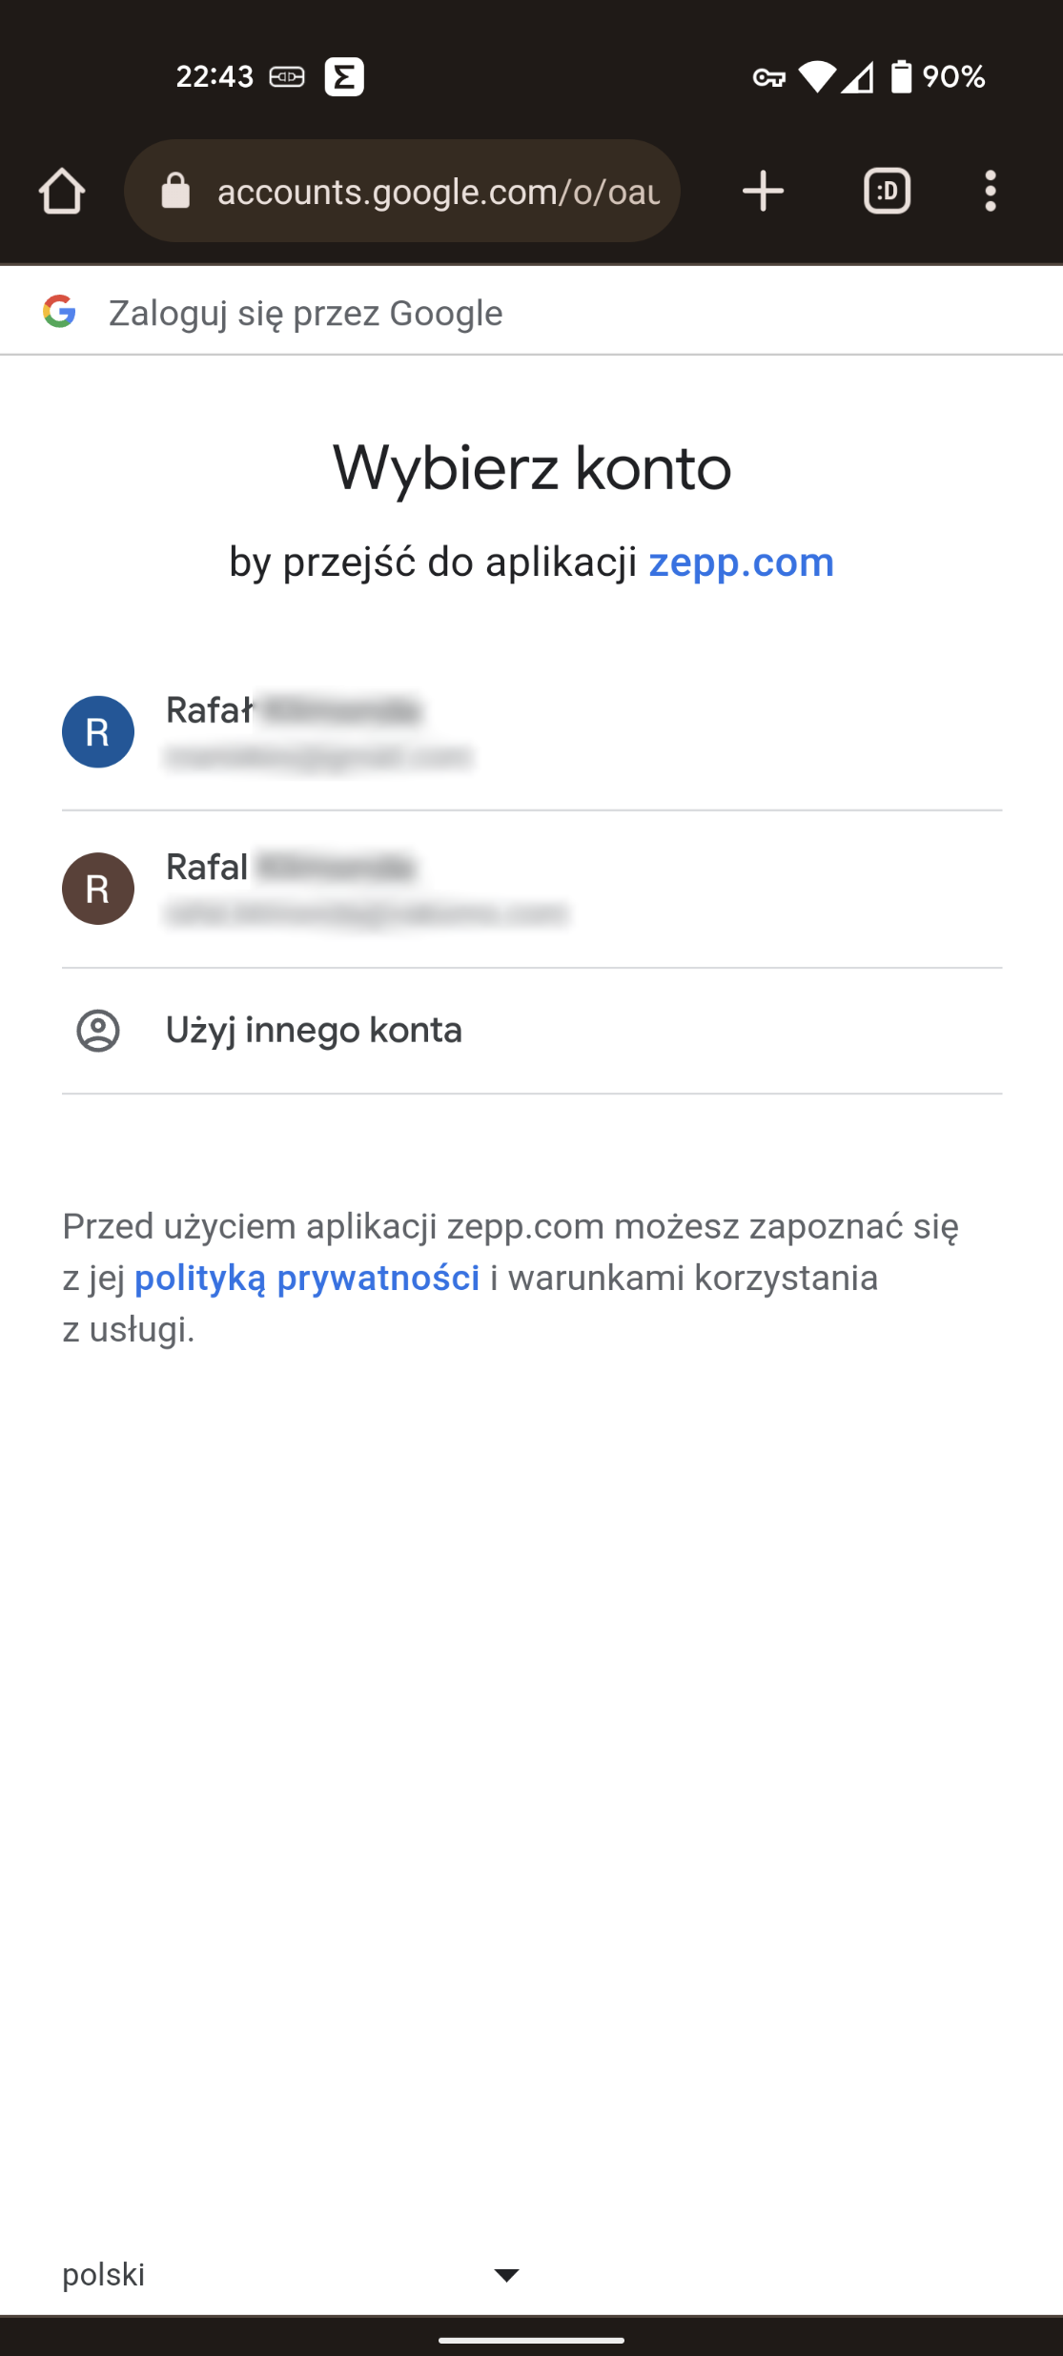
Choose account

Slide 8
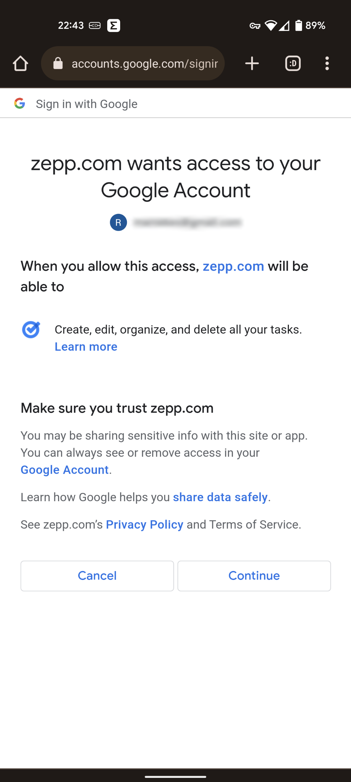
Allow application to access Tasks API

Slide 9
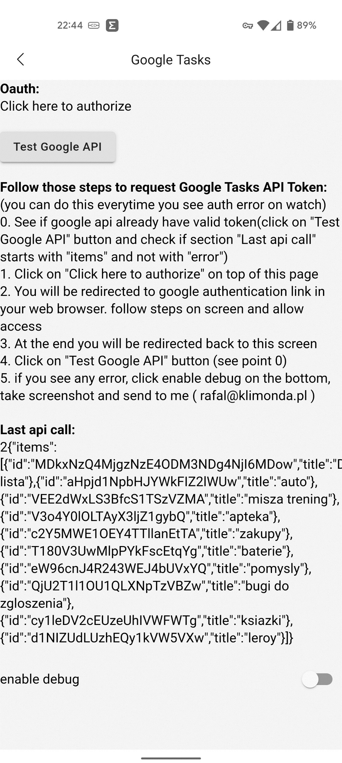
If all worked fine you will be redirected back to application screen. You can use „Test Google API” buton to send sample request
Here instead of 401/403 you will see your task lists

Slide 10
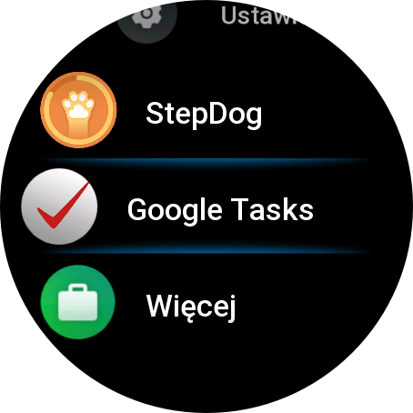
Go to application list on smartwatch and open Google Tasks

Slide 11
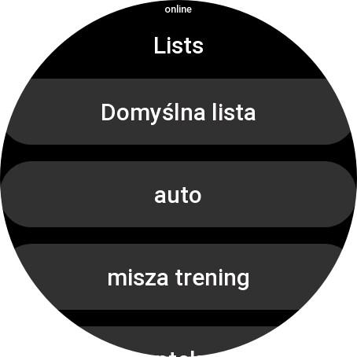
On main screen you will see all your lists
Click on one

Slide 12
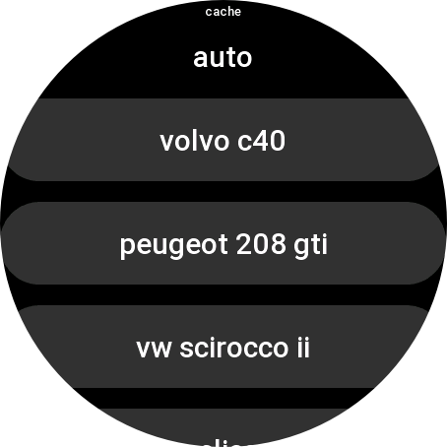
This indicates if you see cached result or fetched online. Usually screen should start with „cache” and after max few seconds change to „online”. This depends on network quality.
Here you see all tasks on selected list.
When you click a task it will be marked as complete.

Slide 13
Thank you for watching ☺
If you have any question regarding application or want to raise a bug send me email: rafal@klimonda.pl

