Slide 1
Google Tasks API Integration
This video shows how to setup Google Tasks Integration app on Zepp OS Smart watch

Slide 2
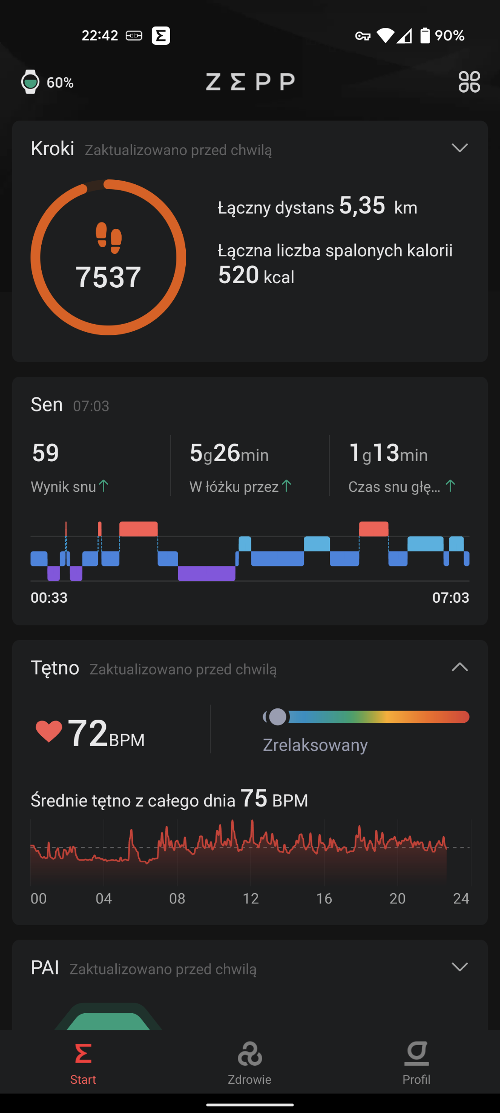
Click on profile to go to apps

Slide 3
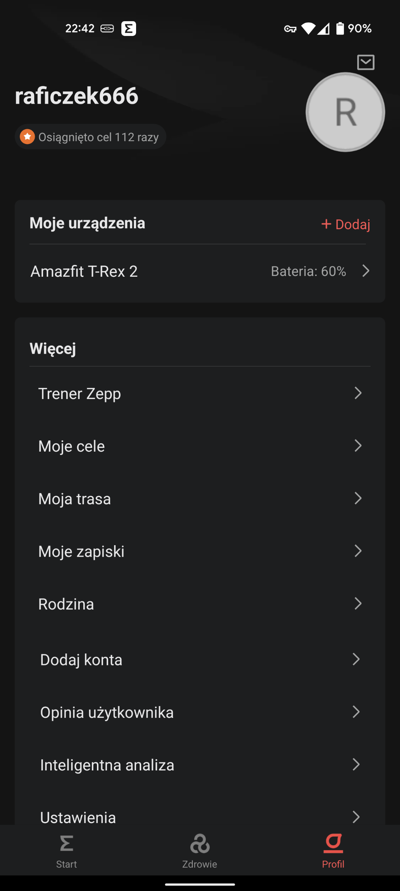
Choose your smartwatch

Slide 4
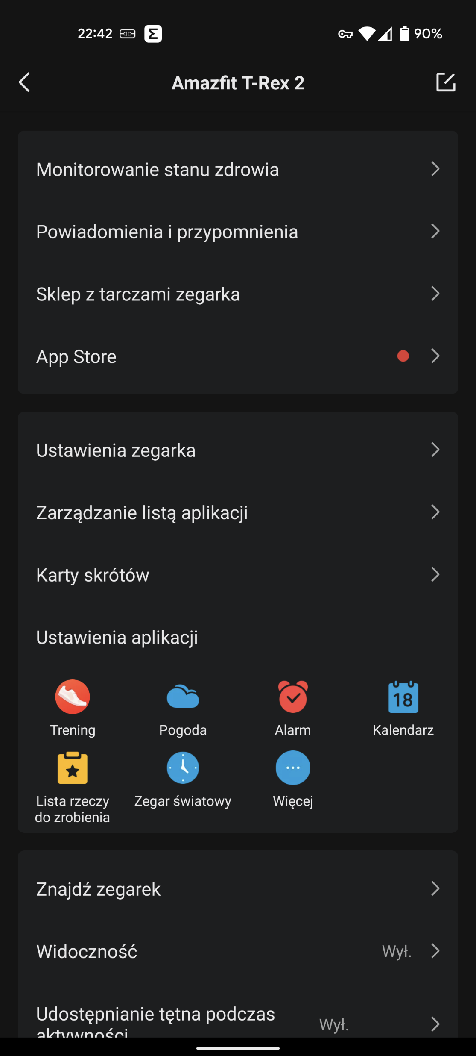
Go to app store

Slide 5
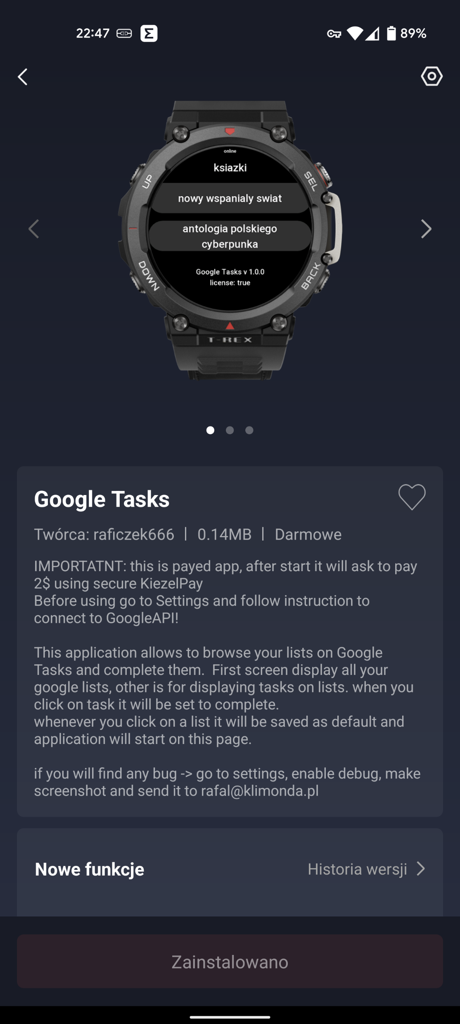
Go to application settings

Slide 6
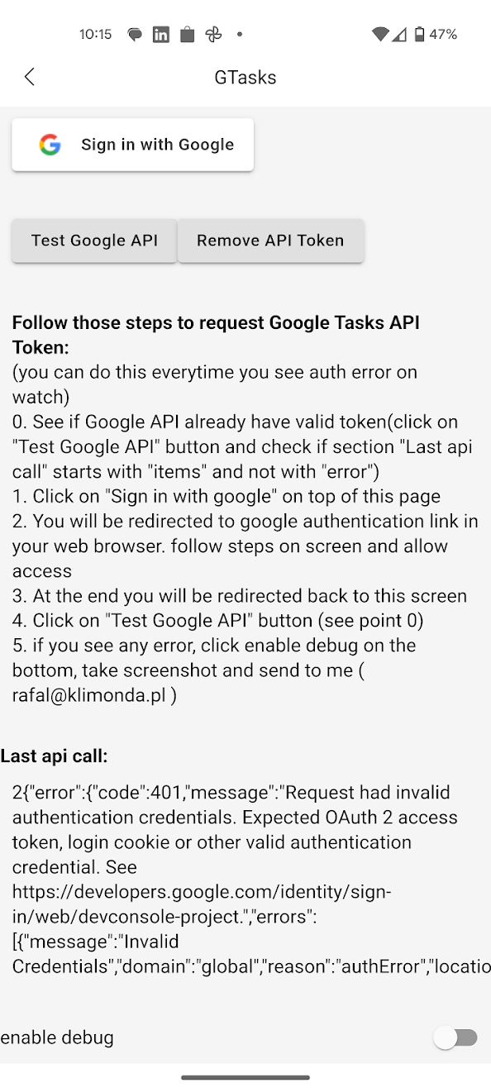
Click on this buton to open web browser on phone and allow application usage of Google Tasks API
This buton will remove current authentication from device
If you see code:401 or 403 it means that you havent initialized application or your token expired/revoked

Slide 7
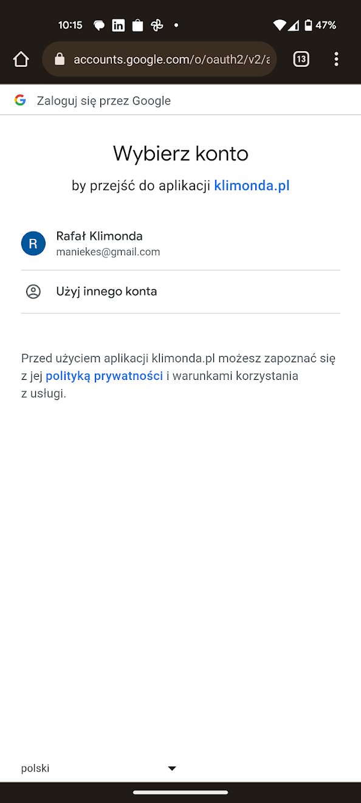
Choose account

Slide 8
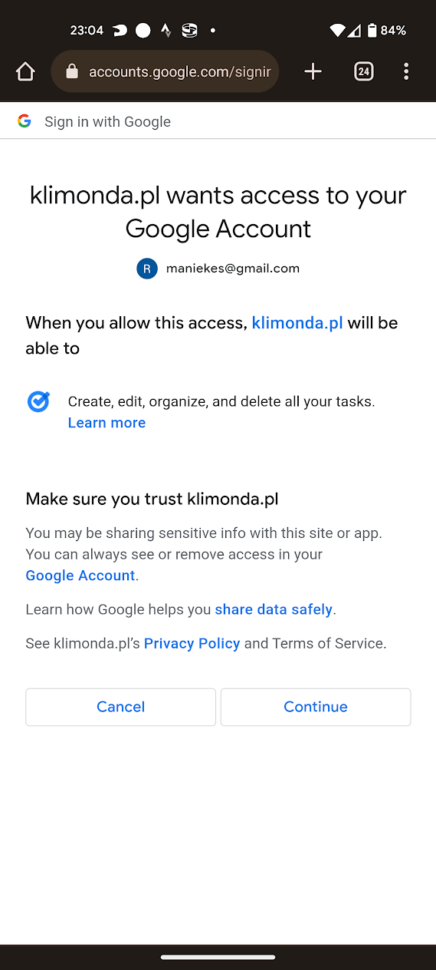
Allow application to access Tasks API

Slide 9
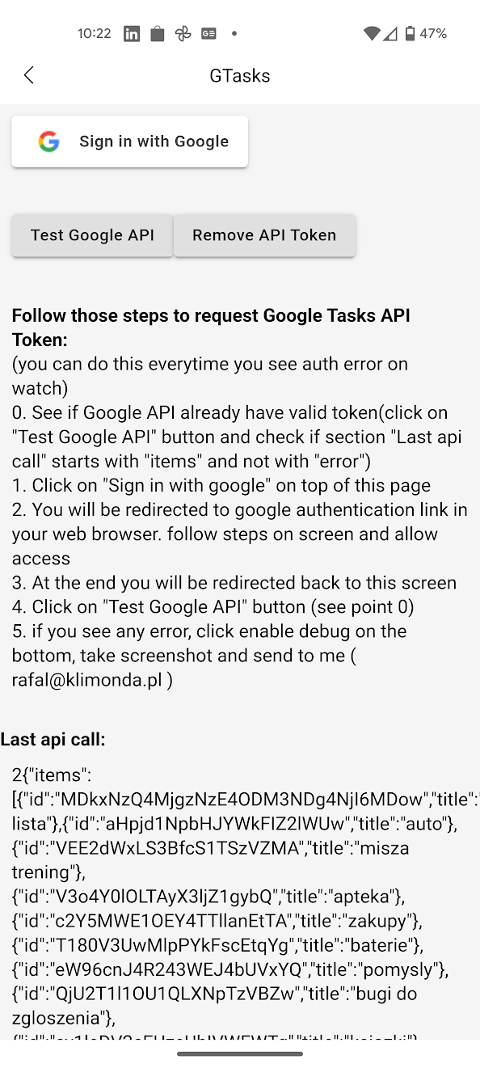
If all worked fine you will be redirected back to application screen. You can use „Test Google API” buton to send sample request
Here instead of 401/403 you will see your task lists

Slide 10
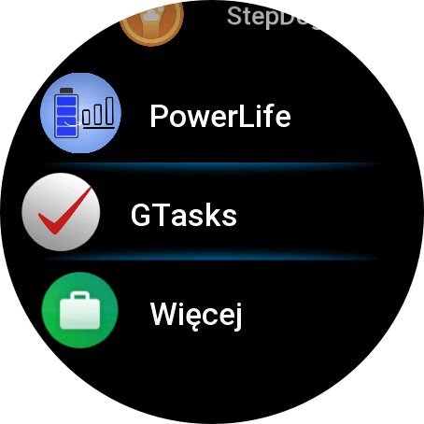
Smartwatch demo
Go to application list on smartwatch and open Google Tasks

Slide 11
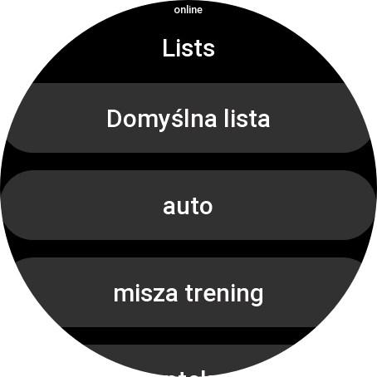
Smartwatch demo
On main screen you will see all your lists
Click on one

Slide 12
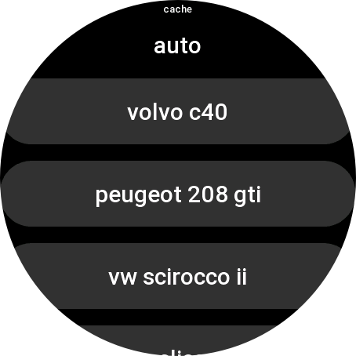
This indicates if you see cached result or fetched online. Usually screen should start with „cache” and after max few seconds change to „online”. This depends on network quality.
Here you see all tasks on selected list.
When you click a task it will be marked as complete.

Slide 13
Application flow for data scopes
This is main screen of the application called „Lists”.
During start it will call Google Tasks api and display all lists assigned to user. Lists are saved into watch as cache. Initially application display saved lists(on the top user see word „cache”), when Google Tasks api call will finish screen will display result of api call and top word will change to „online”.
Application use following endpoint to fetch this data:
https://tasks.googleapis.com/tasks/v1/users/@me/lists?fields=items.id,items.title
When user click on a list application will go to „Tasks” screen.

Slide 14
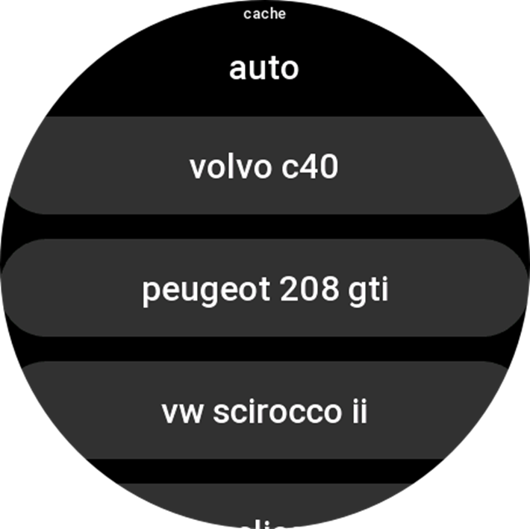
Application flow for data scopes
This is secondary screen of the application called „Lists”.
During start it will call Google Tasks api and display all tasks assigned to list selected in previous screen. Tasks are being saved in smartwatch and cached same way as lists.
Application use following endpoint to fetch this data:
https://tasks.googleapis.com/tasks/v1/lists/${listId}/tasks?showCompleted=false&fields=items.id,items.title
${listId} -> list selected on previous screen

Slide 15
Application flow for data scopes
When user click on a task it will be deleted from display list, and it will send PUT request to Google Tasks API to complete it.
It will use following endpoint to do this:
https://tasks.googleapis.com/tasks/v1/lists/${listId}/tasks/${task.id}
Request body:
{id: task.id, title: task.title, status: 'completed’}

Slide 16
Application flow for data scopes
Data retention in smartwatch:
all data saved in watch is deleted when user unstall application
For extra security user have buton which will remove google auth token from device

Slide 17
Thank you for watching ☺
If you have any question regarding application or want to raise a bug send me email: rafal@klimonda.pl

