Slide 1
Bootstrap-Enhanced Distributionally Robust Scheduling of Loading Yards
Vittorio Maniezzo, University of Bologna
Livio Fenga, University of Exeter

Slide 2
Agenda
The theory behind BESO (Bootstrap Enhanced Scenario Optimization)
The triggering use case: city logistics
The scheduling use case: loading yards

Slide 3
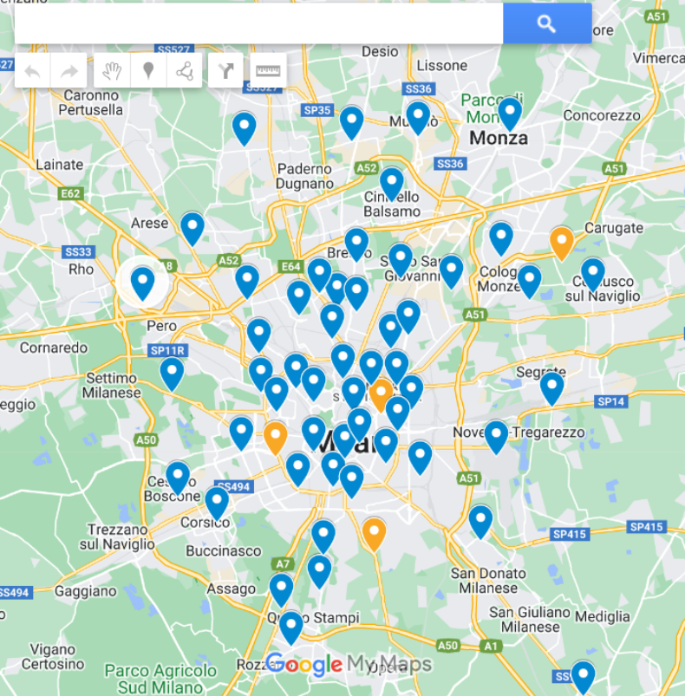
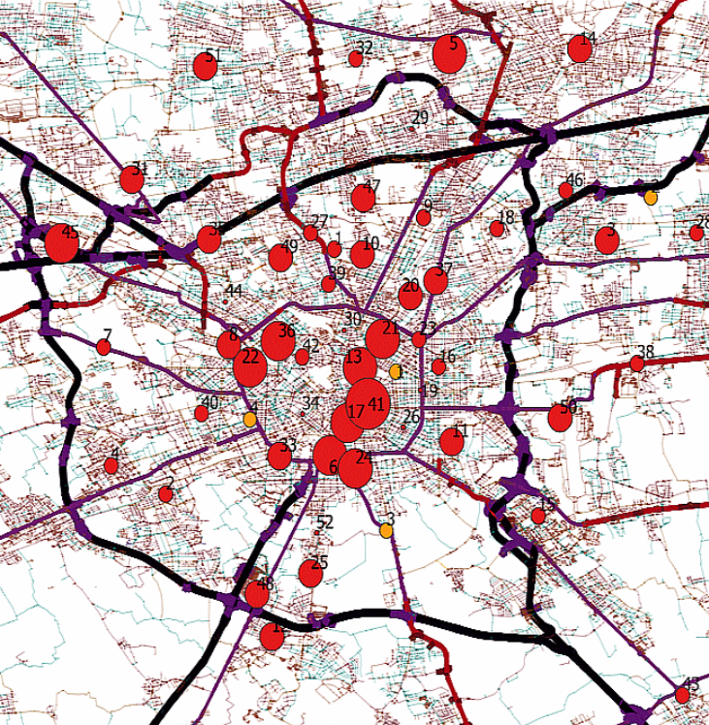
First problem
52 retailer stores
4 DCs: one big, one smaller, 2 satellites close to city center
Allocation for Christmas season! Preliminary analysis during summer.

Slide 4
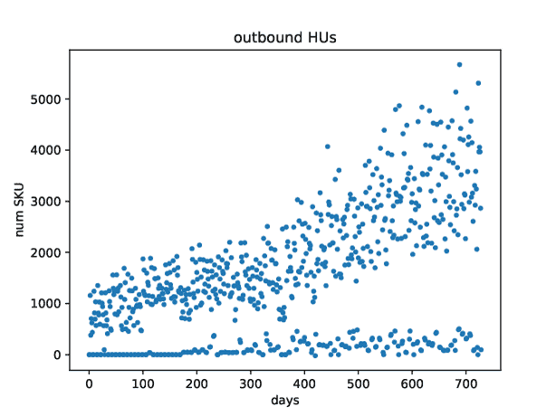
Second problem

Slide 5
The theory

Slide 6
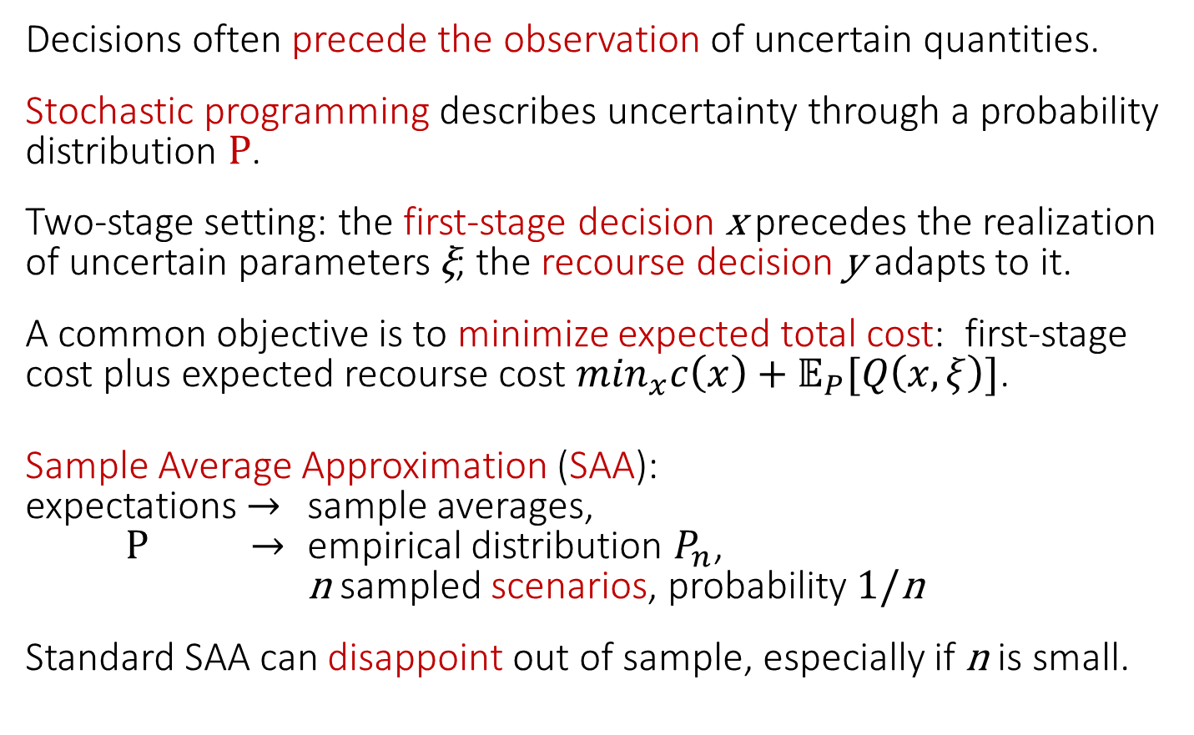
Prequel: Stochastic progr. and SAA
Decisions often precede the observation of uncertain quantities.
Stochastic programming describes uncertainty through a probability distribution P.
Two-stage setting: the first-stage decision x precedes the realization of uncertain parameters ξ; the recourse decision y adapts to it.
A common objective is to minimize expected total cost: first-stage cost plus expected recourse cost $\min_{x}c\left(x\right)+𝔼_{P}[Q\left(x,ξ\right)]$.
Sample Average Approximation (SAA):
expectations $→$ sample averages,
P $→$ empirical distribution $P_{n}$,
n sampled scenarios, probability 1/n
Standard SAA can disappoint out of sample, especially if n is small.

Slide 7
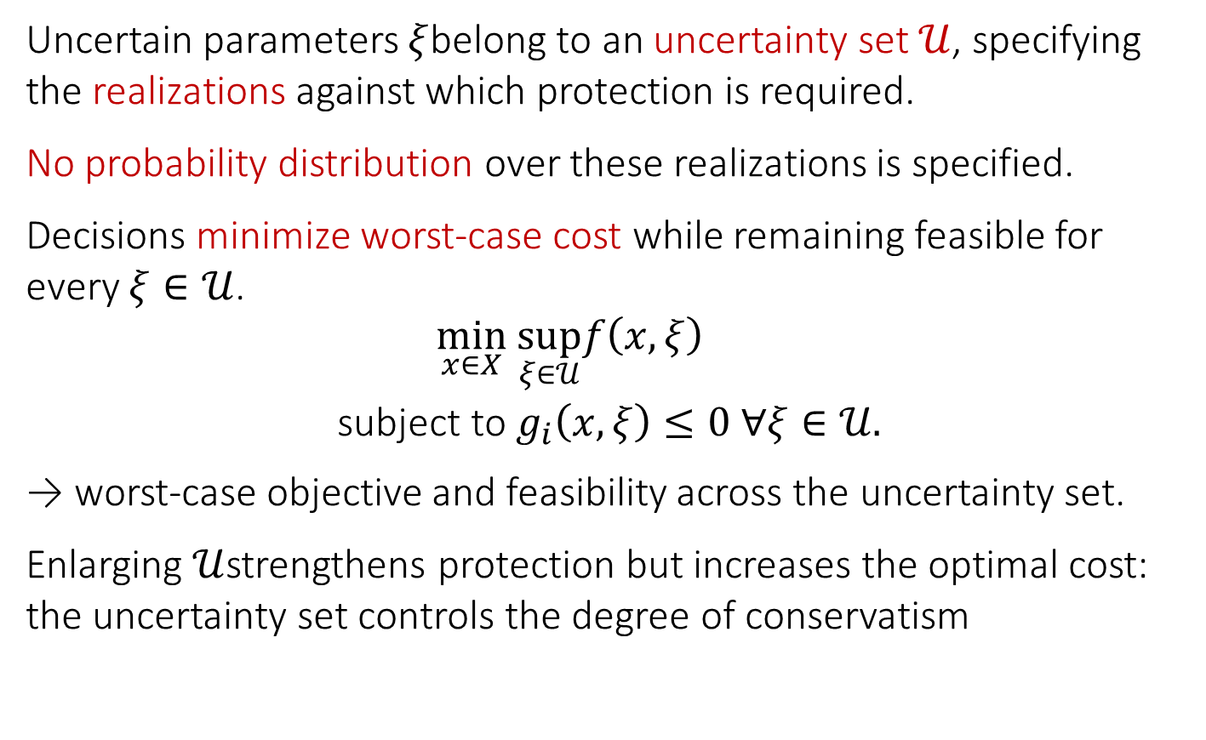
Prequel: Robust optimization
Uncertain parameters $ξ$belong to an uncertainty set $𝒰$, specifying the realizations against which protection is required.
No probability distribution over these realizations is specified.
Decisions minimize worst-case cost while remaining feasible for every $ξ∈𝒰$.
$$\begin{aligned}\min_{x∈X} &\sup_{ξ∈𝒰}f\left(x , ξ\right) \\ \text{subject} \text{to} &g_{i}\left(x , ξ\right)≤0&& ∀ξ∈𝒰.\end{aligned}$$
→ worst-case objective and feasibility across the uncertainty set.
Enlarging $𝒰$strengthens protection but increases the optimal cost: the uncertainty set controls the degree of conservatism

Slide 8
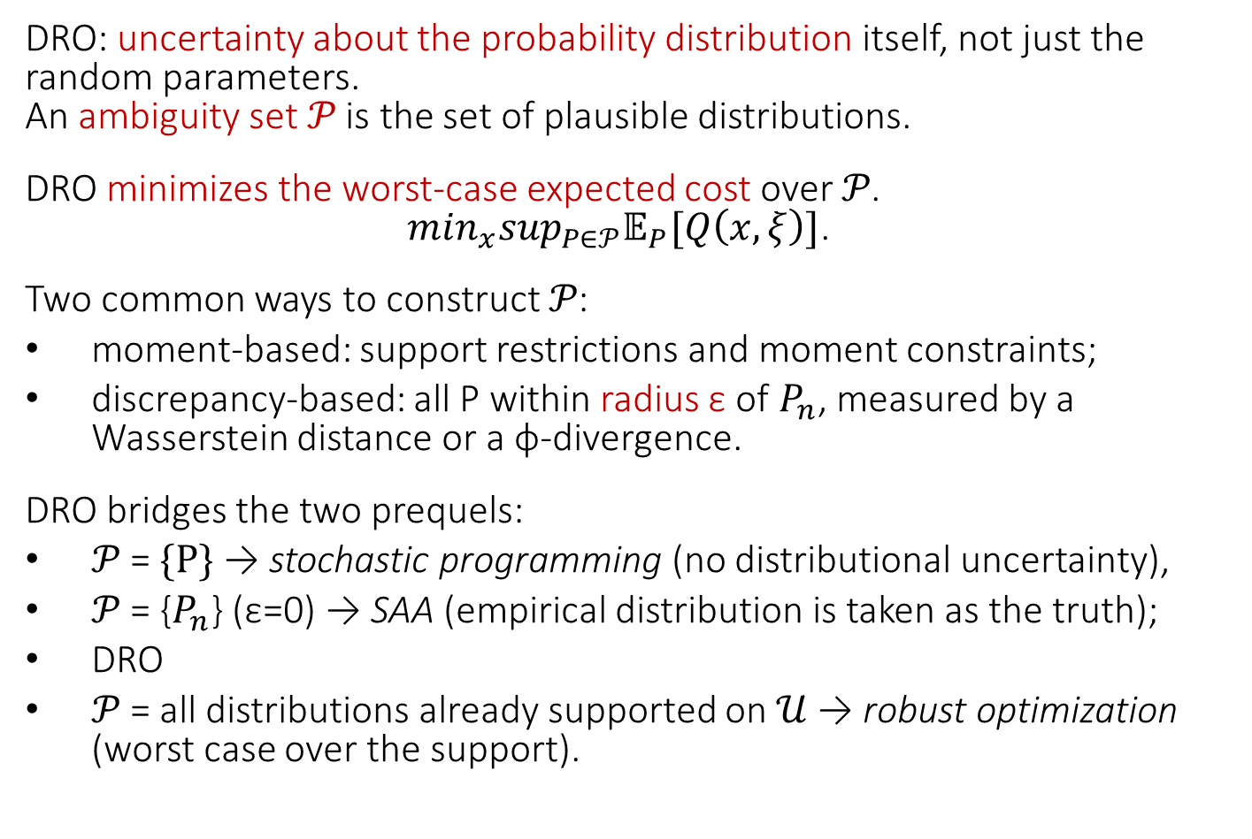
Prequel: Distributionally robust optimization and ambiguity sets
DRO: uncertainty about the probability distribution itself, not just the random parameters.
An ambiguity set 𝒫 is the set of plausible distributions.
DRO minimizes the worst-case expected cost over 𝒫. $\min_{x}\sup_{P∈𝒫}𝔼_{P}[Q\left(x,ξ\right)]$.
Two common ways to construct 𝒫:
moment-based: support restrictions and moment constraints;
discrepancy-based: all P within radius ε of $P_{n}$, measured by a Wasserstein distance or a φ-divergence.
DRO bridges the two prequels:
𝒫 = {P} → stochastic programming (no distributional uncertainty),
𝒫 = {$P_{n}$} (ε=0) → SAA (empirical distribution is taken as the truth);
DRO
𝒫 = all distributions already supported on $𝒰$ → robust optimization (worst case over the support).

Slide 9
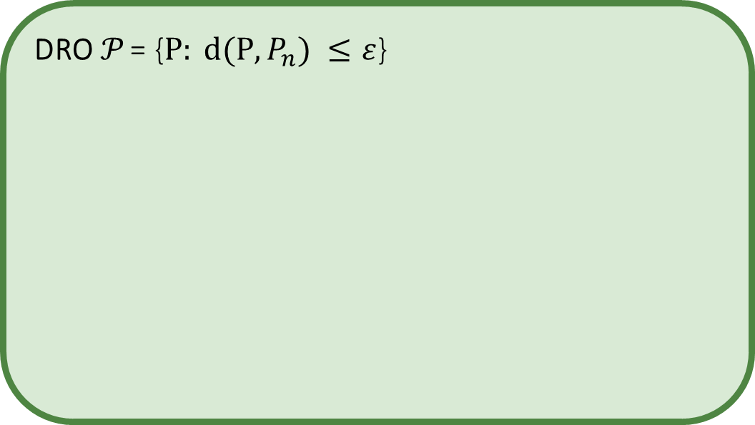
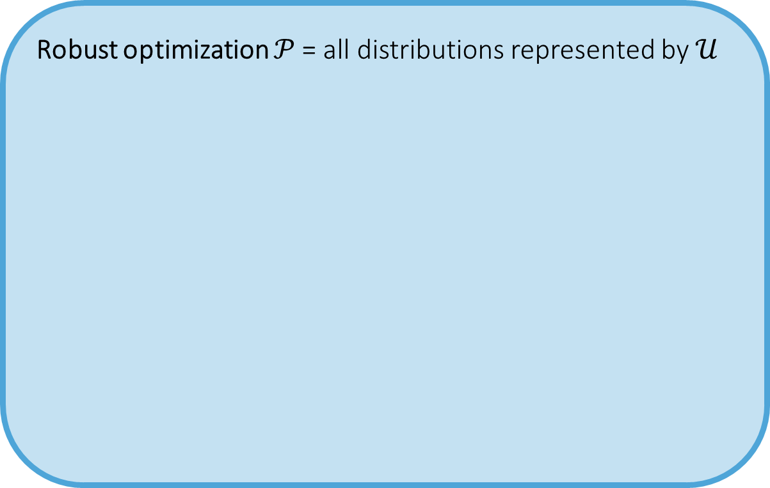
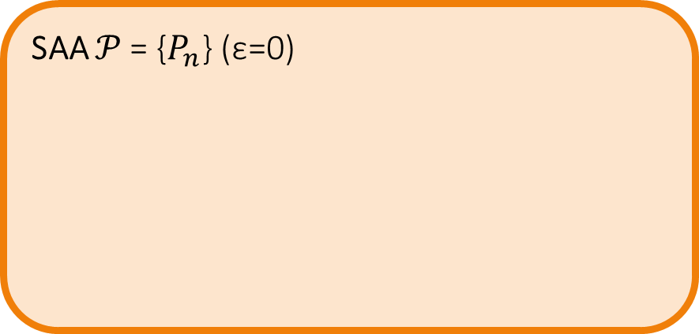
Distributional ignorance
Robust optimization 𝒫 = all distributions represented by $𝒰$
DRO 𝒫 = {${P: d(P,P}_{n}) ≤ε$}
SAA 𝒫 = {$P_{n}$} (ε=0)
Increasing robustness
Distributional knowledge
Stochastic programming 𝒫 = {P}

Slide 10
Smart Predict-then-Optimize (SPO)
SPO uses predictions as inputs to an optimization model.
Conventional prediction models minimize statistical forecast error
→ small forecast errors do not necessarily imply good decisions.
SPO uses a tractable surrogate loss to train predictions according to their decision consequences (Elmachtoub, Grigas, 2017).
Decision awareness enters through the predictor’s training objective: it does not optimize over an ambiguity set of distributions.

Slide 11
BESO, generalities
The BESO framework integrates forecasting and optimization through bidirectional coupling:
the forecasting component embeds optimization-relevant structure (without modifying the forecasting loss function),
the optimization component is built on forecast outputs and their uncertainty characterization.
Appropriate when innovation noise and random shocks do not dominate forecast errors:
→ the forecasts used by the optimizer may be inaccurate but are usable if their errors are not systematically biased.
The two components can be integrated at different levels, resulting in two models: BESO-SAA and BESO-DRO

Slide 12
Univariate time series forecasting
Three widely used families of forecasting methods are:
Statistical models specify explicit structures for temporal dependence and uncertainty.
Examples include ARIMA/SARIMA, ETS, and structural state-space models.
Their assumptions about dynamics and errors depend on the model.
Neural models learn flexible, potentially nonlinear relationships within a chosen architecture.
Examples include MLPs, LSTMs, GRUs, temporal CNNs, and Transformers.
Tree-based ensembles combine decision trees using lagged observations and derived features.
Examples include Random Forests and gradient boosting methods such as XGBoost and LightGBM.
No approach consistently outperforms all others. We can use any of them.

Slide 13
Resampling, bootstrapping
Data-driven distribution estimation is useful when stationarity or known distributional forms cannot be assumed.
It is well suited to complex, noisy, or data-limited real-world settings.
Bootstrap (Efron, 1979): generates empirical distributions by repeatedly sampling from the data with replacement.
MEB (Vinod, 2004): produces bootstrap replicates that preserve time-series dependence and maximizes an information entropy function defined over the resampled data.
We use a predictive model fitted to each MEB replicate, one forecast trajectory per replicate.
The set of trajectories forms the scenario pool.

Slide 14
Prewhitening
Economics-related time series can often be effectively decomposed using STL
(almost) white noise

Slide 15
Recoloring
The prewhitened series only retains residuals unexplained by STL (i.e. innovation noise and random shock).
The observed residuals are realizations of a random variable whose distribution can be identified. (hopefully normally distributed).
Using the distribution of the residual series, we can generate alternative samples that are compatible with the overall model, i.e. samples that could have occurred.

Slide 16
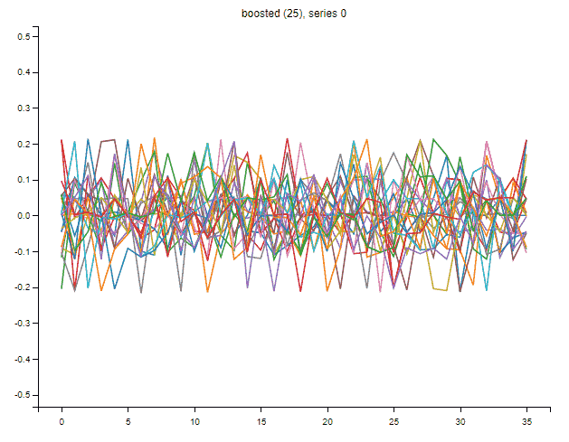
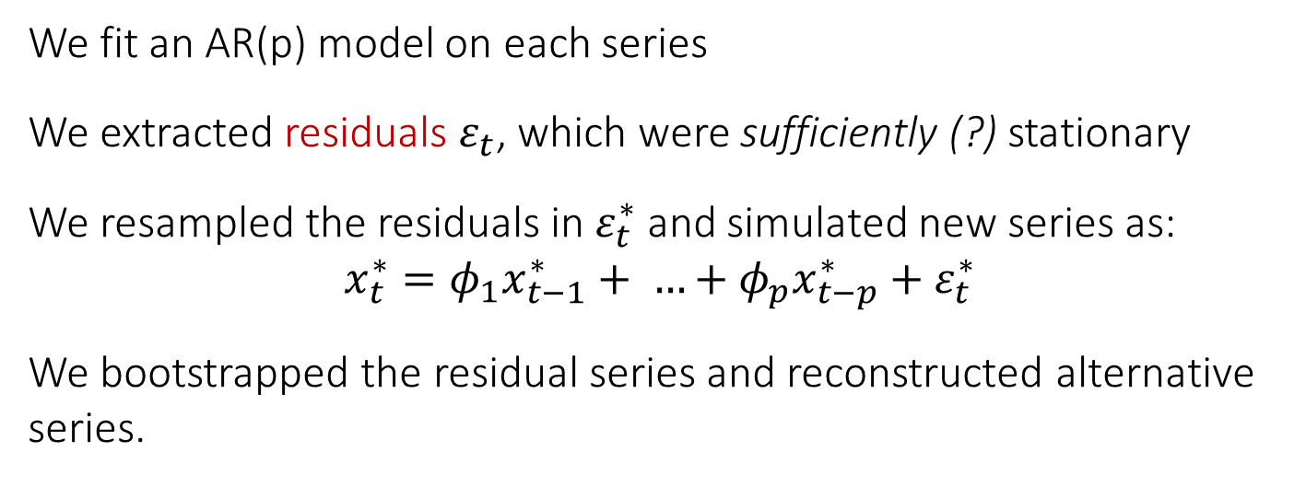
Bootstrapping, how we did it
We fit an AR(p) model on each series
We extracted residuals $ε_{t}$, which were sufficiently (?) stationary
We resampled the residuals in $ε_{t}^{∗}$ and simulated new series as:
$$x_{t}^{∗}=φ_{1}x_{t−1}^{∗}+ …+φ_{p}x_{t−p}^{∗}+ε_{t}^{∗}$$
We bootstrapped the residual series and reconstructed alternative series.

Slide 17
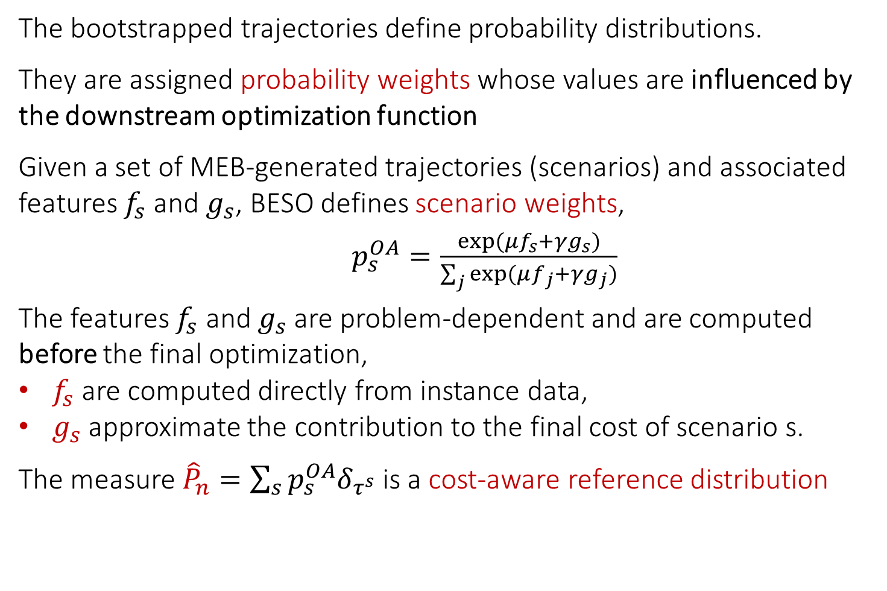
Entropy tilting
The bootstrapped trajectories define probability distributions.
They are assigned probability weights whose values are influenced by the downstream optimization function
Given a set of MEB-generated trajectories (scenarios) and associated features $f_{s}$ and $g_{s}$, BESO defines scenario weights,
$p_{s}^{OA}=\frac{exp⁡(μf_{s}+γg_{s})}{\sum_{j}{exp⁡(μf_{j}+γg_{j})}}$
The features $f_{s}$ and $g_{s}$ are problem-dependent and are computed before the final optimization,
$f_{s}$ are computed directly from instance data,
$g_{s}$ approximate the contribution to the final cost of scenario s.
The measure ${\hat{P}}_{n}=\sum_{s}{p_{s}^{OA}δ_{τ^{s}}}$ is a cost-aware reference distribution

Slide 18
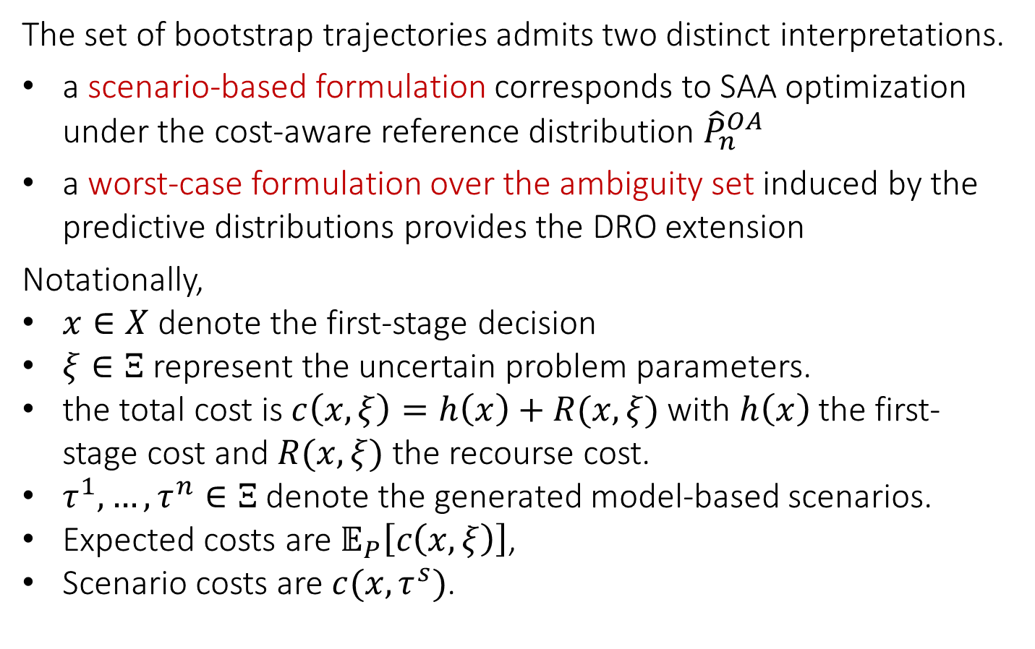
The prescriptive component
The set of bootstrap trajectories admits two distinct interpretations.
a scenario-based formulation corresponds to SAA optimization under the cost-aware reference distribution ${\hat{P}}_{n}^{OA}$
a worst-case formulation over the ambiguity set induced by the predictive distributions provides the DRO extension
Notationally,
$x∈X$ denote the first-stage decision
$ξ∈Ξ$ represent the uncertain problem parameters.
the total cost is $c\left(x,ξ\right)=h\left(x\right)+R(x,ξ)$ with $h\left(x\right)$ the first-stage cost and $R(x,ξ)$ the recourse cost.
$τ^{1}, …, τ^{n}∈Ξ$ denote the generated model-based scenarios.
Expected costs are $𝔼_{P}\left[c\left(x,ξ\right)\right]$,
Scenario costs are $c(x,τ^{s})$.

Slide 19
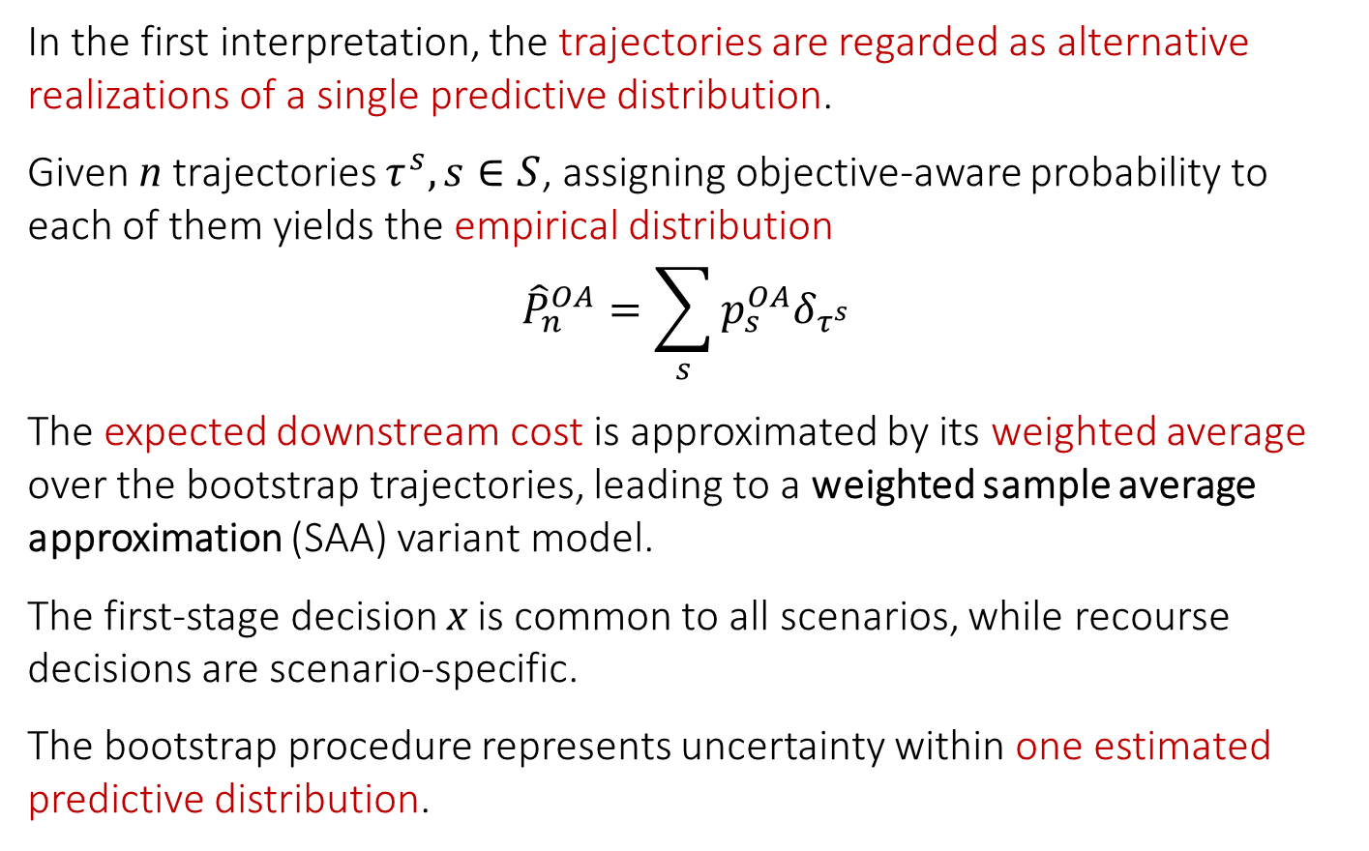
BESO-SAA
In the first interpretation, the trajectories are regarded as alternative realizations of a single predictive distribution.
Given n trajectories $τ^{s}, s∈S$, assigning objective-aware probability to each of them yields the empirical distribution
$${\hat{P}}_{n}^{OA}=\sum_{s}{p_{s}^{OA}δ_{τ^{s}}}$$
The expected downstream cost is approximated by its weighted average over the bootstrap trajectories, leading to a weighted sample average approximation (SAA) variant model.
The first-stage decision x is common to all scenarios, while recourse decisions are scenario-specific.
The bootstrap procedure represents uncertainty within one estimated predictive distribution.

Slide 20
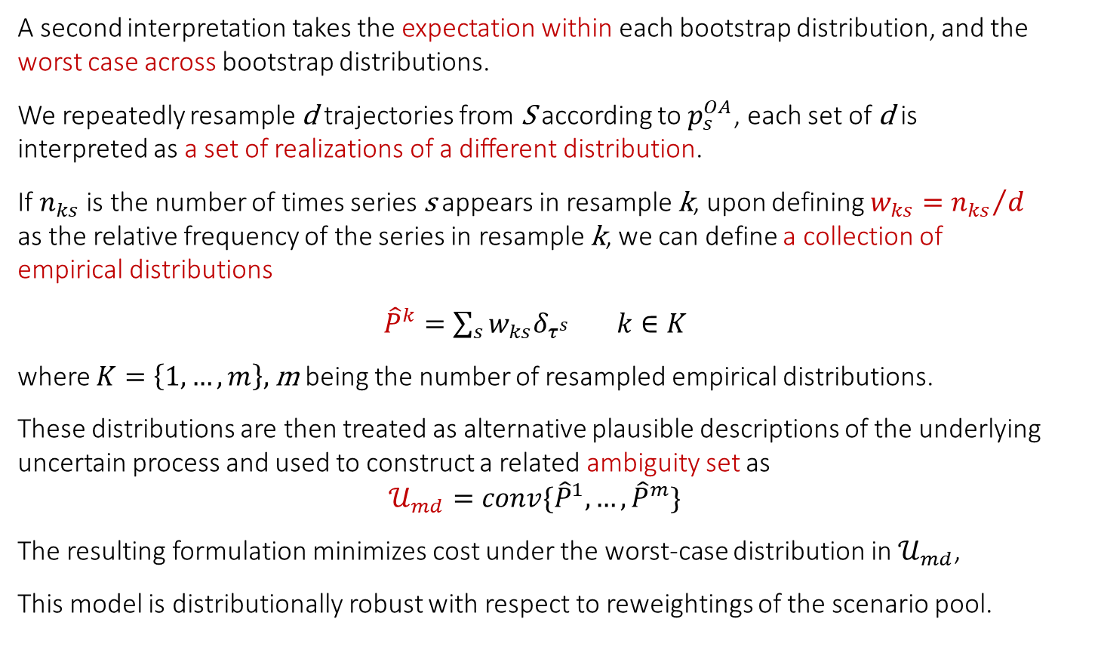
BESO-DRO
A second interpretation takes the expectation within each bootstrap distribution, and the worst case across bootstrap distributions.
We repeatedly resample d trajectories from S according to $p_{s}^{OA}$, each set of d is interpreted as a set of realizations of a different distribution.
If $n_{ks}$ is the number of times series s appears in resample k, upon defining $w_{ks}={n_{ks}}/d$ as the relative frequency of the series in resample k, we can define a collection of empirical distributions
${\hat{P}}^{k}=\sum_{s}{w_{ks}δ_{τ^{s}}}$ $k∈K$
where $K=\left\{1,…,m\right\},$m being the number of resampled empirical distributions.
These distributions are then treated as alternative plausible descriptions of the underlying uncertain process and used to construct a related ambiguity set as
$$𝒰_{md}=conv\{{\hat{P}}^{1}, …, {\hat{P}}^{m}\}$$
The resulting formulation minimizes cost under the worst-case distribution in $𝒰_{md}$,
This model is distributionally robust with respect to reweightings of the scenario pool.

Slide 21
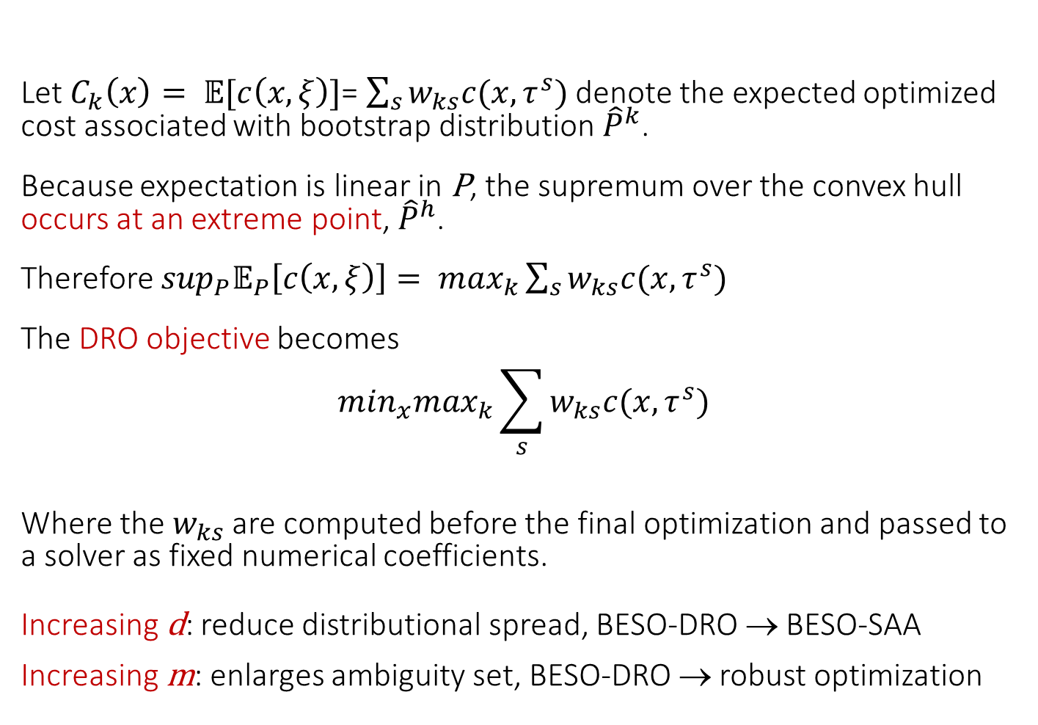
BESO-DRO
Let $C_{k}\left(x\right)= 𝔼[c\left(x,ξ\right)]$= $\sum_{s}{w_{ks}c(x,τ^{s})}$ denote the expected optimized cost associated with bootstrap distribution ${\hat{P}}^{k}$.
Because expectation is linear in P, the supremum over the convex hull occurs at an extreme point, ${\hat{P}}^{h}$.
Therefore $\sup_{P}𝔼_{P}\left[c\left(x,ξ\right)\right]= \max_{k}\sum_{s}{w_{ks}c(x,τ^{s})}$
The DRO objective becomes
$$\min_{x}\max_{k}\sum_{s}{w_{ks}c(x,τ^{s})}$$
Where the $w_{ks}$ are computed before the final optimization and passed to a solver as fixed numerical coefficients.
Increasing d: reduce distributional spread, BESO-DRO → BESO-SAA
Increasing m: enlarges ambiguity set, BESO-DRO → robust optimization

Slide 22
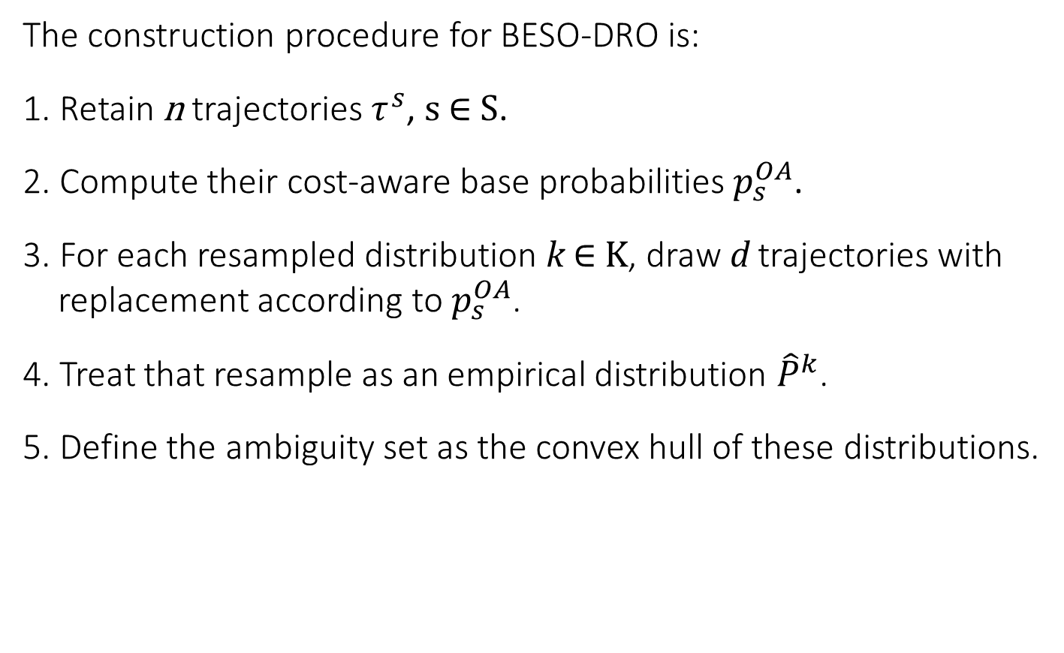
BESO-DRO
The construction procedure for BESO-DRO is:
1. Retain n trajectories $τ^{s}$, s ∈ S.
2. Compute their cost-aware base probabilities $p_{s}^{OA}$.
3. For each resampled distribution k ∈ K, draw d trajectories with replacement according to $p_{s}^{OA}$.
4. Treat that resample as an empirical distribution ${\hat{P}}^{k}$.
5. Define the ambiguity set as the convex hull of these distributions.

Slide 23
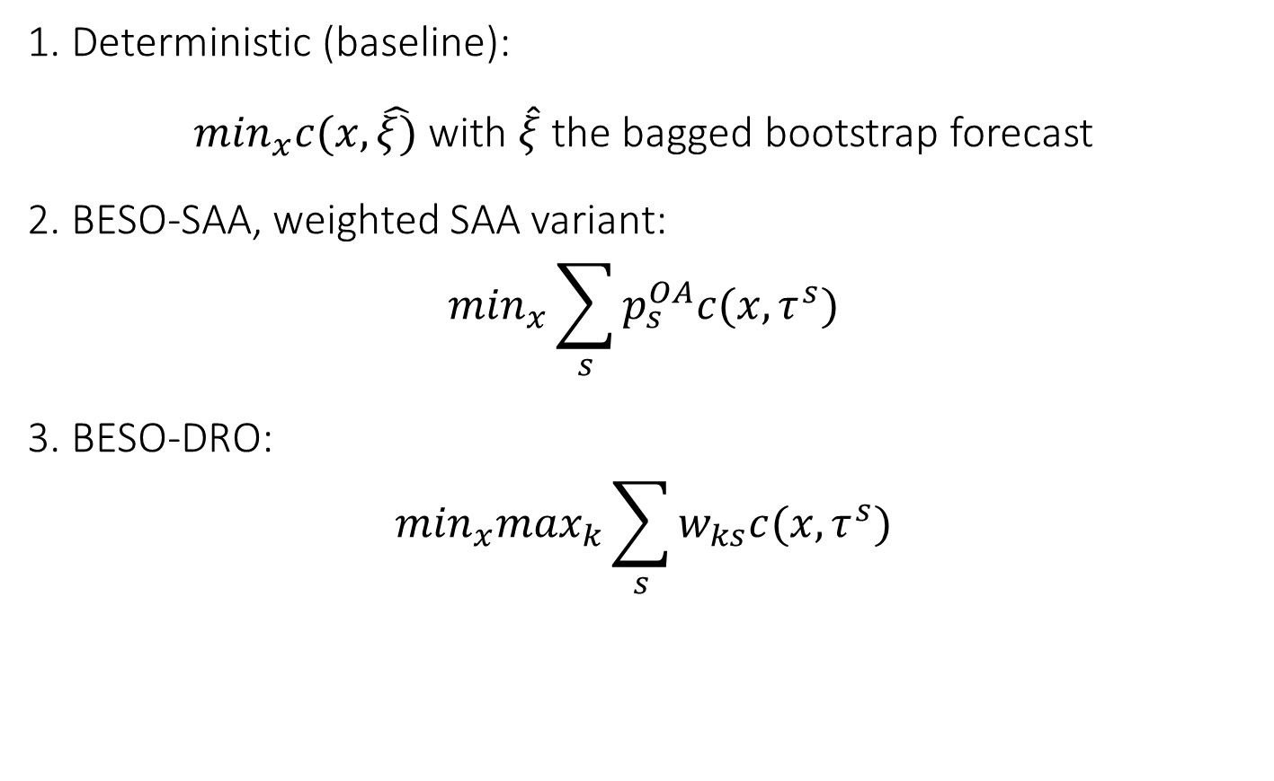
BESO decision models
1. Deterministic (baseline):
$\min_{x}c(x,\hat{ξ)}$ with $\hat{ξ}$ the bagged bootstrap forecast
2. BESO-SAA, weighted SAA variant:
$$\min_{x}\sum_{s}{p_{s}^{OA}c(x,τ^{s})}$$
3. BESO-DRO:
$$\min_{x}\max_{k}\sum_{s}{w_{ks}c(x,τ^{s})}$$

Slide 24
use case 1:
City Logistics

Slide 25
The first case study
Large-scale organized distribution is often structured according to a two-echelon model, in which distribution centers (DCs) are used to store and forward goods to replenish the inventories of the final retailer's stores.
Stores are typically uniquely allocated to DCs for products of the same line, and predictive knowledge of future demand is essential to optimize the distribution process.
In the real-world case study:
city retailer store demands were predicted based on individual sales time series and
used to optimize the allocation of stores to DCs in a tactical planning context.
Our problem required dimensioning multiple DCs and assigning stores to them to meet expected demand during a critical period.

Slide 26
Toward a formulation
Server i
Capacity Q_{i}
Unitary storage cost d_{i}
i
if j is serviced from i, then x_{ij} = 1
j
Client j
Total request req_{j}
Amount serviced by i q_{ij}
Unitary allocation cost to i c_{ij}

Slide 27
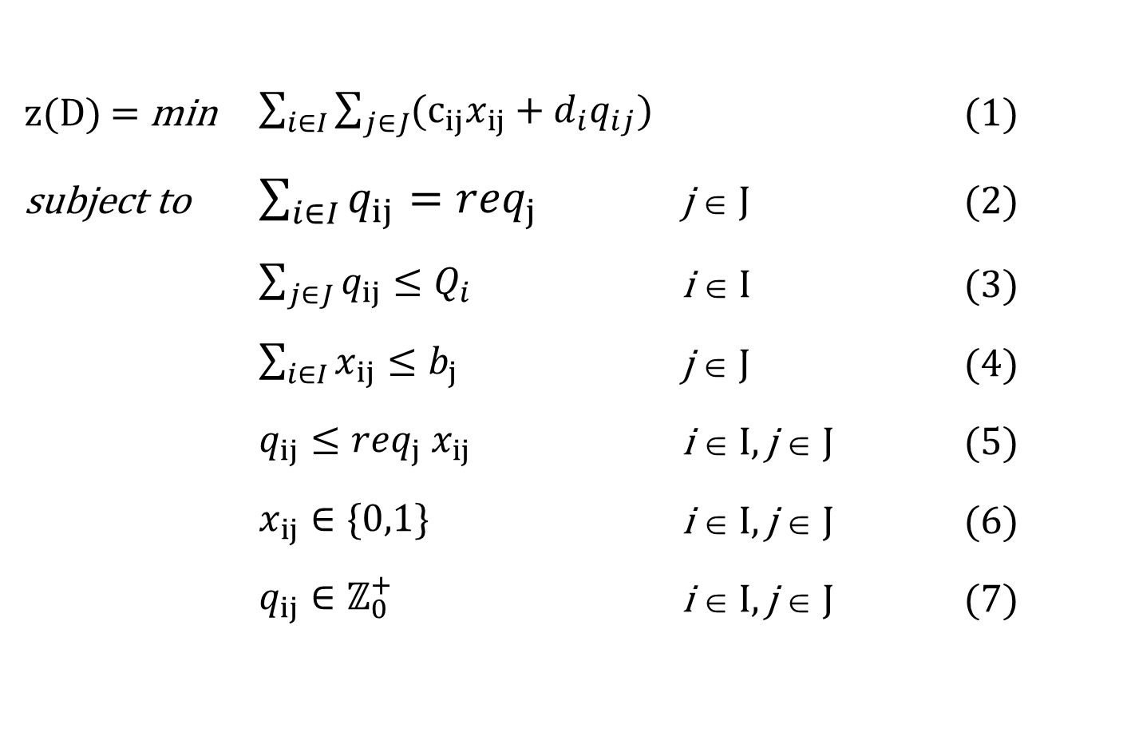
Deterministic allocation (SAP)
z(D) = min $\sum_{i∈I}{\sum_{j∈J}{{(c}_{ij}x_{ij}}}+d_{i}q_{ij})$ (1)
subject to $\sum_{i∈I}{q_{ij}}={req}_{j}$ j ∈ J (2)
$\sum_{j∈J}{q_{ij}}≤Q_{i}$ i ∈ I (3)
$\sum_{i∈I}{x_{ij}}≤b_{j}$ j ∈ J (4)
$q_{ij}≤{req}_{j}{ x}_{ij}$ i ∈ I, j ∈ J (5)
$x_{ij}∈\{0,1\}$ i ∈ I, j ∈ J (6)
$q_{ij}∈ℤ_{0}^{+}$ i ∈ I, j ∈ J (7)

Slide 28
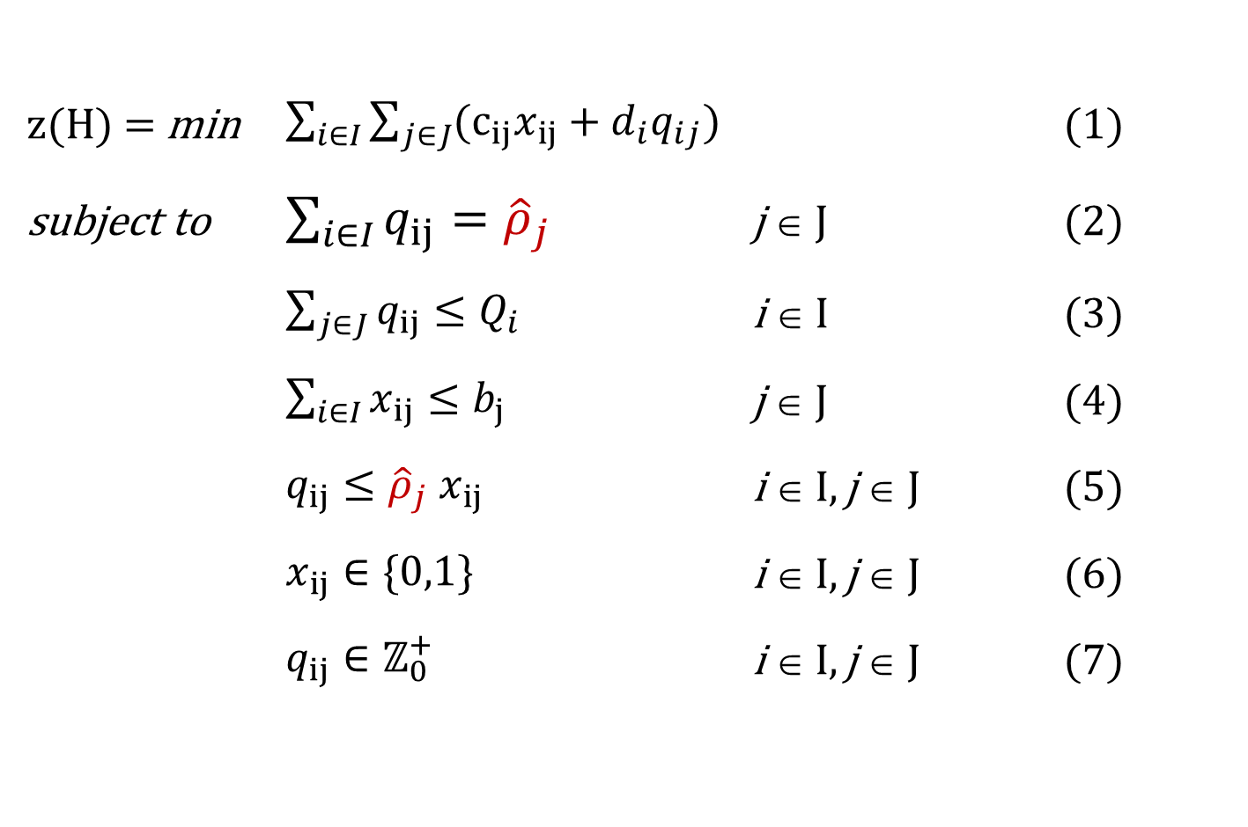
Stochastic allocation
z(H) = min $\sum_{i∈I}{\sum_{j∈J}{{(c}_{ij}x_{ij}}}+d_{i}q_{ij})$ (1)
subject to $\sum_{i∈I}{q_{ij}}={\hat{ρ}}_{j}$ j ∈ J (2)
$\sum_{j∈J}{q_{ij}}≤Q_{i}$ i ∈ I (3)
$\sum_{i∈I}{x_{ij}}≤b_{j}$ j ∈ J (4)
$q_{ij}≤{\hat{ρ}}_{j}{ x}_{ij}$ i ∈ I, j ∈ J (5)
$x_{ij}∈\{0,1\}$ i ∈ I, j ∈ J (6)
$q_{ij}∈ℤ_{0}^{+}$ i ∈ I, j ∈ J (7)

Slide 29
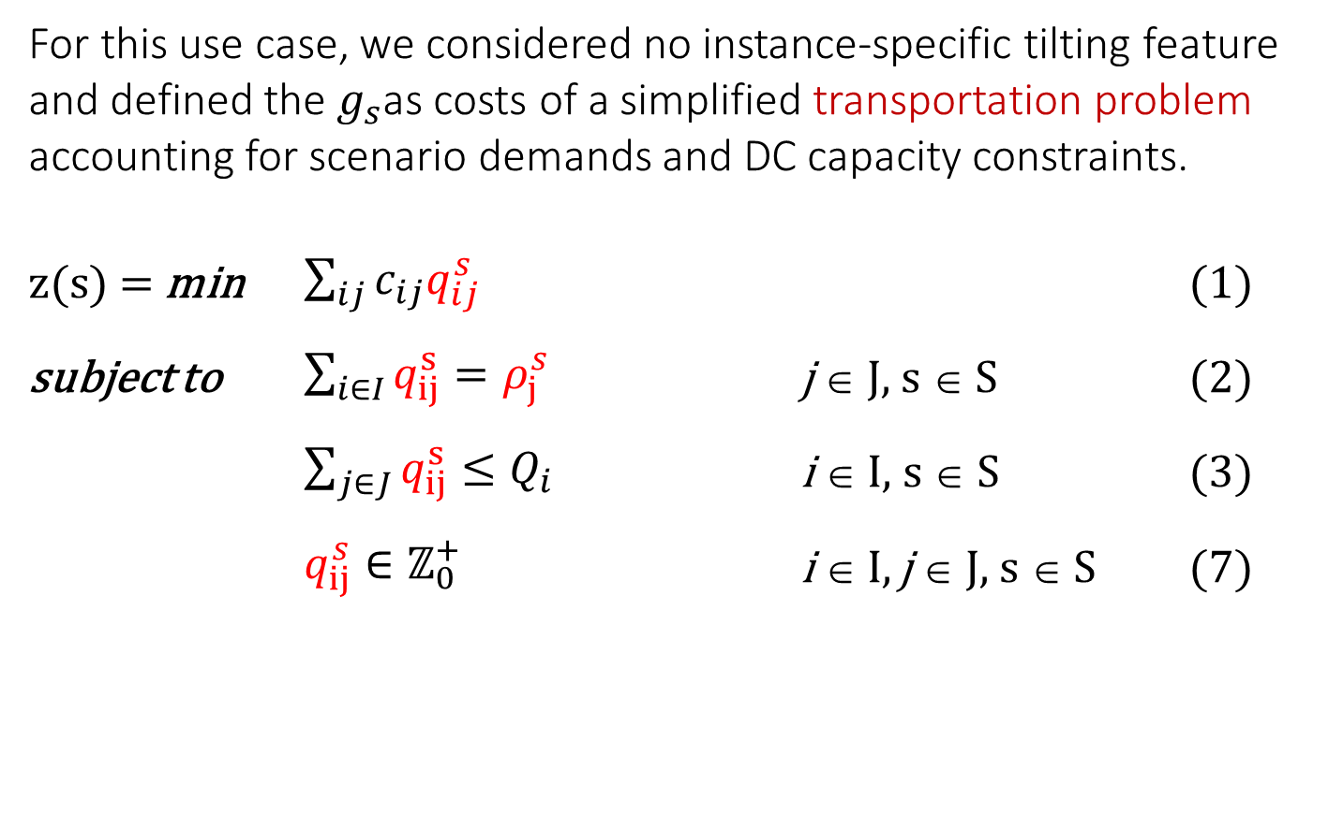
Entropy tilting
For this use case, we considered no instance-specific tilting feature and defined the $g_{s}$as costs of a simplified transportation problem accounting for scenario demands and DC capacity constraints.
z(s) = min $\sum_{ij}{c_{ij}q_{ij}^{s}}$ (1)
subject to $\sum_{i∈I}{q_{ij}^{s}}=ρ_{j}^{s}$ j ∈ J, s ∈ S (2)
$\sum_{j∈J}{q_{ij}^{s}}≤Q_{i}$ i ∈ I, s ∈ S (3)
$q_{ij}^{s}∈ℤ_{0}^{+}$ i ∈ I, j ∈ J, s ∈ S (7)

Slide 30
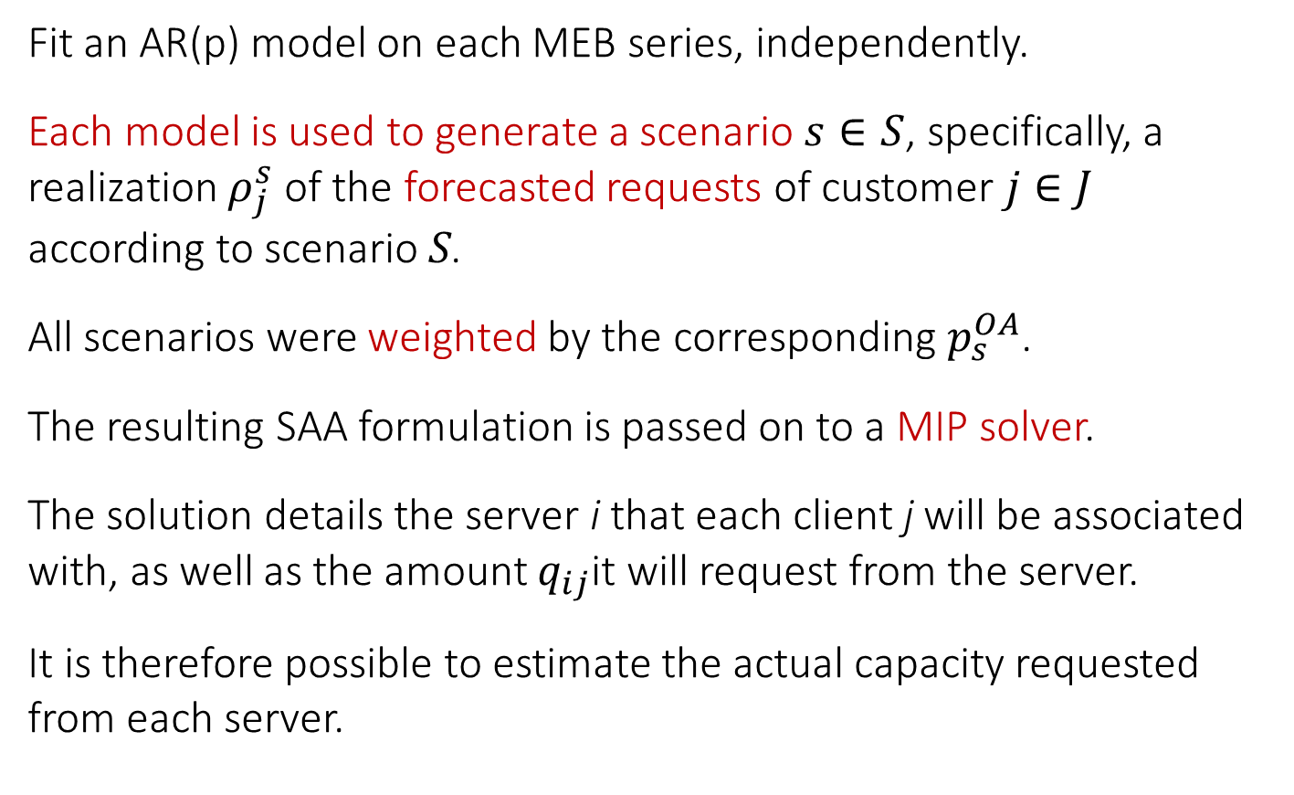
BESO-SAA
Fit an AR(p) model on each MEB series, independently.
Each model is used to generate a scenario $s∈S$, specifically, a realization $ρ_{j}^{s}$ of the forecasted requests of customer $j∈J$ according to scenario S.
All scenarios were weighted by the corresponding $p_{s}^{OA}$.
The resulting SAA formulation is passed on to a MIP solver.
The solution details the server i that each client j will be associated with, as well as the amount $q_{ij}$it will request from the server.
It is therefore possible to estimate the actual capacity requested from each server.

Slide 31
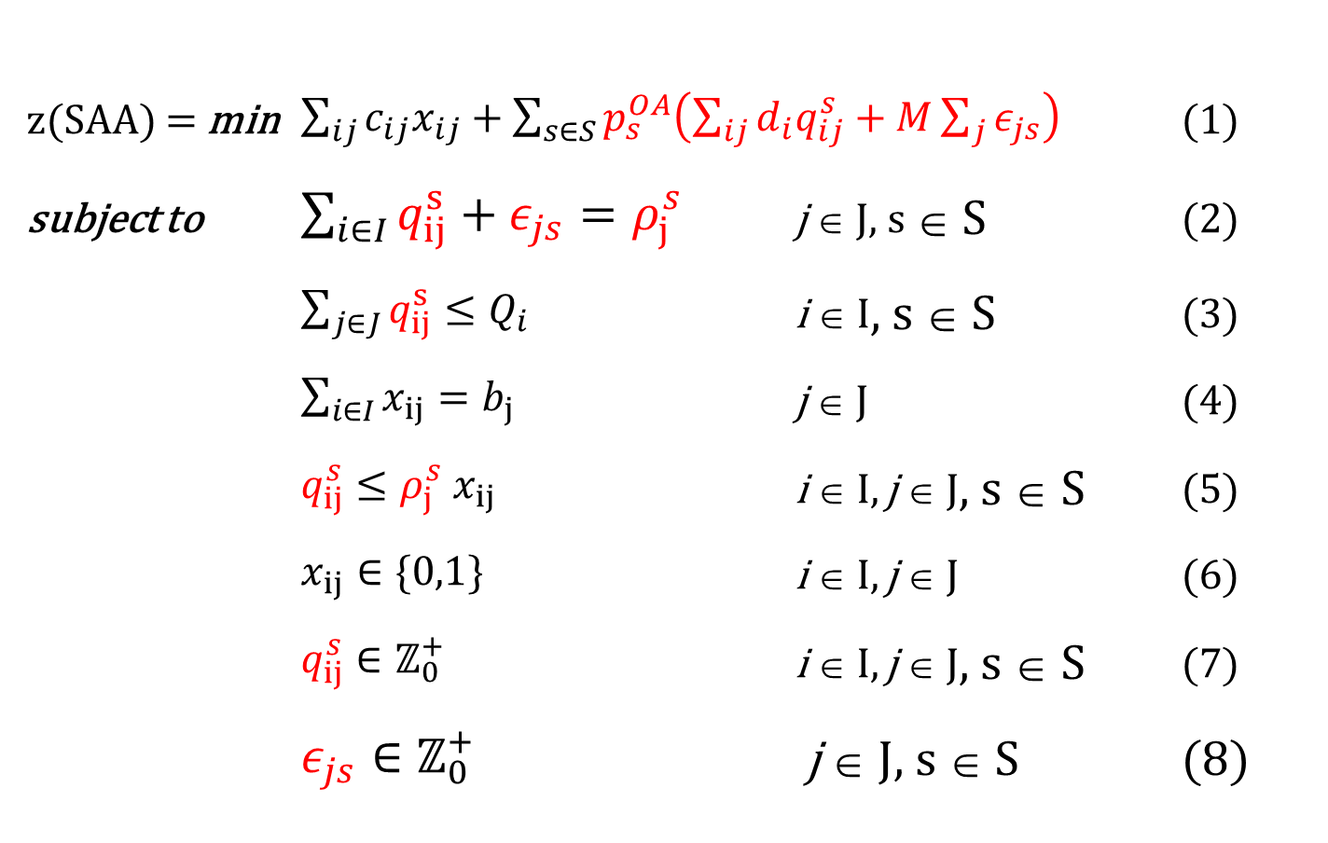
BESO-SAA
z(SAA) = min $\sum_{ij}{c_{ij}x_{ij}}+\sum_{s∈S}{p_{s}^{OA}\left(\sum_{ij}{d_{i}q_{ij}^{s}+M\sum_{j}{ε_{js}}}\right)}$ (1)
subject to $\sum_{i∈I}{q_{ij}^{s}}+ε_{js}=ρ_{j}^{s}$ j ∈ J, s ∈ S (2)
$\sum_{j∈J}{q_{ij}^{s}}≤Q_{i}$ i ∈ I, s ∈ S (3)
$\sum_{i∈I}{x_{ij}}=b_{j}$ j ∈ J (4)
$q_{ij}^{s}≤ρ_{j}^{s}{ x}_{ij}$ i ∈ I, j ∈ J, s ∈ S (5)
$x_{ij}∈\{0,1\}$ i ∈ I, j ∈ J (6)
$q_{ij}^{s}∈ℤ_{0}^{+}$ i ∈ I, j ∈ J, s ∈ S (7)
$ε_{js}∈ℤ_{0}^{+}$ j ∈ J, s ∈ S (8)

Slide 32
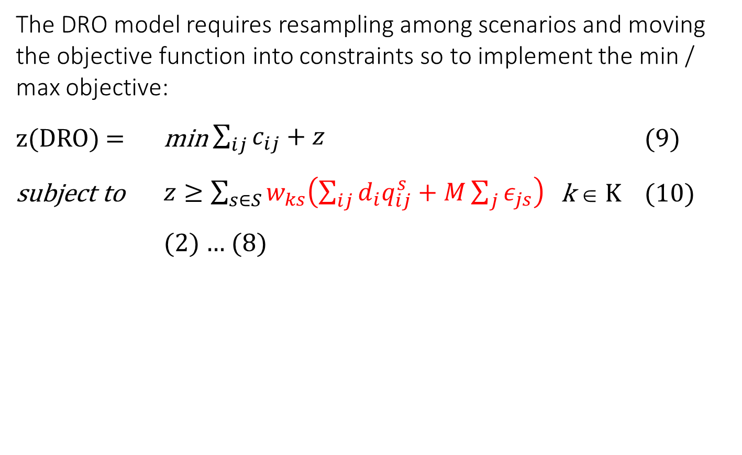
BESO-DRO
The DRO model requires resampling among scenarios and moving the objective function into constraints so to implement the min / max objective:
z(DRO) = min $\sum_{ij}{c_{ij}}+z$ (9)
subject to $z≥\sum_{s∈S}{w_{ks}\left(\sum_{ij}{d_{i}q_{ij}^{s}+M\sum_{j}{ε_{js}}}\right)}$ k ∈ K (10)
(2) … (8)

Slide 33
Tests, forecasts
MEB bootstrap sets were aggregated (bagged) to obtain forecasts.
Besides MEB bagging we also considered alternative forecasts modules based on:
AR
Holt-Winters
SARIMA
Multilayer perceptrons
LSTM networks
Random forests
XGboost

Slide 34
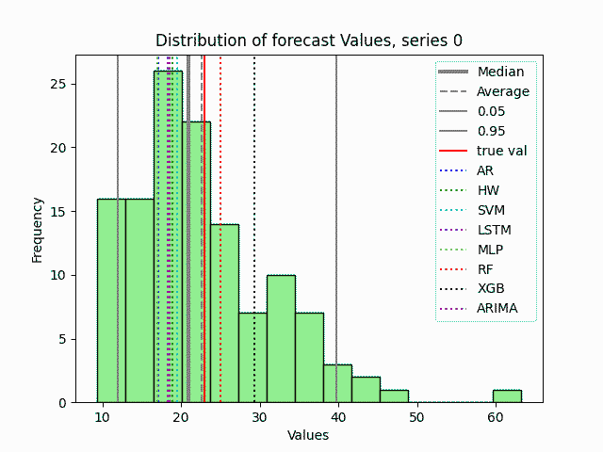
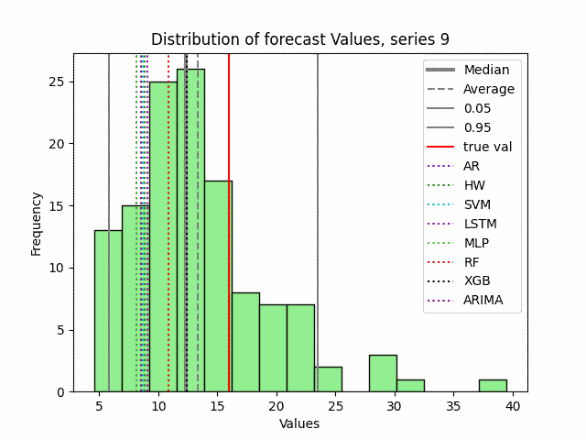
Results, forecasts
MEB based forecasting. Average rankings for different boostset sizes.
 | YW_AR_75 |  | YW_AR_125 |  | YW_AR_175
 | MSE | bias | MSE | bias | MSE | bias
fcast_avg | 2.67 | 0.08 | 2.58 | 0.05 | 3.83 | 0.04
fcast_50 | 3.04 | 0.06 | 3.19 | 0.04 | 2.50 | 0.03
yhw | 5.42 | 0.08 | 6.06 | 0.04 | 5.88 | 0.03
yarima | 5.73 | 0.05 | 6.04 | 0.03 | 6.08 | 0.02
ysvm | 5.88 | 0.08 | 5.50 | 0.05 | 5.50 | 0.03
ylstm | 6.02 | 0.06 | 5.52 | 0.04 | 6.27 | 0.02
yar | 6.06 | 0.04 | 6.54 | 0.02 | 6.79 | 0.02
ymlp | 6.38 | 0.05 | 5.98 | 0.03 | 6.17 | 0.02
yrf | 6.46 | 0.11 | 6.31 | 0.06 | 5.48 | 0.04
yxgb | 7.33 | 0.12 | 7.29 | 0.07 | 6.50 | 0.05

Slide 35
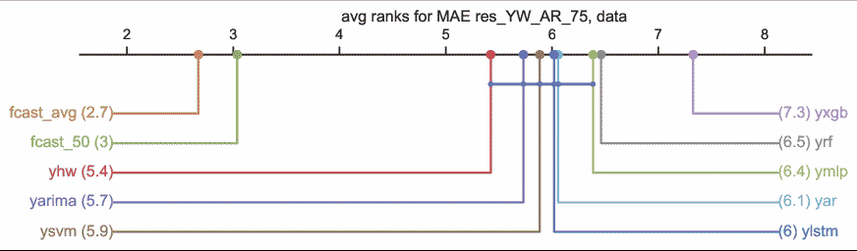
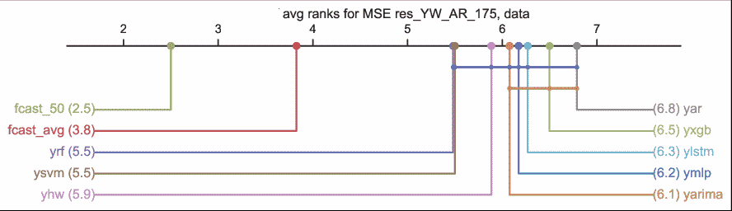
Results, forecasts
Critical difference diagrams (Fawaz et al., 2019)

Slide 36
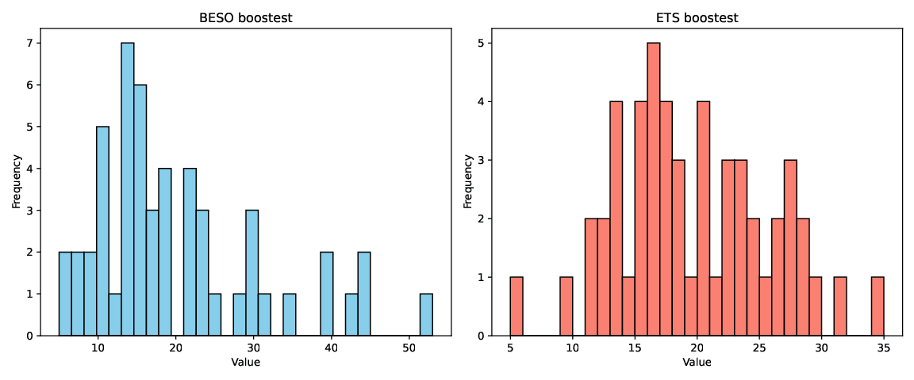
Results, comparison
BESO vs. distribution-based, gaussian derived from confidence intervals of Holt-Winters ETS forecasts.
MEB: wider range and higher skewness

Slide 37
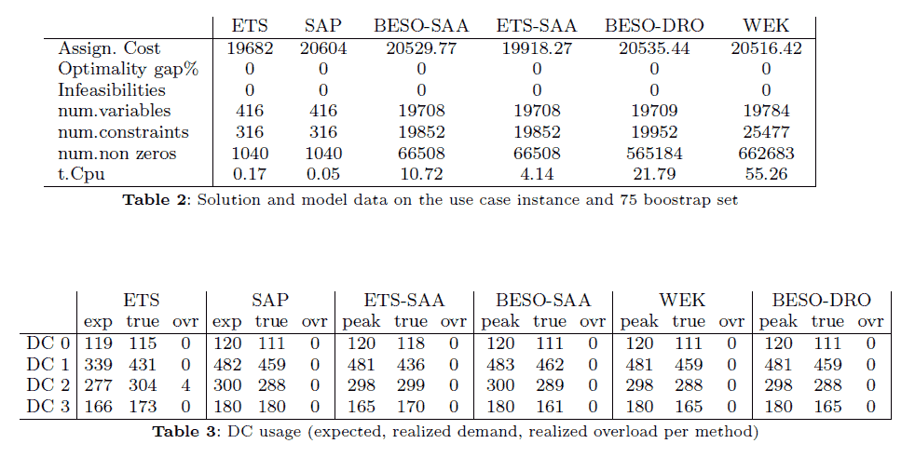
Results, optimization
BESO: same solution than Wasserstein-based, formulation fairly simpler

Slide 38
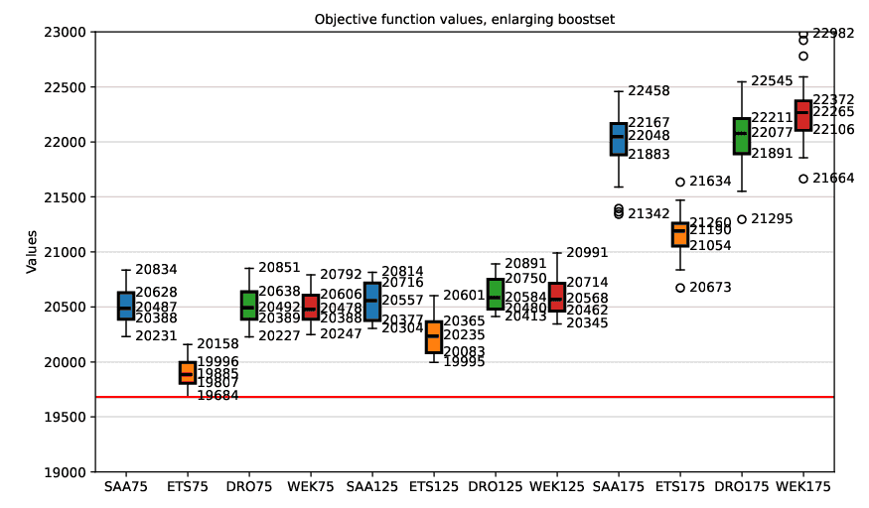
Results, optimization
The cost is essentially stable in the cases of the 75 and 125 series sets but increases significantly in the case of the 175 boostset.
This is due to some extreme scenarios appearing in the forecasts.

Slide 39
Comments, 1st use case
BESO leads from forecasts to decisions that account for forecast uncertainty
Bootstrapped forecasts generate realistic future scenarios directly from data, even from short, irregular histories
Scenarios are weighted by their cost impact and fed into stochastic (SAA) or robust (DRO) optimization
Every step is transparent and explainable: forecast, scenarios, weights, decision
Proof of concept: DC-to-warehouse allocation and capacity sizing, where BESO proved competitive against the state of the art.
Takeaway: wherever decisions rest on uncertain forecasts, BESO turns that uncertainty into decisions that hold up.

Slide 40
use case 2:
Loading yards

Slide 41
Warehousing application
In this case study we use bootstrapping and scenarios (BESO-SAA) by:
Introducing a case study deriving from operation on warehouse outbound logistics.
Formulating the problem as a stochastic optimization problem in a prescriptive analytics context
Defining the predictive module on alternative forecasting techniques, including Maximum Entropy Bootstrap (with bagging)
Using the bootstrap set as a seed for scenario-based optimization (BESO-SAA, no DRO here)

Slide 42
Internal flows
Satellite storage
Fast-pick area
Line feed area
Production
Bulk storage area
Staging areas
Loading bays
AS/RS area
X-dock

Slide 43
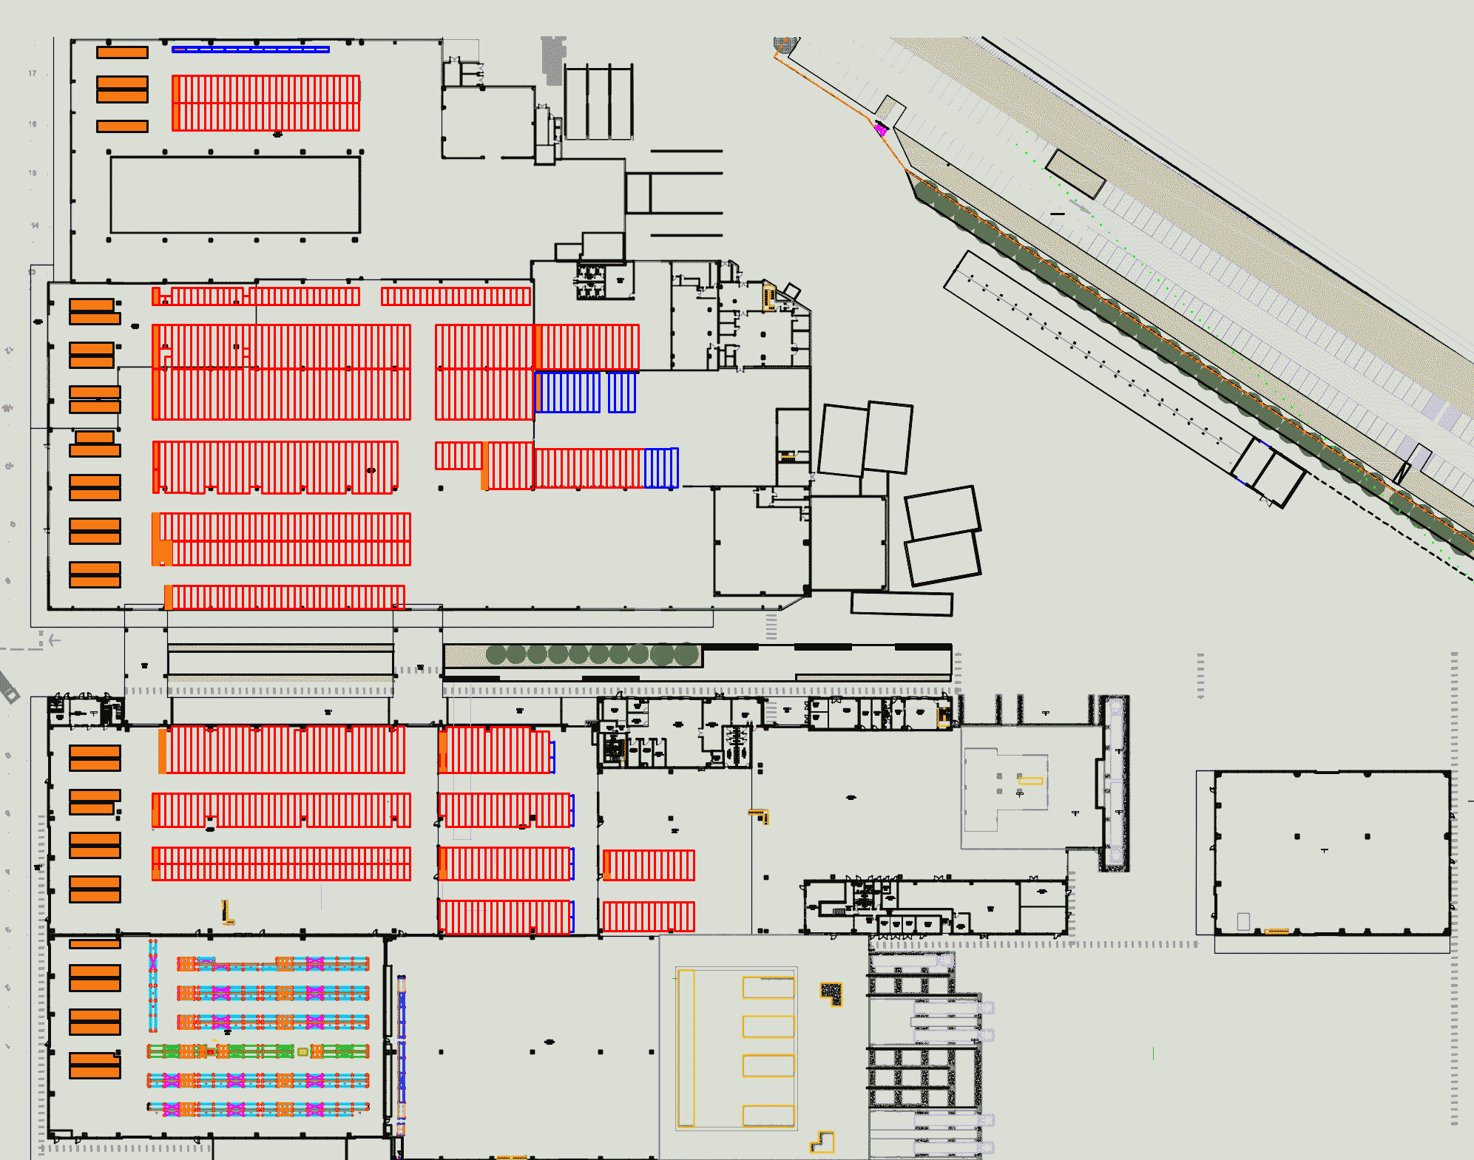
A warehouse
Inbound areas
Automated Storage and Retrieval System
Staging areas
Pallet bays
Fast-pick area

Slide 44

Staging area
(Image from the web)

Slide 45
Daily number of outbound SKUs
The problem was to determine if and when the current infrastructure would become insufficient to accommodate all outbound requests.
A series was available reporting the number of SKU (pallets, HU) and corresponding daily shipments (trucks) serviced at the warehouse.

Slide 46

If one has a hammer …

Slide 47
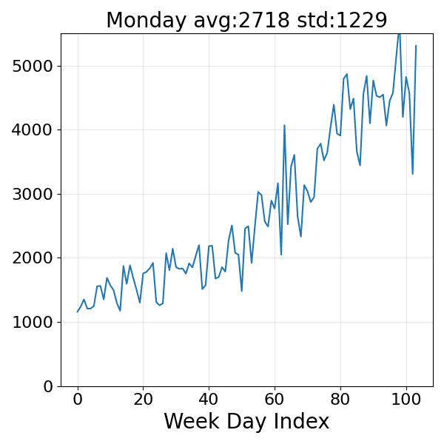
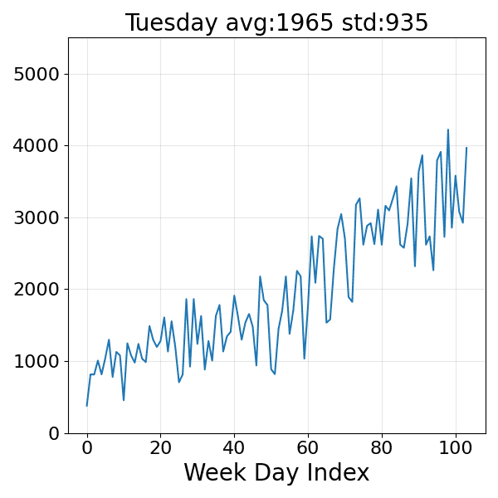
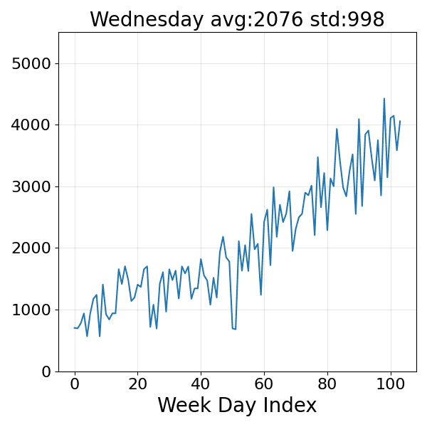
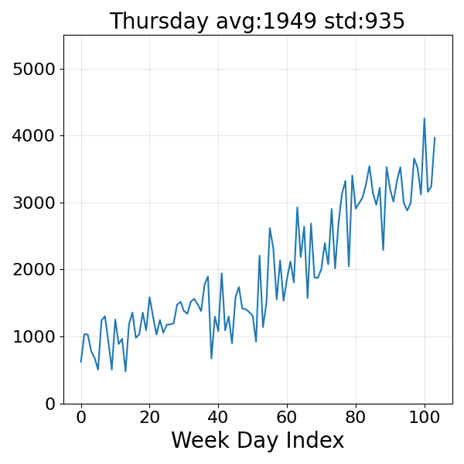
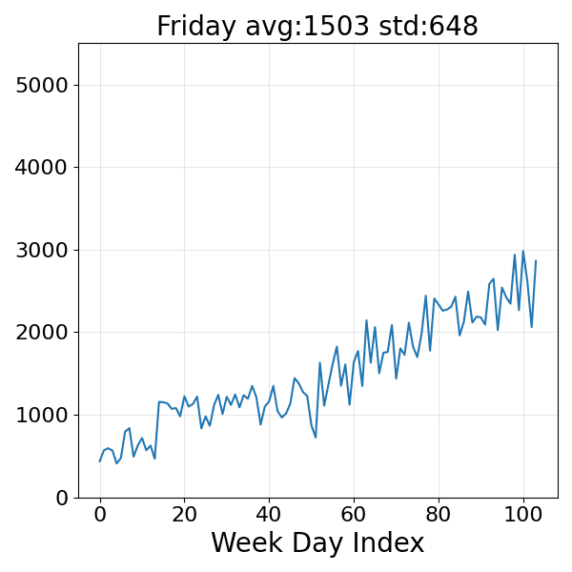
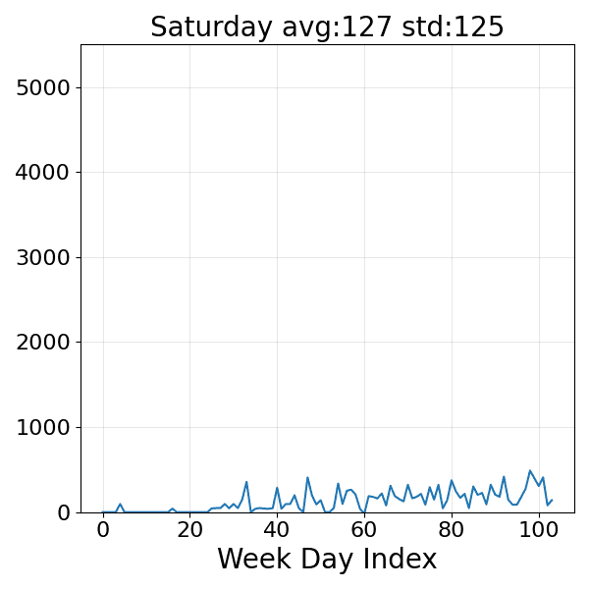
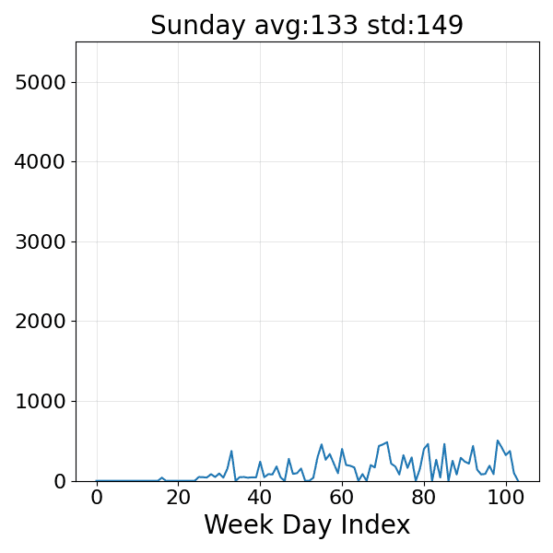
Daily number of outbound SKUs
Separating the outbound requests for each day of the week.

Slide 48
From global to detailed
Inputs available:
The number of daily SKUs and corresponding trucks
A customer (shipment) profile: ≈ 25 categories
Request (load) distribution per category
Distribution of pallets flowing from each WH area to staging areas for each category (mostly stable percentages)
Shipment forecast procedure
# provides the set of shipments to serve and their load
Forecast total Monday shipments per category
Estimate each shipment’s request from its category request distribution
Split requests across WH areas of origin
Compute pickup/loading time for each shipment/area pair

Slide 49
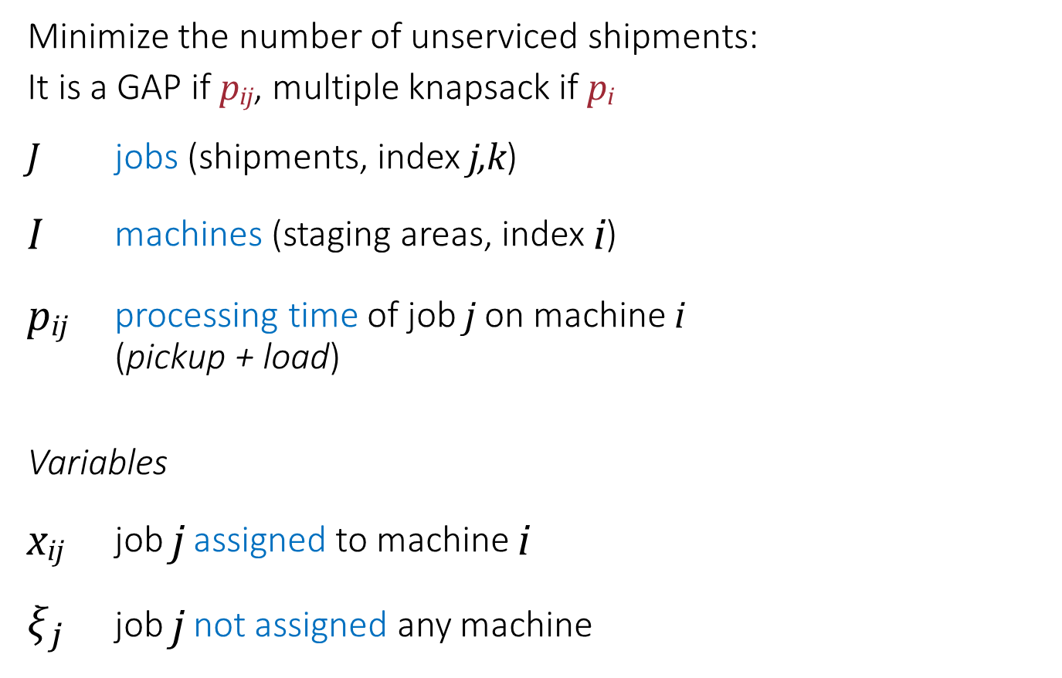
Deterministic scheduling: F1
Minimize the number of unserviced shipments:
It is a GAP if p_{ij}, multiple knapsack if p_{i}
J jobs (shipments, index j,k)
I machines (staging areas, index i)
p_{ij} processing time of job j on machine i
(pickup + load)
Variables
x_{ij} job j assigned to machine i
$ξ_{j}$ job j not assigned any machine
Standard scheduling nomenclature:
jobs = shipments,
machines = staging areas

Slide 50
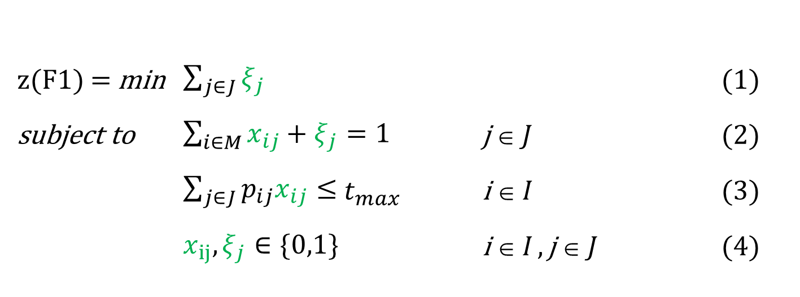
Deterministic scheduling F1
Just minimize the number of unsupported shipments (trucks)
z(F1) = min $\sum_{j∈J}{ξ_{j}}$ (1)
subject to $\sum_{i∈M}{x_{ij}}+ξ_{j}=1$ j ∈ J (2)
$\sum_{j∈J}{p_{ij}x_{ij}}≤$ $t_{max}$ i ∈ I (3)
$x_{ij}, ξ_{j}∈\{0,1\}$ i ∈ I , j ∈ J (4)
Maximize the number of on-time jobs on unrelated machines with a common due date. No sequencing decisions are needed

Slide 51
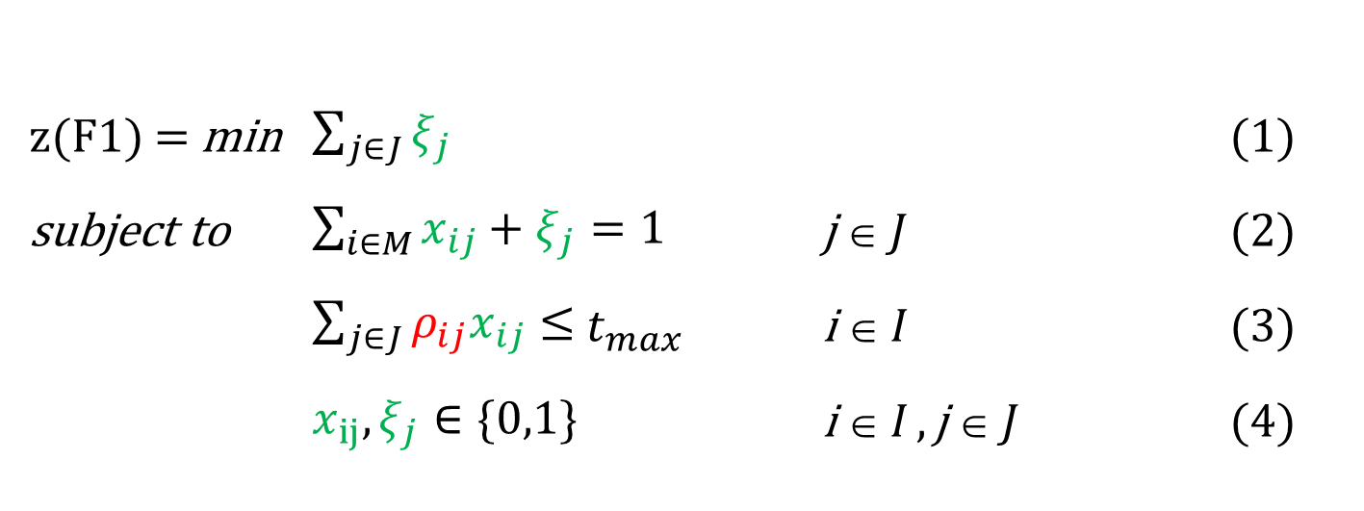
Stochastic scheduling, F1
z(F1) = min $\sum_{j∈J}{ξ_{j}}$ (1)
subject to $\sum_{i∈M}{x_{ij}}+ξ_{j}=1$ j ∈ J (2)
$\sum_{j∈J}{ρ_{ij}x_{ij}}≤$ $t_{max}$ i ∈ I (3)
$x_{ij}, ξ_{j}∈\{0,1\}$ i ∈ I , j ∈ J (4)
Uncertainty on the load

Slide 52
Deterministic scheduling: F2
J jobs (shipments, index j,k)
I machines (areas, index i)
p_{ij} processing time of job j on machine i
r_{j} release time of job j
Variables
c_{j} completion time of job j
t_{j} tardiness of job j
s_{j} start time of job j
x_{ij} job j assigned to machine i
z_{jk} truck k follows truck j
t_{max} scheduling horizon
An unrelated-machine problem with a common due date. With job-level overtime, sequencing matters, the model needs pairwise precedence variables.
Jobs finishing before d cost nothing, the choice of jobs in the window [0, d] on each machine is a knapsack-like decision

Slide 53
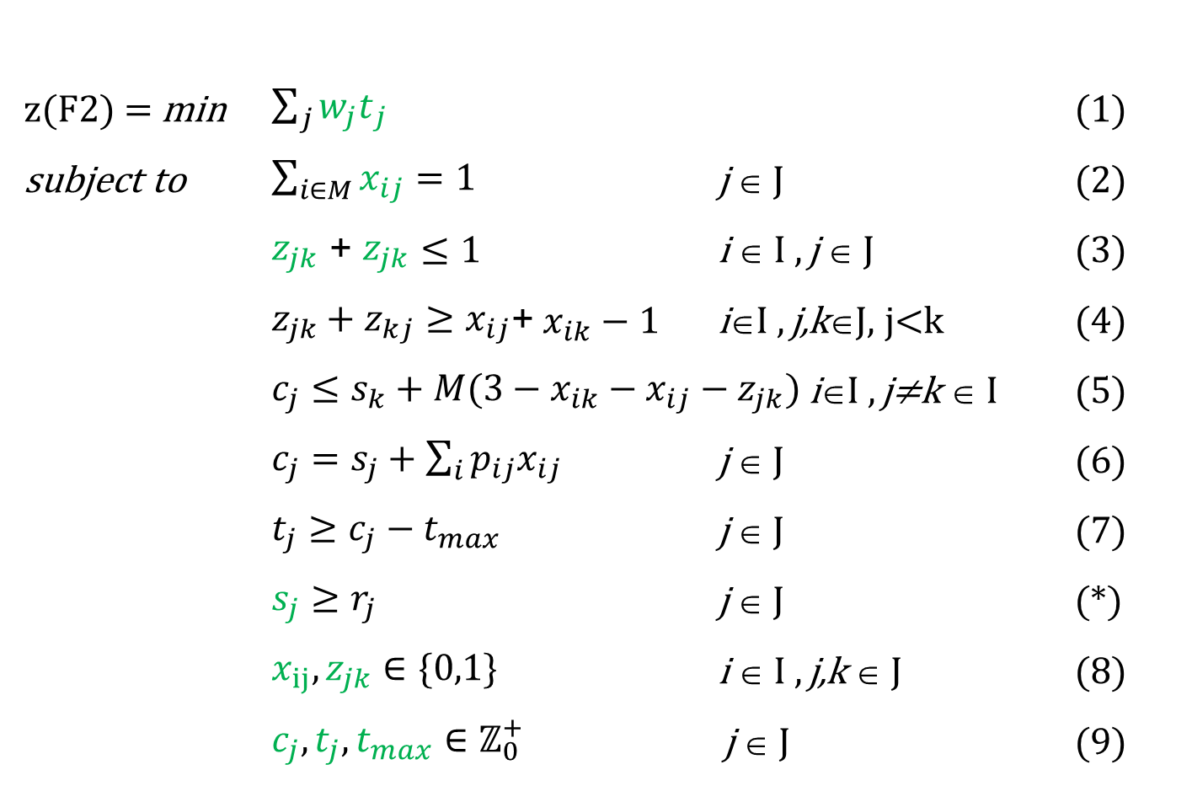
Deterministic scheduling F2
Minimize the weighted total tardiness of the shipments
z(F2) = min $\sum_{j}{{w_{j}t}_{j}}$ (1)
subject to $\sum_{i∈M}{x_{ij}}=1$ j ∈ J (2)
$z_{jk}$ + $z_{jk}$ $≤$ $1$ i ∈ I , j ∈ J (3)
$z_{jk}+z_{kj}≥x_{ij}$+ $x_{ik}−1$ i∈I , j,k∈J, j<k (4)
$c_{j}≤s_{k}+M(3−x_{ik}−x_{ij}−z_{jk})$i∈I , j≠k ∈ I (5)
$c_{j}=s_{j}+\sum_{i}{p_{ij}x_{ij}}$ j ∈ J (6)
$t_{j}≥c_{j}−t_{max}$ j ∈ J (7)
$s_{j}≥r_{j}$ j ∈ J (*)
$x_{ij}, z_{jk}∈\{0,1\}$ i ∈ I , j,k ∈ J (8)
${c_{j},t_{j},t}_{max}∈ℤ_{0}^{+}$ j ∈ J (9)

Slide 54
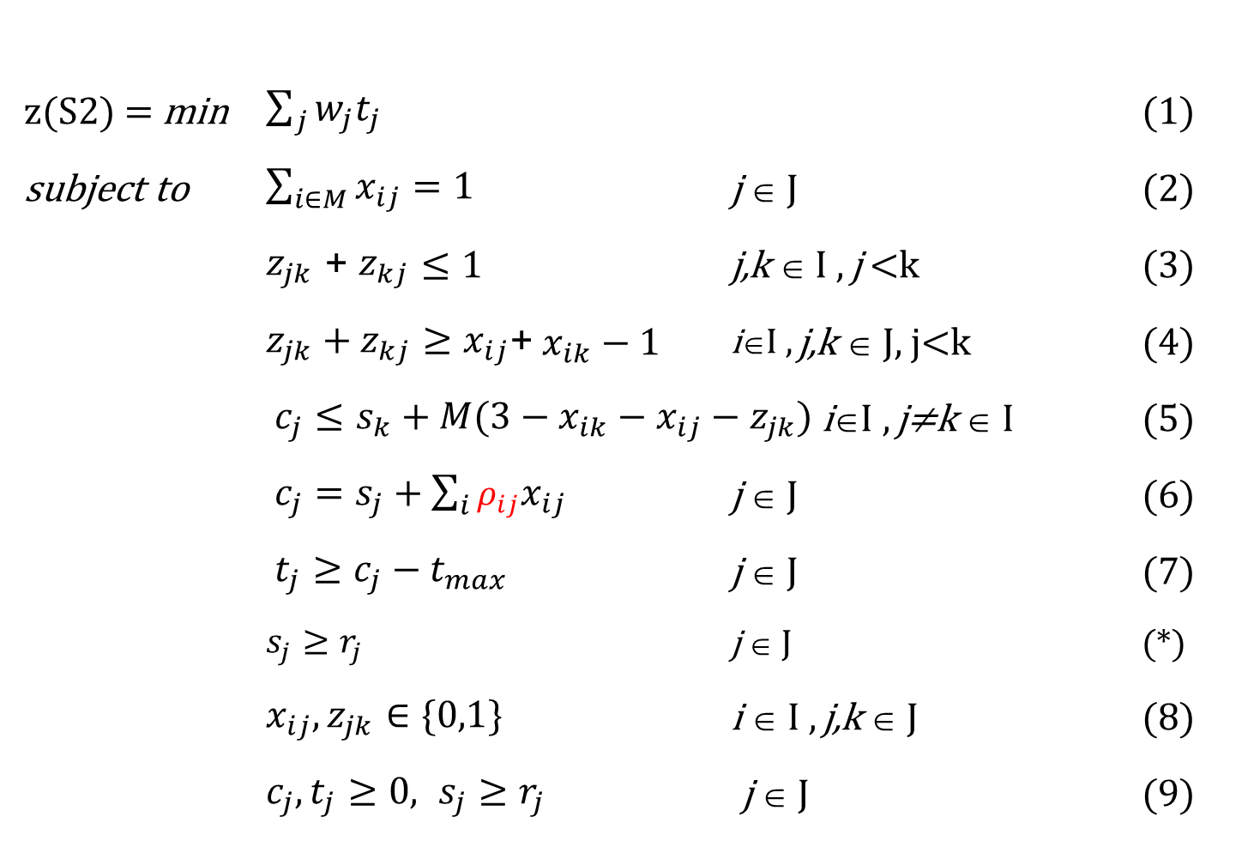
Stochastic scheduling F2
z(S2) = min $\sum_{j}{w_{j}t_{j}}$ (1)
subject to $\sum_{i∈M}{x_{ij}}=1$ j ∈ J (2)
$z_{jk}$ + $z_{kj}$ $≤$ $1$ j,k ∈ I , j <k (3)
$z_{jk}+z_{kj}≥x_{ij}$+ $x_{ik}−1$ i∈I , j,k ∈ J, j<k (4)
$c_{j}≤s_{k}+M(3−x_{ik}−x_{ij}−z_{jk})$i∈I , j≠k ∈ I (5)
$c_{j}=s_{j}+\sum_{i}{ρ_{ij}x_{ij}}$ j ∈ J (6)
$t_{j}≥c_{j}−t_{max}$ j ∈ J (7)
$s_{j}≥r_{j}$ j ∈ J (*)
$x_{ij}, z_{jk}∈\{0,1\}$ i ∈ I , j,k ∈ J (8)
$c_{j}, t_{j}≥0, s_{j}≥r_{j}$ j ∈ J (9)
Same first-stage decisions across all scenarios

Slide 55
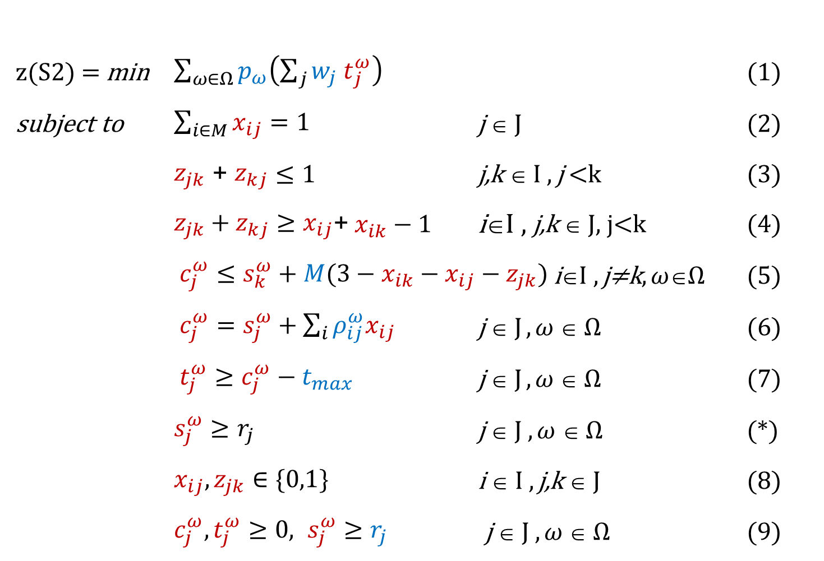
BESO-SAA F2
We forecast these
z(S2) = min $\sum_{ω∈Ω}{p_{ω}\left(\sum_{j}{{w_{j} t}_{j}^{ω}}\right)}$ (1)
subject to $\sum_{i∈M}{x_{ij}}=1$ j ∈ J (2)
$z_{jk}$ + $z_{kj}$ $≤$ $1$ j,k ∈ I , j <k (3)
$z_{jk}+z_{kj}≥x_{ij}$+ $x_{ik}−1$ i∈I , j,k ∈ J, j<k (4)
$c_{j}^{ω}≤s_{k}^{ω}+M(3−x_{ik}−x_{ij}−z_{jk})$i∈I , j≠k, $ω$∈$Ω$ (5)
$c_{j}^{ω}=s_{j}^{ω}+\sum_{i}{ρ_{ij}^{ω}x_{ij}}$ j ∈ J , $ω$ ∈ $Ω$ (6)
$t_{j}^{ω}≥c_{j}^{ω}−t_{max}$ j ∈ J , $ω$ ∈ $Ω$ (7)
$s_{j}^{ω}≥r_{j}$ j ∈ J , $ω$ ∈ $Ω$ (*)
$x_{ij}, z_{jk}∈\{0,1\}$ i ∈ I , j,k ∈ J (8)
$c_{j}^{ω}, t_{j}^{ω}≥0, s_{j}^{ω}≥r_{j}$ j ∈ J , $ω$ ∈ $Ω$ (9)

Slide 56
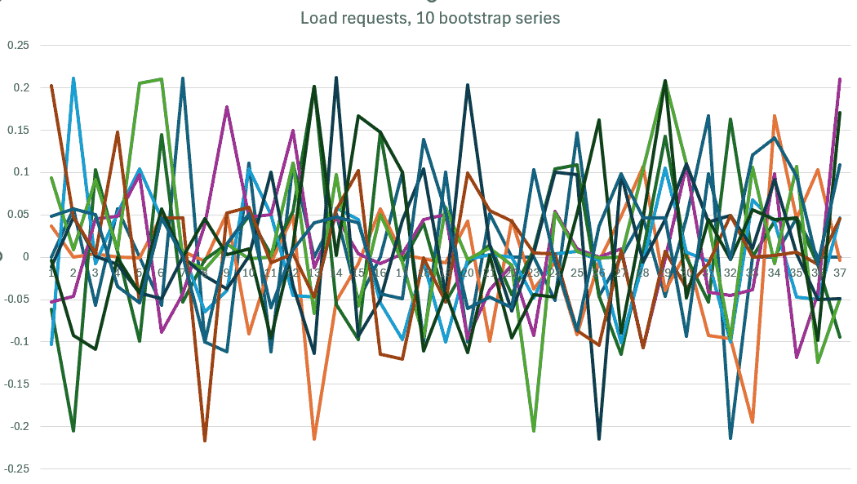
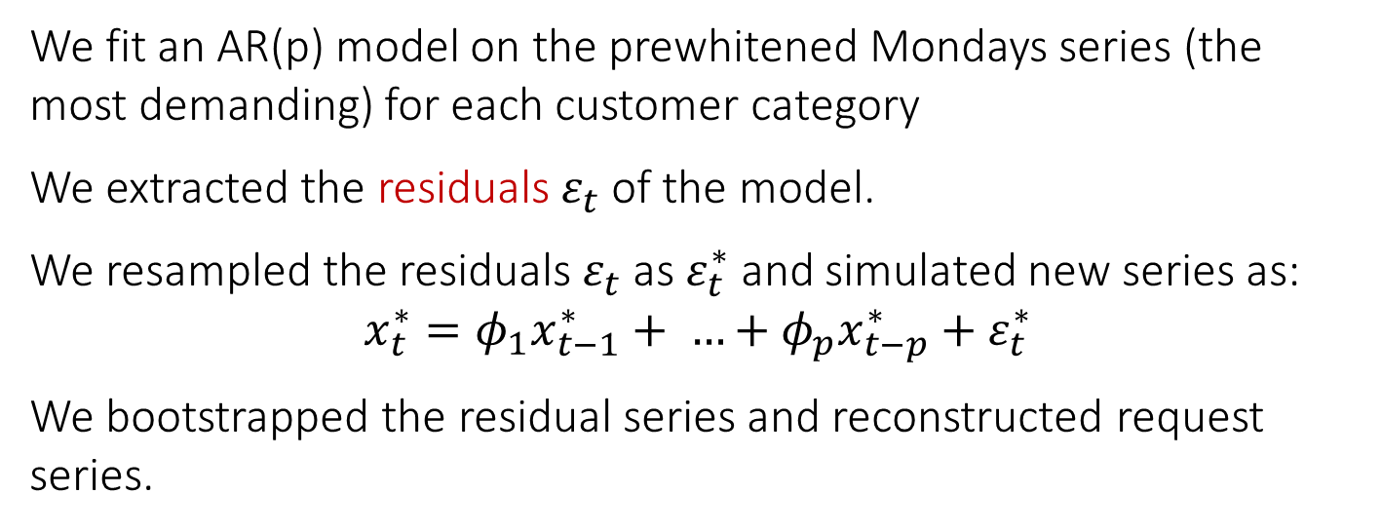
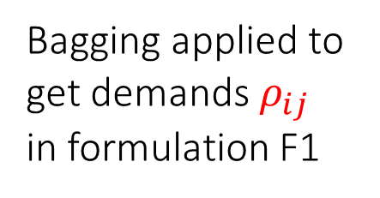
bootstrapping
We fit an AR(p) model on the prewhitened Mondays series (the most demanding) for each customer category
We extracted the residuals $ε_{t}$ of the model.
We resampled the residuals $ε_{t}$ as $ε_{t}^{∗}$ and simulated new series as:
$$x_{t}^{∗}=φ_{1}x_{t−1}^{∗}+ …+φ_{p}x_{t−p}^{∗}+ε_{t}^{∗}$$
We bootstrapped the residual series and reconstructed request series.
Bagging applied to get demands $ρ_{ij}$ in formulation F1

Slide 57
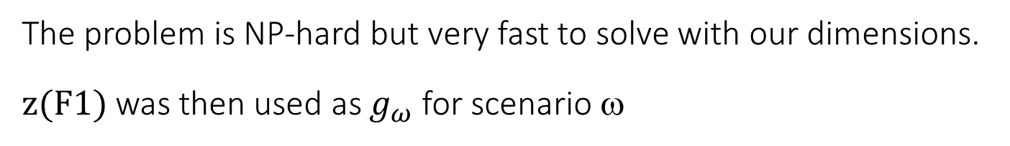
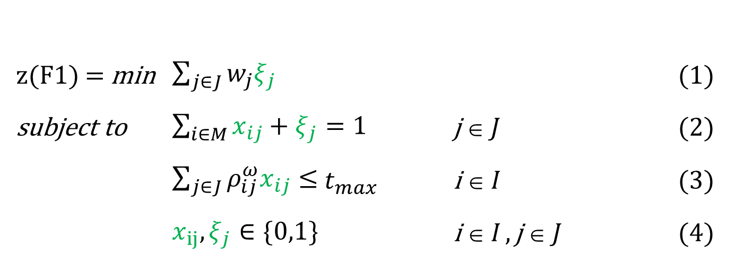
Entropy tilting
For each scenario we optimized a F1 GAP-like instance with predefined costs for unserved customers
z(F1) = min $\sum_{j∈J}{{w_{j}ξ}_{j}}$ (1)
subject to $\sum_{i∈M}{x_{ij}}+ξ_{j}=1$ j ∈ J (2)
$\sum_{j∈J}{ρ_{ij}^{ω}x_{ij}}≤$ $t_{max}$ i ∈ I (3)
$x_{ij}, ξ_{j}∈\{0,1\}$ i ∈ I , j ∈ J (4)
The problem is NP-hard but very fast to solve with our dimensions.
z(F1) was then used as $g_{ω}$ for scenario ω

Slide 58

Closer to the literature
For comparison, SAA based on formulation S3. Same load forecasts, no release time.
Ω is a set of S scenarios, with realizations $ρ_{ij}^{ω}$.
$x_{ijk}=1$ if job j is in position k on machine i, $k∈K$.
$c_{ik}^{ω}$, completion time of position k, $t_{j}^{ω}$ tardiness of job j in scenario ω .
z(F3) = min $\frac{1}{S}\sum_{ω}{\sum_{i}{{w_{j}t}_{j}^{ω}}}$
subject to
$\sum_{i}{\sum_{k}{x_{ijk}=1}}$ $∀j$
$\sum_{j}{x_{ijk}≤1}$ $∀i,k$
$\sum_{j}{x_{ijk}}≥\sum_{j}{x_{ijk+1} }$ $∀i,k$ (no gaps)
$c_{ik}^{ω}=c_{ik−1}^{ω}+\sum_{j}{ρ_{ij}^{ω}}x_{ijk}$ $∀i,k, ω (c_{i0}^{ω}=0)$
$t_{j}^{ω}≥c_{ik}^{ω}−t_{max} −M(1−x_{ijk})$ $∀i,j,k, ω$
$x_{ijk}∈\left\{0,1\right\}, {c_{ik}^{ω},t}_{j}^{ω}≥0$
Smaller but looser. It was just used for validation on a limited number of test cases.

Slide 59
Optimization, details
Use case with 33 staging areas, no limit on forklift number, loading times computed on the actual warehouse corridors graph.
Forklift allowed to load only one pallet at a time. Travel speed the average of actual travel speeds.
Pickup locations defined according with ABC policy within each area.
Bootstrap on the Monday series of customer categories, tests on 75 and 125 bootstraps.
Implementation in C++, linking Cplex 22.11, max 600 sec CPU time.
What-if analysis with data projected 6 months ahead (point forecasts).

Slide 60
Results, optimization
We generated 75 and 125 bootstrapped series.
The cost increases significantly in the case of the 125 boostset.
in the case of the 75 boostset 3 scenarios were deemed exceeding the future infrastructure.
in the case of the 125 boostset 18 scenarios were deemed exceeding the future infrastructure.
Solution was heuristic after 600 seconds, optimal guaranteed after 3600 (0% gap from previous incumbent).
High quality solution obtained in limited computation time.
The degree of robustness can be gauged using easy-to-understand parameters.

Slide 61

A result
A usage-ready solution, robustness absorbed in the staging preparation times

Slide 62
Comments
We applied the BESO approach to a real-world warehouse logistics case featuring:
empirical probability distribution estimation enabled by bootstrapped forecasting
data-driven, cost-aware scenario generation fed into stochastic SAA optimization
easy application to real-world contexts even with nonstationary noisy historical data
managerial interest also because of the justified insights it provides after easily described steps.
Takeaway: wherever decisions rest on uncertain forecasts, BESO turns that uncertainty into decisions that hold up.

