Slide 1
Bootstrap Enhanced Scenario Optimization for Two-Echelon Logistics, a Case Study in Large-Scale Retail
Vittorio Maniezzo, University of Bologna
Livio Fenga, University of Exeter

Slide 2
The case study
52 retailer stores
4 DCs: one big, one smaller, 2 satellites close to city center
Allocation for Christmas season! Preliminary analysis during summer.

Slide 3
The first case study
Large-scale organized distribution is often structured according to a two-echelon model, in which distribution centers (DCs) are used to store and forward goods to replenish the inventories of the final retailer's stores.
Stores are typically uniquely allocated to DCs for products of the same line, and predictive knowledge of future demand is essential to optimize the distribution process.
In the real-world case study:
city retailer store demands were predicted based on individual sales time series and
used to optimize the allocation of stores to DCs in a tactical planning context.
Our problem required dimensioning multiple DCs and assigning stores to them to meet expected demand during a critical period.

Slide 4
DRO
Robust optimization proposes a deterministic reformulation considering worst-case outcomes within a defined uncertainty set.
Distributionally Robust Optimization (DRO) seeks a solution most resilient against the worst-case probability distribution for uncertain parameters, typically within an ambiguity set (U): a set of probability distributions that the true, unknown distribution of the parameters is assumed to belong to.
DRO optimizes the worst-case performance over all distributions within this set. Mainstream DRO approaches define this ambiguity set in different ways.
Delage and Ye (2010) define the set based on known moment constraints (e.g., bounds on the mean and covariance) of the uncertain parameters.
Ben-Tal et al. (2013) construct ambiguity sets centered at the empirical distribution using discrepancy measures based on ϕ-divergences.
Esfahani and Kuhn (2018) define the ambiguity set as a Wasserstein ball around the empirical distribution, yielding tractable convex (often linear) reformulations
Notes:
Robust optimization proposes a deterministic reformulation considering worst-case outcomes within a defined uncertainty set.
Distributionally Robust Optimization (DRO) seeks a solution most resilient against the worst-case probability distribution for uncertain parameters, typically within an ambiguity set.
The ambiguity set (U) in DRO is a set of probability distributions that the true, unknown distribution of the uncertain parameters is assumed to belong to.
The core of DRO is to optimize the worst-case performance over all distributions within this set.
Mainstream DRO approaches define this ambiguity set in different ways.
Delage and Ye (2010) define the set based on known moment constraints (e.g., bounds on the mean and covariance) of the uncertain parameters. This methodology provides strong theoretical guarantees but requires the designer to make choices on the ambiguity set’s structure and size.
Ben-Tal et al. (2013) utilize specific discrepancy measures to construct an ambiguity set centered around the empirical distribution, such as those based on the ϕ-divergence (or f-divergence).
Esfahani and Kuhn (2018) define the ambiguity set as a Wasserstein ball around the empirical distribution, yielding tractable convex (often linear) reformulations

Slide 5
SAA and SPO
Scenario-Based Optimization associates a probability to different parameter realizations (scenarios), and optimizes decisions across all scenarios.
Sample Average Approximation (SAA) is the special case where scenarios are independent and identically distributed realizations, each assigned equal weight 1/N. Expectation can be replaced by mean, and the stochastic problem is transformed into a deterministic equivalent.
Bertsimas and Kallus (2020) generalize SAA by replacing uniform scenario weights with covariate-dependent weights (e.g., via k-nearest), yielding a conditional approximation of the distribution given observed side information.
A distinct line of work addresses the same challenge — uncertain parameters estimated from data — from the learning side rather than the distributional side.
Elmachtoub and Grigas (2022) propose Smart Predict-then-Optimize (SPO), training a prediction model with a loss function that measures the resulting decision error, rather than prediction error.
Notes:
The identification of stochastic variable distributions is a critical challenge.
Scenario-Based Optimization associates a probability to each scenario, formulating an optimization problem to find decisions that perform well across this set of scenarios. Sample Average Approximation (SAA) is the special case where scenarios are independent and identically distributed realizations, each assigned equal weight 1/N. By replacing the true expectation with this sample mean, the original stochastic problem is transformed into a deterministic equivalent, solvable using standard techniques.
Bertsimas and Kallus (2020) generalize SAA by replacing uniform scenario weights with covariate-dependent weights (e.g., via k-nearest neighbors or kernel regression), yielding a conditional approximation of the distribution given observed side information, rather than an unconditional one.
A distinct line of work addresses the same underlying challenge — uncertain parameters estimated from data — from the learning side rather than the distributional side.
Elmachtoub and Grigas (2022) propose Smart Predict-then-Optimize (SPO), training the prediction model with a loss function that measures the resulting decision error, rather than conventional prediction error, so that the model is trained to be useful for the downstream optimization problem rather than merely accurate.

Slide 6
Toward a formulation
Server i
Capacity Q_{i}
Unitary storage cost d_{i}
i
if j is serviced from i, then x_{ij} = 1
j
Client j
Total request req_{j}
Allocation cost to i c_{ij}
Amount serviced by i q_{ij}

Slide 7
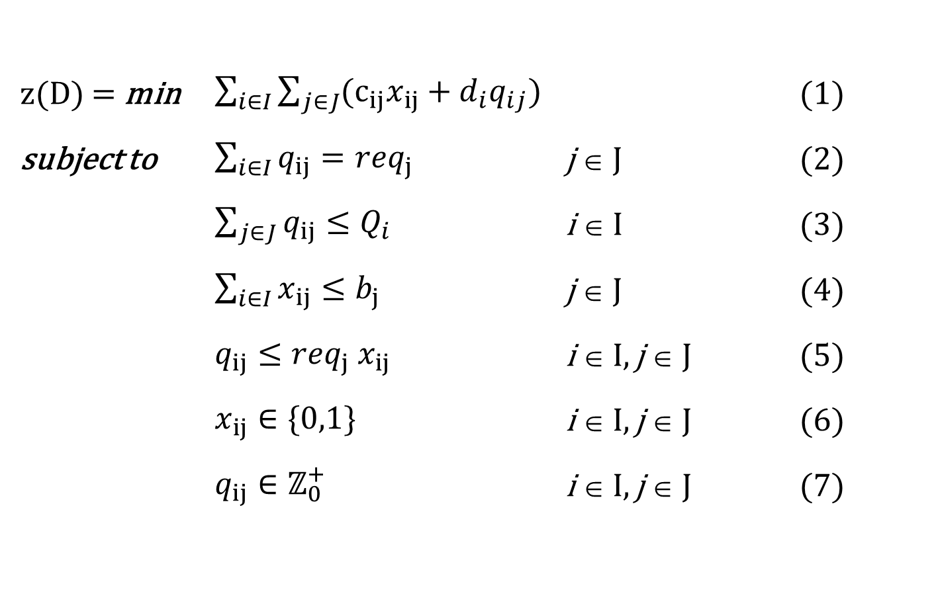
Deterministic allocation
z(D) = min $\sum_{i∈I}{\sum_{j∈J}{{(c}_{ij}x_{ij}}}+d_{i}q_{ij})$ (1)
subject to $\sum_{i∈I}{q_{ij}}={req}_{j}$ j ∈ J (2)
$\sum_{j∈J}{q_{ij}}≤Q_{i}$ i ∈ I (3)
$\sum_{i∈I}{x_{ij}}≤b_{j}$ j ∈ J (4)
$q_{ij}≤{req}_{j}{ x}_{ij}$ i ∈ I, j ∈ J (5)
$x_{ij}∈\{0,1\}$ i ∈ I, j ∈ J (6)
$q_{ij}∈ℤ_{0}^{+}$ i ∈ I, j ∈ J (7)

Slide 8
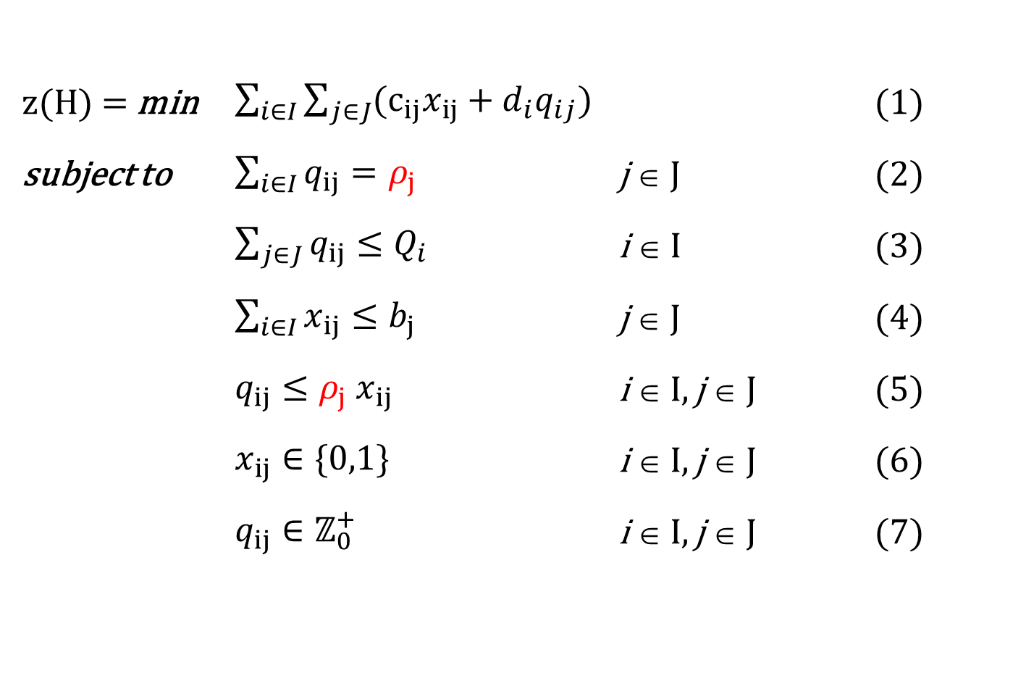
Stochastic allocation
z(H) = min $\sum_{i∈I}{\sum_{j∈J}{{(c}_{ij}x_{ij}}}+d_{i}q_{ij})$ (1)
subject to $\sum_{i∈I}{q_{ij}}=ρ_{j}$ j ∈ J (2)
$\sum_{j∈J}{q_{ij}}≤Q_{i}$ i ∈ I (3)
$\sum_{i∈I}{x_{ij}}≤b_{j}$ j ∈ J (4)
$q_{ij}≤ρ_{j}{ x}_{ij}$ i ∈ I, j ∈ J (5)
$x_{ij}∈\{0,1\}$ i ∈ I, j ∈ J (6)
$q_{ij}∈ℤ_{0}^{+}$ i ∈ I, j ∈ J (7)

Slide 9
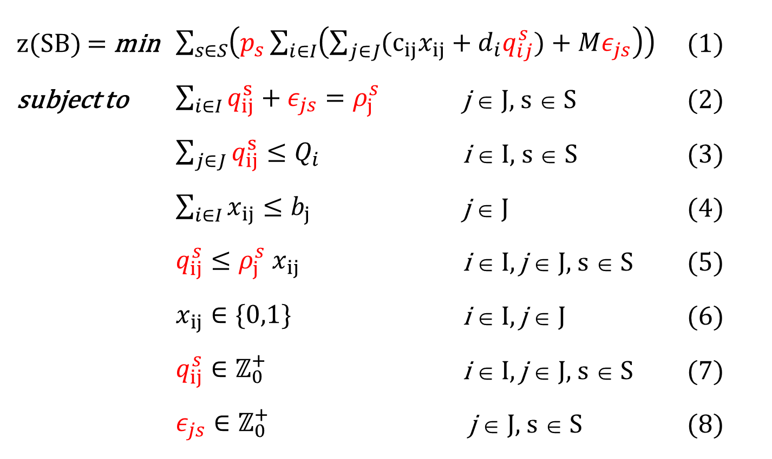
Scenario-based
z(SB) = min $\sum_{s∈S}{\left(p_{s}\sum_{i∈I}{\left(\sum_{j∈J}{{(c}_{ij}x_{ij}}+d_{i}q_{ij}^{s})+Mε_{js}\right)}\right)}$ (1)
subject to $\sum_{i∈I}{q_{ij}^{s}}+ε_{js}=ρ_{j}^{s}$ j ∈ J, s ∈ S (2)
$\sum_{j∈J}{q_{ij}^{s}}≤Q_{i}$ i ∈ I, s ∈ S (3)
$\sum_{i∈I}{x_{ij}}≤b_{j}$ j ∈ J (4)
$q_{ij}^{s}≤ρ_{j}^{s}{ x}_{ij}$ i ∈ I, j ∈ J, s ∈ S (5)
$x_{ij}∈\{0,1\}$ i ∈ I, j ∈ J (6)
$q_{ij}^{s}∈ℤ_{0}^{+}$ i ∈ I, j ∈ J, s ∈ S (7)
$ε_{js}∈ℤ_{0}^{+}$ j ∈ J, s ∈ S (8)
We forecast these

Slide 10
Prewhitening
Economics-related time series can often be effectively decomposed using STL
(almost) white noise

Slide 11
Recoloring
The prewhitened series only retains residuals unexplained by the model (i.e. random shock).
Residuals are (hopefully) normally distributed.
The observed residuals are realizations of a random variable whose distribution can be identified.
Using the average and standard deviation of the residual series, I can generate alternative samples that are compatible with the overall model, i.e. samples that could have occurred.

Slide 12
Bootstrapping time series
Bootstrapping is non-parametric resampling technique used when historical data is available. It makes no assumptions about the underlying probability distribution of the stochastic variables.
The assumption of bootstrapping is that the observed historical data sample mimics the characteristics of the true, unknown population distribution.
Bootstrapping repeatedly draws samples with replacement from the observed data to generate "bootstrap samples". Each sample is a plausible realization of what a new data sample from the true population *might* look like.
Autoregressive models are particularly suitable for data series bootstrap set generation.

Slide 13
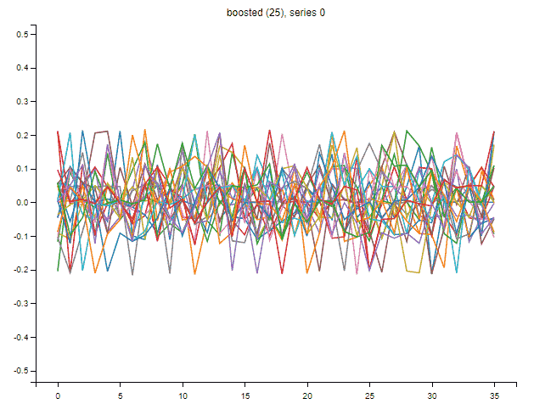
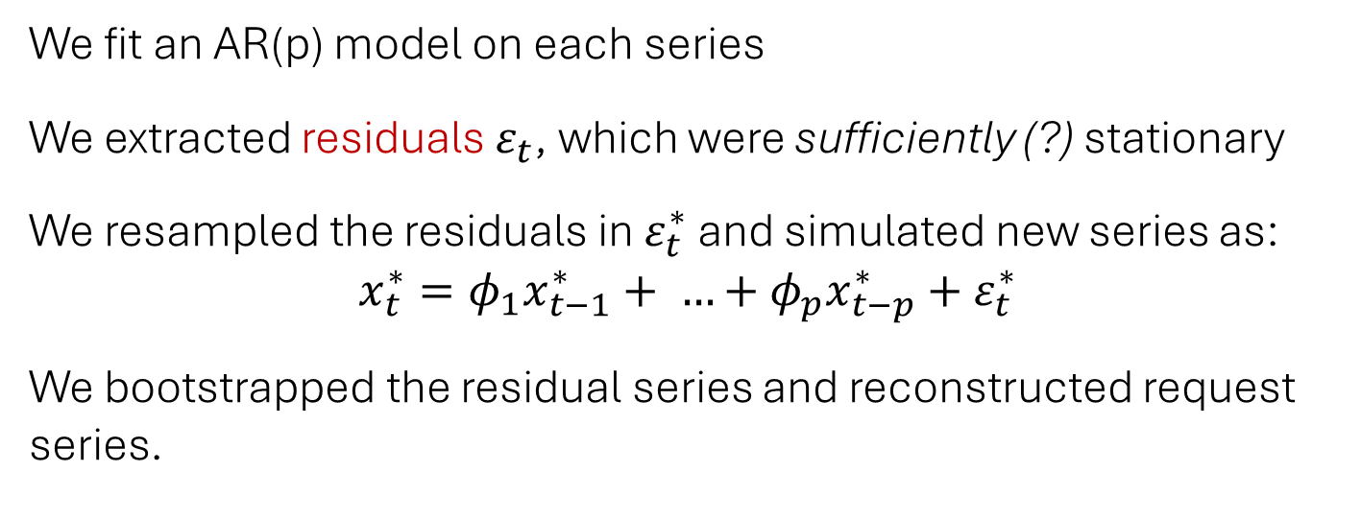
Bootstrapping
We fit an AR(p) model on each series
We extracted residuals $ε_{t}$, which were sufficiently (?) stationary
We resampled the residuals in $ε_{t}^{∗}$ and simulated new series as:
$$x_{t}^{∗}=φ_{1}x_{t−1}^{∗}+ …+φ_{p}x_{t−p}^{∗}+ε_{t}^{∗}$$
We bootstrapped the residual series and reconstructed request series.

Slide 14
Maximum entropy bootstrap
We were working on short data series, that often produce biased estimates.
The resampling process was guided according to Maximum Entropy Bootstrap (MEB, Vinod 1993), associating a probability with each outcome and maximizing an information entropy function defined over the resampled data, subject to constraints reflecting statistics computed on the original data.
This guarantees that the generated bootstraps are the least biased, i.e., the most non-committal estimates consistent with the known constraints, i.e., with the observed data.

Slide 15
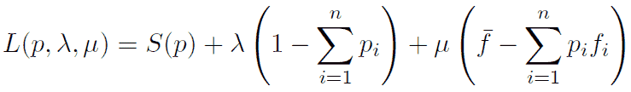
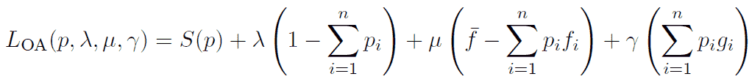
Objective-Augmented Maximum Entropy Bootstrap (OA-MEB)
Standard MEB defines a probability distribution maximizing entropy subject to constraints derived from statistics computed on the empirical dataset.
It can be formulated in a Lagrangian fashion as
We added to the formulation an auxiliary objective-related component, representing scenario-wise quantities that are relevant to downstream cost functions
This produces synthetic datasets that reflect the uncertainty of the original data but also adhere to the specific objectives and constraints

Slide 16
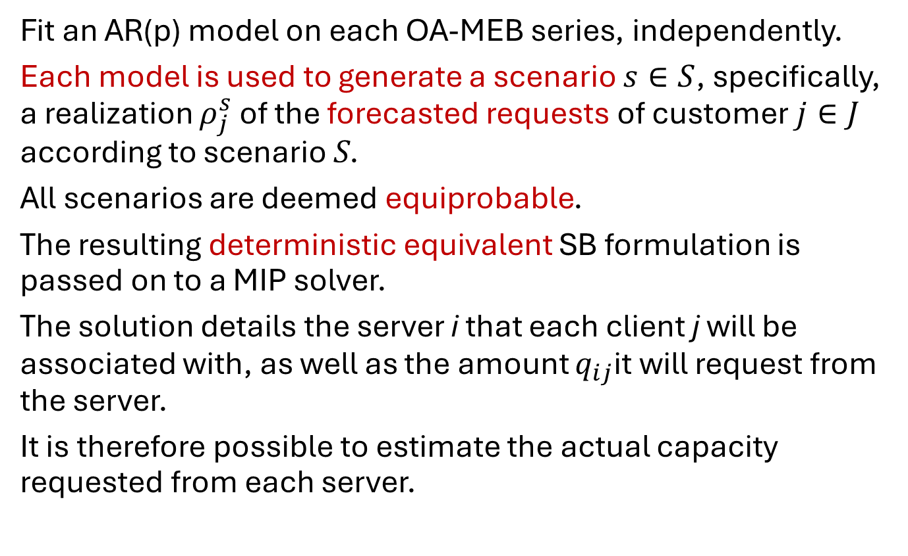
BESO: Bootstrapped Enhanced Scenario Optimization
Fit an AR(p) model on each OA-MEB series, independently.
Each model is used to generate a scenario $s∈S$, specifically, a realization $ρ_{j}^{s}$ of the forecasted requests of customer $j∈J$ according to scenario S.
All scenarios are deemed equiprobable.
The resulting deterministic equivalent SB formulation is passed on to a MIP solver.
The solution details the server i that each client j will be associated with, as well as the amount $q_{ij}$it will request from the server.
It is therefore possible to estimate the actual capacity requested from each server.

Slide 17
Forecasts
MEB bootstrap sets were aggregated (bagged) to obtain forecasts.
Besides MEB bagging we also considered alternative forecasts modules based on:
AR
Holt-Winters
SARIMA
Multilayer perceptrons
LSTM networks
Random forests
XGboost

Slide 18
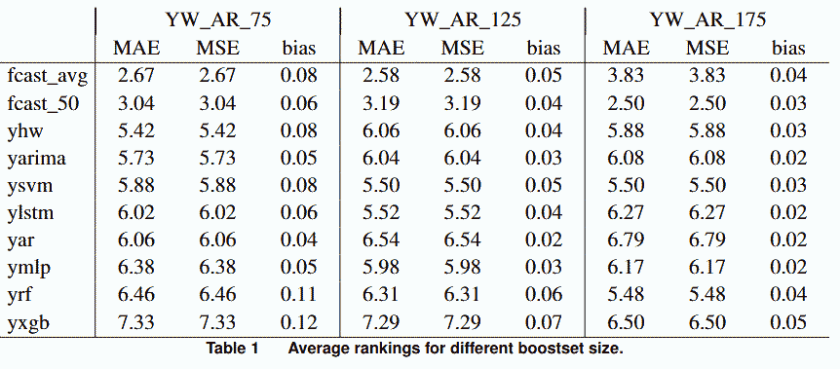
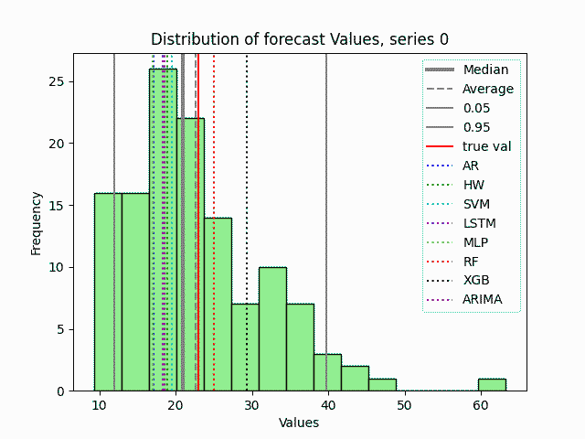
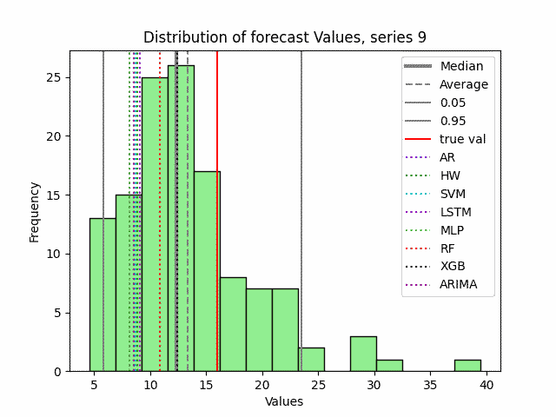
Results, forecasts
MEB based forecasting. Average rankings for different boostset sizes.

Slide 19
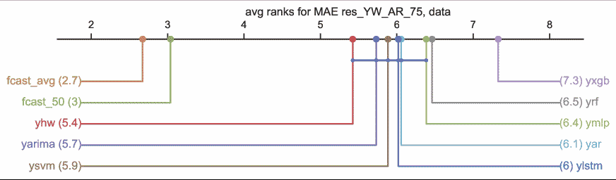
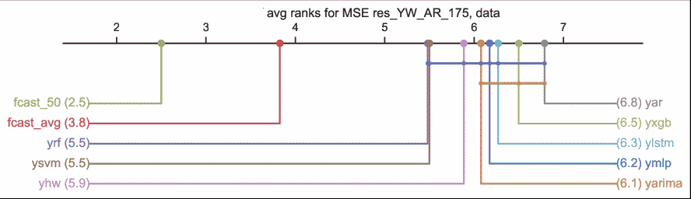
Results, forecasts
Critical difference diagrams (Fawaz et al., 2019)

Slide 20
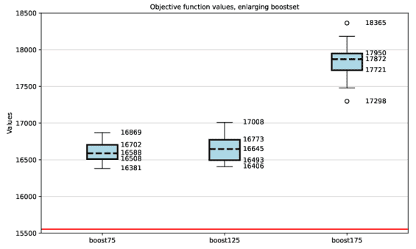
Results, optimization
The cost is essentially stable in the cases of the 75 and 125 series sets but increases significantly in the case of the 175 boostset.
This is due to some extreme scenarios appearing in the forecasts.
All instances were feasible, but 7 out of 35 tests still had a gap between lower and upper bound after 600 seconds of CPU time.

Slide 21
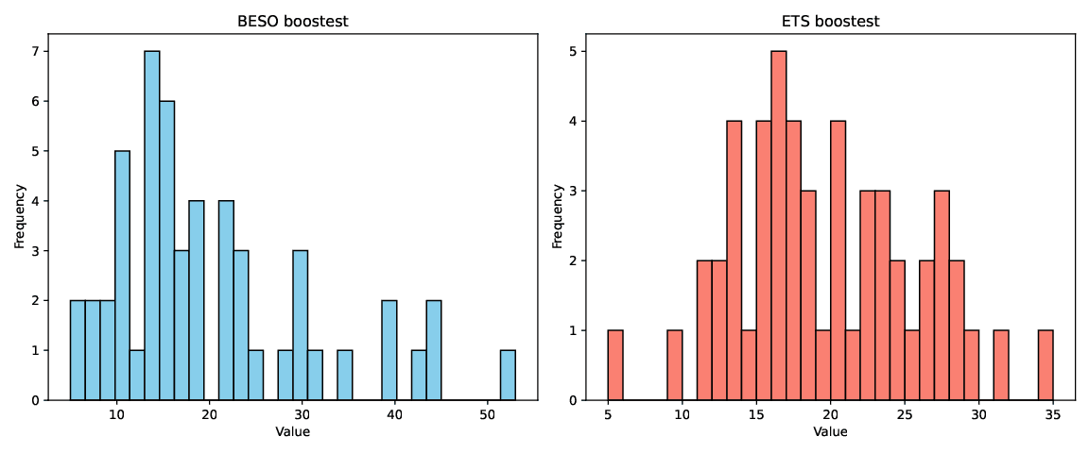
Results, comparison
BESO vs. distribution-based, gaussian derived from confidence intervals of Holt-Winters ETS forecasts.

Slide 22
Results, comparison
Comparing against a distribution-based optimization (Holt-Winters, confidence intervals)
No rental cost With rental cost
BESO ETS BESO ETS
Assign. Cost 17781 15423 5446720 4378380
Optimality gap % 0 0 16.07 0.69
Infeasibilities 0 1 0 1
t.Cpu 33 29 7200 7200
Allocated capacities:
Server 0 67 / 120 119 / 120 82 / 120 116 / 120
Server 1 571 / 1000 430 / 1000 532 / 1000 428 / 1000
Server 2 257 / 300 301 / 300 257 / 300 303 / 300
Server 3 128 / 180 173 / 180 152 / 180 176 / 180

Slide 23
Comments
BESO is a framework for deriving predictive prescriptions from relevant data series. It integrates statistically grounded forecasting with scenario-based optimization by generating future scenarios via bootstrapped autoregressive time series, while incorporating feedback from the optimization stage.
Bootstrapped forecasting identifies a probability distribution of future retailer requests, supporting data-driven scenario generation while considering both costs and forecast uncertainty.
The validity of the BESO approach extends beyond the case study.
Integrating forecasting and optimization within a unified empirical loop enhances stability, operational effectiveness and result justification.

