Slide 1
Extended set covering for time series segmentation
Vittorio Maniezzo
University of Bologna
vittorio.maniezzo@unibo.it

Slide 2
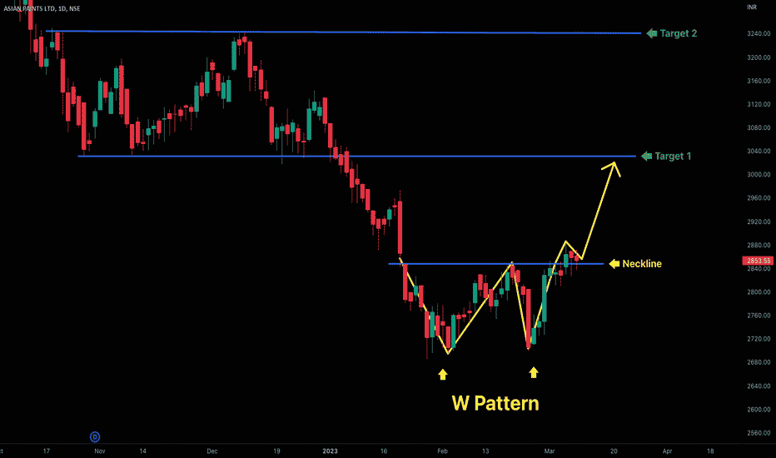
Fintech, trading

Slide 3
Time series segmentation
Time series segmentation asks to partition a time series into distinct, non-overlapping time segments, each characterized by homogeneous patterns or behaviors.
Segmenting a time series entails identifying points of change in the series: temporal shifts, transitions, or abrupt changes that carry critical information.
Change points identify events in a time series where the statistical properties of the data undergo a significant change, contributing to the understanding of:
evolving trends,
prediction of future behavior,
identification of anomalous events.

Slide 4
Piecewise linear regression
The segments can correspond to any pattern of interest, but because of its computational efficiency and immediacy of understanding, linear regression plays a predominant role.
Segmentation into linear intervals is known as piecewise linear regression.
Piecewise linear regression recognizes the presence of distinct segments in the data, each characterized by its own linear trend.
Several approaches in the literature for time series segmentation and change point detection, including classical statistical techniques, Bayesian approaches, machine learning algorithms, and hybrid models.
JUST MIP IT!

Slide 5
The SPP model
The idea:
quantify the fitness of each acceptable run of values of the series
select the subset of runs that collectively cover the entire series
minimizing the cost of residuals or maximizing model fitness.
Further constraints can be added to accommodate specific desiderata on the model, thanks to the modeling flexibility of mixed-integer programming and the effectiveness of state-of-the-art general MIP solvers
A Set Partitioning Problem (SPP) is at the core of the model, where the objective is to minimize the cost of the residuals and the constraints ensure that each point of the series has a corresponding one in the model.
No assumption is made about the nature of the model of the segments.

Slide 6
The SCP model
The cost c_{j} of each run can be computed according to any of the fitness measures proposed in the literature, including R², SER, χ², RMSE, simple variance etc.
The constraints ensure that each point of the series is covered by a selected run.
BUT the number of feasible runs for a real-world application can be very large, and the SPP can take an unacceptable amount of time to solve.
We relax the equality constraints into inequalities, transforming the problem into a Set Covering Problem (SCP), which can typically be solved in much higher dimensions, at the cost of having multiple runs covering some of the series points.
It requires postprocessing to get a feasible segmentation. We simply cut one of the overlaps (very rough).

Slide 7
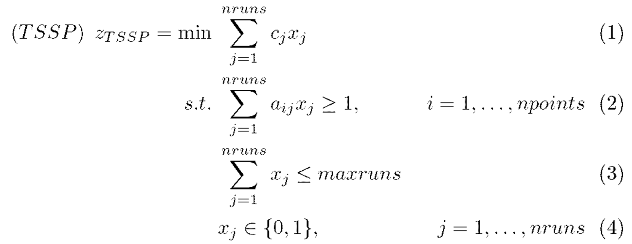
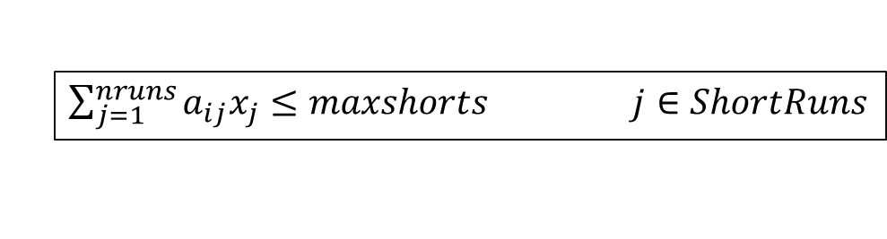
The extended SCP model
$\sum_{j=1}^{nruns}{a_{ij}x_{j}≤maxshorts}$ $j∈ShortRuns$

Slide 8
The Lagrangian model
Dualizing covering constraints (2), you simply have to pick the most negative maxruns columns, if so many exist.
function LagrHeuristic();
1 identify an “easy” subproblem LR(λ)
2 initialize the penalty vector λ
3 repeat
4 solve subproblem LR(λ), get (infeasible) solution x
5 check for unsatisfied constraints
6 construct problem solution x^{h} using x and λ
7 if z(x^{h})<z∗ then x∗=x^{h} // z(x^{h}),z∗ the costs of x^{h},x∗
8 update penalties λ
9 until end_condition

Slide 9
LagrHeuristic details
Subgradient algorithm for penalty updates
Polyak rule for alpha decrease
Restart when α < α_{min}
Fixing heuristic: take the incumbent subproblem solution at each iteration, possibly infeasible because it does not satisfy all relaxed constraints, and add variables in order of increasing cost until it becomes feasible.

Slide 10
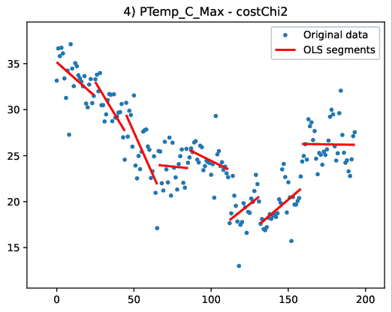
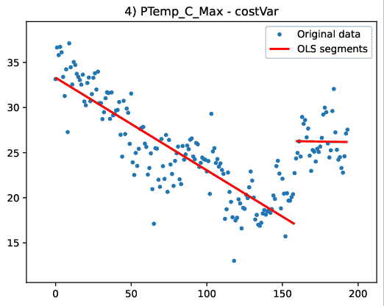
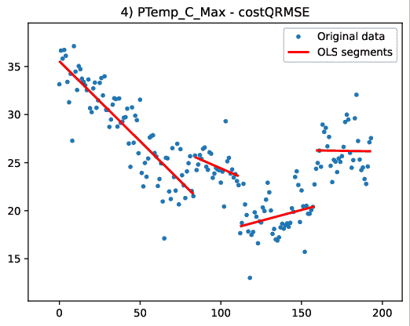
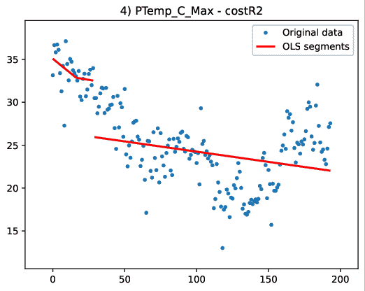
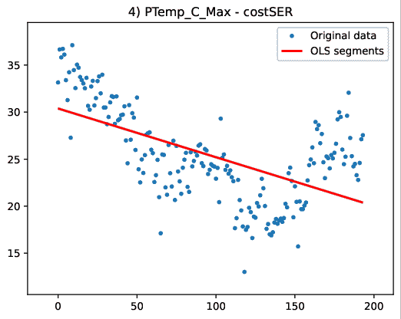







Cost functions
$$χ^{2}=∑\frac{{\left(\hat{y_{i}}−y_{i}\right)}^{2}}{\hat{y_{i}}}$$
$$σ_{r}^{2}=∑\frac{{\left(\hat{r_{i}}−\overline{r}\right)}^{2}}{n−1}$$
$$QRMSE=∑\frac{{\left(\hat{y_{i}}−y_{i}\right)}^{2}}{\sqrt{n}}$$
$$R^{2}=1−\frac{\sum{{\left(\hat{y_{i}}−y_{i}\right)}^{2}}}{\sum{{\left(y_{i}−\overline{y}\right)}^{2}}}$$
$$SER=\sqrt{\frac{\sum{{\left(\hat{r_{i}}−\overline{r}\right)}^{2}}}{n−2}}$$
$$RMSE=∑\frac{{\left(\hat{y_{i}}−y_{i}\right)}^{2}}{n}$$

Slide 11

A real world application
The series were produced in the context of the SMARTLAGOON project, an EU H2020 project, whose objective is real-time monitoring, analysis, and prediction of the socio-environmental evolution of the vulnerable area Mar Menor, which is the largest saltwater coastal lagoon in Europe.
Within the framework
of the project, smart
buoys were deployed in
the lagoon and their
sensors generated series
on 12 attributes.

Slide 12
Testsets
A set of IoT series on different physical variables August 2022 to April 2023 at different sampling frequency (daily or every 60 mins).
Three other benchmark sets from the M competitions¹ on time series forecasting:
M3 (micro, industry, macro, finance, demographic, other)
M4 (micro, industry, macro, finance, demographic, other)
M6 (daily adjusted close prices of the M6 assets)
Comparison against codes in ruptures² (Truong et al., 2020): DYNP (needs the number of breaks in input), PELT (Killick et al., 2012), BINSEG (Keogh, 2001).
Results are percentage over (below for LB) the best solution we found over the many runs we made.
Code in C++, solver CPLEX 22.11, platform desktop Windows 11 using a single core. Lagrangian run for 180 seconds.
¹ https://en.wikipedia.org/wiki/Makridakis_Competitions
² https://centre-borelli.github.io/ruptures-docs/

Slide 13
Results, IoT
 | MIP |  | Lagrangian |  |  | PELT |  | BINSEG |  | DYNP
 | cost | tcpu | zlb | zub | t.zub | cost | tcpu | cost | tcpu | cost | tcpu
IBatt_Min | 0.00% | 0 | -12.29% | 21.27% | 0 | 155.08% | 0 | 113.72% | 0 | 101.31% | 0
PTemp_C_Avg | 18.01% | 0 | -3.55% | 5.95% | 1 | 42.67% | 0 | 36.04% | 0 | 4.88% | 0
PTemp_C_Max | 0.00% | 0 | -1.31% | 0.00% | 2 | 18.16% | 0 | 16.98% | 0 | 2.65% | 0
SDI_Temp_1m | 18.50% | 357 | -59.66% | 5.93% | 19 | 273.81% | 0 | 273.81% | 0 | 0.00% | 0
ThermTemp1_Avg | 15.09% | 0 | -48.96% | 4.45% | 2 | 920.51% | 0 | 920.51% | 0 | 13.05% | 0
V_in_chg_Avg | 0.00% | 0 | -12.75% | 8.88% | 0 | 84.19% | 0 | 84.19% | 0 | 33.43% | 0
Vapor_Press_Avg | 41.97% | 0 | -4.17% | 0.00% | 0 | 141.06% | 0 | 141.06% | 0 | 20.10% | 0
Vapor_Press_Avg_2 | 0.00% | 362 | -14.48% | 0.00% | 46 | 45.23% | 0 | 45.23% | 0 | 0.27% | 0
WS_ms_Avg | 0.00% | 358 | 0.00% | 0.00% | 0 | 0.00% | 0 | 0.00% | 0 | 14.51% | 0
WTemp_C1_Avg | 10.10% | 349 | -59.44% | 19.63% | 55 | 299.05% | 0 | 299.05% | 0 | 0.00% | 0
WTemp_C2_Avg | 1.03% | 0 | -28.84% | 6.63% | 2 | 87.30% | 0 | 123.16% | 0 | 61.77% | 0

Slide 14
Results M3, various domains
 | MIP |  | Lagrangian |  |  | PELT |  | BINSEG |  | DYNP
 | cost | tcpu | zlb | zub | t.zub | cost | tcpu | cost | tcpu | cost | tcpu
N1879 | 0.00% | 0 | -2.07% | 0.00% | 0 | 17.89% | 0 | 2.80% | 0 | 6.33% | 0
N1881 | 1.48% | 0 | -6.55% | 1.49% | 0 | 19.84% | 0 | 6.73% | 0 | 7.43% | 0
N1882 | 2.56% | 0 | -3.13% | 0.00% | 0 | 36.10% | 0 | 38.40% | 0 | 24.26% | 0
N1883 | 0.00% | 0 | -24.51% | 1.54% | 0 | 84.93% | 0 | 89.84% | 0 | 42.75% | 0
N1884 | 31.42% | 0 | -41.57% | 11.82% | 1 | 46.27% | 0 | 44.99% | 0 | 28.46% | 0
N2830 | 20.05% | 0 | -1.65% | 0.00% | 0 | 60.29% | 0 | 87.55% | 0 | 63.44% | 0
N2831 | 36.20% | 0 | -21.46% | 29.47% | 0 | 112.33% | 0 | 65.80% | 0 | 122.90% | 0
N2832 | 27.47% | 0 | 0.00% | 0.00% | 0 | 89.42% | 0 | 45.24% | 0 | 57.79% | 0
N2833 | 22.88% | 0 | -9.70% | 13.00% | 0 | 49.37% | 0 | 70.68% | 0 | 75.08% | 0
N2834 | 81.03% | 0 | -4.84% | 16.86% | 0 | 194.79% | 0 | 194.79% | 0 | 113.19% | 0

Slide 15
Results M4, various domains
 | MIP |  | Lagrangian |  |  | PELT |  | BINSEG |  | DYNP
 | cost | tcpu | zlb | zub | t.zub | cost | tcpu | cost | tcpu | cost | tcpu
Q2002 | 6.78% | 0 | -1.88% | 0.12% | 1 | 58.12% | 0 | 41.62% | 0 | 32.72% | 0
Q5109 | 26.69% | 92 | -72.90% | 7.89% | 125 | 916.13% | 0 | 861.14% | 0 | 868.30% | 0
Q8030 | 0.00% | 0 | -99.79% | 23.45% | 0 | 5559.62% | 0 | 3797.48% | 0 | 5126.12% | 0
Q14640 | 0.00% | 0 | 0.00% | 0.00% | 0 | 0.00% | 0 | 0.00% | 0 | 0.00% | 0
Q15444 | 0.05% | 0 | -0.94% | 0.00% | 0 | 9.69% | 0 | 9.69% | 0 | 11.96% | 0
Q18148 | 0.00% | 0 | 0.00% | 0.00% | 0 | 52.65% | 0 | 27.41% | 0 | 31.18% | 0
Q18496 | 0.00% | 0 | -0.02% | 1.11% | 0 | 26.76% | 0 | 33.97% | 0 | 18.13% | 0
Q19604 | 4.68% | 0 | -99.02% | 2.87% | 0 | 261.96% | 0 | 73.64% | 0 | 72.84% | 0
Q19637 | 6.28% | 0 | -5.64% | 0.00% | 0 | 212.55% | 0 | 181.90% | 0 | 173.02% | 0
Q22221 | 76.41% | 52 | -7.76% | 34.43% | 4 | 44.66% | 0 | 0.00% | 0 | 3.92% | 0

Slide 16
Results M6, financial
 | MIP |  | Lagrangian |  |  | PELT |  | BINSEG |  | DYNP
 | cost | tcpu | zlb | zub | t.zub | cost | tcpu | cost | tcpu | cost | tcpu
ABBV | 38.10% | 1 | 0.00% | 0.00% | 0 | 303.76% | 0 | 428.81% | 0 | 22.89% | 0
BTCUSD | 20.32% | 5 | -44.77% | 3.53% | 1 | 42.84% | 0 | 0.00% | 0 | 8.07% | 0
EURCHF | 1.00% | 1 | -9.42% | 0.03% | 3 | 823.56% | 0 | 823.56% | 0 | 0.00% | 0
EURUSD | 0.00% | 1 | -6.82% | 0.45% | 0 | 428.05% | 0 | 428.05% | 0 | 21.07% | 0
EWG | 13.16% | 1 | 0.00% | 0.00% | 3 | 1114.94% | 0 | 1114.94% | 0 | 7.58% | 0
EWQ | 0.00% | 1 | -0.27% | 1.47% | 1 | 678.02% | 0 | 678.02% | 0 | 3.29% | 0
EWZ | 14.43% | 1 | -1.13% | 3.44% | 2 | 336.95% | 0 | 336.95% | 0 | 21.71% | 0
GBPUSD | 0.00% | 1 | 0.00% | 0.00% | 0 | 488.35% | 0 | 488.35% | 0 | 6.95% | 0
PYPL | 0.00% | 1 | -2.33% | 0.78% | 0 | 235.19% | 0 | 235.19% | 0 | 40.25% | 0
RBLX | 8.71% | 1 | -11.77% | 5.93% | 2 | 93.30% | 0 | 211.80% | 0 | 21.83% | 0
ROST | 7.12% | 1 | -3.76% | 0.00% | 2 | 103.87% | 0 | 319.71% | 0 | 14.26% | 0
SLV | 107.86% | 1 | -6.81% | 2.60% | 0 | 424.57% | 0 | 424.57% | 0 | 14.12% | 0
USDJPY | 26.61% | 1 | -10.13% | 27.17% | 0 | 469.71% | 0 | 469.71% | 0 | 0.00% | 0

Slide 17
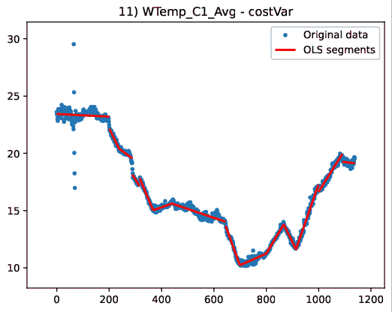
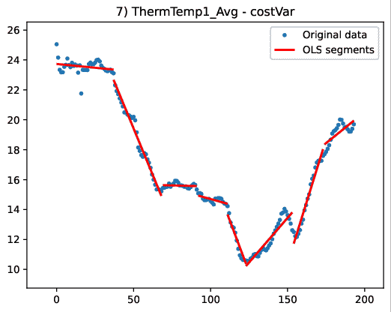
IoT, environmental

Slide 18
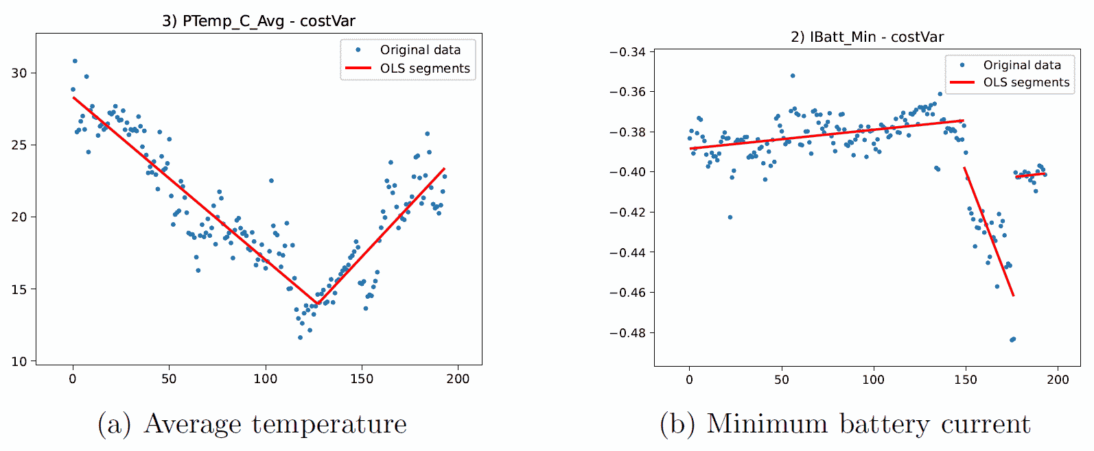
IoT, environmental

Slide 19
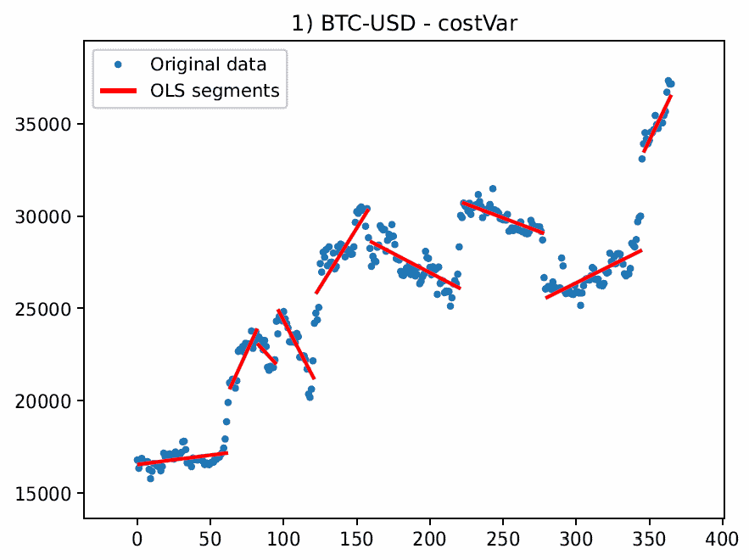
M6, bitcoin exchange rate vs USD

Slide 20
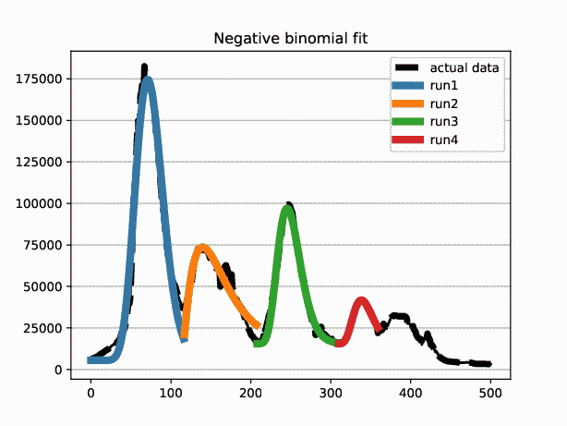
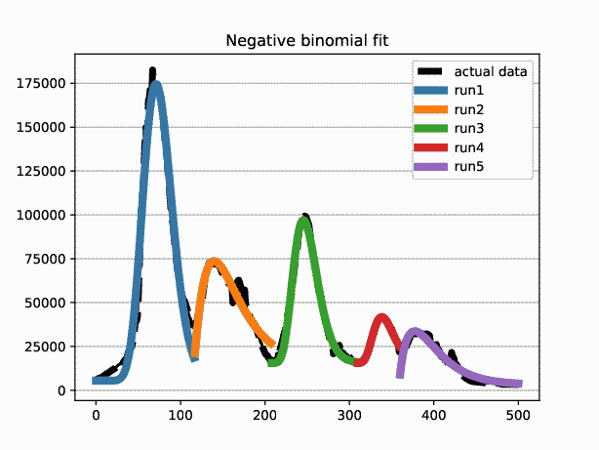
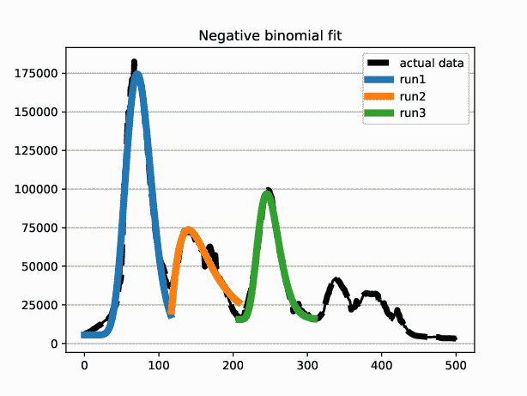
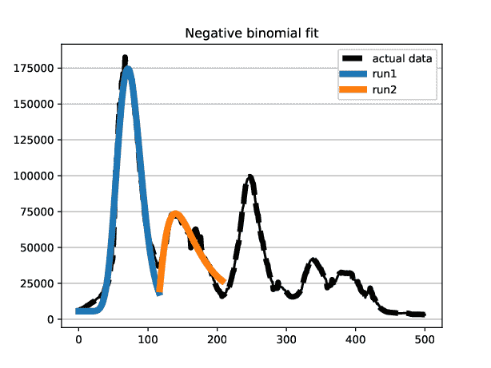
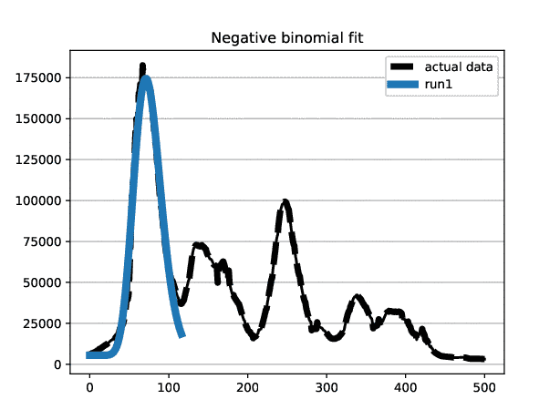
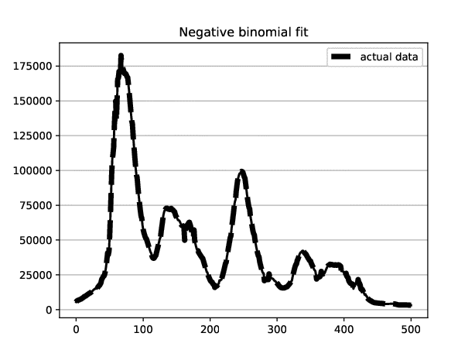
COVID infection, Italy 2022->
Disease spread modelled by negative binomials

