Slide 1
Forecasting-oriented changepoint detection
Vittorio Maniezzo
University of Bologna
vittorio.maniezzo@unibo.it
Livio Fenga
University of Exeter
L.Fenga@exeter.ac.uk

Slide 2
Changepoint detection
Given a univariate time series T, changepoint detection identifies time points where the statistical properties of the data undergo a significant change.
Most common use case is linear piecewise approximation, where the subseries between changepoints are approximated by best fit linear segments.
State-of-the-art methods are implemented in the ruptures package (Truong et al., 2020). Two DP-based examples: Dynp (requires the number of breakpoints as input) and PELT (Killick et al., 2012), which selects the number of breakpoints automatically via a penalized cost (e.g. AIC/BIC)

Slide 3
Regime switching detection
Changepoint detection assumes a finite number of shifts, each permanent (the series settles into a new regime and doesn't return to the old one).
Regime-switching models allow the process to revisit earlier regimes, with switches governed by some rule rather than treated as isolated breaks.
Two classical families:
Threshold-based (deterministic switching rule). SETAR (Tong 1978/1990), TAR, STAR: the AR regime in force at time t is determined by whether a lagged value of the series crosses a threshold (or smoothly transitions in case of STAR).
Markov-switching (latent stochastic switching rule). Markov-Switching Autoregressive model (Hamilton, 1989): regime is an unobserved discrete state following a Markov chain. Used for business-cycle identification (expansion / recession) and, in finance, for volatility regimes (e.g. Markov-switching GARCH).

Slide 4
Modelling and forecasting
Segmenting the time series in order both to model active regimes in the past and forecast future behavior is largely unexplored.
Current changepoint detection methods are designed to model the time series in-sample; segmentation is chosen with no out-of-sample forecasting intent.
Even regime-switching models are built for description, not forecasting.
SETAR: switches deterministically between a fixed, predefined set of regimes — cannot represent structural changes beyond that fixed parametric set.
Markov-switching: regime is latent and only known probabilistically at the forecast origin; multi-step forecasts average over regimes, diluting the regime-specific dynamics of interest for in-sample analysis.
(Clements & Krolzig,1998, find no clear forecasting advantage over linear benchmarks for either SETAR or MS models of US GNP).
We propose to identify time segments using the predictive accuracy of a forecasting model (AR, theta, MLP, … ) as a cost function, in place of the standard in-sample fit criteria (e.g. RSS/likelihood) used by existing segmentation methods.

Slide 5
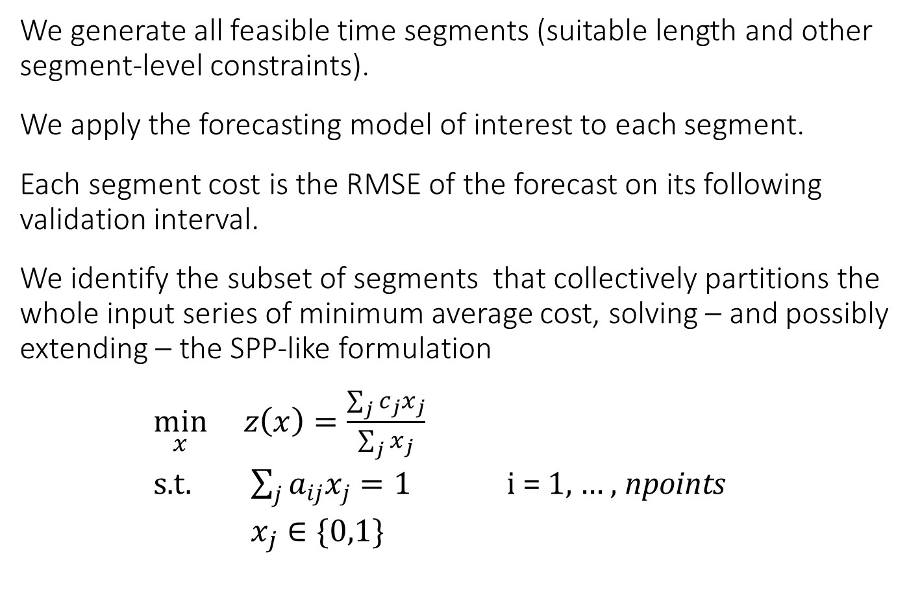
Segment and forecast
We generate all feasible time segments (suitable length and other segment-level constraints).
We apply the forecasting model of interest to each segment.
Each segment cost is the RMSE of the forecast on its following validation interval.
We identify the subset of segments that collectively partitions the whole input series of minimum average cost, solving – and possibly extending – the SPP-like formulation
$\min_{x} z\left(x\right)=\frac{\sum_{j}{c_{j}x_{j}}}{\sum_{j}{x_{j}}}$
s.t. $\sum_{j}{{a_{ij}x}_{j}}=1$ i = 1, … , npoints
$x_{j}∈\{0,1\}$

Slide 6
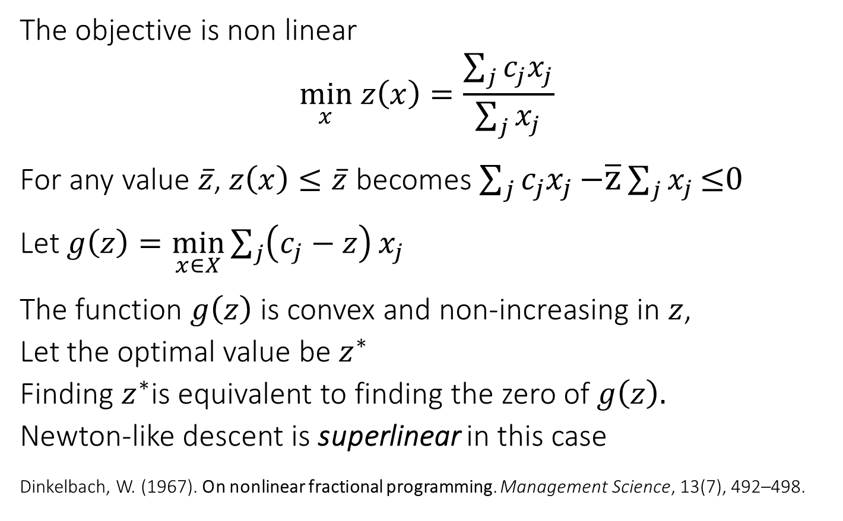
Fractional programming at work
The objective is non linear
$$\min_{x} z\left(x\right)=\frac{\sum_{j}{c_{j}x_{j}}}{\sum_{j}{x_{j}}}$$
For any value $\overline{z}$, $z\left(x\right)≤\overline{z}$ becomes $\sum_{j}{c_{j}x_{j}}\text{−}\overline{\text{z}}\sum_{j}{x_{j}}\text{≤0}$
Let $g\left(z\right)=\min_{x∈X}{\sum_{j}{\left(c_{j}−z\right)}x_{j}}$
The function $g\left(z\right)$ is convex and non-increasing in $z$,
Let the optimal value be $z^{∗}$
Finding $z^{∗}$is equivalent to finding the zero of $g\left(z\right).$
Newton-like descent is superlinear in this case
Dinkelbach, W. (1967). On nonlinear fractional programming. Management Science, 13(7), 492–498.

Slide 7
Testsets
Benchmark sets from the M competitions¹ on time series forecasting:
M3 (micro, industry, macro, finance, demographic, other)
M4 (micro, industry, macro, finance, demographic, other)
5 series randomly selected within each category.
+ a preliminary small set of IoT series.
Forecasting models are autoregressive AR(1), ETS Holt-Winters, theta, random forest.
Code in Python, Gurobi solver, platform desktop Windows 11.
¹ https://en.wikipedia.org/wiki/Makridakis_Competitions

Slide 8
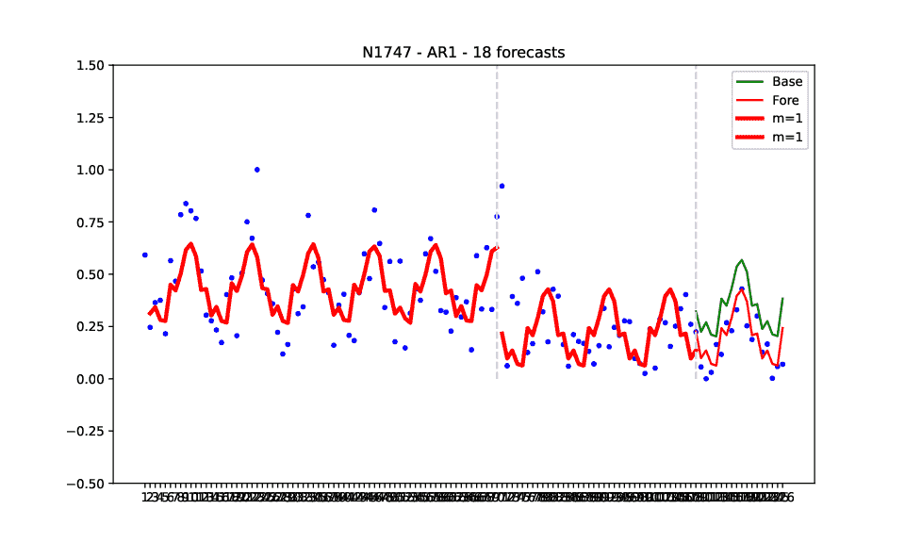
M3, N1747, AR(1)

Slide 9
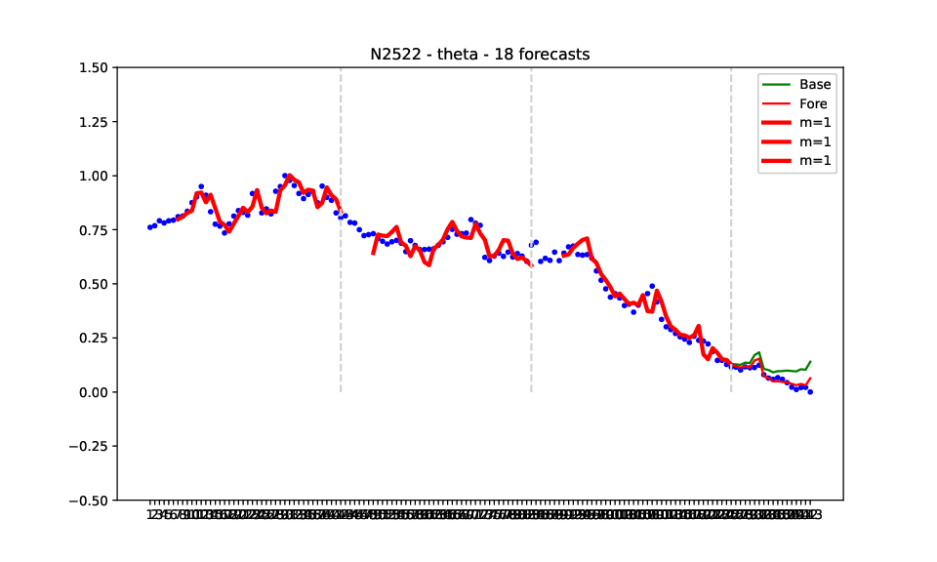

Slide 10
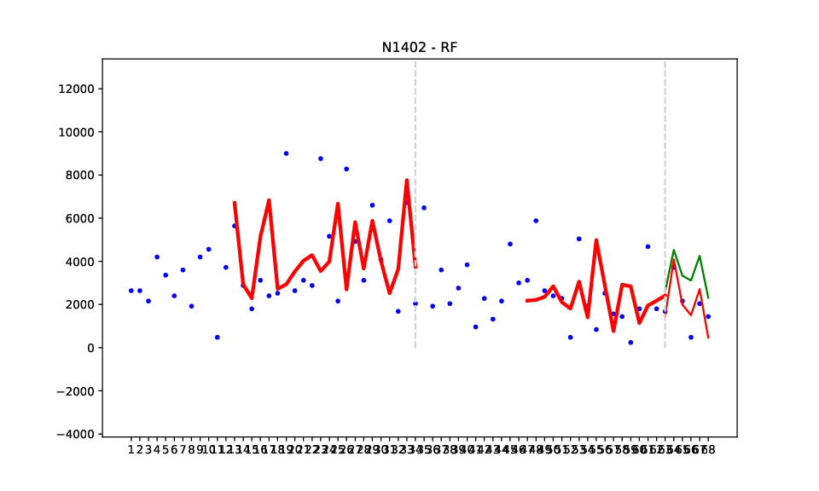

Slide 11
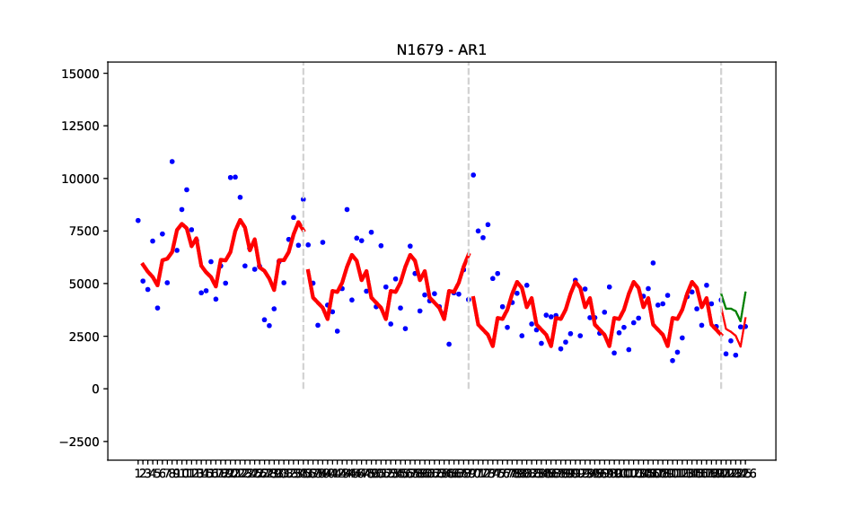

Slide 12
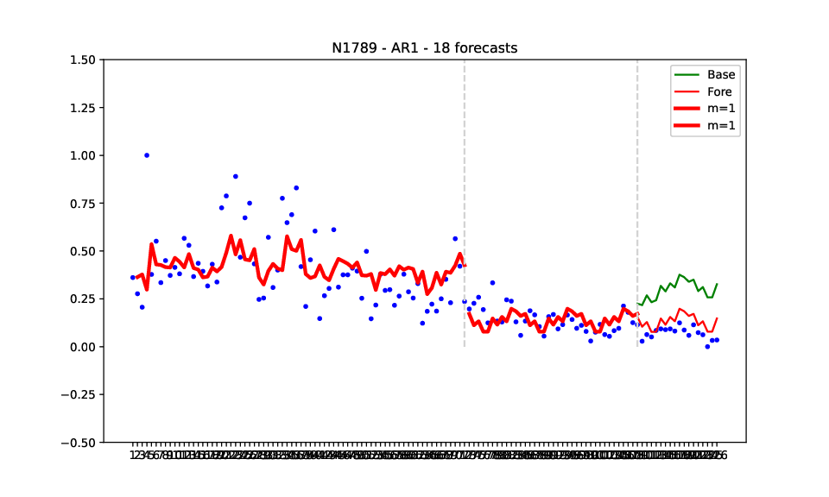

Slide 13
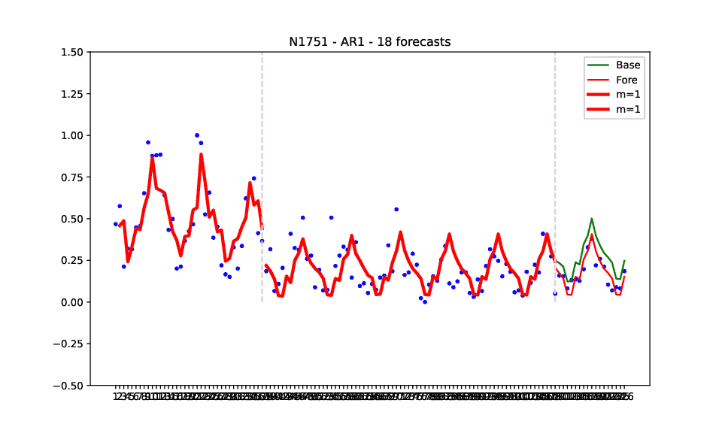

Slide 14
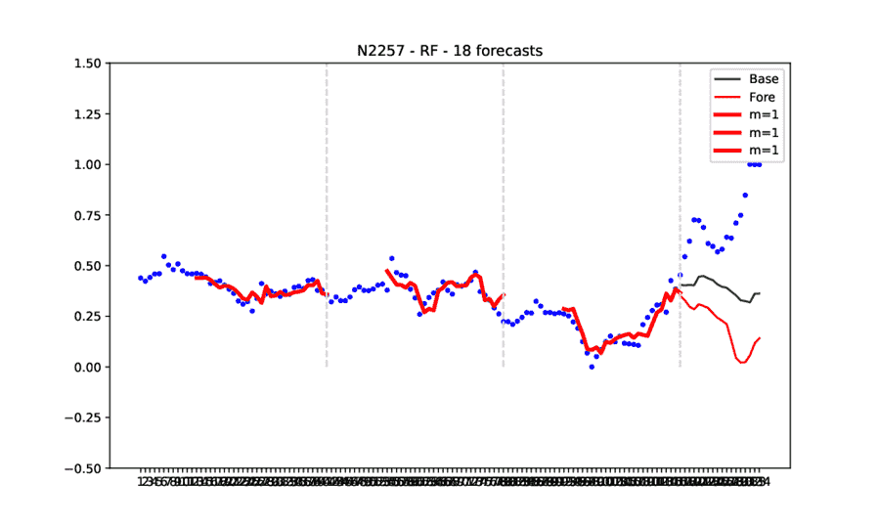
But …

