Slide 1
Fore-and-Back for Changepoint Detection
Vittorio Maniezzo
University of Bologna
vittorio.maniezzo@unibo.it

Slide 2
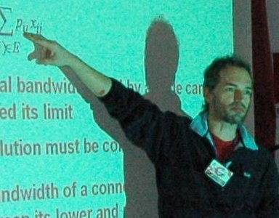
LION-1, Andalo, 2007

Slide 3
The intuition
z
x

Slide 4
Fore-and-Back matheuristic
Basically, an extension of Beam Search (BS).
BS: At each level of the search tree, generates all successors of the current states, but expands only the δ best (δ is the beam width).
F&B extends BS by alternating expansions in opposite search directions and by learning from partial solutions generated in previous iterations.
These learned partial results are then used as a look-ahead mechanism to complete partial solutions when the search proceeds in the opposite direction.
It becomes an exact approach when unlimited computational power is allowed,
it generates bounds on the cost required to complete partial solutions, even though it operates as a primal-only method.

Slide 5
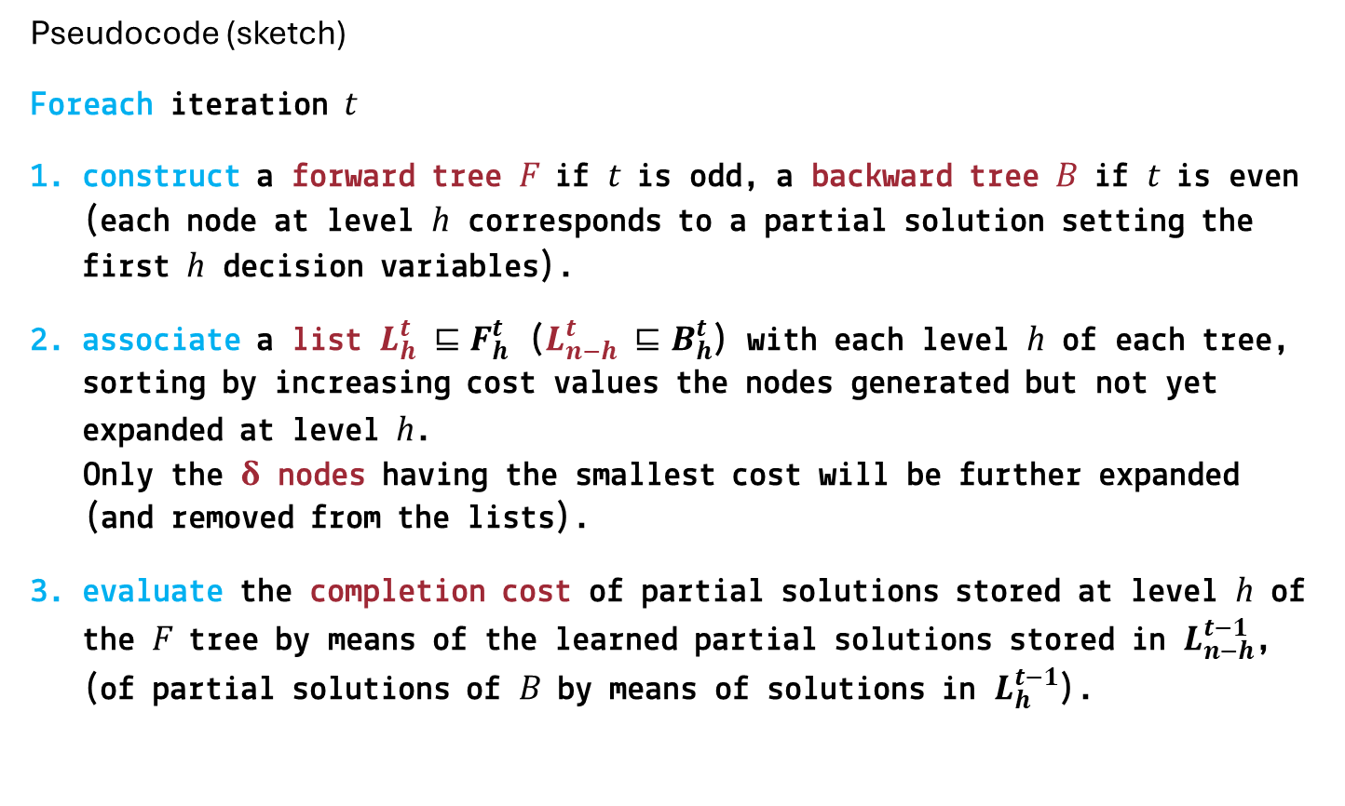
Fore-and-Back matheuristic
Pseudocode (sketch)
Foreach iteration t
construct a forward tree F if t is odd, a backward tree B if t is even (each node at level h corresponds to a partial solution setting the first h decision variables).
associate a list $L_{h}^{t} ⊑F_{h}^{t}$ ($L_{n−h}^{t} ⊑B_{h}^{t}$) with each level h of each tree, sorting by increasing cost values the nodes generated but not yet expanded at level h.
Only the δ nodes having the smallest cost will be further expanded (and removed from the lists).
evaluate the completion cost of partial solutions stored at level h of the F tree by means of the learned partial solutions stored in $L_{n−h}^{t−1}$, (of partial solutions of B by means of solutions in $L_{h}^{t−1}$).

Slide 6
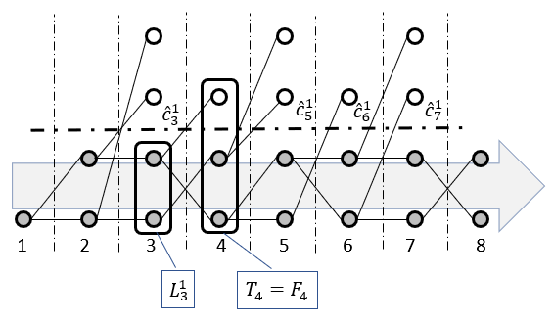
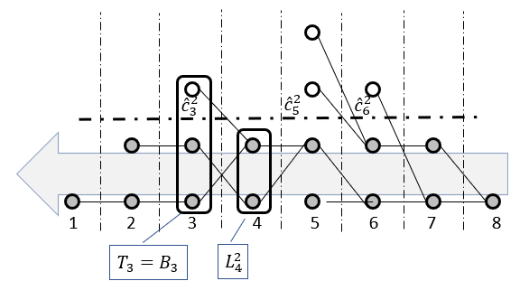
Fore-and-Back matheuristic

Slide 7
Time series segmentation
Time series segmentation asks to partition a time series into distinct, non-overlapping time segments, each characterized by homogeneous patterns or behaviors.
Segmenting a time series entails identifying points of change in the series: temporal shifts, transitions, or abrupt changes that carry critical information.
Change points identify events in a time series where the statistical properties of the data undergo a significant change, contributing to the understanding of:
evolving trends,
prediction of future behavior,
identification of anomalous events.

Slide 8
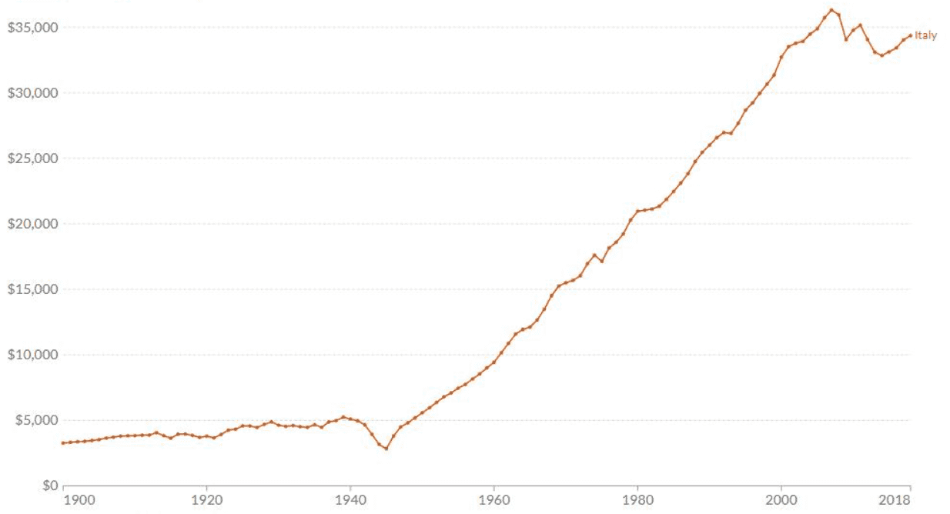
Italian GDP per capita

Slide 9
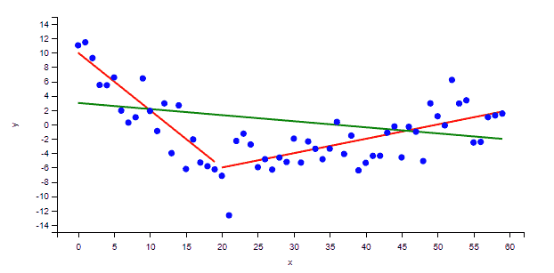
Sub-super-addittivity
Green can be better or worse.
It depends on the cost function.
It depends on how much you penalize the number of lines.

Slide 10
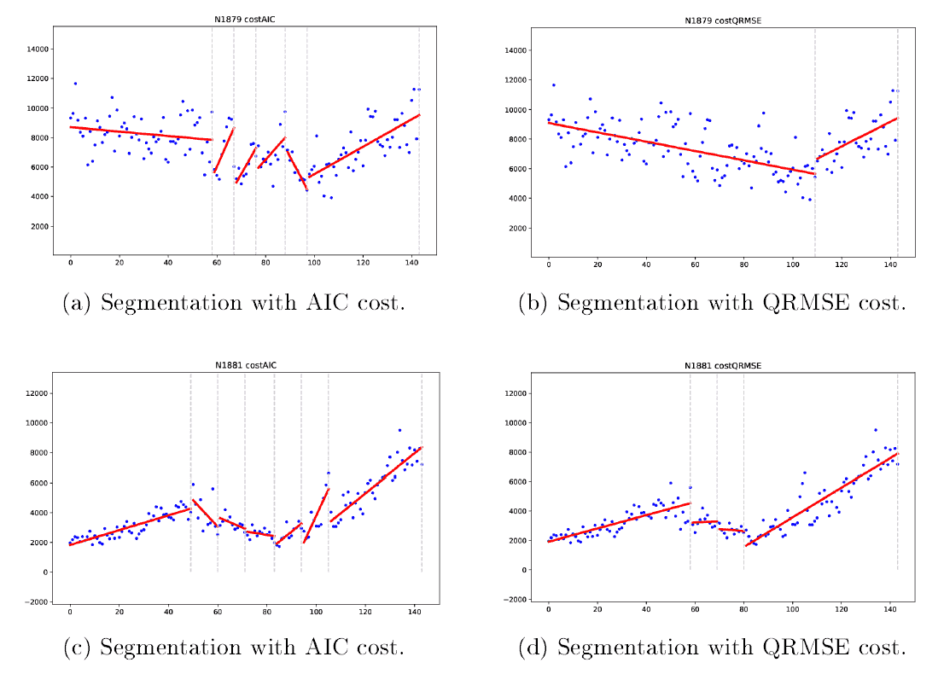
AIC vs. QRMSE

Slide 11
Testsets
Four benchmark sets from the M competitions¹ on time series forecasting:
M3 (micro, industry, macro, finance, demographic, other)
M4 (micro, industry, macro, finance, demographic, other)
M5 (retail data)
M6 (daily adjusted close prices of the financial M6 assets)
A set of IoT series on different physical variables at different sampling frequency (daily or every 60 mins).
Comparison against codes in ruptures² (Truong et al., 2020): DYNP (needs the number of breaks in input), PELT (Killick et al., 2012) optimal only with AIC cost.
Code in C++, platform desktop Windows 11.
¹ https://en.wikipedia.org/wiki/Makridakis_Competitions
² https://centre-borelli.github.io/ruptures-docs/

Slide 12
AIC – M3
 |  |  | FnB |  | PELT |  | DYNP
Name | category | n | n.segm | t.cpu | n.segm | t.cpu | n.segm | t.cpu
M3/N1879 | Industry | 144 | 8 | 0.052 | 2 | 0.062 | 8 | 0.0156
M3/N1881 | Industry | 144 | 8 | 0.054 | 4 | 0.109 | 8 | 0.0156
M3/N1882 | Industry | 144 | 8 | 0.052 | 12 | 0.046 | 8 | 0.015
M3/N1883 | Industry | 144 | 8 | 0.042 | 15 | 0.046 | 8 | 0.015
M3/N1884 | Industry | 144 | 8 | 0.060 | 19 | 0.031 | 8 | 0.031
M3/N1918 | Industry | 144 | 8 | 0.064 | 5 | 0.078 | 8 | 0.015
M3/N2830 | Micro | 104 | 8 | 0.024 | 7 | 0.031 | 8 | 0
M3/N2831 | Micro | 104 | 8 | 0.022 | 10 | 0.031 | 8 | 0.015
M3/N2832 | Micro | 104 | 6 | 0.024 | 4 | 0.062 | 8 | 0
M3/N2833 | Micro | 104 | 8 | 0.022 | 7 | 0.046 | 8 | 0.015
M3/N2834 | Finance | 104 | 8 | 0.026 | 9 | 0.046 | 8 | 0

Slide 13
AIC – M4
 |  |  | FnB |  | PELT |  | DYNP
Name | category | n | n.segm | t.cpu | n.segm | t.cpu | n.segm | t.cpu
Q14640 | Industry | 115 | 2 | 0.036 | 1 | 0.015 | 8 | 0
Q15444 | Industry | 126 | 4 | 0.050 | 3 | 0.031 | 8 | 0.015
Q18148 | Industry | 71 | 5 | 0.006 | 4 | 0.046 | 8 | 0.015
Q18496 | Industry | 126 | 8 | 0.038 | 5 | 0.046 | 8 | 0
Q19604 | Industry | 123 | 8 | 0.038 | 8 | 0.046 | 8 | 0.015
Q19637 | Industry | 123 | 3 | 0.044 | 14 | 0.031 | 8 | 0.015
Q2002 | Macro | 170 | 8 | 0.094 | 11 | 0.078 | 8 | 0.031
Q22221 | Finance | 738 | 8 | 0.713 | 58 | 0.359 | 8 | 0.593
Q5109 | Macro | 866 | 8 | 1.074 | 102 | 0.296 | 8 | 0.828
Q7774 | Micro | 115 | 6 | 0.026 | 3 | 0.078 | 8 | 0.015
Q8030 | Micro | 97 | 8 | 0.022 | 6 | 0.031 | 8 | 0.015

Slide 14
AIC – M6
 |  |  | FnB |  | PELT |  | DYNP
Name | category | n | n.segm | t.cpu | n.segm | t.cpu | n.segm | t.cpu
M6/ABBV | Finance | 253 | 8 | 0.196 | 19 | 0.109 | 8 | 0.062
M6/BTCUSD | Finance | 367 | 8 | 0.246 | 22 | 0.156 | 8 | 0.125
M6/EWG | Finance | 253 | 8 | 0.176 | 15 | 0.109 | 8 | 0.046
M6/EWQ | Finance | 253 | 8 | 0.168 | 14 | 0.125 | 8 | 0.062
M6/EWZ | Finance | 253 | 8 | 0.182 | 16 | 0.125 | 8 | 0.046
M6/GBPUSD | Finance | 263 | 8 | 0.184 | 17 | 0.093 | 8 | 0.078
M6/PYPL | Finance | 253 | 8 | 0.162 | 19 | 0.109 | 8 | 0.062
M6/RBLX | Finance | 253 | 8 | 0.170 | 21 | 0.093 | 8 | 0.046
M6/ROST | Finance | 253 | 8 | 0.172 | 20 | 0.078 | 8 | 0.062
M6/SLV | Finance | 253 | 8 | 0.168 | 23 | 0.109 | 8 | 0.078
M6/USDJPY | Finance | 263 | 8 | 0.182 | 22 | 0.109 | 8 | 0.062

Slide 15
QRMSE – M3
Name | Category | n | t.prec | t.cpu | topt | num.matches | n.fathomed | n.brk | b-f
N1879 | INDUSTRY | 144 | 0.008 | 0.005 | 0.002 | 66 | 34124 | 7 | 5
N1881 | INDUSTRY | 144 | 0.007 | 0.003 | 0.001 | 131 | 61701 | 7 | 4
N1882 | INDUSTRY | 144 | 0.008 | 0.004 | 0.004 | 196 | 88413 | 7 | 5
N1883 | INDUSTRY | 144 | 0.007 | 0.004 | 0.003 | 267 | 117019 | 7 | 4
N2270 | MACRO | 144 | 0.008 | 0.004 | 0.003 | 339 | 149421 | 7 | 4
N2459 | MACRO | 144 | 0.008 | 0.004 | 0.002 | 400 | 174193 | 6 | 4
N2460 | MACRO | 144 | 0.008 | 0.004 | 0.003 | 464 | 210921 | 7 | 5
N2461 | MACRO | 144 | 0.007 | 0.005 | 0.002 | 522 | 240255 | 7 | 4
N2523 | FINANCE | 144 | 0.009 | 0.004 | 0.004 | 584 | 266915 | 7 | 4
N2524 | FINANCE | 144 | 0.009 | 0.005 | 0.003 | 646 | 293345 | 7 | 4
N2525 | FINANCE | 144 | 0.008 | 0.004 | 0.003 | 708 | 318483 | 7 | 4
N2526 | FINANCE | 144 | 0.009 | 0.004 | 0.003 | 769 | 346194 | 7 | 4
N2773 | DEMOGRAPHIC | 138 | 0.008 | 0.004 | 0.003 | 831 | 368531 | 7 | 4
N2774 | DEMOGRAPHIC | 138 | 0.007 | 0.004 | 0.002 | 892 | 387848 | 7 | 4
N2775 | DEMOGRAPHIC | 138 | 0.007 | 0.004 | 0.003 | 953 | 406769 | 7 | 4
N2776 | DEMOGRAPHIC | 138 | 0.007 | 0.005 | 0.004 | 1012 | 426722 | 7 | 4
N1679 | MICRO | 126 | 0.006 | 0.003 | 0.001 | 1070 | 450831 | 7 | 4
N1680 | MICRO | 126 | 0.006 | 0.003 | 0.001 | 1131 | 475371 | 7 | 4
N1681 | MICRO | 126 | 0.006 | 0.002 | 0.001 | 1192 | 497600 | 7 | 3
N1682 | MICRO | 126 | 0.005 | 0.004 | 0.003 | 1250 | 520971 | 7 | 4
N2778 | OTHER | 96 | 0.002 | 0.002 | 0.002 | 1291 | 530569 | 4 | 4
N2779 | OTHER | 96 | 0.002 | 0.002 | 0.001 | 1333 | 541209 | 5 | 4
N2781 | OTHER | 96 | 0.003 | 0.001 | 0 | 1375 | 550652 | 3 | 4
N2782 | OTHER | 96 | 0.004 | 0.001 | 0 | 1417 | 560034 | 4 | 4

Slide 16
QRMSE – M4
Name | Category | n | t.prec | t.cpu | topt | num.matches | n.fathomed | n.brk | b-f
Q13050 | Demographic | 735 | 0.52 | 0.199 | 0.172 | 294 | 2205557 | 7 | 8
Q13073 | Demographic | 699 | 0.456 | 0.176 | 0.172 | 642 | 3674339 | 7 | 7
Q13086 | Demographic | 699 | 0.445 | 0.166 | 0.154 | 1027 | 5447070 | 7 | 7
Q13075 | Demographic | 598 | 0.307 | 0.127 | 0.117 | 1331 | 6721769 | 7 | 7
Q22221 | Finance | 738 | 0.505 | 0.203 | 0.175 | 1963 | 9604633 | 7 | 8
Q23114 | Finance | 611 | 0.316 | 0.135 | 0.123 | 2147 | 10933843 | 7 | 7
Q22468 | Finance | 598 | 0.288 | 0.148 | 0.135 | 2445 | 12130699 | 7 | 7
Q22451 | Finance | 482 | 0.168 | 0.072 | 0.065 | 2632 | 12716218 | 7 | 6
Q15697 | Industry | 737 | 0.524 | 0.31 | 0.271 | 3141 | 15384120 | 7 | 7
Q15691 | Industry | 736 | 0.496 | 0.212 | 0.198 | 3481 | 17432186 | 7 | 8
Q15651 | Industry | 728 | 0.498 | 0.185 | 0.164 | 3803 | 18968434 | 7 | 7
Q15643 | Industry | 725 | 0.49 | 0.224 | 0.19 | 4152 | 20856708 | 7 | 6
Q5109 | Macro | 866 | 0.764 | 0.265 | 0.251 | 4897 | 25540190 | 7 | 7
Q4810 | Macro | 737 | 0.506 | 0.217 | 0.205 | 5255 | 28122257 | 7 | 9
Q4803 | Macro | 726 | 0.484 | 0.17 | 0.147 | 5618 | 29977489 | 7 | 7
Q4802 | Macro | 736 | 0.511 | 0.187 | 0.179 | 5987 | 32004632 | 7 | 8
Q10414 | Micro | 737 | 0.537 | 0.2 | 0.189 | 6702 | 36207186 | 7 | 7
Q10412 | Micro | 722 | 0.509 | 0.191 | 0.153 | 7068 | 37999942 | 7 | 7
Q10403 | Micro | 688 | 0.461 | 0.177 | 0.171 | 7420 | 39544803 | 7 | 8
Q10691 | Micro | 542 | 0.237 | 0.099 | 0.086 | 7622 | 40716701 | 7 | 8
Q23661 | Other | 701 | 0.446 | 0.212 | 0.193 | 8110 | 42867141 | 7 | 8
Q23601 | Other | 699 | 0.444 | 0.193 | 0.187 | 8500 | 44411181 | 7 | 6
Q23646 | Other | 670 | 0.4 | 0.183 | 0.163 | 8830 | 46223265 | 7 | 8
Q23673 | Other | 551 | 0.244 | 0.099 | 0.084 | 9096 | 47125866 | 7 | 7

Slide 17
QRMSE – M5
Name | n | t.prec | t.cpu | topt | num.matches | n.fathomed | n.brk | b-f
M5/5859 | 1941 | 6.74 | 1.243 | 1.024 | 963 | 18552797 | 7 | 6
M5/18055 | 1941 | 6.83 | 1.571 | 1.501 | 2038 | 41416657 | 7 | 9
M5/23793 | 1941 | 6.986 | 1.509 | 1.176 | 3065 | 64324064 | 7 | 8
M5/6344 | 1941 | 6.785 | 2.049 | 1.847 | 4066 | 93861549 | 7 | 12
M5/15559 | 1941 | 6.835 | 1.244 | 1.131 | 5014 | 110859792 | 7 | 7
M5/27444 | 1941 | 6.71 | 1.628 | 1.576 | 6105 | 133856002 | 7 | 9
M5/6776 | 1941 | 6.78 | 1.62 | 1.557 | 7009 | 157277412 | 7 | 11
M5/13272 | 1941 | 6.735 | 1.863 | 1.636 | 7983 | 185133115 | 7 | 12
M5/28437 | 1941 | 6.839 | 1.479 | 1.35 | 8933 | 206245302 | 7 | 8

Slide 18
QRMSE – M6
Name | n | t.prec | t.cpu | topt | num.matches | n.fathomed | n.brk | b-f
ABBV | 253 | 0.034 | 0.015 | 0.014 | 100 | 122013 | 7 | 5
COP | 265 | 0.037 | 0.017 | 0.016 | 227 | 276124 | 7 | 5
HST | 265 | 0.044 | 0.005 | 0.005 | 227 | 294184 | 7 | 2
PYPL | 253 | 0.04 | 0.018 | 0.016 | 369 | 423530 | 7 | 5
ROST | 253 | 0.037 | 0.016 | 0.015 | 450 | 550858 | 7 | 5
RBLX | 253 | 0.038 | 0.016 | 0.015 | 550 | 672188 | 7 | 5
EWG | 253 | 0.039 | 0.004 | 0.004 | 550 | 690884 | 7 | 2
EWQ | 253 | 0.038 | 0.004 | 0.003 | 550 | 711664 | 7 | 2
EWZ | 253 | 0.037 | 0.006 | 0.005 | 550 | 730103 | 7 | 2
SLV | 265 | 0.042 | 0.007 | 0.006 | 550 | 749526 | 7 | 2
VXX | 265 | 0.043 | 0.03 | 0.027 | 550 | 782110 | 7 | 2
BTCUSD | 367 | 0.093 | 0.045 | 0.041 | 719 | 1100469 | 7 | 6
EURCHF | 263 | 0.038 | 0.005 | 0 | 719 | 1100723 | 0 | 2
EURUSD | 263 | 0.038 | 0.001 | 0.001 | 719 | 1100977 | 0 | 2
GBPUSD | 263 | 0.039 | 0.001 | 0.001 | 719 | 1101231 | 0 | 2
USDJPY | 263 | 0.044 | 0.007 | 0.006 | 719 | 1122824 | 7 | 2

Slide 19
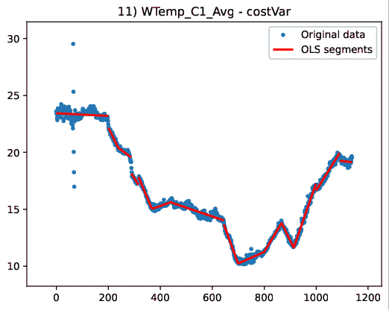
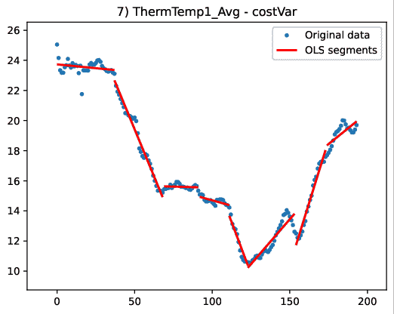
IoT, environmental

Slide 20
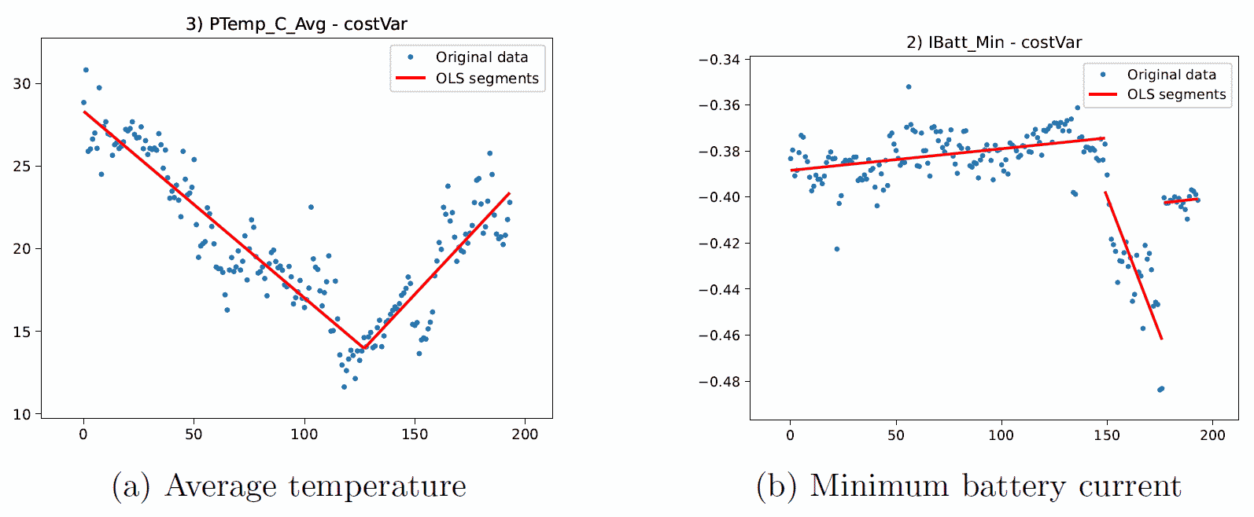
IoT, environmental

Slide 21
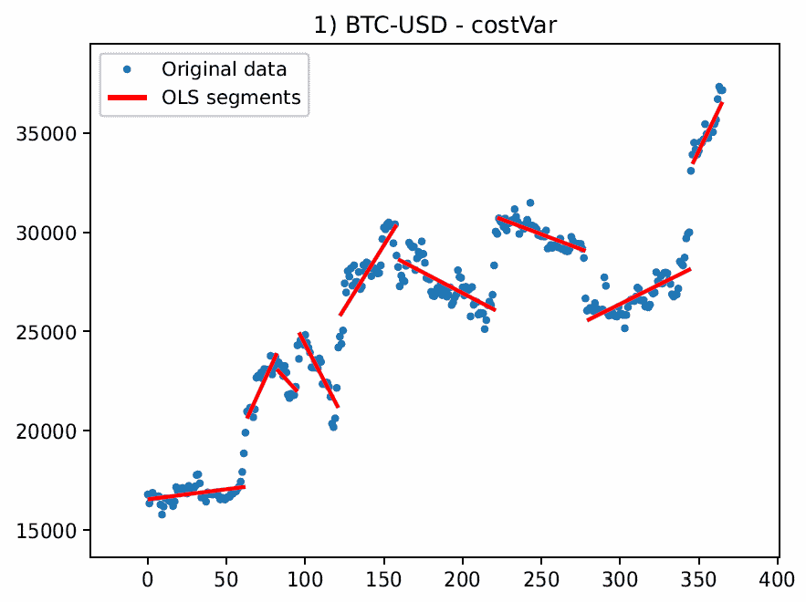
bitcoin vs USD exchange rate

