Slide 1

Automatic Fruit Ripeness Detection and Quality Grading Using Image Analysis
DSA0216-Computer Vision With Open CV For Modern AI
PRESENTED BY:
R .Jayanth(192424286)
S .Manigandan (192424057)
GUIDE:
DR. S . Senthilvadivu DR. T . Kumaragurubaran
PROFESSOR.

Slide 2


ABSTRACT
Automatic Fruit Ripeness Detection and Quality Grading Using Image Analysis is a smart agricultural system designed to automatically identify the ripeness level and quality of fruits using computer vision techniques. The system captures fruit images through a camera and processes them using image preprocessing methods such as resizing, noise removal, and color correction. Important features like color, texture, shape, and size are extracted to analyze the fruit condition accurately. Machine learning or deep learning algorithms are then applied to classify fruits into different ripeness stages such as unripe, semi-ripe, and fully ripe. The system can also detect defects, bruises, and surface damage for quality grading. This automated approach reduces manual effort, minimizes human error, and ensures consistent grading standards.

Slide 3
INTRODUCTION
Fruit ripeness and quality assessment are important in agriculture and the food industry..
Traditional grading methods are done manually, which can be time-consuming and inconsistent.
Human inspection may lead to errors due to fatigue and subjective judgment.
Image processing and computer vision provide an automated solution for fruit analysis.
Machine learning algorithms help classify fruits into different ripeness levels accurately.
The technology reduces post-harvest losses and improves supply chain efficiency

Slide 4
OBJECTIVES
Develop an automated system to detect the ripeness level of fruits using image analysis techniques.
Classify fruits into different quality grades based on color, texture, and size features extracted from images.
Reduce human error and labor costs in fruit sorting and quality assessment processes.
Implement real-time detection and grading to facilitate faster processing in agricultural and supply chain systems.
Enhance post-harvest management by providing accurate and consistent ripeness and quality information for fruits.

Slide 5
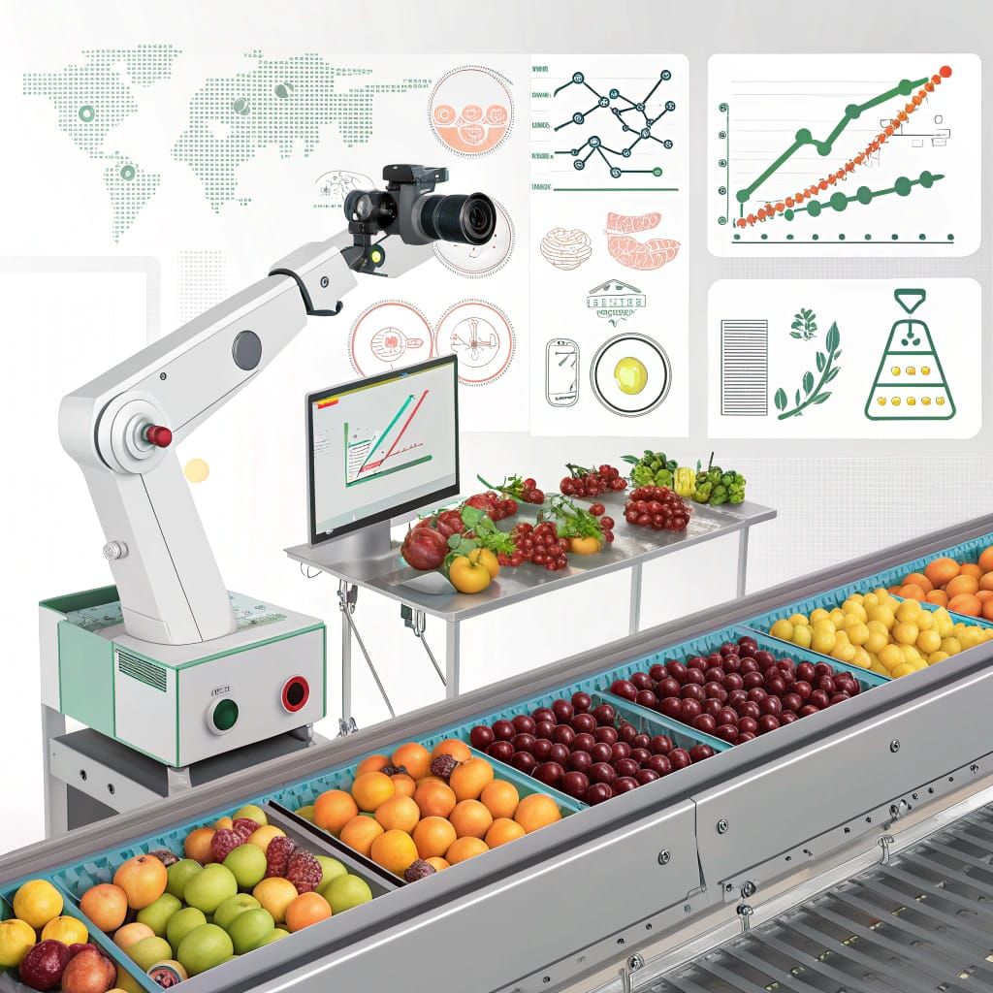
METHODOLOGY
Image Acquisition: Capture fruit images using a digital camera or mobile camera under controlled lighting conditions.
Image Preprocessing: Resize images, remove noise, adjust brightness, and enhance contrast for better analysis
Feature Extraction: Extract important features such as color (RGB/HSV values), texture (GLCM), shape, and size.
Performance Evaluation: Measure accuracy, precision, recall, and F1-score to evaluate model performance.
Result Display: Display the predicted ripeness level and quality grade in real time.

Slide 6
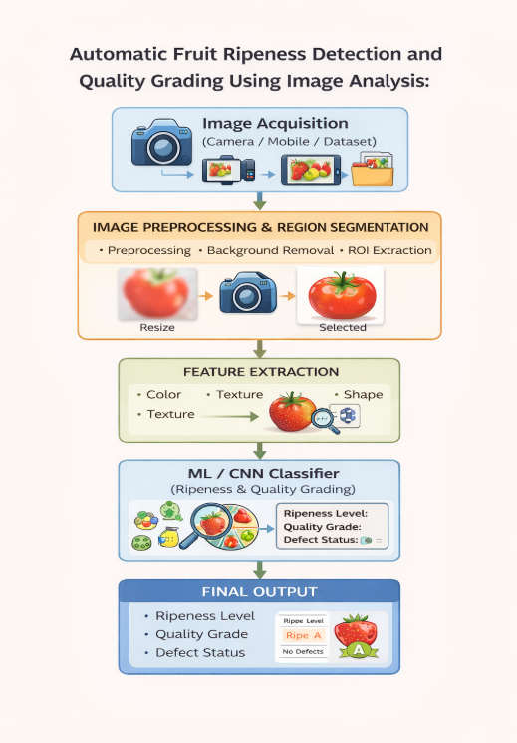
SYSTEM ARCHITECTURE

Slide 7
LITERATURE REVIEW
Author / Year | Method / Technique | Fruit Type | Key Features Used | Accuracy / Outcome | Remarks
Zhang et al., 2023 | Image processing (RGB & HSV analysis) | Apple | Color, Shape | ~85% | Works well under controlled lighting
Rahman et al., 2024 | Convolutional Neural Networks (CNN) | Banana | Colour, Texture, Shape | >90% | Automated feature extraction, high accuracy
Li & Sun, 2025 | Support Vector Machine (SVM) | Tomato | Color Histogram, Shape, Texture | 87% | Needs manual feature extraction, good for small datasets
Wu et al., 2024 | Hyperspectral Imaging | Strawberry | Spectral Features (Sugar, Firmness) | 95% | Very high accuracy, but requires expensive hardware

Slide 8
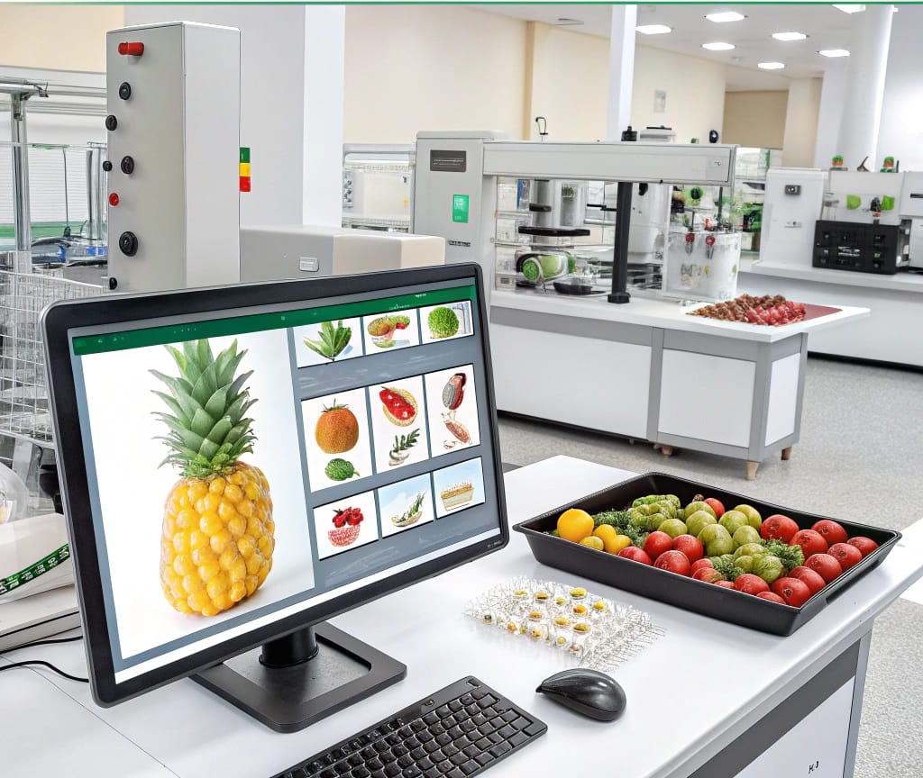
MODULE 1-Fruit Image Preprocessing and Region Segmentation
Capture fruit images using camera or dataset.
Resize and normalize images to a standard size.
Remove noise using filtering techniques.
Enhance image quality through contrast and brightness adjustment.
Extract the Region of Interest (ROI) for further analysis.
Segment the fruit from the background using thresholding or clustering

Slide 9
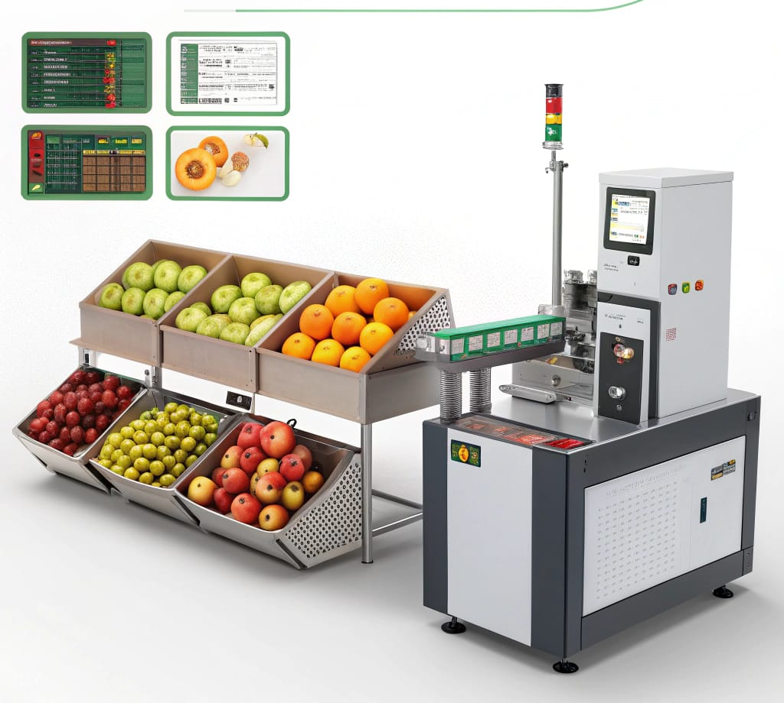
MODULE 2 - Ripeness Detection and Quality Classification
Extract HSV color intensity features to identify ripeness changes.
Calculate texture features (entropy, contrast, GLCM metrics) for defect evaluation.
Train KNN/SVM classifiers for multi-stage ripeness and quality grading.
Apply threshold-based rules for simple color/defect-based classification.
Assess classification using accuracy, confusion matrix, and feature visualization.

Slide 10
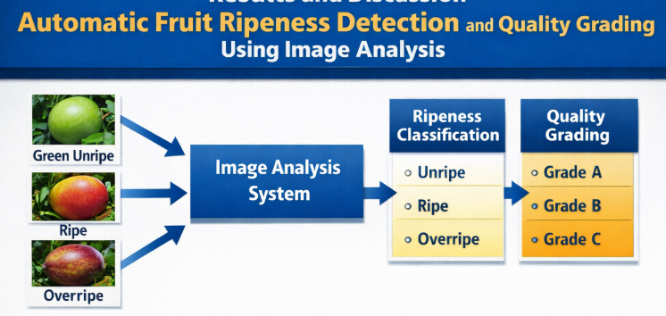
RESULTS AND DISCUSSION
High Ripeness Classification Accuracy – The system successfully identified unripe, ripe, and overripe fruit.
Effective Quality Grading – Fruits were automatically categorized into Grade A, B, and C based on size, shape, and surface defects.
Reduced Manual Effort and Time – Automated image processing significantly decreased human intervention.
Robust Performance Under Different Conditions – The model maintained stable performance under varying lighting and background conditions, making it suitable for real-time industrial applications.

Slide 11
CONCLUSION
The system accurately detects fruit ripeness and quality using image processing.
Color and texture features help classify fruits more reliably than manual inspection.
Automation improves speed, consistency, and reduces human error.
The model is flexible and can work with different fruit types.
The project supports smarter, technology-driven agricultural practices.
The system helps reduce post-harvest losses by identifying overripe or defective fruits early.
It provides a strong foundation for developing advanced smart-farming and automated grading systems.

Slide 12
FUTURE ENHANCEMENT
.
Implement advanced deep learning models (CNN) for better accuracy.
Develop a mobile app for on-field fruit analysis.
Extend the system to support multiple fruit types.
Use cloud-based data storage and monitoring systems.
Add internal defect detection using hyperspectral imaging.
Improve performance under different lighting conditions.
Deploy the system on a large industrial scale.

Slide 13
REFERENCES
Morshed, M. S., Ahmed, S., Ahmed, T., Islam, M. U., & Rahman, A. B. M. A. — Fruit Quality Assessment with Densely Connected Convolutional Neural Network (Dense Net). Ar Xiv preprint, 2022.
Liu, Y., Li, M., & Ma, Q. — Efficient Apple Maturity and Damage Assessment: A Lightweight Detection Model with GAN and Attention Mechanism. Ar Xiv preprint, 2023
Oli sah, C. C., Trewhella, B., Li, B., Smith, M. L., Winstone, B., Whitfield, E. C., … Fernández, F. — CNN Ensemble Learning for Hyperspectral Imaging-based Blackberry Fruit Ripeness Detection in Uncontrolled Farm Environment. ar Xiv preprint, 2024.
Luo, D., Luo, R., Cheng, J., & Liu, X. — Quality detection and grading of peach fruit based on image processing method and neural networks in agricultural industry. Frontiers in Plant Science, 2024.

Slide 14


