Slide 1

PAPL (M30235) UXDI (M32605)
Lecture 8
AI, Debugging and Coverage
AI
Debugging
Test coverage

Slide 2
AI

Slide 3
AI
Tech news
Microsoft Imagine Cup
  Startup competition: the deadline is 28 Feb 2027 to submit a student project pitch.
  $100000 prize and mentorship from Microsoft.
  Entrants receive Azure credits, access to AI models and startup incubator support.
  Ideal launchpad for turning projects into real products.
Model Context Protocol (MCP):
  Standard connecting AI models directly to external tools and data
  E.g., configure an MCP server so Copilot can query SQLite databases, inspect git history or run CLI tools directly from chat.
  Eliminates manual copy-pasting (waste of tokens), as data/tools are exposed directly to the model.
  A tutorial is here: Build an MCP server - Model Context Protocol

Slide 4
AI
Student opportunities and projects
TreePrep: treeprep.com
  Free coding platform built by a student for technical interview preparation.
  Learn patterns and concepts for coding problems.
  Features in-built code visualisation and interview-style follow-up questions.
Summer 2027 Research Internship Scheme:
  The university research internship scheme for students is open.
  Applications open in March 2027; look out for an email from Research and Innovation.

Slide 5
AI
Using Copilot effectively
Copilot’s assistance is ideal with writing repetitive code, boilerplate, syntax fixes, and test cases.
It does not replace software architecture knowledge or code review.
Even in the future, someone should understand the AI-generated code.
Inline suggestions predict the next few tokens or lines as you write code.
Copilot Chat explains code, plans multi-step edits, and refactors logic.
Learn more in GitHub's guide:
Best practices for using GitHub Copilot

Slide 6
AI
Prompt and context
Output quality depends directly on the context provided.
Keep relevant files open in the editor; close unrelated files to prevent context dilution.
In Copilot Chat, reference exact files with #file or highlight specific code.
State requirements explicitly:
  Follow naming conventions
  Code style
  Architecture patterns and constraints.
Don’t trust generated code; always verify logic, review diffs, and run automated tests.

Slide 7
Debugging

Slide 8
Debugging
Flutter DevTools and layout issues
Let’s try again the Flutter DevTools suite from the VS Code status bar or Command Palette.
The Flutter Inspector visualises the widget tree in real time.
“Select Widget Mode” highlights a widget on the device when selected in the tree.
“Layout Explorer” visualises flex containers (Row, Column) and constraint bounds.
Yellow and black hazard stripes indicate a render flex overflow where content exceeds available space.
Notes:
1. Start debugging with F5 on an Android emulator or device.
2. From the home screen, select any film to open its details page in lib/views/movie_listing.dart.
3. Locate a widget for example PrimaryButton inside the build method of lib/views/movie_listing.dart, and paste the following subtotal Row directly above it:
Row(
children: [
Text(
'Current ticket subtotal for ${widget.movie.title}:',
style: const TextStyle(fontWeight: FontWeight.bold),
),
const SizedBox(width: 8),
Text(
'£$widget.movie.ticketPrice * _quantity',
style: const TextStyle(fontWeight: FontWeight.bold),
),
],
),
const SizedBox(height: 12),
4. Save the file to trigger hot reload.
5. Observe the two symptoms on the screen:
- The subtotal displays raw text such as £10.0 * 0 instead of a calculated number, because $ without curly braces only interpolates the immediate identifier.
- Yellow and black hazard stripes appear on the right edge of the screen, and the debug console reports a RenderFlex overflow.
6. In lib/views/movie_listing.dart, set a breakpoint in the gutter margin next to line 26 inside _addToOrder().
7. In the running app, select a ticket quantity such as 2 in the dropdown and tap Add to order.
8. When execution halts at the breakpoint:
- Open the variables pane on the left to inspect _quantity and widget.movie.ticketPrice.
- In the debug console, evaluate widget.movie.ticketPrice * _quantity to verify that the expression computes the correct total in memory.
9. Press F5 to resume execution.
10. Open the Command Palette (Ctrl + Shift + P on Windows or Cmd + Shift + P on macOS), run Flutter: Open DevTools, and select the Flutter Inspector.
11. Enable Toggle Select Widget Mode (the crosshair icon) in DevTools and tap the hazard stripes on the screen to highlight the overflowing Row in the widget tree.
12. Switch to the Layout Explorer tab to view the constraint diagram, noting that the Row children exceed the available parent width because the text cannot shrink without a flexible wrapper.
13. In lib/views/movie_listing.dart, replace the subtotal Row with the corrected version:
Row(
children: [
Expanded(
child: Text(
'Current ticket subtotal for ${widget.movie.title}:',
style: const TextStyle(fontWeight: FontWeight.bold),
),
),
Text(
'£${(widget.movie.ticketPrice * _quantity).toStringAsFixed(2)}',
style: const TextStyle(fontWeight: FontWeight.bold),
),
],
),
const SizedBox(height: 12),
14. Save the file and trigger hot reload.
15. Verify that the hazard stripes disappear, the label text wraps neatly to fit the screen, and changing the quantity dropdown recalculates the subtotal dynamically.

Slide 9
Test coverage

Slide 10
Test coverage
Measuring automated tests
Test coverage measures the proportion of code executed while running automated tests.
Run tests and export a Linux Coverage (LCOV) trace file:
flutter test --coverage
Line execution data is written to coverage/lcov.info.
Automated pipelines and teams use coverage metrics to discover untested logic.
More in the Flutter guide: Testing Flutter apps

Slide 11
Test coverage
Visualising coverage in VS
You can get a Flutter Coverage extension that parses coverage/lcov.info directly inside the editor.
You should see an overall line coverage and open the file coverage tree.
Other extensions like coverage gutters highlight covered lines in green and untested branches in red.
Focus test effort on models, calculations, database queries and state logic.
Recommended extension: Flutter Coverage - Visual Studio Marketplace

Slide 12
Test coverage
Limitations and verification
High coverage means lines ran; it does not guarantee that tests assert correctness.
A test without an expect still marks lines green in coverage reports.
Verify tests catch bugs: deliberately break a calculation or database query.
Running tests against broken code must produce an immediate test failure.
Coverage highlights blind spots, but meaningful assertions protect against regressions.

Slide 13
Demo 4
Union of Worksheet 7 and Worksheet 8 exercises: SQLite bookings, past bookings, tests and working with AI.
Test coverage and a test folder that mirrors lib carry a significant portion of the marks.
Demonstrate in your own timetabled practical session.
You can only do one demo in each window.
More information on the web page: manighahrmani.github.io/sandwich_shop/

Slide 14
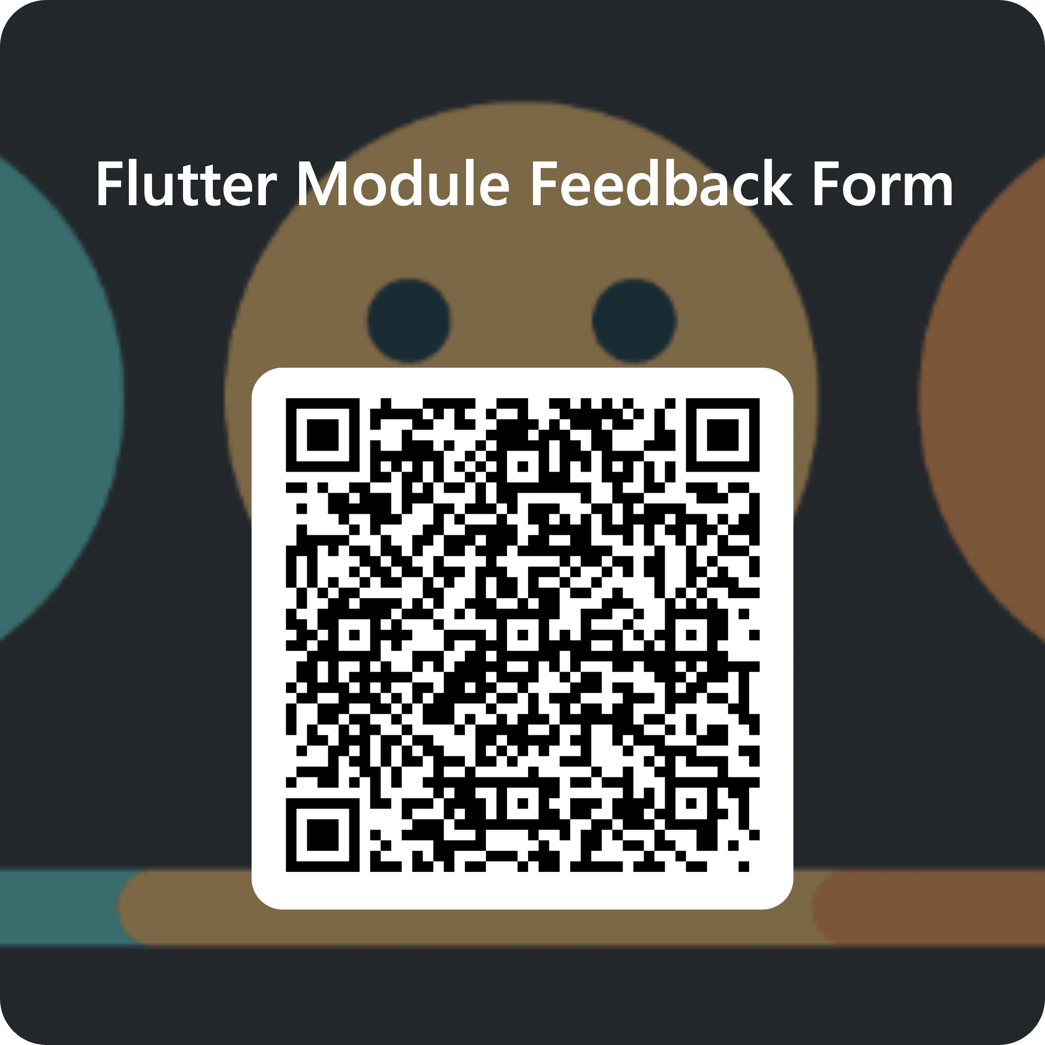
Module feedback
Give us your feedback, comments, criticisms, or insults by filling out the following form.
It’s anonymous; you need to sign in via your student account, but your details aren’t recorded.
Use this link or the QR code: forms.cloud.microsoft/e/88jd4UGAui

