Slide 1

PAPL (M30235) UXDI (M32605)
Lecture 7
Emulators and SQLite
Emulators
SQL databases
SQLite in Flutter

Slide 2
Emulators

Slide 3
Emulators
News
Deep Learning Projects:
  Dr Stefana Juncu (from Psychology) and Dr Gelayol Golcarenarenji (Computing) propose two projects.
    Deep Learning for Forensic Facial Age Progression
    Generative AI for Fair Eyewitness Lineups
  If you’re interested in having ML/DL in your CV, let me know.

Slide 4
Emulators
Leaving the browser
Some packages call native code on the device, so they do not work on the web.
sqflite is one of them: it talks to SQLite in Android, iOS and macOS.
An emulator is a virtual phone that runs on your computer.
A physical phone could work too.
Pick the device in the VS Code status bar, or list devices in the terminal: flutter devices
For a guide, check the setup and an Android emulator guide on Flutter’s documentation page: Set up Android development

Slide 5
Emulators
Data on the device
The app writes its files to its own private folder on the device.
These files survive a restart of the app.
Uninstalling the app or clearing its storage deletes them.
Optionally, if you want to inspect the database, adb (Android Debug Bridge) command lets you copy files from the device to inspect them.

Slide 6
SQL databases

Slide 7
SQL databases
SQL databases
We need to choose where to store data.
Fixed data, or data that doesn’t need to be (re)written often, can be shipped with the app as JSON
A few small settings (that can be stored as key-values) can be handled via the shared preferences package
A growing list of records to search and sort (multiple read and write operations) done on the SQL database
MySQL and PostgreSQL run on a server; SQLite is a single file on the device; No server.
Flutter's recipe: Persist data with SQLite

Slide 8
SQL databases
Tables, rows and keys
A table has named, typed columns; each row is one record.
A primary key gives every row a unique id.
CREATE TABLE notes (
id INTEGER PRIMARY KEY AUTOINCREMENT,
title TEXT NOT NULL,
rating REAL
);
INTEGER, TEXT and REAL hold whole numbers, strings and decimals.
NOT NULL means a value is required.

Slide 9
SQL databases
Tables, rows and keys
INSERT INTO notes (title, rating) VALUES ('First note', 4.5);
SELECT * FROM notes ORDER BY id DESC;
SELECT MAX(id) FROM notes;
INSERT adds a row; SELECT reads rows.
ORDER BY ... DESC sorts from highest to lowest.
MAX returns the largest value, or NULL if the table is empty.
If you need a refresher on SQL, check out this SQLite Tutorial

Slide 10
SQLite in Flutter

Slide 11
SQLite in Flutter
Opening a database
You need to install two packages:
flutter pub add sqflite path
(path is the library to handle locations of files.)
You can open a connection to a database with:
final String folder = await getDatabasesPath();
final Database db = await openDatabase(
join(folder, 'notes.db'),
version: 1,
onCreate: createTables,
);
openDatabase creates the file the first time and reopens it after that.
onCreate would be a function that runs only once, when the file is created; createTables runs the CREATE TABLE with db.execute.
Keep one shared helper (a singleton) that owns the connection.

Slide 12
SQLite in Flutter
Rows are Maps
Each row comes back as a Map<String, Object?>, much like JSON in Lecture 6.
await db.insert('notes', <String, Object?>{
'title': 'First note',
'rating': 4.5,
});
final List<Map<String, Object?>> rows =
await db.query('notes', orderBy: 'id DESC');
insert and query build the INSERT and SELECT for you.
A model class turns rows into objects with toMap and fromMap.

Slide 13
SQLite in Flutter
Testing without a device
sqflite_common_ffi runs SQLite on your computer, so tests need no emulator.
flutter pub add --dev sqflite_common_ffi
sqfliteFfiInit() gets SQLite ready tests.
openDatabase(inMemoryDatabasePath) opens a temporary database, not a saved file.
We need setUp to run before each test: open an empty database and create its tables.
tearDown runs afterwards, even if the test fails: await db.close() closes the database and discards its data.
This keeps each test independent of the others.

Slide 14
Demo 4
Union of Worksheet 7 and Worksheet 8 exercises: SQLite bookings, past bookings, tests and working with AI.
You must run this demo on an Android emulator.
Or set it up on your OS or actual mobile phone.
Demonstrate in your own timetabled practical session.
You can only do one demo in each window.
More information on the web page: manighahrmani.github.io/sandwich_shop/

Slide 15
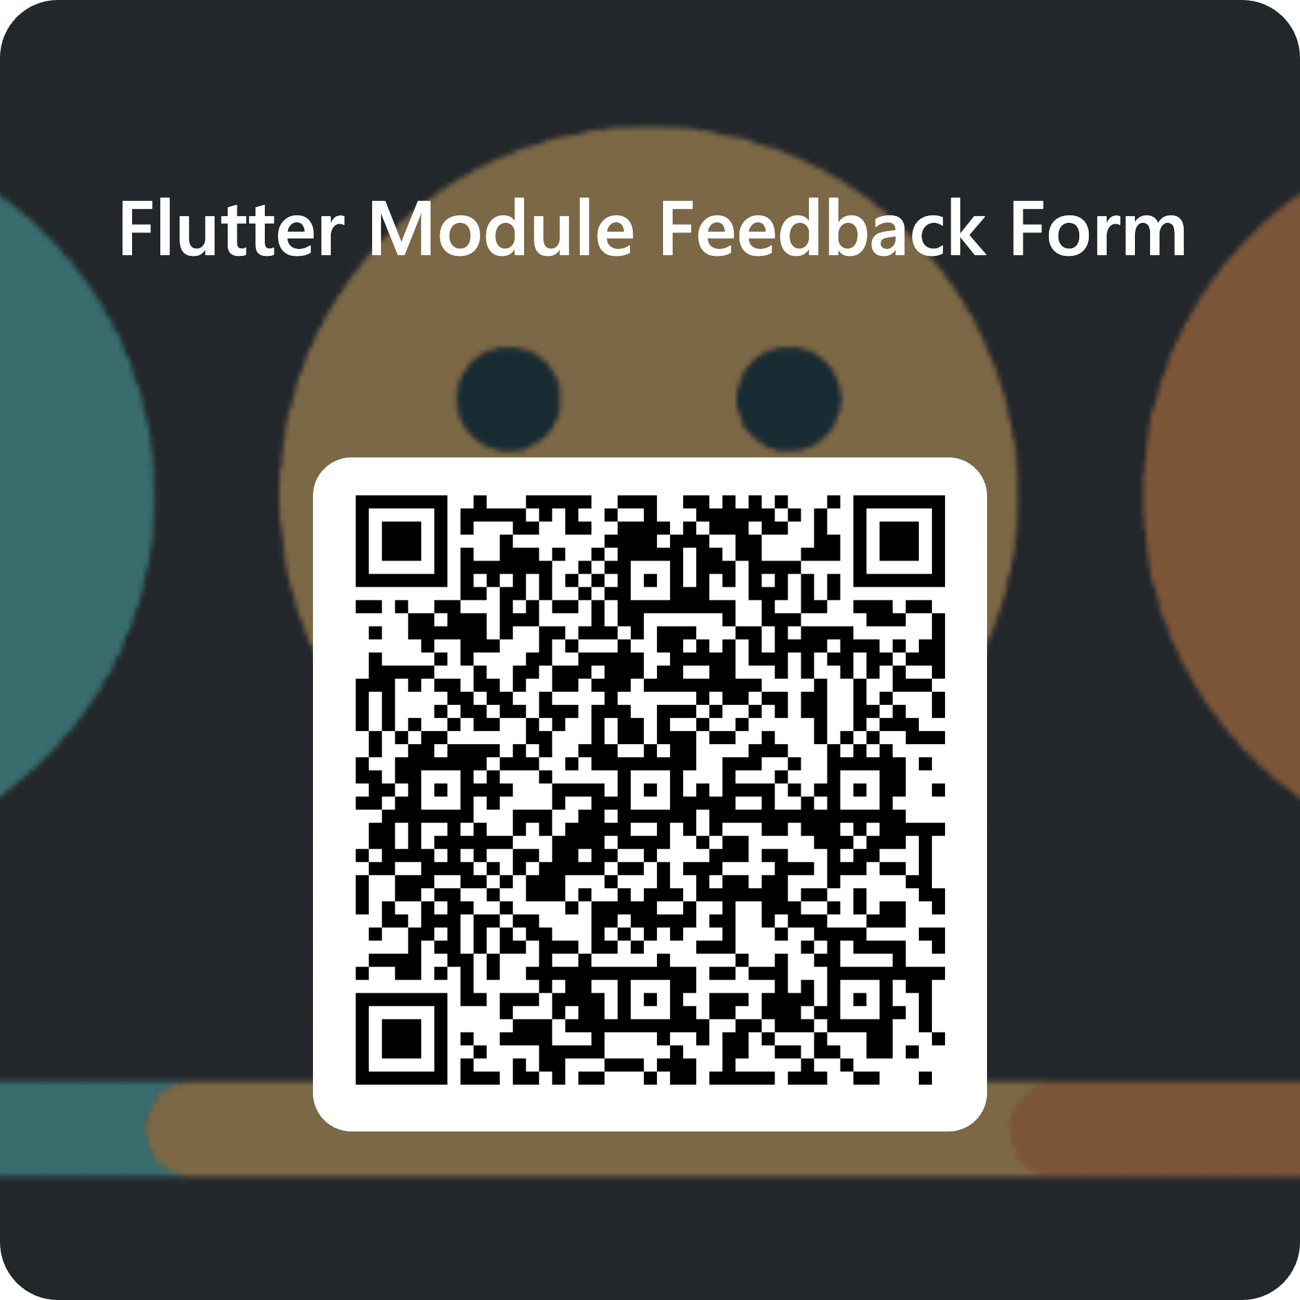
Module feedback
Give us your feedback, comments, criticisms, or insults by filling out the following form.
It’s anonymous; you need to sign in via your student account, but your details aren’t recorded.
Use this link or the QR code: forms.cloud.microsoft/e/88jd4UGAui

