Slide 1

PAPL (M30235) UXDI (M32605)
Lecture 4
Testing
Automated Testing
Unit testing
Widget testing

Slide 2
Automated Testing

Slide 3
Testing
News?
Become a Course Representative:
  Shape teaching and assessment.
  CV experience in leadership, advocacy, and public speaking …
Santander Brighter Futures Grants:
  Ten students receive £1,000 to spend freely on rent, bills, or study materials.
  5-minute application. Closes 3 December.
  Apply here: app.santanderopenacademy.com/en/program/santander-brighter-futures-grants-2026
Dual Degree (Computer Science only):
  Do an extra year in Canada (Brock University) and finish with two degrees for (almost) the price of one.
  Good marks from first year (+60%) and good maths.
  Still have 2-3 places, and the possibility for transfer is closed at the end of October.
  Contact janka.chlebikova@port.ac.uk
One more thing on Discord …

Slide 4
Testing
What’s automated testing
Manual testing, testing an application by hand, is slow and error-prone.
You click through the app, check the screen, and repeat after every change.
Automated tests run in seconds and, if they are designed well, can catch bugs early on.
Tests also document expected behaviour: a new team member reads the tests to understand what the code should do.
(That’s in addition to documentation, which we will learn about later.)

Slide 5
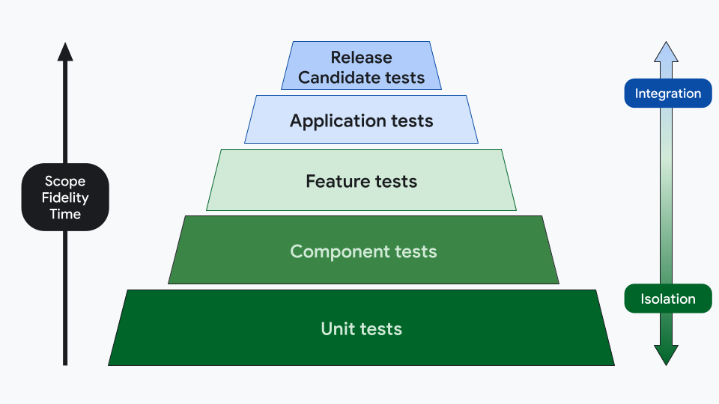
Testing
Testing strategies
The testing pyramid: many fast unit tests at the base, fewer widget tests in the middle, very few integration tests at the top.
Release and Application tests correspond to integration tests on builds (more on this later).
Feature and Component testing correspond to widget testing in Flutter.
We’ll learn about Unit and Widget testing now.
Image Source: "Testing strategies", Android Developers, Google. Available at: developer.android.com/training/testing/fundamentals/strategies

Slide 6
Testing
Integration testing
Integration tests verify how multiple units work together or test the full application on a real device or browser.
Simulates complete user journeys end-to-end, such as navigating screens, submitting forms, and saving data.
Slower than unit and widget tests, but provides the highest confidence before releasing.
We will cover it later, but for more info on the integration testing, check the documentation: https://docs.flutter.dev/testing/integration-tests

Slide 7
Testing
Test coverage
Test coverage measures the proportion of your codebase executed while running automated tests.
Helps identify untested branches, missing edge cases, and dead code.
Run flutter test --coverage to generate coverage data in coverage/lcov.info.
Visualise coverage directly in your editor using coverage extensions.

Slide 8
Unit testing

Slide 9
Unit testing
Unit testing
A unit test exercises a single function, method, or class in isolation.
No Flutter widgets, no UI rendering, no device needed.
Use the test package: test(), expect(), matchers like equals, isTrue, throwsA.
See examples here: pub.dev/packages/test
Group related tests with group() for readability.
Also group related tests into a file (ideally a test file corresponding to a unit).
Good tests are independent, repeatable, and fast.

Slide 10
Widget testing

Slide 11
Widget testing
Widget testing
A widget test renders a widget in a test environment and verifies its behaviour.
Use testWidgets(), WidgetTester, and finders like find.text(), find.byType().
pumpWidget() builds the widget tree; pump() triggers a rebuild after state changes.
tester.tap() simulates user interaction; follow it with pump() to see the result.
You need to check the documentation page to learn the basics for this one:
An introduction to widget testing

Slide 12
Widget testing
Widget testing
A widget test renders a widget in a test environment and verifies its behaviour.
Behaviours like:
  Does the widget display the correct text and icons for a given model?
  Does tapping a button update the UI as expected?
  Does navigation push the right screen when a list item is tapped?
Keep widget tests focused on one behaviour per test (they can be grouped into files or groups just like unit tests).

Slide 13
Live coding
Conflicts are normal and not something to fear. They happen when two people (or two branches) edit the same line.
The tooling in VS Code makes resolution straightforward.
A tutorial on YouTube: youtu.be/HosPml1qkrg?si=43A4MrLa24Dl4X99
Avoiding conflicts in practice:
  Pull before you push. Fetch and merge (or rebase) regularly.
  Keep branches short-lived. Merge back to main often.
  Communicate with your team about who is working on which files.
  Use meaningful commit messages so the merge history is readable.
Notes:
Create a new repository on GitHub.
In VS Code, press `Ctrl+Shift+P` (or `Cmd+Shift+P` on macOS), select `Git: Clone`, paste the repository URL, and open the cloned folder.
In Explorer, create a file named `greeting.txt` with the initial text.
In Source Control (`Ctrl+Shift+G`), stage the file with `+`, enter `docs: add greeting`, click `Commit`, and then click `Sync Changes` (or `Publish Branch`).
In Terminal you can do the same thing as above with:
```bash
git clone https://github.com/<your-username>/<name-of-your-repository>.git
cd <name-of-your-repository>
echo "line 1: hello" > greeting.txt
git add greeting.txt
git commit -m "docs: add greeting"
git push origin main
```
Click the current branch name (`main`) in the bottom-left status bar, select `Create new branch...`, and name it `experiment`.
Open `greeting.txt`, update the text, then in Source Control stage the change, enter `feat: update greeting on experiment`, click `Commit`, and click `Publish Branch`.
Here is how you can do the same thing in Terminal:
```bash
git checkout -b experiment
echo "line 1: hello from experiment" > greeting.txt
git add greeting.txt
git commit -m "feat: update greeting on experiment"
git push -u origin experiment
```
Click the branch name in the status bar at the bottom-left and switch back to `main`.
Open `greeting.txt`, change line 1 to a different message, then stage and commit this change in Source Control and click `Sync Changes` to push to GitHub.
Here is the command for the same thing as above:
```bash
git checkout main
echo "line 1: hello from main" > greeting.txt
git add greeting.txt
git commit -m "feat: update greeting on main"
git push origin main
```
In GitHub, open a pull request from `experiment` into `main`.
GitHub will warn that the branch has conflicts that must be resolved.
To resolve it locally in VS Code, open the built-in terminal (`Ctrl+\`` or ``Cmd+\```) while on `main` and run the merge command.
```bash
git merge experiment
git status
```
Open `greeting.txt` in VS Code. VS Code automatically highlights the conflict and provides clickable CodeLens actions above the conflict region: `Accept Current Change` keeps the version from `main`, `Accept Incoming Change` uses the version from `experiment`, `Accept Both Changes` keeps both lines, and `Compare Changes` opens a side-by-side diff.
Alternatively, click `Resolve in Merge Editor` in the bottom-right corner to review incoming versus current changes side by side.
Select your preferred resolution (such as accepting both or editing the text manually to combine them), then save the file.
In Source Control, click `+` next to `greeting.txt` to mark it as resolved, enter a commit message like `fix: resolve greeting conflict`, click `Commit`, and click `Sync Changes` to update GitHub.
```bash
git add greeting.txt
git commit -m "fix: resolve greeting conflict"
git push origin main
```
Inspect the merge history visually by opening the built-in terminal and running the graph log command, or by opening the Command Palette and selecting `Git: View Graph`.
```bash
git log --oneline --graph --all
```

Slide 14
Demo 3
Union of Worksheet 4 and Worksheet 5 exercises: home view with movie cards and navigation to dynamic listing.
Also unit tests and widget tests covering almost all of your codebase.
Demonstrate in your own timetabled practical session.
You can only do one demo in each window.
More information on the web page: manighahrmani.github.io/sandwich_shop/

Slide 15

Module feedback
Give us your feedback, comments, criticisms, or insults by filling out the following form.
It’s anonymous; you need to sign in via your student account, but your details aren’t recorded.
Use this link or the QR code: forms.cloud.microsoft/e/88jd4UGAui

