Slide 1

PAPL (M30235) UXDI (M32605)
Lecture 2
Widgets
Everything is a widget
Declarative UI
Stateless vs stateful

Slide 2
Everything is a widget

Slide 3
Everything is a widget
Everything is a widget
Text, buttons, padding, layout, the whole screen: all widgets.
You build screens by composing small widgets, not by editing one big file.
The UI is a tree of widgets
Widget fundamentals tutorial: Create widgets

Slide 4
Everything is a widget
Composition and layout
Small widgets combine into bigger ones (Column, Row, Container).
Reuse your own widgets; they take parameters too, like a function.
Layout: Flutter learning pathway
Widget of the Week: youtube.com/playlist?list=PLjxrf2q8roU23XGwz3Km7sQZFTdB996iG&si=Y_Q70zf_feTc0Kq0

Slide 5
Declarative UI

Slide 6
Declarative UI
Declarative UI
You describe what the UI should look like for the current data.
You do not manually mutate the screen; you change the data and rebuild.
All of these sound very abstract.
You can learn it easier by doing the worksheets or trying my new favourite website:
docs.flutter.dev/learn/pathway

Slide 7
Stateless vs stateful

Slide 8
Stateless vs stateful
Stateless vs stateful
Stateless: fixed once built (a snapshot).
Stateful: holds data that changes over time and rebuilds itself.
Ephemeral state now; app-wide state later.
For more info, refer to:
docs.flutter.dev/data-and-backend/state-mgmt/ephemeral-vs-app

Slide 9
Stateless vs stateful
Stateless vs stateful
StatelessWidget:
StatelessWidget class - widgets library - Dart API
StatefulWidget:
StatefulWidget class - widgets library - Dart API
Change the data inside setState, and Flutter rebuilds.
Change it without setState, and the screen does not update.
More info on this tutorial page on adding interactivity. docs.flutter.dev/ui/interactivity

Slide 10
Demo 1
Union of Worksheet 1 and Worksheet 2 exercises: a movie listing page.
Complete by the week ending with Friday, 2 October 2026.
Demo in your own timetabled practical (you will not get marks if you attend a different session).
Marked on functionality, quality, and understanding of your own code.
I will ask two questions about your code, chosen at random, during the demo.
You will find these questions easy if you’ve done the coding yourself.

Slide 11
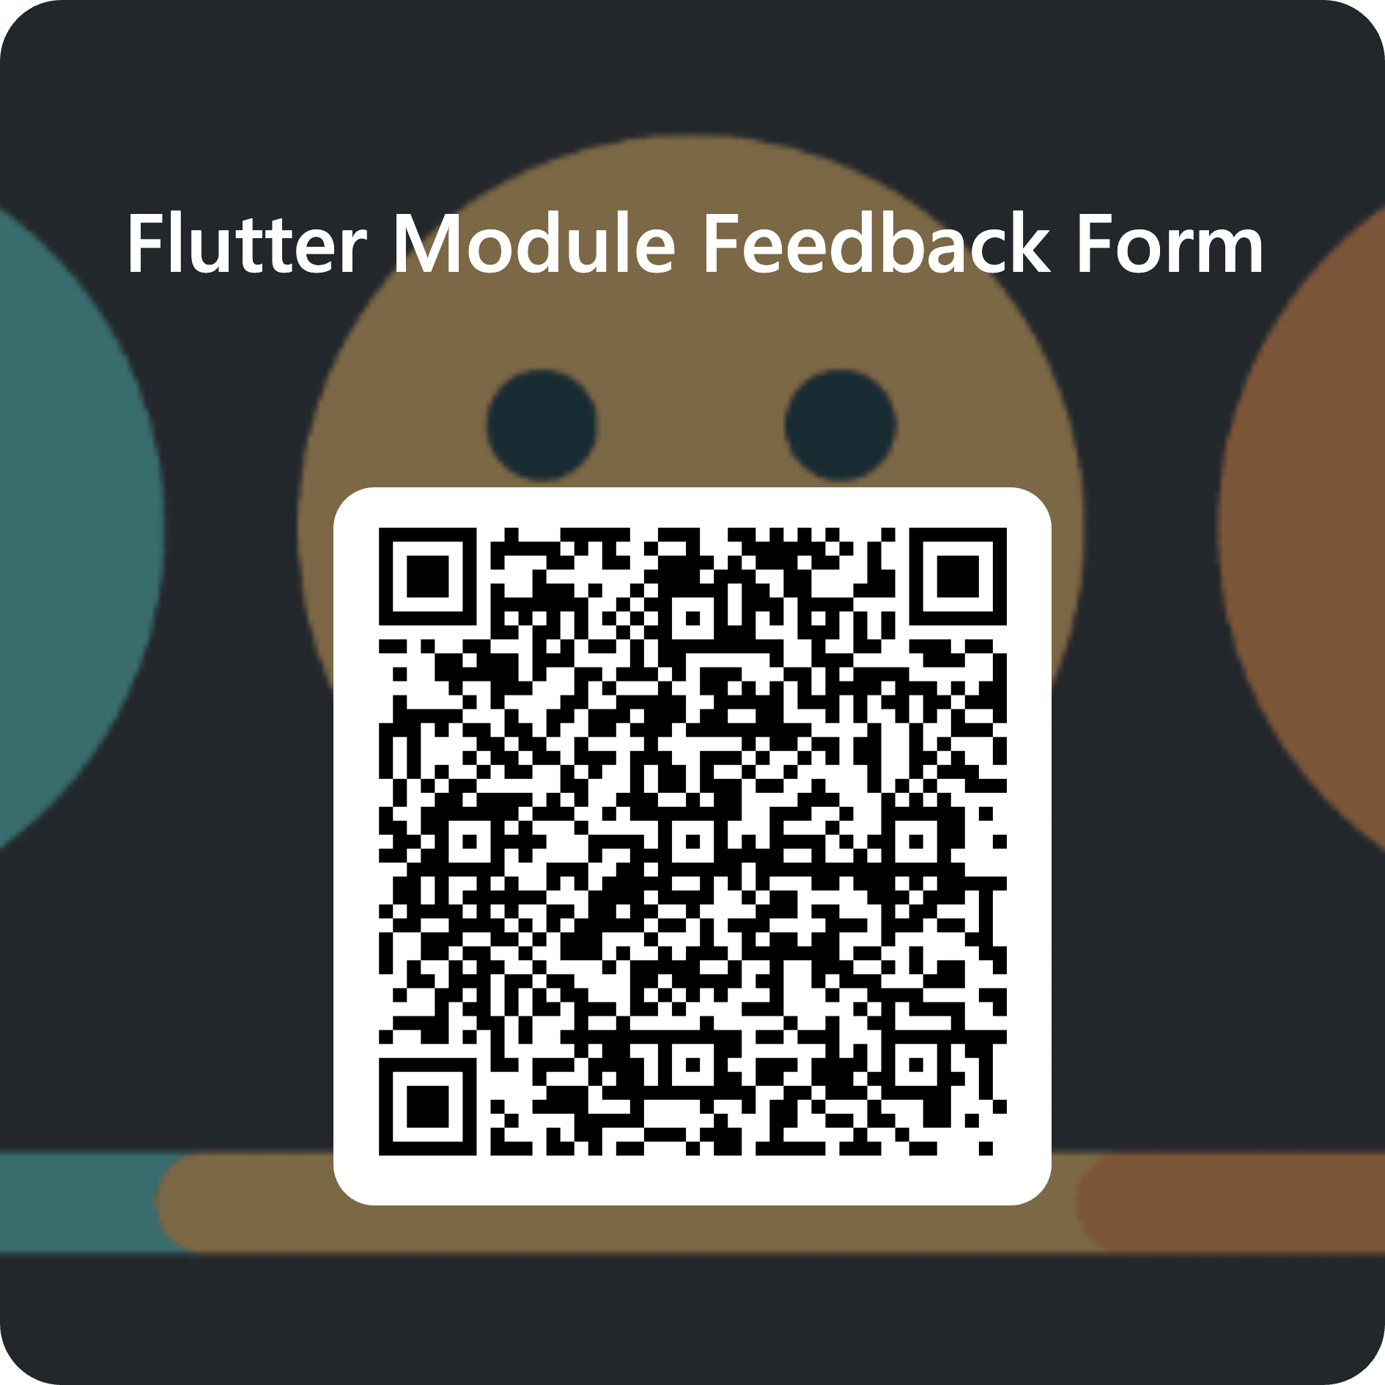
Module feedback
Give us your feedback, comments, criticisms, or insults by filling out the following form.
It’s anonymous; you need to sign in via your student account, but your details aren’t recorded.
Use this link or the QR code: forms.cloud.microsoft/e/88jd4UGAui

