Slide 1

PAPL (M30235) UXDI (M32605)
Lecture 1
Welcome
Preamble
Overview
Assessment

Slide 2
Preamble

Slide 3
Preamble
Preamble
I need tech news from you!
I will provide you some of my own.
Most of you should consider doing a placement next year, so I’d like these lectures to help.
To get started, Flutter blog: medium.com/flutter
GitHub Trending github.com/trending
Widget of the Week youtube.com/playlist?list=PLjxrf2q8roU23XGwz3Km7sQZFTdB996iG

Slide 4
Preamble
Preamble
Job sites:
Gradcracker: gradcracker.com RateMyPlacement: ratemyplacement.co.uk
Prospects: prospects.ac.uk
LinkedIn Jobs: linkedin.com/jobs
Use these terms: 'placement', 'industrial year'.

Slide 5
Overview

Slide 6
Overview
Overview
Just call me Mani.
Email: mani.ghahremani@port.ac.uk
“DrMani” on Discord: soc.port.ac.uk/discord
I teach the first half, Teaching Block 1 (TB1).
Homepage: manighahrmani.github.io/sandwich_shop/
'sandwich_shop' because the worksheets build a sandwich shop app.
1-hour lectures and 1-hour practicals per week for 10 weeks (schedule on homepage).
No optional drop-ins.
Worksheet 1 this week (21-25/09/2026).

Slide 7
Assessment

Slide 8
Assessment
Assessment
Item 1 = 50% of the module.
Assessed in five demos, but the mark for the top four counts (each demo = 25% of Item 1).
Miss one: no harm (best four count). Miss two: mark capped.
Each 25% demo has a mark for functionality (9%), code quality (8%), and your understanding of your own work (8%).
Full detail: Assessment Guide.
Demo 1 window: complete by Friday 2 October 2026.
Extenuating Circumstances: submit an ECF early; email me if approved.

Slide 9
Assessment
Assessment
Submit the repo link on Moodle before the first demo, then attend the practical for the demo.
You aren’t submitting code; you are submitting a link to a GitHub repository.
Sign up to GH: github.com/signup – use a personal email, not uni.
Get your GitHub Student Developer Pack: education.github.com/pack (needs student ID, on-campus or University of Portsmouth VPN).
You can use your own device to develop if you have good specs (CPU and RAM).
Or use the university machines.

Slide 10
Assessment
Assessment
You may use Copilot/AI, but you must be able to explain everything you submit.
Understanding is 8% of Item 1 and is asked live.
Learn by hand; get a good working knowledge first.
You can branch out, speed up and automate once you understand everything.
Time for a little demo.

Slide 11
Assessment
Assessment
Create an app, run it in Chrome, switch devices, commit, and push to GitHub.
Widget inspector demo: docs.flutter.dev/tools/devtools/inspector.
VS Code features:
IntelliSense
Member/completion after dot, seeing suggestions (autocomplete)
Parameter hints (signature help) and hover / quick info (docs on hover)
Rename symbol (F2)
Quick fix / lightbulb (Cmd .)
Format-on-save
Hot reload vs hot restart.

Slide 12
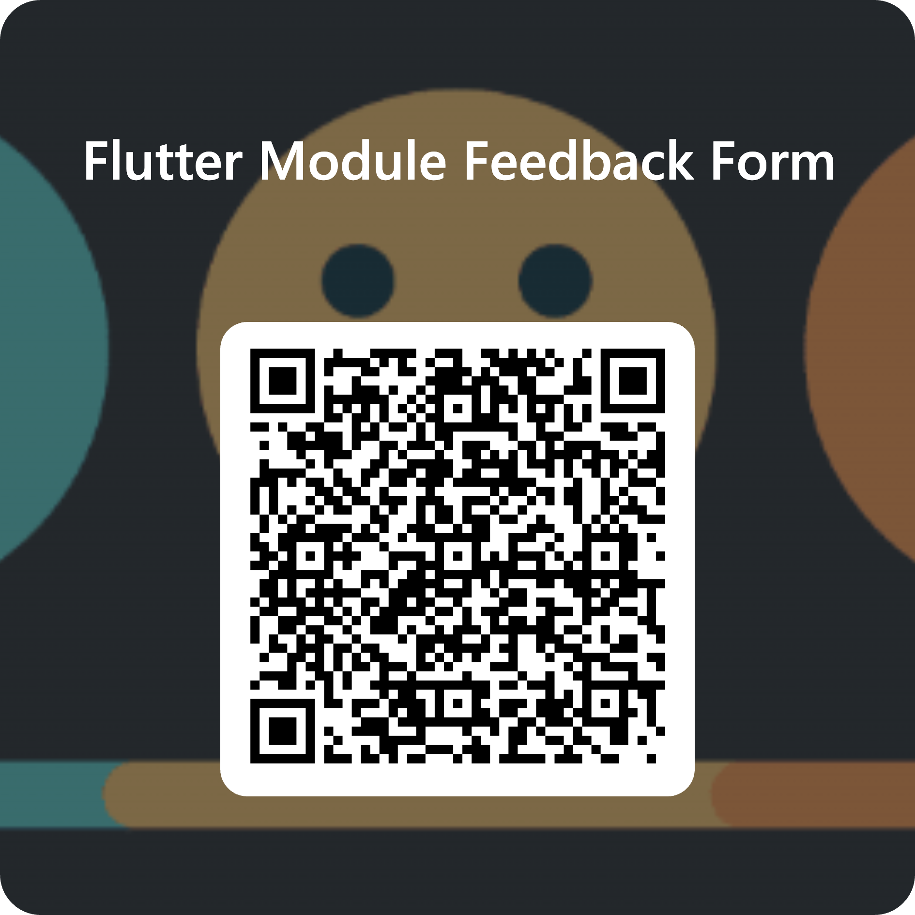
Module feedback
Give us your feedback, comments, criticisms, or insults by filling out the following form.
It’s anonymous; you need to sign in via your student account, but your details aren’t recorded.
Use this link or the QR code: forms.cloud.microsoft/e/88jd4UGAui

