Slide 1

SUPERVISED BY
Dr.N.R.Raja Lakshmi
Professor
PRESENTED BY
V.SAI NAVADEEP KRISHNA (VTU 24596)(23UECS0600)
P.HARSHA VARDHAN (VTU 24747)(23UECS0433)
3. B.YASHWANTH (VTU 24565)(23UECS0076)

Slide 2
BONE FACTURE DETECTION SYSTEM
USING YOLO DEEP LEARNING
AGENDA
Introduction
Literature Survey
Problem Statement
Proposed Methodology
Proposed System Architecture
Implementation Plan/Timeline

Slide 3
Introduction
Problem Statement:
Slow Diagnostic Workflow: Manually examining X-ray images is a time-consuming process that often delays patient care, especially in critical emergency room settings.
Need for Consistent Accuracy: Diagnoses can be subjective due to the inherent difficulty of reading X-rays, creating a demand for a reliable, objective, AI-based system to ensure diagnostic consistency.
Lack of Automated Localization: Healthcare currently lacks a fast, immediate system that can use deep learning (like YOLO) to pinpoint and visually outline the exact location and severity of a fracture (using bounding boxes).
Data Security and Access Gaps: There is a crucial need for a secure digital platform that employs encryption and allows patients to maintain control over access permissions for their sensitive medical images.

Slide 4
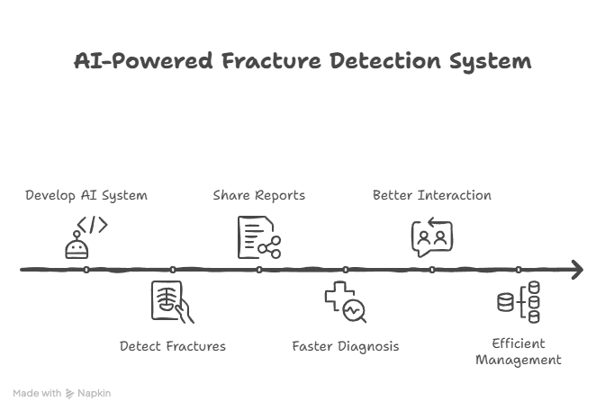
Introduction
Project Goal:
The goal of this project is to develop an AI-powered system that detects bone fractures from X-ray images using YOLO deep learning.
Provides a secure platform for patients to share reports with doctors.
This helps in faster diagnosis, better patient–doctor interaction, and efficient medical record management.

Slide 5
Introduction
Brief Overview:
AI-Powered Fracture Detection: The core of the system is the use of the YOLO deep learning algorithm to analyze uploaded X-ray images.
Providing automated assistance by detecting the type and severity of bone fractures and highlighting them with bounding boxes.
Encrypted and stored in the database.
Patient-Controlled Data Access: Patients securely upload their X-ray images and maintain control over their data by explicitly choosing the desired doctor to grant permission for viewing the report.
Streamlined Doctor Review: Authorized Doctors can log in and immediately view all patient reports for patients who have granted them access, allowing them to provide a prescription based on the AI-assisted results.

Slide 6
Literature Survey
Existing Systems and Related Works:
[1] A. Kutbi, A. Al-Saggaf, and A. M. Al-Ahmadi, “Artificial intelligence-based applications for bone fracture detection: A systematic review,” Healthcare, vol. 12, no. 3, pp. 309–325, 2024.
(Survey of existing fracture detection methods – shows gaps in current solutions.)
[2] L. Su, Y. Wang, and H. Chen, “Skeletal fracture detection with deep learning: A comprehensive review,” Frontiers in Radiology, vol. 2, pp. 112–128, 2023.
(Covers existing deep learning approaches and their challenges.)
[3] P. Rajpurkar et al., “MURA: Large dataset for abnormality detection in musculoskeletal radiographs,” arXiv preprint arXiv:1712.06957, 2017.
(Important dataset used for many existing fracture detection systems.)
[4] X. Ju et al., “Fracture detection in pediatric wrist trauma X-ray images using YOLOv8,” Scientific Reports, vol. 13, no. 12567, pp. 1–12, 2023.
(Supports your approach – shows YOLO is effective for fracture detection.)
[5] Z. Wu et al., “YOLOv9: Improved real-time object detection with enhanced feature learning,” arXiv preprint arXiv:2402.13616, 2024.
(Latest YOLO variant – supports your use of YOLO-based methods.)

Slide 7
Problem Statement
Limitations of Existing Solutions:
Subtle Fracture Errors: Current models, including many YOLO variants, often struggle to reliably detect subtle, small, or hairline fractures.
Data Scarcity and Bias: High-quality, diverse, and well-annotated datasets are scarce, which limits the models' ability to generalize across different populations or X-ray qualities.
Algorithmic Limitations: Models can struggle with complex X-rays involving multiple fractures or the presence of orthopedic implants.
Clinical Integration Issues: Integrating AI smoothly into existing hospital systems (PACS/EHR) is challenging, and AI is currently only approved as an assistance tool, not a final diagnostic replacement.

Slide 8
Proposed Methodology
YOLO deep learning algorithm on X-Ray images to detect fractures, show their severity, and highlight them with bounding boxes.
All user passwords, for both doctors and patients, are stored in the database in
Patients can upload their X-Ray images and grant permission for a specific doctor to access the report.
Detection results, including the type of fracture and severity, are saved in a database.
Doctors can log in to the system to view all patient X-Ray reports for which they have been given permission.

Slide 9
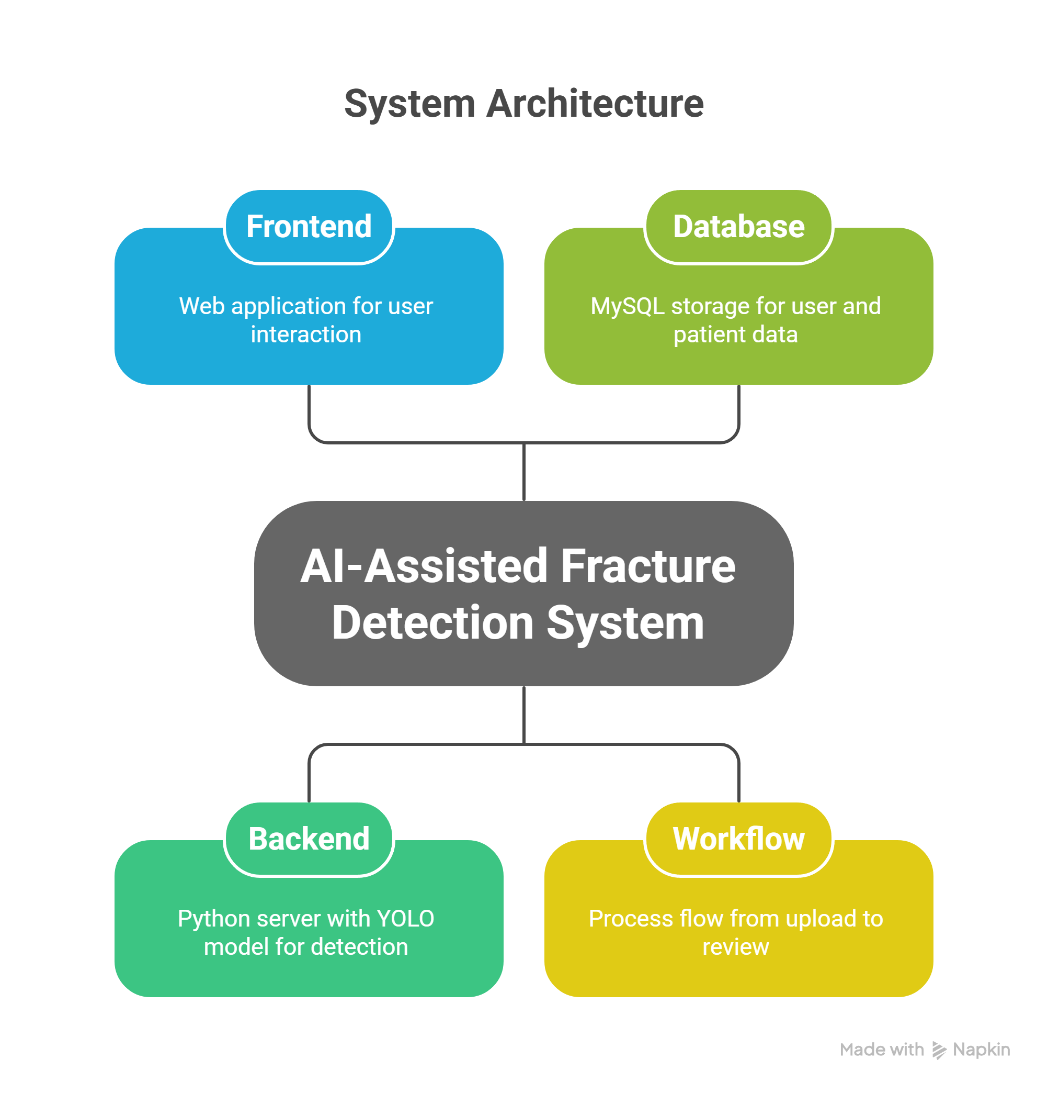
Proposed System Architecture
Frontend (Web App): Used by both patients and doctors for sign-up, login, patient X-ray upload, and viewing of reports and past results.
Backend (Python Server / YOLO Model): The main application logic and the deep learning engine. It applies the YOLO deep learning algorithm on the uploaded X-Rays for fracture detection.
Database (MySQL): Stores user credentials (passwords are encrypted), patient records, X-Ray file names, detection results, and access permissions.
Workflow: Patient Upload-> YOLO Detection -> Classification of image -> Save Result -> Doctor Review

Slide 10
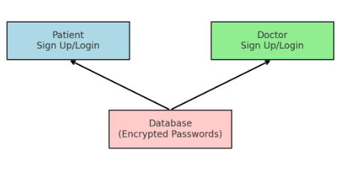
Summary of Module -1
Module 1: Authentication Module
This module handles sign up and login for both patients and doctors.
Users must register with basic details (name, email, password, etc.).
Password encryption is applied before storing data in the database to ensure security.
After login, patients and doctors are redirected to their respective dashboards.
Provides the foundation of security and controls access to the system.

Slide 11
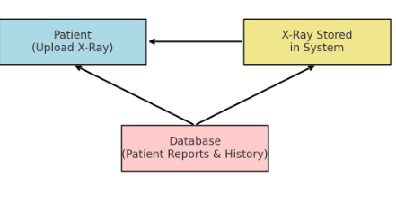
Summary of Module -2
Module 2: Patient Module
Patients can upload X-ray images to the system.
They can choose and grant access to a specific doctor.
Patients can view past reports and history of uploaded X-rays.
Provides patients with a secure and easy interface to manage their medical records

Slide 12
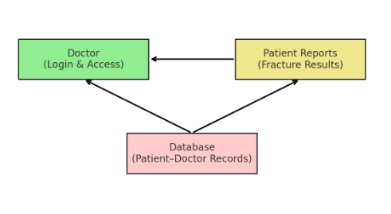
Summary of Modules -3
Module 3: Doctor Module
Doctors can log in securely.
Access patient reports only if permission is granted by the patient.
View X-ray images and detection results (fracture type & severity).
Provide medical suggestions or prescriptions based on reports.

Slide 13
Summary of Modules -4
Module 4: Fracture Detection Module
Handles AI-based analysis of uploaded X-ray images.
Uses the YOLO deep learning algorithm for detecting fractures.
Identifies fracture type and severity with bounding boxes.
Detection results are saved in the database for patients and doctors.

Slide 14
Software & Hardware Requirements Specification
🔹 Hardware Requirements
Minimum (for basic testing):
Processor: Intel i3 or AMD equivalent
RAM: 4 GB
Storage: 20 GB free space
GPU: Not mandatory (can run CPU, but slower)
Recommended (for training & faster YOLO detection):
Processor: Intel i5/i7 or AMD Ryzen 5/7
RAM: 8–16 GB
Storage: 50 GB+ (to store datasets & models)
GPU: NVIDIA GPU with CUDA support (e.g., GTX 1050 Ti or higher, 4 GB+ VRAM)
🔹 Software / Tech Stack
Programming Language: Python
Framework: Django
Deep Learning: PyTorch /
Computer Vision: OpenCV
Database: MySQL
Frontend: HTML, CSS, JavaScript
Security: bcrypt / hashlib
Environment: Anaconda / Virtualenv
Server: Localhost (Flask/Django runserver) or Apache/Nginx

Slide 15
Implementation Plan/Timeline
Key Milestones:
Week 1-2:Literature review, data collection & preparation, environment setup.
Week 3-4:Data preprocessing & Augmentation, Database & User Module Setup, Initial Model Training.
Week 5-6:Model Fine-Tuning, Backend Integration, Prototype UI.
Week 7-8:Access Control Implementation, Feature Refinement & Validation, Initial Testing & Documentation Prep.

Slide 16
THANK YOU

