Slide 1

DEPARTMENT OF COMPUTER SCIENCE & ENGINEERING
SCHOOL OF COMPUTING
10214CS601 MINOR PROJECT -I
SUMMER SEMESTER(2025-2026)
INITIAL REVIEW
“BONE FACTURE DECTION SYSTEM”
SUPERVISED BY
PRESENTED BY
Dr.N.R.RajaLakshmi, B.E., M.E., Ph.D
1.V.Sai Navadeep Krishna (VTU24596)(23UECS0600)
2.P.Harsha Vardhan (VTU24747)(23UECS0433)
3.B.Yashwanth (VTU24565)(23UECS0076)

Slide 2
PROJECT TITLE JUSTIFICATION(In Accordance with Community Service Project Survey undertaken/ New concept)
The Bone Fracture Detection System enhances the accuracy and efficiency of fracture diagnosis by integrating secure patient–doctor interaction with deep learning-based analysis. Traditional diagnosis often relies on manual inspection of X-ray images, which can be time-consuming and subject to human error. This project addresses these challenges by offering a platform where both patients and doctors can collaborate securely.
Doctors and patients can register through encrypted sign-up processes, ensuring data privacy. Patients can upload their X-ray images and selectively grant access to doctors of their choice, maintaining full control over their medical data.
The system employs the YOLO deep learning algorithm to assist in detecting fractures, identifying their type and severity using bounding boxes. These preliminary results help doctors make faster, informed decisions while reducing workload. All detection reports are securely stored in the database, ensuring quick retrieval and continuity of care.
By combining encrypted data handling with machine learning assistance, this system improves diagnostic speed, enhances patient–doctor communication, and provides a reliable foundation for more effective fracture treatment planning.

Slide 3
OBJECTIVE & SCOPE OF THE PROJECT
OBJECTIVE
To develop a secure and efficient system for detecting bone fractures from X-ray images using the YOLO deep learning algorithm.
To assist doctors by providing preliminary fracture detection results, reducing diagnostic time and workload
To enable patients to upload X-rays and control access to their medical data through secure, encrypted communication.
To store and manage detection results and reports for future reference and improved treatment planning.
SCOPE
User Modules: Includes separate modules for doctors and patients with secure sign-up and login functionality.
Data Privacy: All passwords are encrypted, and patients can selectively share X-rays with their chosen doctors.
X-Ray Analysis: Uses YOLO deep learning to detect fracture type and severity, displaying bounding boxes for clarity.
Result Management: Automatic storage of detection results and reports in the database for easy access and continuity of care.
Workflow Enhancement: Reduces time for manual diagnosis, improves doctor–patient communication, and enhances treatment planning.
Scalability: Can be extended to support multiple doctors, hospitals, or clinics, with potential integration into larger healthcare systems.

Slide 4
TOOLS TO BE USED IN THE PROJECT
Programming Language:
Python – for implementing machine learning models, image processing, and backend logic.
Deep Learning Framework:
TensorFlow / PyTorch – to train, test, and deploy the YOLO-based fracture detection model.
YOLO (You Only Look Once):
For object detection and identifying fracture regions in X-ray images.
Database:
MySQL / PostgreSQL – to store user credentials (encrypted), detection results, and reports.
Web Framework:
Flask / Django – to create the web application and manage patient–doctor interactions.
Frontend Technologies:
HTML, CSS, JavaScript, Bootstrap – for creating a user-friendly interface for patients and doctors.
Encryption Library:
bcrypt / hashlib – for secure password encryption and authentication.
Image Handling Libraries:
OpenCV, PIL (Pillow) – for preprocessing and handling X-ray images before detection.

Slide 5
SOCIETAL IMPORTANCE OF THE PROJECT
The Bone Fracture Detection System provides significant societal benefits by improving healthcare accessibility, accuracy, and efficiency in fracture diagnosis. Traditional methods often involve delays in getting X-ray reports and require doctors to spend additional time on manual analysis, which can lead to longer treatment initiation and increased patient discomfort.
This system allows faster detection of fractures using machine learning, helping doctors focus more on treatment rather than prolonged diagnosis. By integrating secure communication channels between patients and doctors, it ensures that patients in remote or rural areas can easily upload their X-rays and receive expert feedback without the need for repeated hospital visits.
The encryption and permission-based access feature enhances data privacy, building trust in digital healthcare solutions. Early and accurate detection of fractures reduces the risk of complications, accelerates recovery, and ultimately leads to better quality of life for patients.
On a broader scale, such systems can reduce healthcare workload, optimize hospital resources, and pave the way for technologically advanced, patient-centric healthcare models.

Slide 6
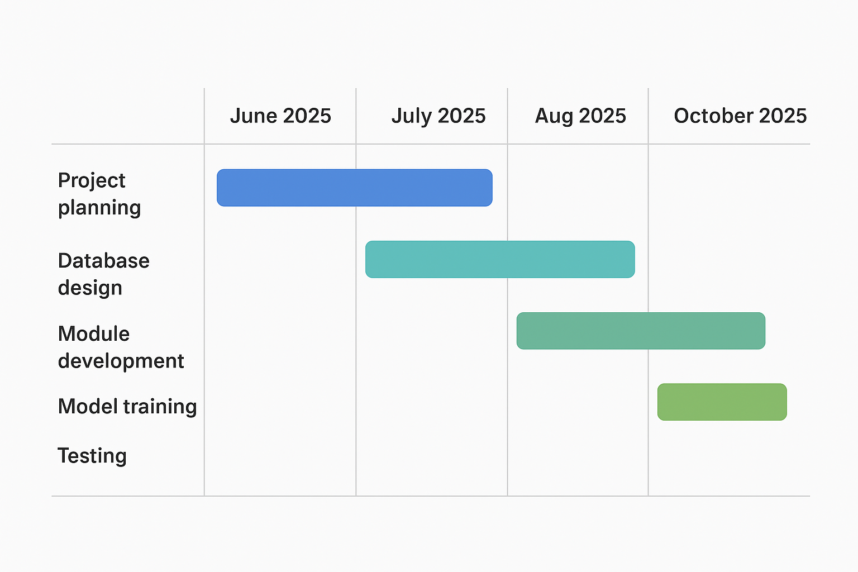
TIMELINE OF THE PROJECT

Slide 7
THANK YOU

