Slide 1

Vel Tech Rangarajan Dr. Sagunthala R&D Institute of Science and Technology
School of Computing
Department of Computer Science and Engineering
10211CS224 / FULL STACK APPLICATION DEVELOPMENT (JAVA)
END SEMESTER PROJECT REVIEW
Date: 06-05-2026
DESIGN AND DEVELOP A REACT JS-BASED WEB APPLICATION FOR TICKET BOOKING OF AN INTERNAL DEPARTMENT EVENT
SDG: SDG No – SDG Title(Example: SDG 4 – Quality Education)
Presented By:
Mani Manjunath V– VTU24573 – Reg.No23UECS0615
Courses Handling Faculty:
Dr X. Arogya Presskila,
Assistant Professor

Slide 2
INTRODUCTION
1
Educational institutions have adopted digital technologies for many administrative tasks, but event management still relies heavily on manual processes like paper forms and physical ticket sales.
College events, symposiums, and cultural fests typically involve disjointed Google Forms, long registration queues, and cash transactions leading to mismanaged funds and data entry errors.
A centralized digital platform is critically needed to seamlessly connect event organizers with students through event discovery, ticket booking, payments, and attendance verification.
Campus Cultural is specifically designed for college ecosystems, tailored to unique educational institution requirements including academic profile integration and campus-specific workflows.
The platform empowers students to effortlessly discover upcoming events, book tickets, and access event information through an intuitive and modern interface.
Built using React.js frontend, Node.js backend, and MySQL database, the platform ensures scalability, security, and high performance for campus-wide usage.
2
3
4
5
6
7
8
9

Slide 3
PROBLEM STATEMENT
1
Traditional college event management relies on manual processes like paper forms, physical ticket sales, and cash transactions that are inefficient and error-prone.
Disjointed tools such as Google Forms, spreadsheets, and manual record-keeping create fragmented data and lack real-time synchronization.
Long registration queues and on-the-spot payments lead to poor student experience and wasted time during high-demand events.
Event organizers lack real-time visibility into ticket sales, capacity utilization, and attendance metrics for informed decision-making.
Absence of academic profile integration means student verification is manual, creating security gaps in campus-only events.
Existing commercial platforms charge high commission fees and lack customization for educational institution requirements
2
3
4
5
6
7
8
9

Slide 4
OBJECTIVE(S)
1
To design and develop a centralized web application that automates the complete event management lifecycle including event discovery, ticket booking, secure payment processing, and digital attendance verification for college campuses.
To eliminate manual processes by integrating real-time capacity tracking, dynamic QR code-based validation, and automated email confirmations, ensuring fraud prevention and operational efficiency.
To provide a role-based platform with a student-centric interface for seamless booking and an administrative dashboard for event creation, analytics, and data-driven decision-making.
2
3
4
5
6
7
8
9

Slide 5
PROPOSED SYSTEM
1
A single web application consolidates all event management functions including event listing, ticket booking, payment processing, and attendance tracking into one unified system.
Live ticket availability tracking prevents overselling and automatically updates as bookings occur, giving organizers and students instant visibility into event status.
Time-restricted QR codes that activate only 30 minutes before events eliminate ticket duplication, screenshot sharing, and unauthorized entry attempts.
Seamless Razorpay integration enables secure digital payments via UPI, cards, and net banking, removing the need for cash handling and reducing financial discrepancies.
Built-in VTU number and department validation ensures only authorized students can book tickets, maintaining event exclusivity for the college community.
Separate student and admin portals provide tailored experiences where students browse and book while administrators manage events, view analytics, and validate entries.
2
3
4
5
6
7
8
9

Slide 6
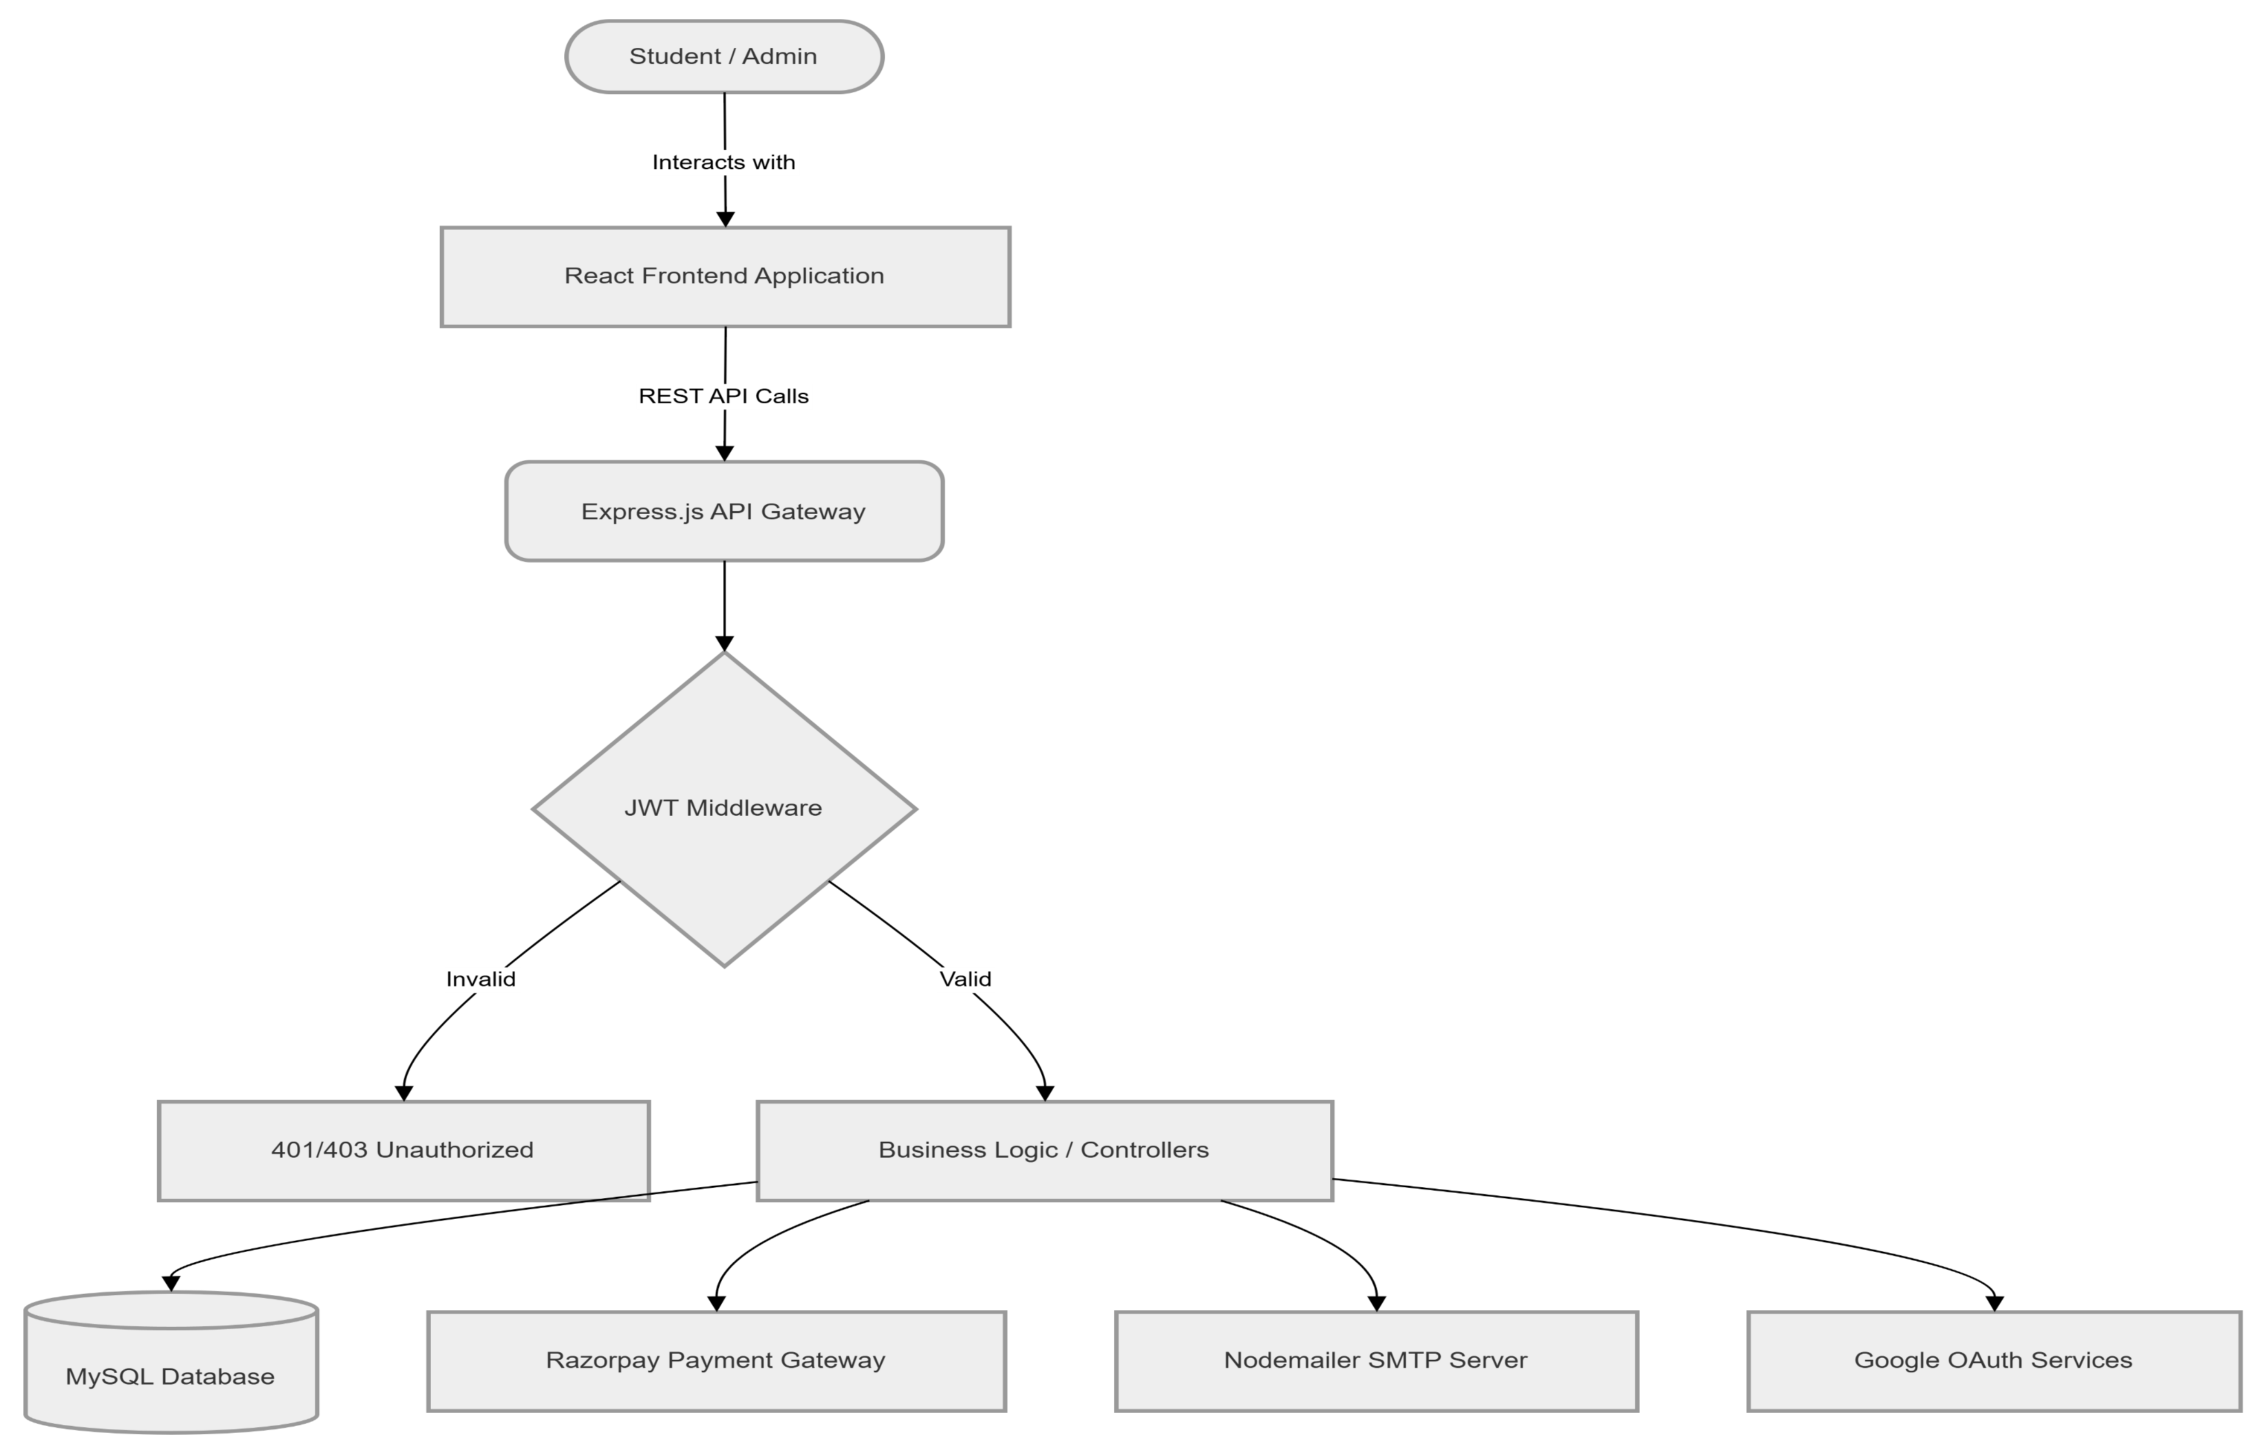
PROPOSED SYSTEM ARCHITECTURE
1
2
3
4
5
6
7
8
9

Slide 7
PROPOSED SYSTEM ARCHITECTURE
INPUT:
Student data including registration details, VTU number, department, and login credentials for account creation and authentication.
PROCESSING:
React frontend handles user interactions, form validations, and dynamic rendering while Node.js and Express backend executes business logic, API routing, and middleware authentication.
JWT token verification secures every request, and Razorpay integration processes payments.
DATABASE:
Users and admins tables store authentication credentials, profile information, and role-based access permissions for the platform's dual-role system.
OUTPUT:
Student-facing outputs include event listings with live capacity, booking confirmations with digital tickets, downloadable PDF passes, and time-restricted QR codes for secure entry.
Admin-facing outputs comprise real-time analytics dashboard, comprehensive booking history, CSV export reports, and gate validation scan results for attendance tracking.
1
2
3
4
5
6
7
8
9

Slide 8
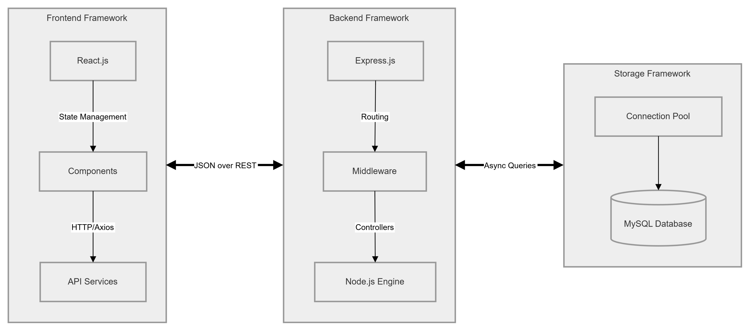
WORKFLOW
1
2
3
4
5
6
7
8
9

Slide 9
TECHNOLOGIES USED
Frontend:
React.js with component-based architecture for dynamic user interface
CSS BentoGrid layout for responsive and modern event display
Backend:
Node.js with Express.js framework for RESTful API development
JWT authentication middleware for secure session management
Database:
MySQL relational database for structured data storage
Connection pooling via mysql2 for efficient query performance
Third-Party API:
Razorpay API for payment gateway integration and transaction processing
Google OAuth 2.0 for secure one-click student authentication
Tools:
Visual Studio Code as development environment
Postman for API testing and npm for package management
1
2
3
4
5
6
7
8
9

Slide 10
MODULE DESCRIPTION
Module 1: User Management Handles student and admin registration, login with email/password and Google OAuth, JWT-based authentication, and profile management with VTU number and department details.
Module 2: Event Management Enables administrators to create, update, and manage events with details like date, venue, price, and capacity, while dynamically displaying them to students with real-time availability.
Module 3: Ticket Booking & Payment Processes ticket selection, attendee form collection, Razorpay payment integration, transaction verification, and booking confirmation with automated email dispatch.
Module 4: QR Verification & Security Generates time-restricted dynamic QR codes that activate only 30 minutes before events, prevents ticket duplication, and provides gate scanning for secure entry validation.
Module 5: Admin Dashboard & Analytics Provides real-time dashboard with booking statistics, revenue tracking, attendance reports, CSV data export, and comprehensive search across student booking records.
1
2
3
4
5
6
7
8
9

Slide 11
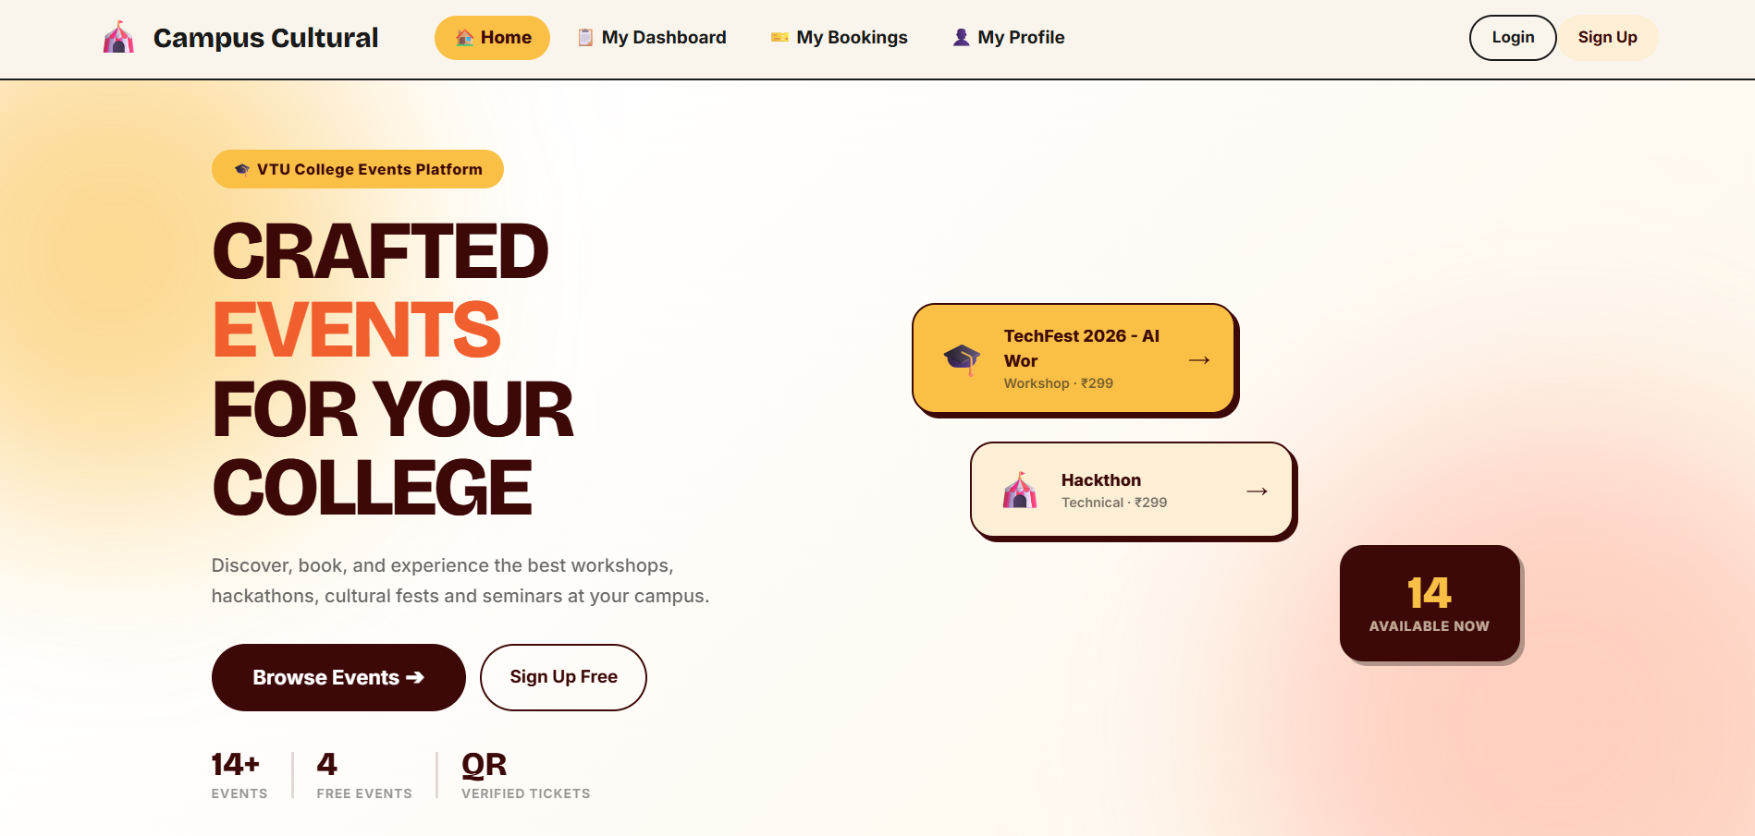
IMPLEMENTATION SCREENSHOTS
1
Home Page:
Dynamic landing page with animated hero section, platform statistics, and BentoGrid layout displaying upcoming events with hover effects for interactive browsing.
Real-time event cards fetched from database showing event name, date, venue, price, and live capacity indicators with direct booking access.
2
3
4
5
6
7
8
9

Slide 12
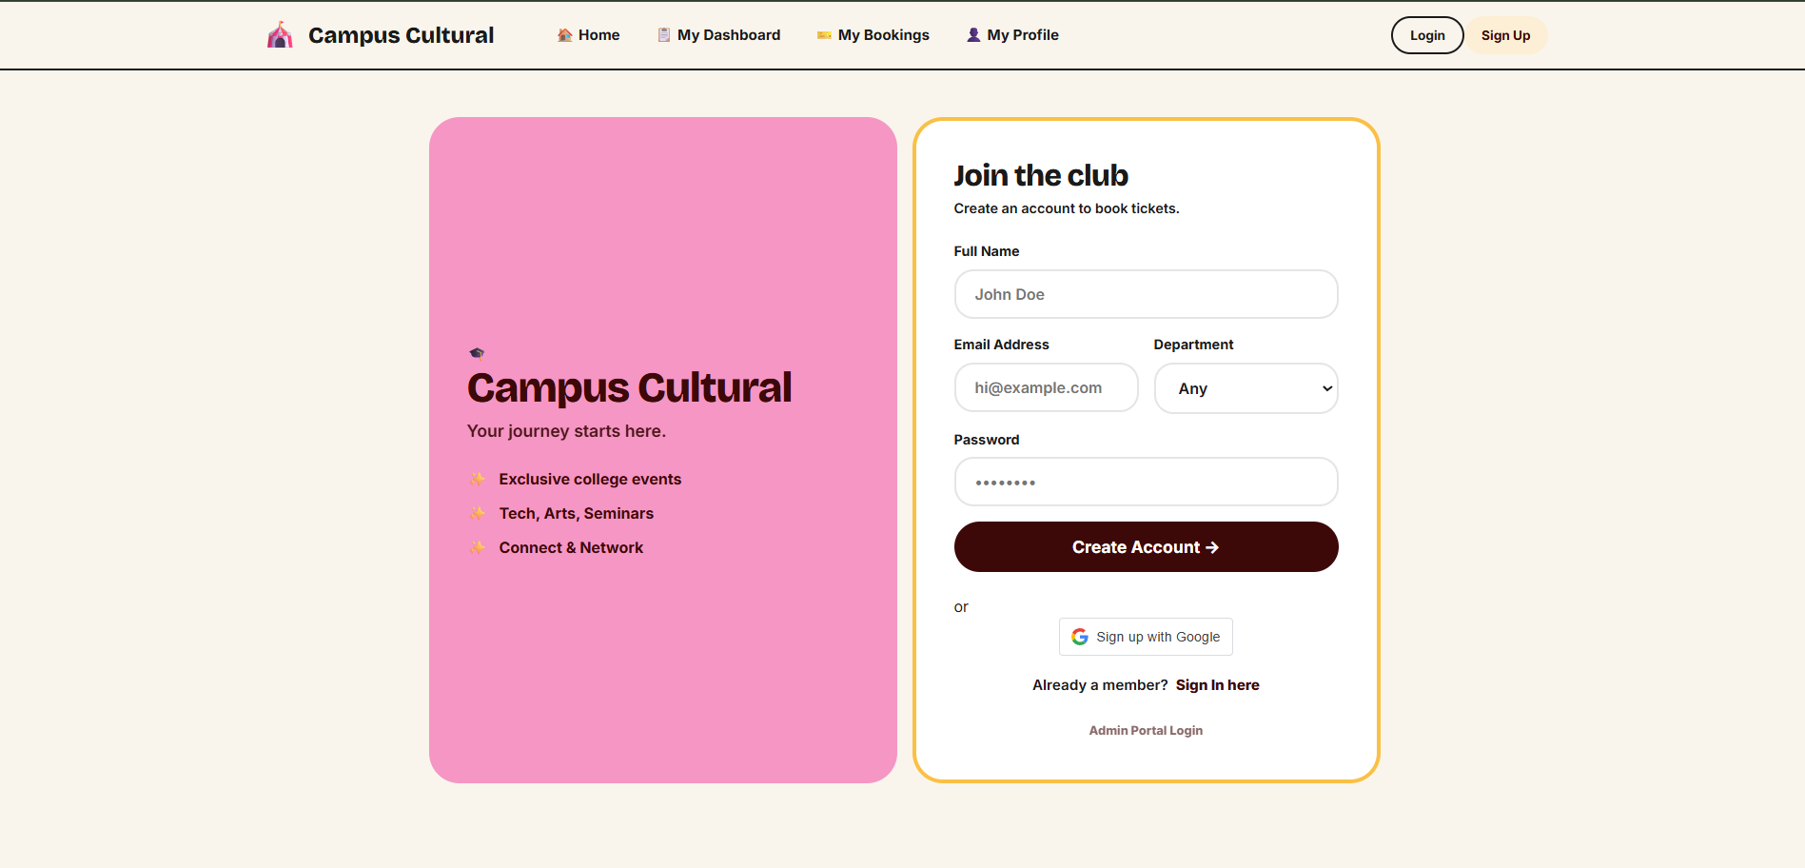
IMPLEMENTATION SCREENSHOTS
Registration Page:
Student sign-up form capturing name, email, password, VTU number, and department with client-side validation for data accuracy.
Secure password hashing using bcryptjs before database storage ensuring credential protection from security breaches.
1
2
3
4
5
6
7
8(A)
9

Slide 13
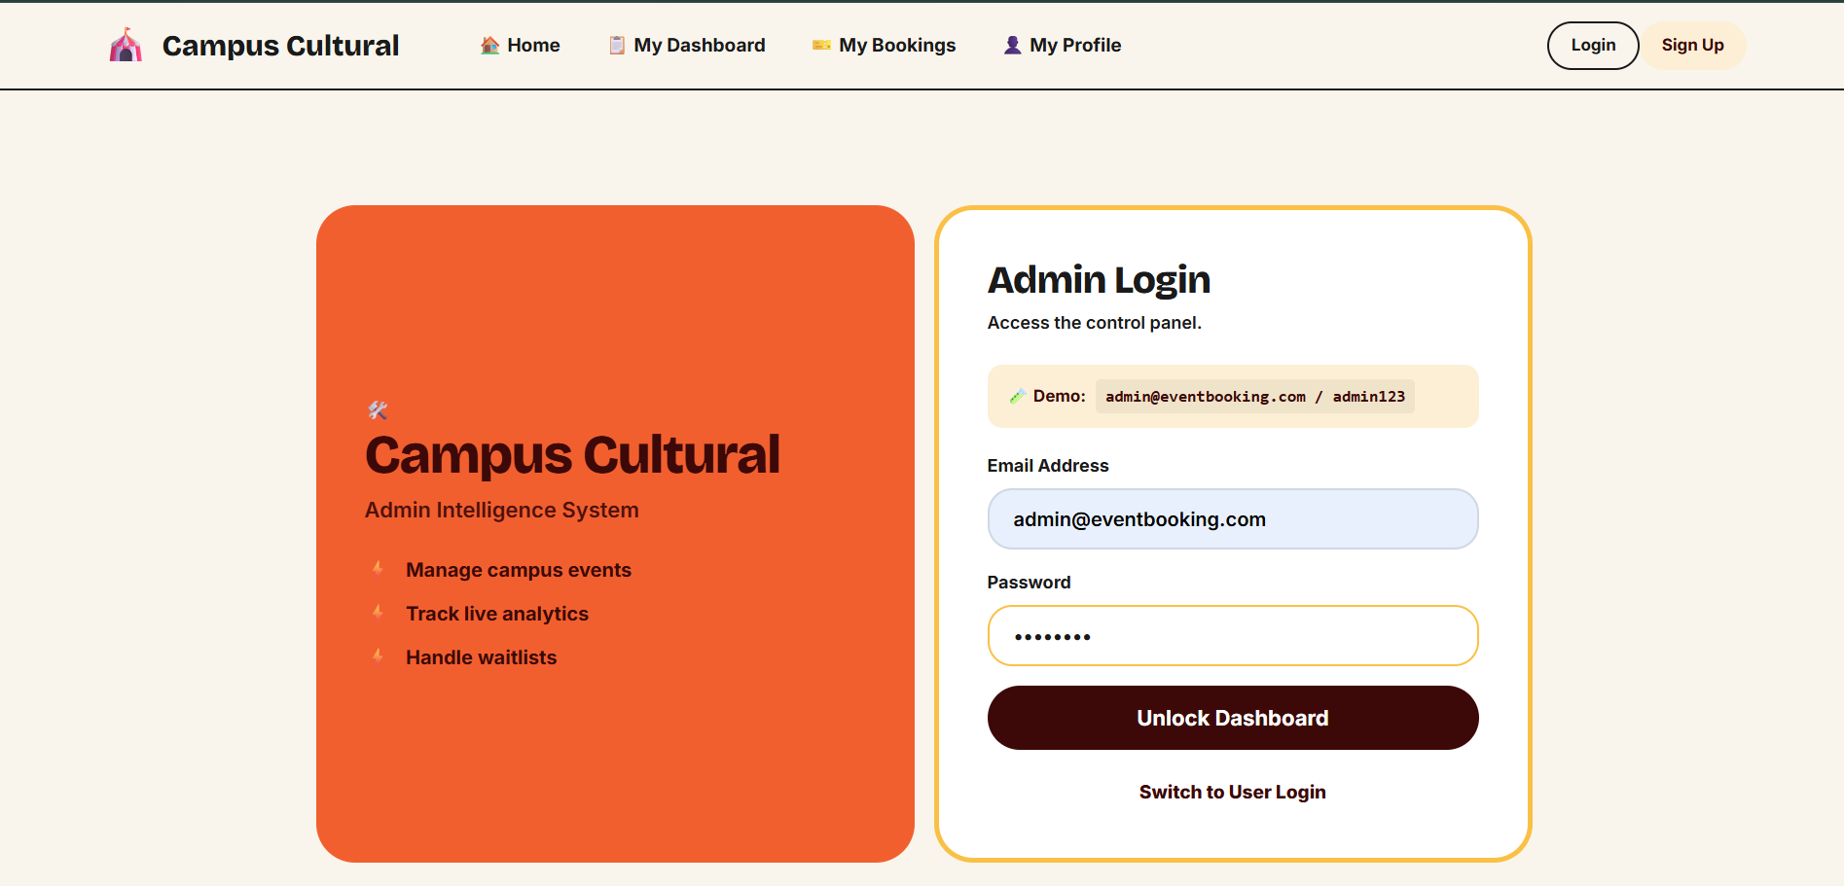
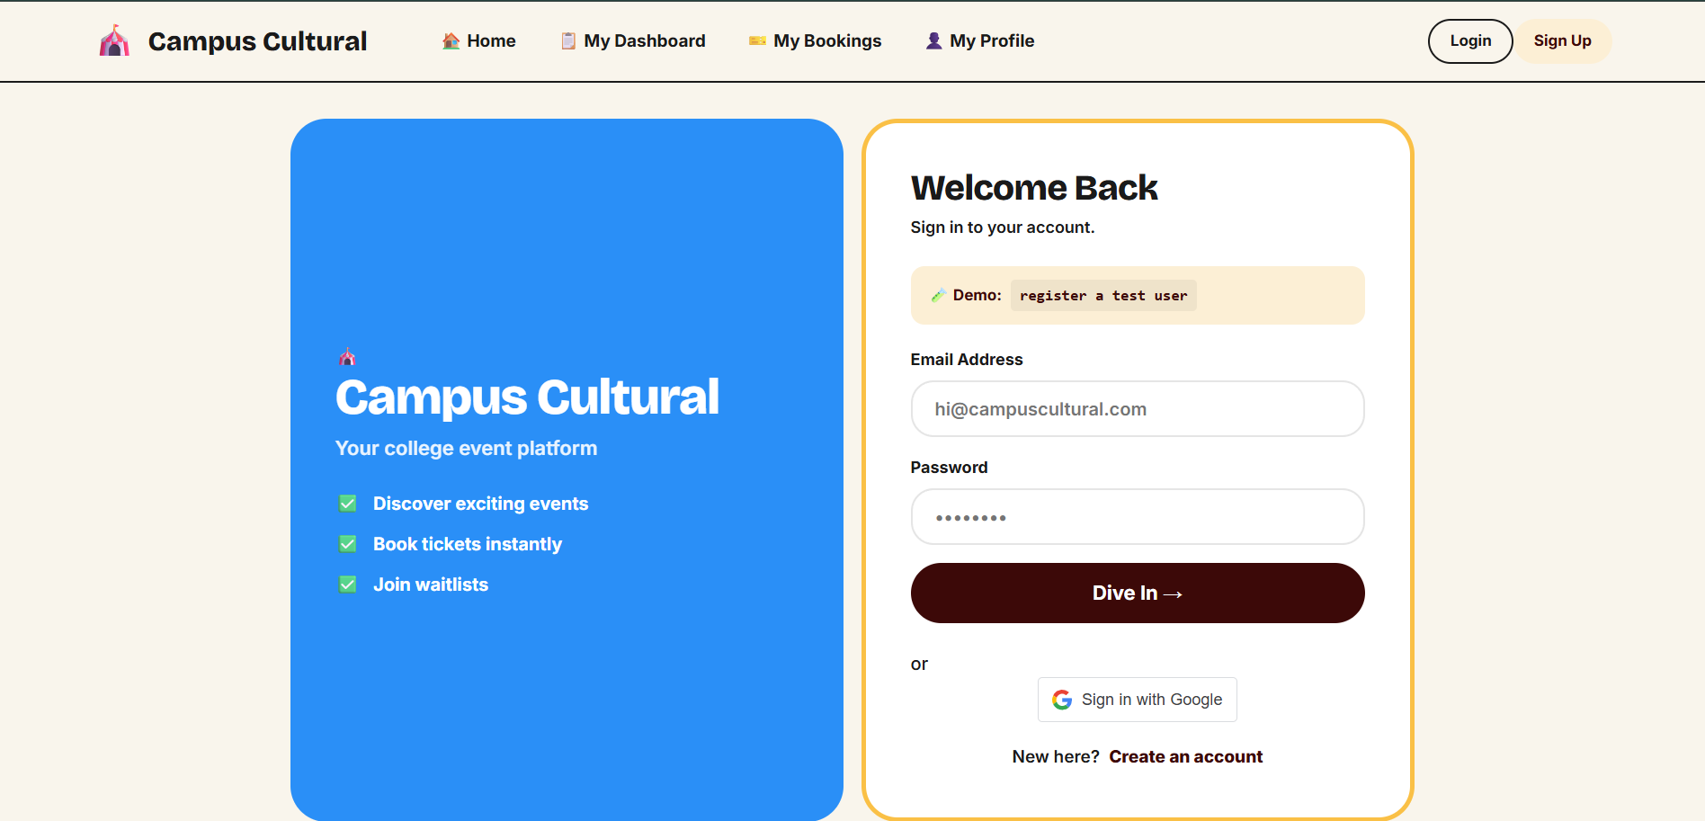
IMPLEMENTATION SCREENSHOTS
Admin Login Page
Login Page:
Dual authentication interface supporting traditional email/password login and Google OAuth 2.0 one-click sign-in for quick access.
Separate routing for admin portal with JWT token generation.
User Login Page
Login Page:
Dual authentication interface supporting traditional email/password login and Google OAuth 2.0 one-click sign-in for quick access.
Separate routing for student portal with JWT token generation.
1
2
3
4
5
6
7
8(B)
9

Slide 14
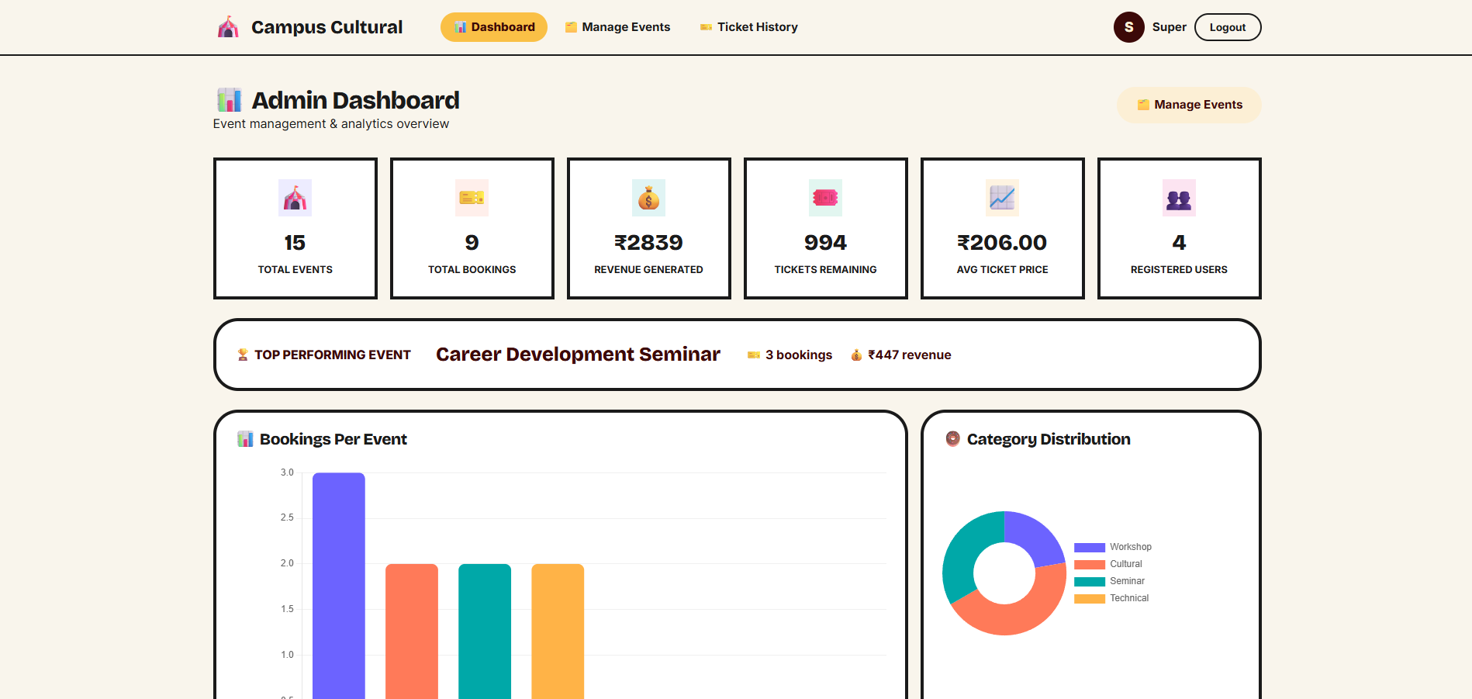
IMPLEMENTATION SCREENSHOTS
Admin Dashboard:
Summary cards displaying key metrics including total bookings, revenue collected, tickets sold, and upcoming events count in real-time.
Comprehensive searchable table of all student bookings with filters for event, department, and date range with CSV export functionality.
1
2
3
4
5
6
7
8(C)
9

Slide 15
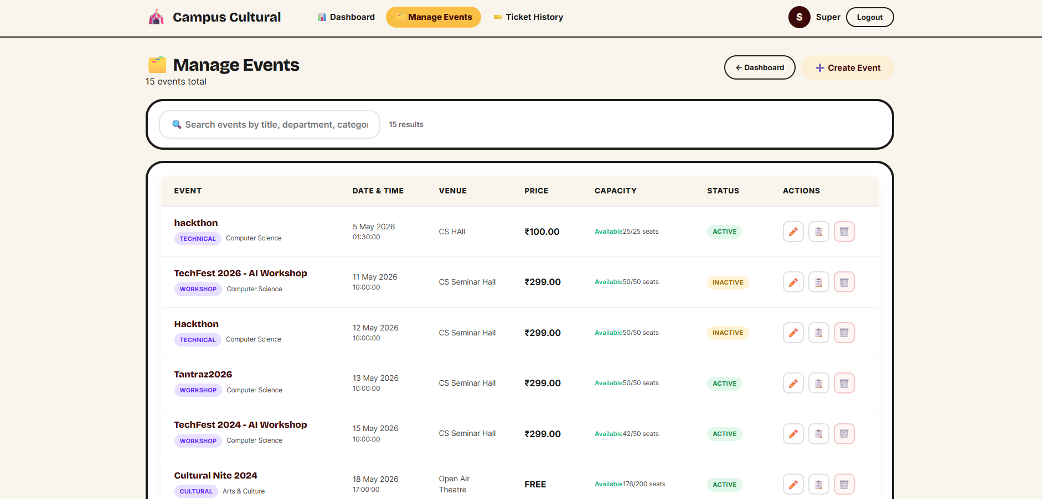
IMPLEMENTATION SCREENSHOTS
Admin Event Management:
Modal-based event creation form for adding new events with name, date, time, venue, price, capacity, and description fields.
Edit and manage existing events with ability to update details, view booking counts, and monitor capacity utilization in real-time.
1
2
3
4
5
6
7
8(C)
9

Slide 16
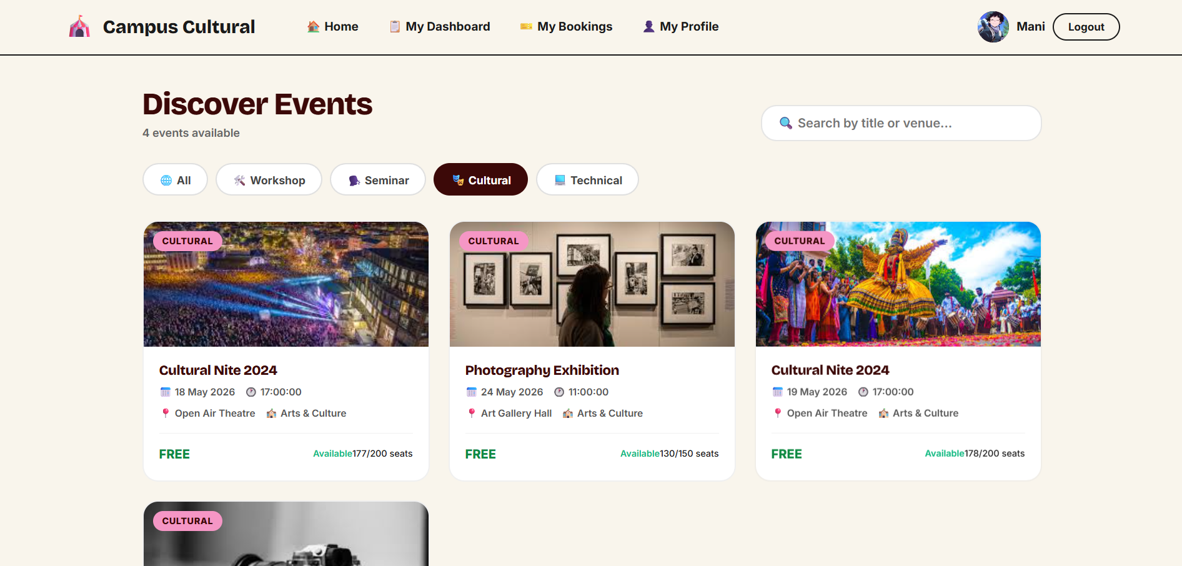
IMPLEMENTATION SCREENSHOTS
Event Listing Page:
Comprehensive catalog of all upcoming events with categorization, search functionality, and visual sold-out indicators for high-demand events.
Each event card displays complete details including description, schedule, venue, ticket price, and remaining capacity with instant booking button.
1
2
3
4
5
6
7
8(C)
9

Slide 17
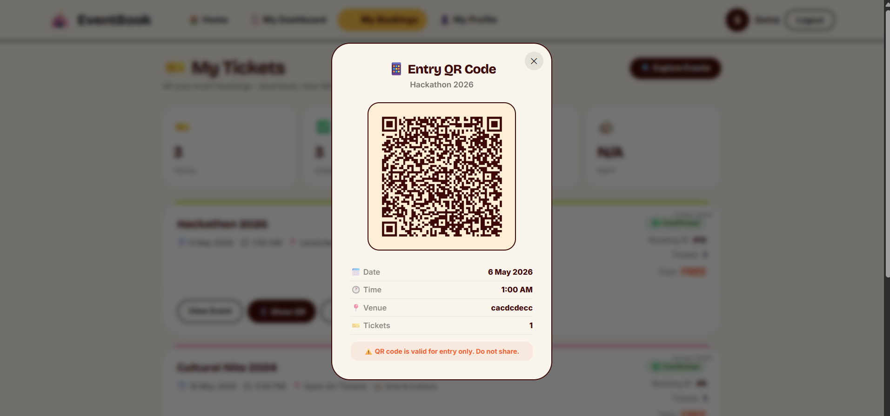
IMPLEMENTATION SCREENSHOTS
QR Verification Page:
Dedicated scanning interface for gate administrators to validate student tickets by scanning dynamic QR codes at entry points.
Instant validation response displaying student name, event details, booking status with used token flagging to prevent duplicate entry attempts.
1
2
3
4
5
6
7
8(C)
9

Slide 18
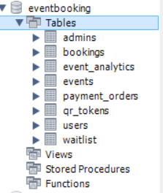
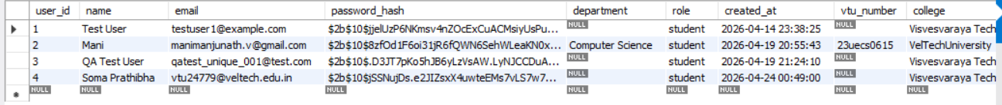

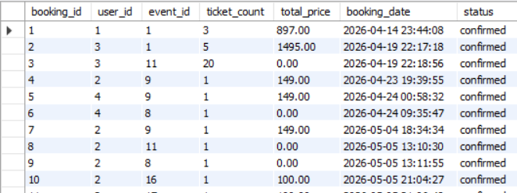
IMPLEMENTATION SCREENSHOTS
1
2
3
4
5
6
7
8(C)
9

Slide 19
ADVANTAGES & LIMITATIONS
1
Advantages:
Exceptional Security: Time-restricted dynamic QR codes activate only 30 minutes before events.
Real-Time Visibility: Live capacity tracking and instant booking updates prevent overselling while giving students and organisers accurate availability status.
Academic Integration: Built-in VTU number and department validation ensures only authorized students access to campus-exclusive events.
Automated Communication: Instant email confirmations with ticket details, event logistics, and QR codes eliminate manual notification efforts.
Admin Empowerment: Comprehensive dashboard provides live analytics, revenue tracking, attendance reports, and CSV export for data-driven decisions.
Limitations:
Internet Dependency: Dynamic QR generation and verification strictly require stable internet connectivity at venue gates, causing potential entry delays during network outages.
Third-Party Reliance: Core functionalities depend on external service uptime including Razorpay for payments and Google for authentication, creating vulnerability to API disruptions.
2
3
4
5
6
7
8
9

Slide 20
Thank you

