Slide 1

Using machine learning to Predict illicit transactions in cryptocurrency trading
BY – MANIK MARWAHA
ID – A1797063
APPLIED MACHINE LEARNING (COMP SCI 7416)

Slide 2
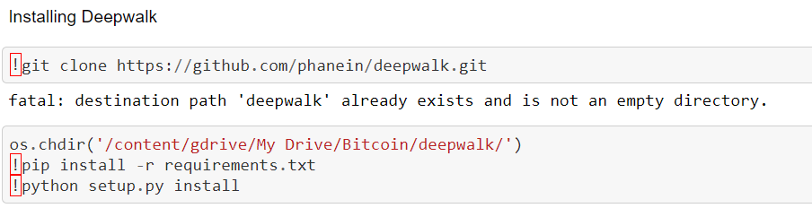
PROJECT OVERVIEW
Project Goal
Correctly identify the fraudulent transactions in cryptocurrency trading to make it a more safer future currency
DATA SET : Elliptic dataset
(Source : Weber, M. et al. (2019) ‘Anti-Money Laundering in Bitcoin : Experimenting with Graph Convolutional Networks for Financial Forensics’,arXiv:1908.02591[cs,q-fin].)
Key requirements
NetworkX, matplotlib and seaborn library
Scikit learn library for ML algorithms
DeepWalk installation

Slide 3
SOFTWARE QUALITY AND Highlights
Novel problem-solving approach
Using DeepWalk algorithm which is a graph neural network algorithm that uses randomized path traversing technique to find node embedding. Requirements – PyTorch
Line Count → 650 lines of code
Challenges
Data is temporal and in the form of Graph (Each node is a transaction, edges are flow of crypto coins between transactions)
Initial analysis show that data is highly unbalanced (licit transaction >>> illicit transactions)
Treating the class imbalance and trying several under-sampling and oversampling techniques

Slide 4
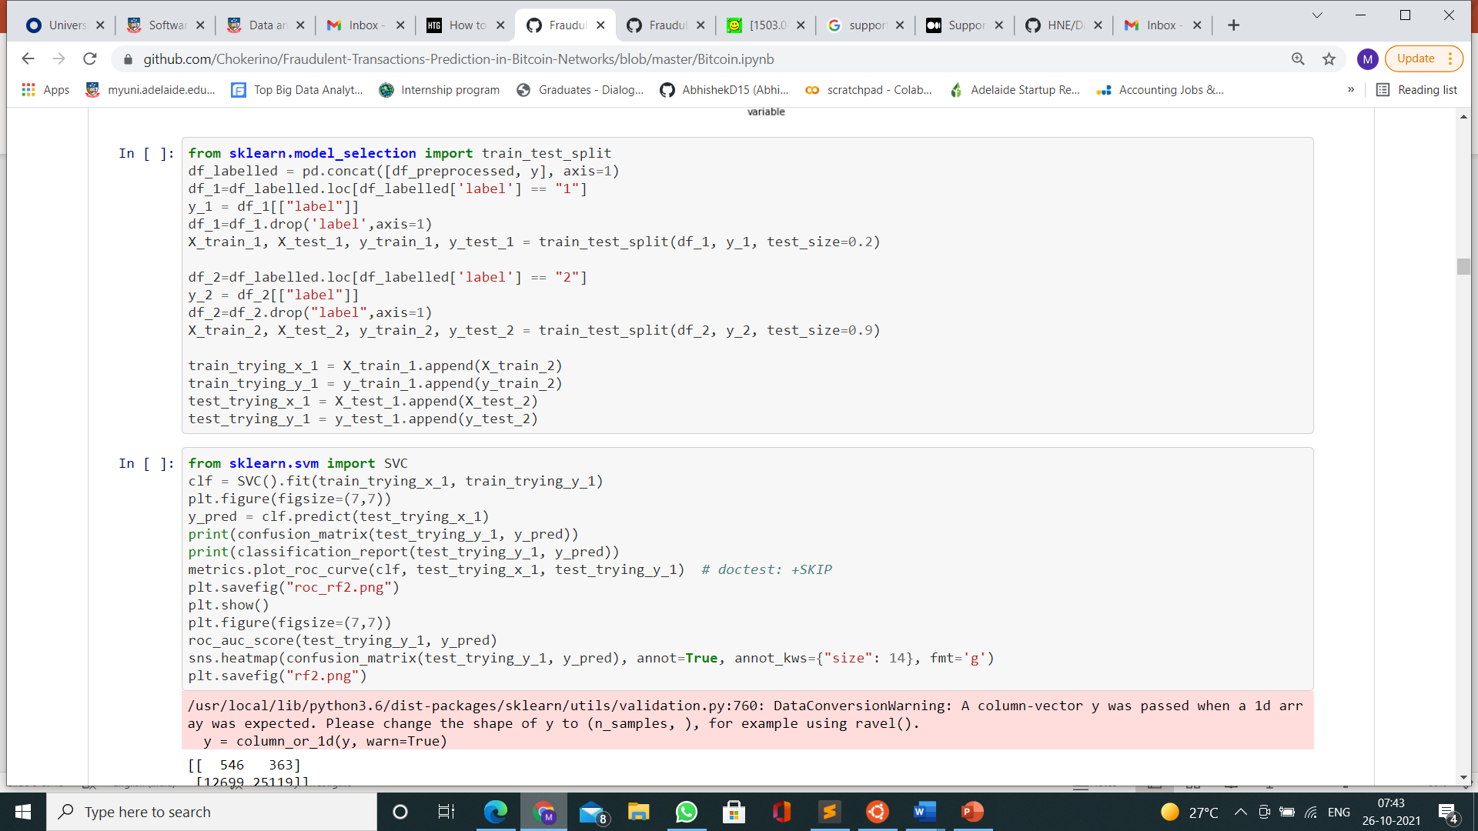
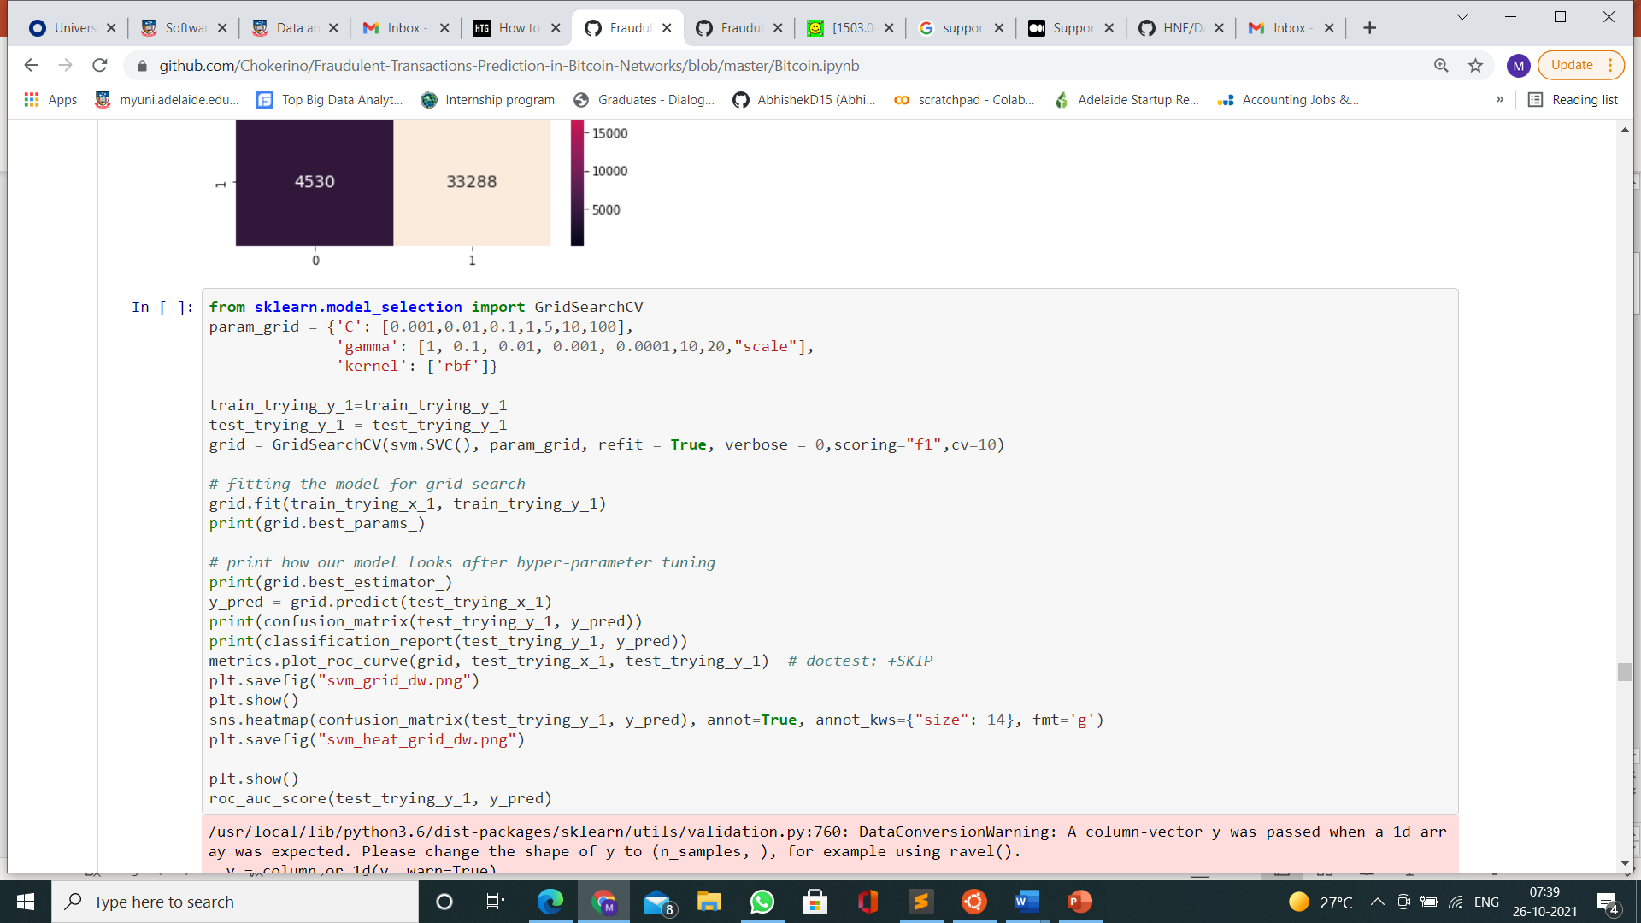
Software style

Slide 5
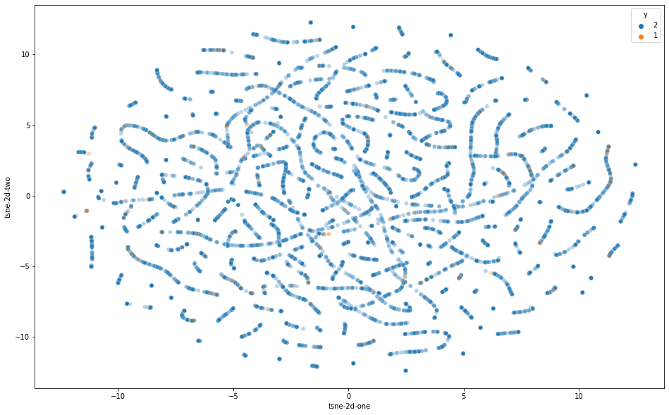
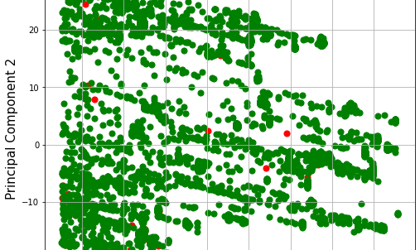
Machine learning implementation
Data Cleaning
Irrelevant columns like column id, time step can be droppedNo duplicate features present
Rows with NaN values are removed
Dropping columns with high collinearity
Feature transformation
Normalization : Features were scaled such that their mean is 0 and standard deviation = 1
Dimensionality reduction using t-SNE and PCA

Slide 6
HANDLING CLASS IMBALANCE
Under-sampling
We can perform stratified under-sampling on the two classes by removing random observation from to create test and trainsets (Requiremement – imbLearn library)
Oversampling using Gaussian Mixture Model:
GMM is an unsupervised learning algorithm which is similar to K-nearest neighbors but instead uses Expectation maximization to estimate normal distributions which fit the data. (Requirement – Scikit learn)
MAIN IDEA : dataset may have observations coming from different subpopulations that have their own characteristics. GMM helps in extracting the subpopulations where each subpopulation is a cluster.
SMOTE
SMOTE is a widely used algorithm for over-sampling which oversamples the minority class by using an approach similar to K-nearest neighbor. It creates new samples for minority class by changing the class of k- nearest samples (Requiremement – imbLearn library)

Slide 7
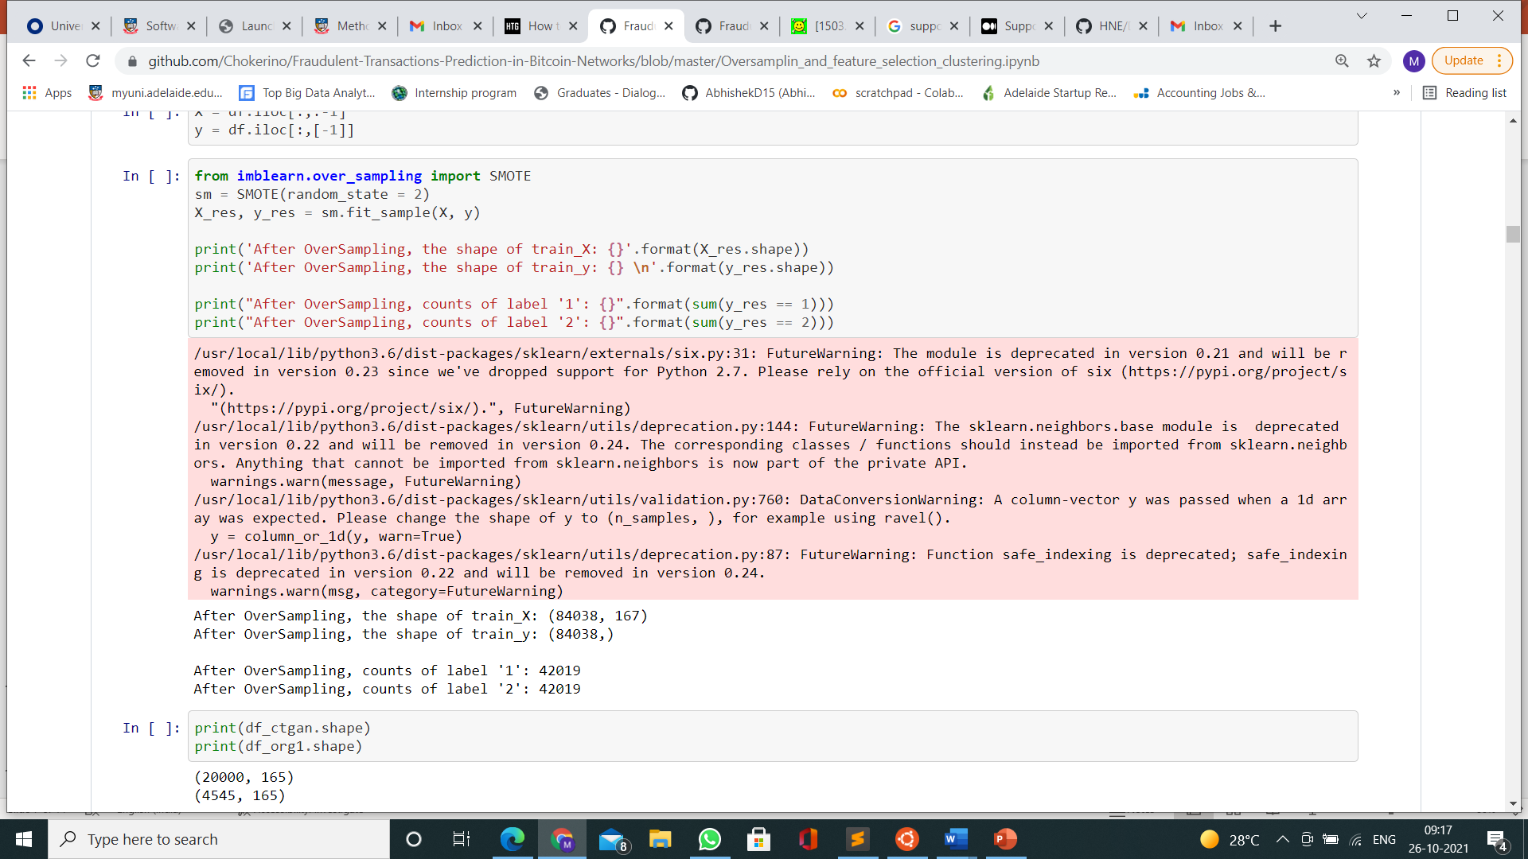
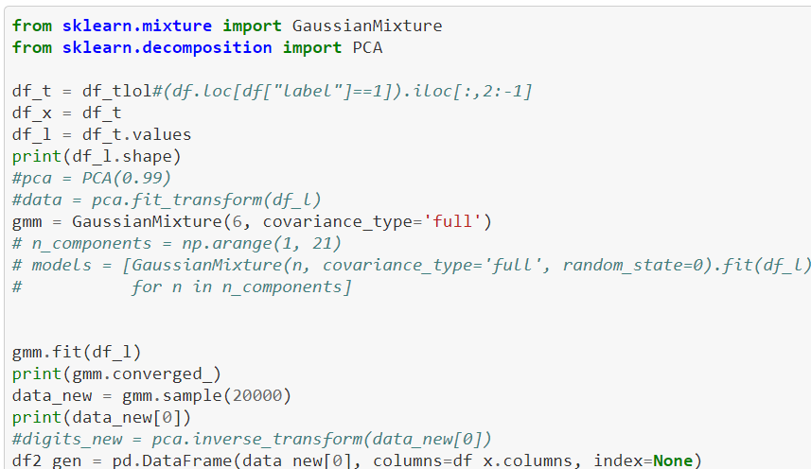
code snippets sowing implementation of smote and gmm oversampling TASKS

Slide 8
CLASSIFICATION TASKS
Several classical ML algorithms like Random Forest, SVM, Logistic regression, multi layer perceptron (MLP) for classification on the oversampled and under-sampled data
DeepWalk Algorithm : a novel approach to learn representation of graphs by walking on vertices. DeepWalk uses local information from its random walks to learn representations of the graph. The random walks can be thought of as small sentences of phrases. These random walks are essential in capturing local community information in the graph which ultimately give a better understanding of the features and the neighbourhood of a node. The DeepWalk algorithm then uses the information retrieved to generate the embeddings of the graph. Once node embeddings are generated use classical ML algorithms on those embeddings.
Evaluation Metrics
RECALL AND F1 SCORE – Our goal is anti money laundering. So our aim is to minimize false negatives and tight threshold on false positives
ACCURACY – Useful metric when class imbalance removed

Slide 9
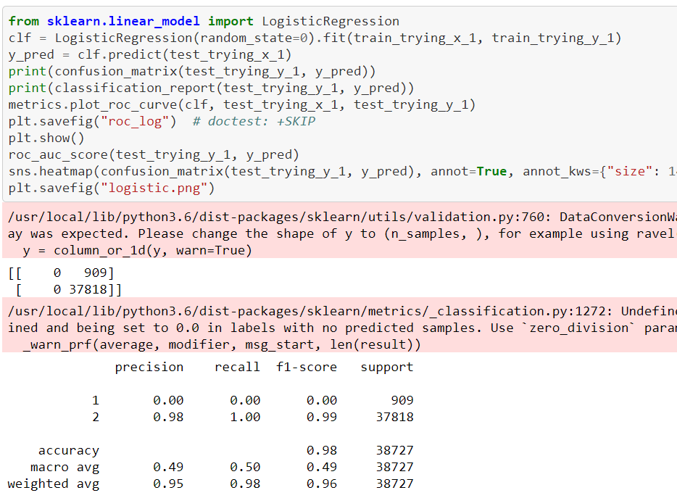
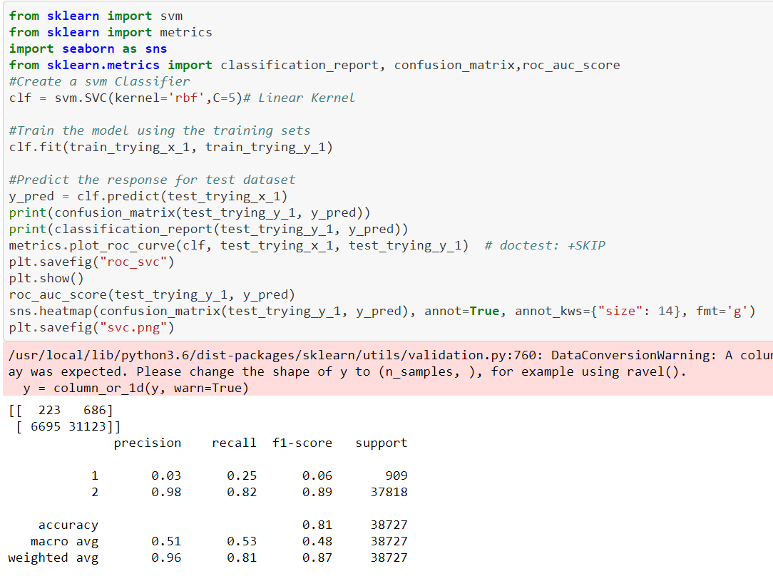
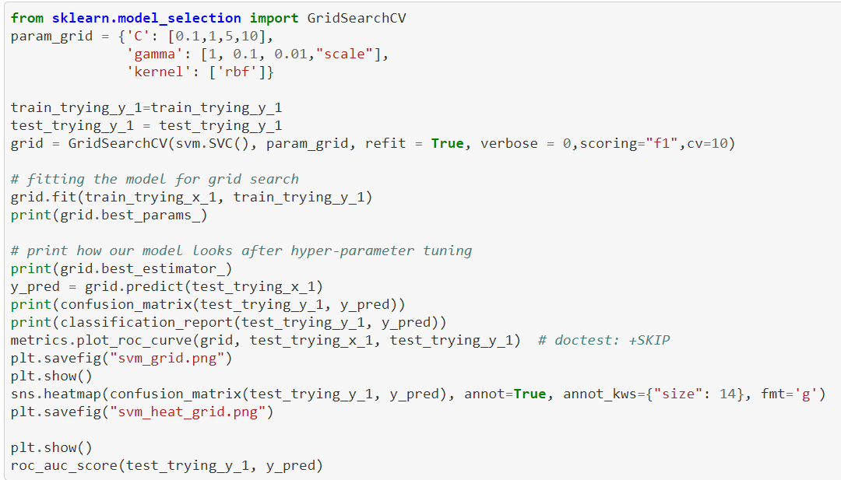
Some Code snippets showing classification tasks

Slide 10
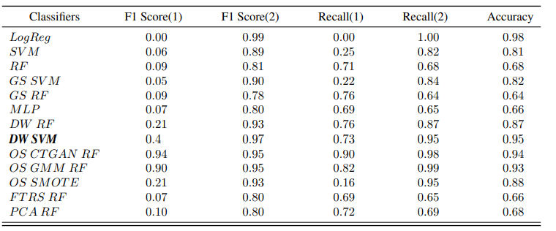
RESULTS
Node embeddings/Features generated by DeepWalk algorithm when used with SVM gives the best results for classification
With features generated by Deepwalk giving better results than regular features, we can say that illicit transactions generally are part of a larger flow of illicit transactions

Slide 11
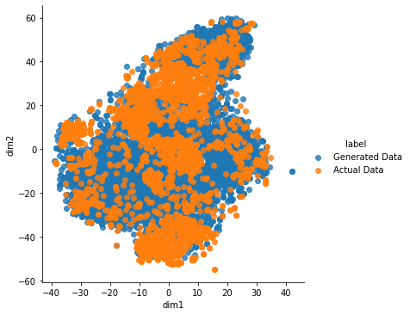
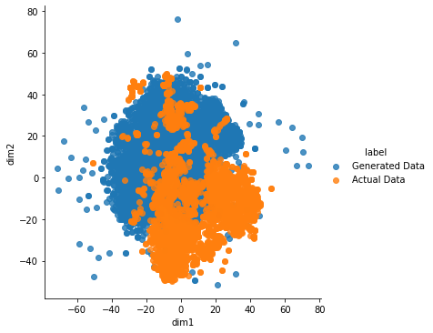
Other Interesting insights from results
Oversampling is better than under- sampling
SMOTE tends to overfit to the data which would mean that it is trying to replicate the samples. However, it appears that there is a better capture of the probability distribution in case of GMM as shown below.
GMM SMOTE
Random Forest performs the best for classification task. Among all the models we tried, Random Forest unequivocally gives the best results when the features provided by the dataset were used

Slide 12
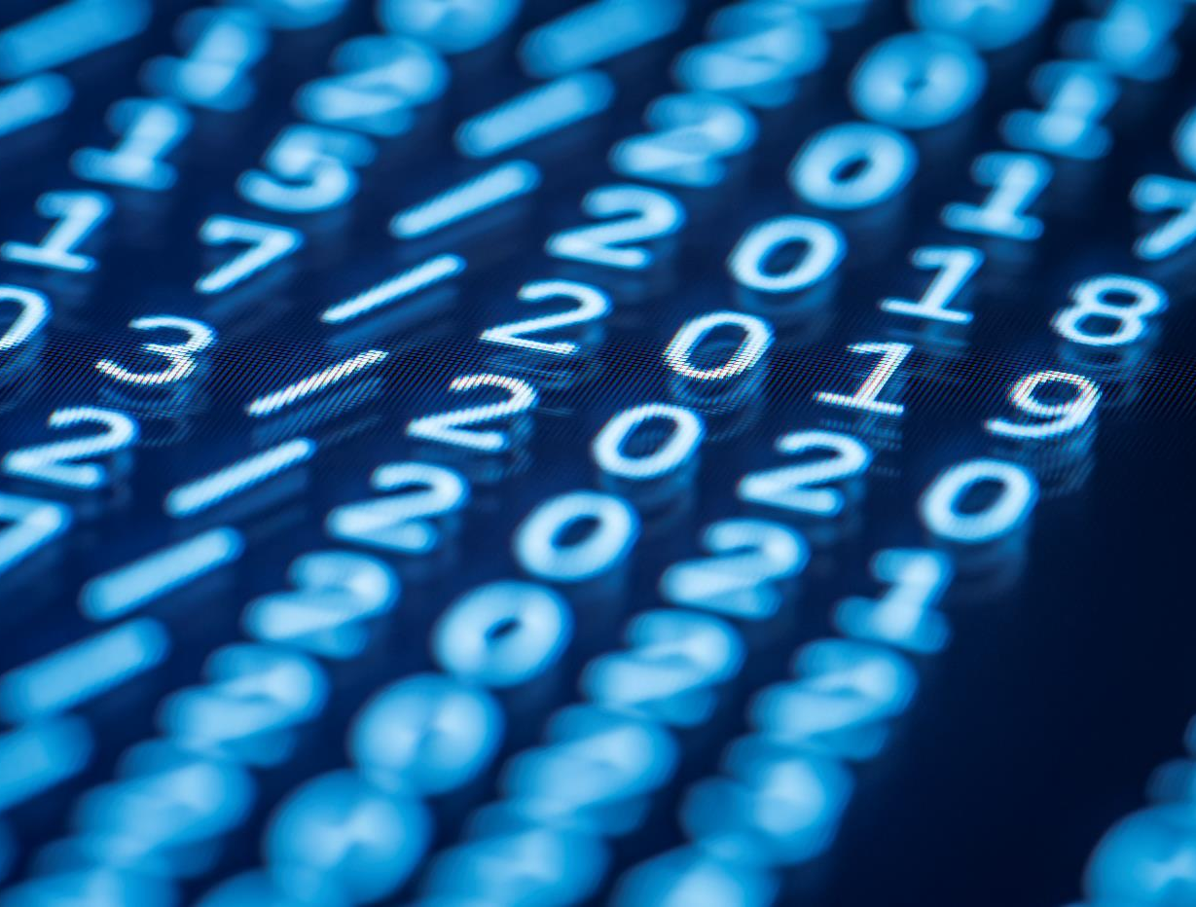
Thank You
a1797096@student.Adelaide.edu.au

