Slide 1


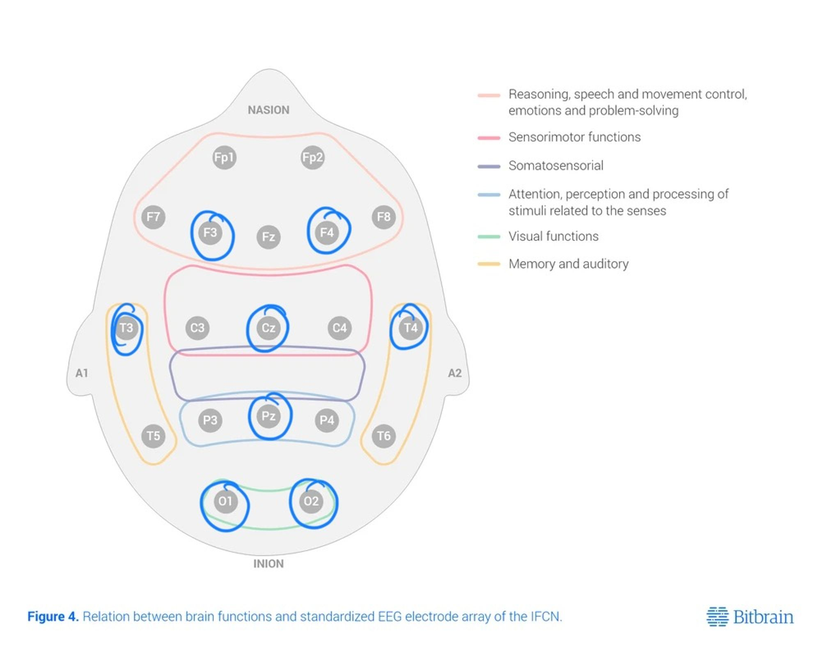
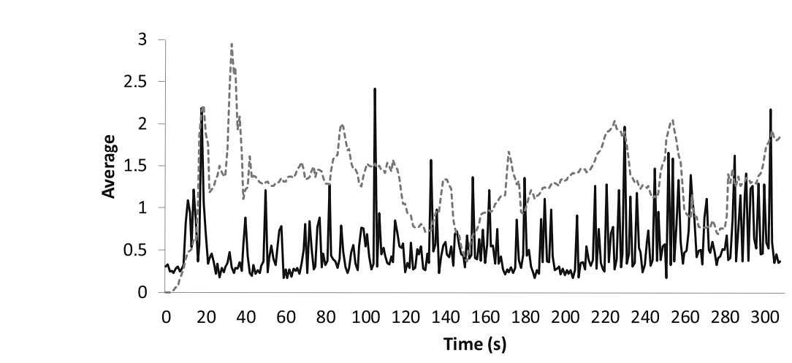
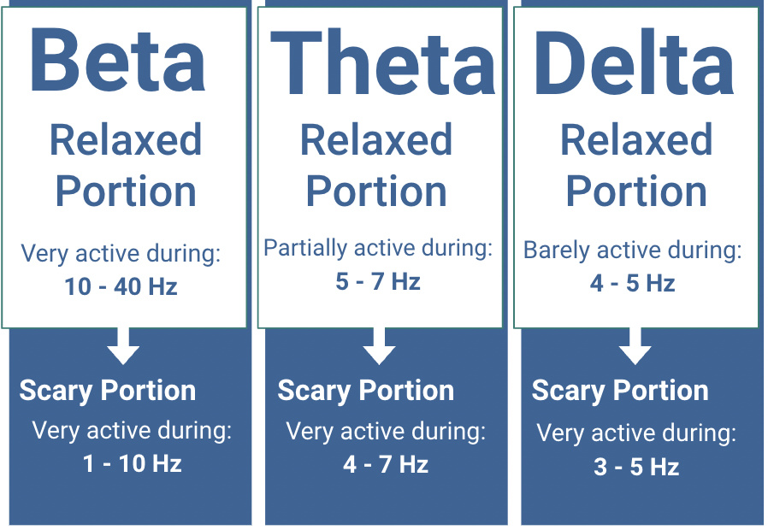
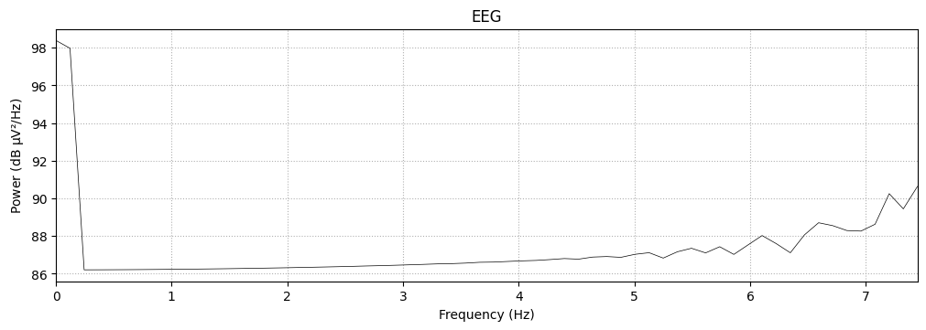
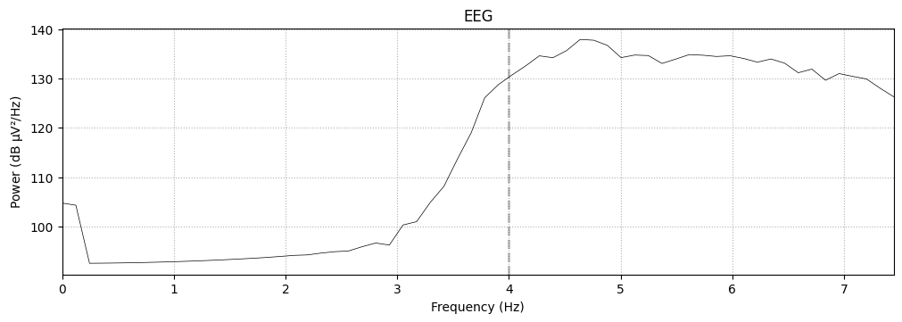
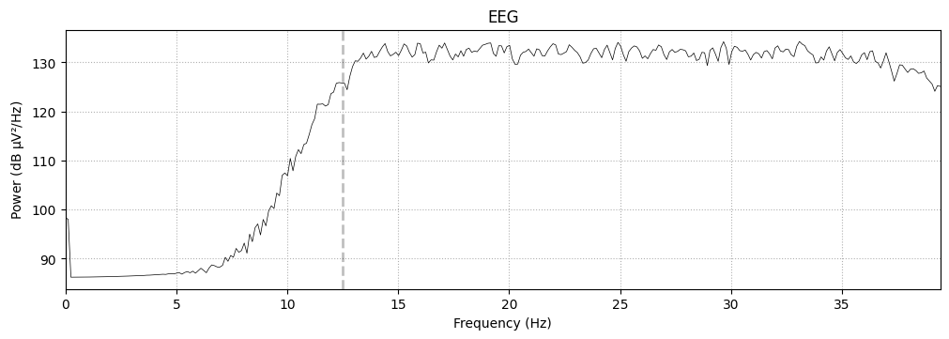
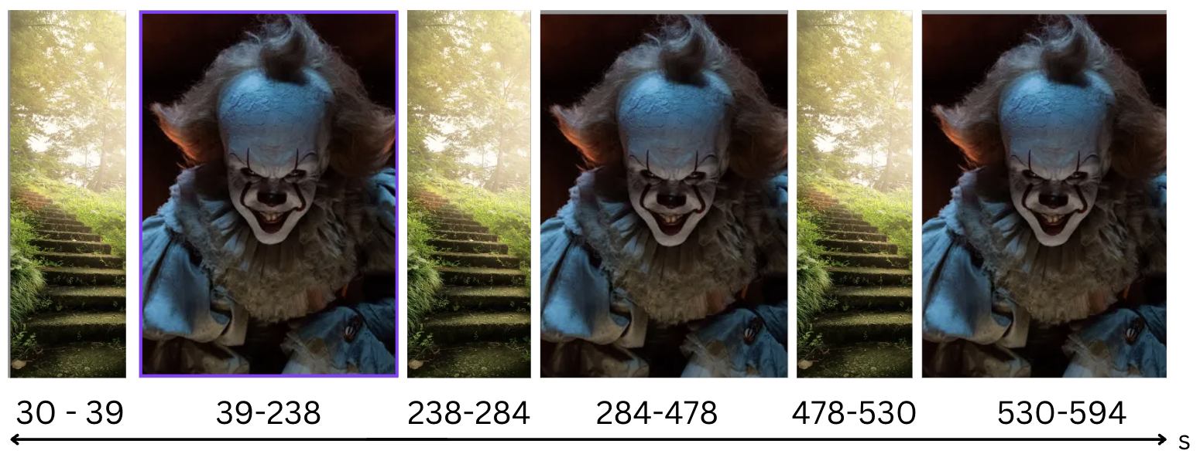
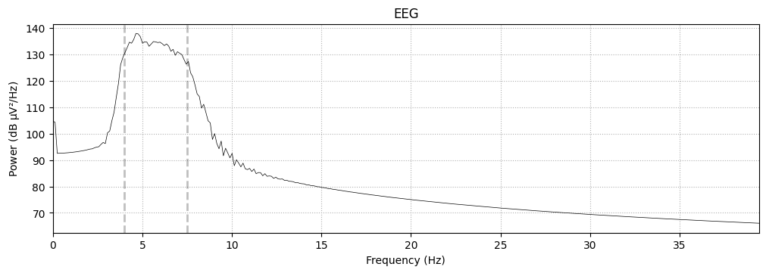
Power Dynamics of Fear Response: An Investigation using Electroencephalogram Data
Manik Sethi, Carlos Paredes, BaoTran Tran, Amit Bhongiri, Rahul Ravindranath, Henry Pacheco
Neurotech@Davis, University of California, Davis, CA
Background
Methods Pt. 1
Results / Conclusion
The amygdala, a key structure in the medial temporal lobe, plays a pivotal role in fear processing. During fear-inducing scenarios, the amygdala initiates a cascade of neural events, leading to the "fight or flight" response. This response involves distinct patterns of brain wave activity, including changes in theta, beta, and delta waves.
The OpenBCI cyton board was used to gather EEG data from consenting participants. Electrode placement can be seen in Figure 1, and was chosen based on research done by Ribas et al^{[2]}. All eight channels were utilized for data collection, and processing of data. Specifically, we chose the “T” electrode placements because of their proximity to the temporal lobe, which is linked to fear processing. The “F” nodes were chosen as the best option to detect amygdala, which is difficult due to how deep it is in the brain. Participants would then be presented with a video, with the experimenter promptly leaving the room. The video had three different segments, with each segment being one of two types of clips. These clips were labeled as being “Scary” or “Relaxed”. Relaxing clips would be scenic shots of the sea, where scary clips were scenes from popular horror movies. The aim of showing relaxed clips before was to collect baseline data, as well as to calibrate the participants brain activity to help guide further analysis. Participants were also instructed before the start of the trial on how to end data collection in an effort to reduce extraneous data at the end.
After collecting data, and processing it, we noticed an interesting difference between the beta waves, and the theta and delta waves. Plotting the power spectral density graph of the latter two as shown in figures 1 and 2, we notice that existing frequencies only become stronger, this trend did not occur with the beta waves. Taking a look figure 5, we can see frequencies in the >12.5 Hz range are already elevated. Once our participant is exposed to the scary stimulus, the band “inverts”, and frequencies that were inactive before become active, and vice versa. From these findings, we can conclude that while these three bands are all strong correlates of fear, the beta band has its own unique behavior. We currently do not have any suspicions as to why this phenomena occurs.
Figure 2: EEG Node Placements
Figure 1: Theta brainwaves (solid black) compared to rotary meter values (dashed grey)
By analyzing these brain wave patterns using electroencephalography (EEG), researchers can quantify fear responses in human subjects. Ongoing investigations leverage these findings to develop brain-computer interfaces (BCIs) and machine learning algorithms for applications in neuroscience, psychology, and safety.
Methods pt. 2
Following data collection, we advanced to the pre-processing phase. Initial steps involved subjecting our data to a band-pass filter spanning frequencies from 0.5Hz to 45Hz. This filtering technique effectively mitigated noise and electrical interference while preserving frequencies associated with theta, delta, and beta bands of interest. Next, an Infinite Impulse Response (IIR) filter was used to amplify desired signals while eliminating noise. Further refinement involved segmenting each participant's data into three distinct sections corresponding to specific segments of the video stimulus. Each segment was averaged out, and underwent band-specific processing through tailored filters, aligning with the frequency ranges characteristic of Theta, Delta, and Beta bands. This process yielded six graphical representations for each participant, composed of two averaged trials, each annotated with band-specific data points.
Figure 3: Theta waves from participant during relaxed state
Aim
Acknowledgements
Our BCI (Brain Computer Interface) project aims to predict, and gain a deeper understanding of the power dynamics for waves involved with fear. We hope to discern patterns of how different frequencies behave when introduced to scary stimuli, and lay the foundation for future projects. Such future projects may include determining the feasibility of using EEG devices to track fear response in real time, and prevent the consequences of such fear. We see our research being used to create a neural “kill-switch”, and ultimately lead to a safer world.
We would like to thank several individuals and organizations for making this project possible:
Neurotech@Davis for supporting our project from the beginning by giving us valuable resources and guidance
Dr. Moxon and her lab for providing the resources needed to materialize the project
Figure 4: Theta waves from participant during scared state
References
Possibilities / Limits
1. Man, Jeroen De, and Nicolette Stassen. Analyzing Fear Using a Single-Sensor EEG Device, https://eudl.eu/pdf/10.1007/978-3-319-49616-0_8.
2. Ribas, Valdenilson Ribeiro et al. “Pattern of anxiety, insecurity, fear, panic and/or phobia observed by quantitative electroencephalography (QEEG).” Dementia & neuropsychologia vol. 12,3 (2018): 264-271. doi:10.1590/1980-57642018dn12-030007
3. Center for BrainHealth. "EEG study findings reveal how fear is processed in the brain." ScienceDaily. ScienceDaily, 15 September 2014. <www.sciencedaily.com/releases/2014/09/140915165258.htm>.
A limitation of this project was recording accurate data due to equipment and the location of the part of brain that we wanted to observe. Not only would better equipment make this endeavor much more accurate, but considering a switch from surface level EEG to invasive EEG would prove much more effective albeit a rather aggressive approach. Given our results, we hope to have laid foundational research for developing neural “kill-switches”. Through our data, builders of these mechanisms will know what behaviors to look for.
Figure 5: Beta waves from participant during relaxed state
Figure 7: Sequential presentation of scary stimuli (clown) followed by baseline periods (grass staircase) in video experiment.
Figure 6: Beta waves from participant during scared state

