Slide 1

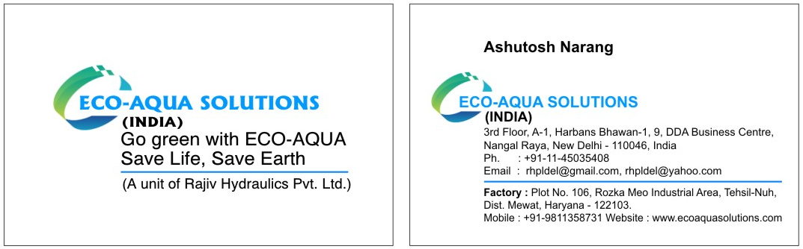
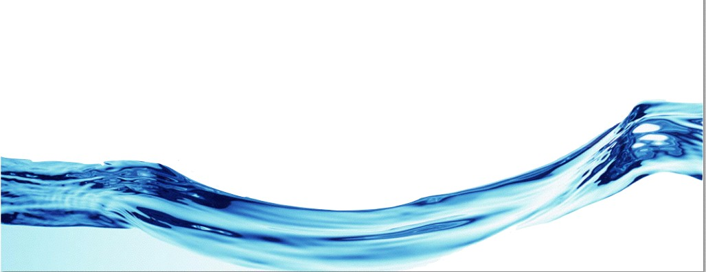
“Green” Disinfection Systems: New Era of Electrochemical activation of solutions (ECAS) Technology

Slide 2
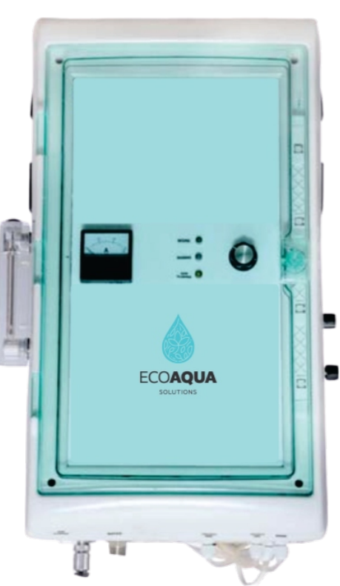
ECOAQUA overview
It is an onsite disinfectant generation system
Provides a high capacity disinfectant with consistent quality
Its application reduces the safety and cost issues associated with handling and storage of legacy disinfectants
The device is wall mounted
Negligible power consumption

Slide 3
ECOAQUA Technology
ECOAQUA works on the principle of electrolysis, the device has an electrolysis chamber containing a dilute NaCl solution (Brine). The chamber includes a diaphragm (membrane or septum), which is used to separate the cathode and anode.
The disinfectant DESY is generated at the anode consisting of active ingredient HClO (hypochlorous acid) and available chlorine content of 0.2%.

Slide 4
Anolyte DESY
Hypochlorous acid is an oxyacid chlorine and an active ingredient of DESY
Hypochlorous Acid is recognized by USFDA as one of the most effective alternative to traditional chemical biocides.
Green and Ecofriendly
No disinfection biproducts (DBPs)
Dissociates spontaneously after use and does not require neutralization or washing
Effective at neutral pH (6.5-7.5)
0

Slide 5
DESY disinfection efficacy
  100 times more biocidal than chlorine bleach
  Effective against G⁺ and G⁻ bacteria(>6 log reduction in 1min)
  Effective against Clostridium difficile spores
  Effective against VRE, MRSA, and MRSE
  Effective against Mycobacterium tuberculosis
  Effective against HIV, HBV, HCV, and CMV
  Effective against Fungi (>6 log reduction in 1min)
  Effective against bacterial and fungal spores (6 log reduction in 1min)

Slide 6
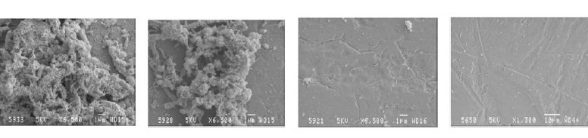
Effect of DESY on BIOFILMS
Biofilm before treatment After treatment by After treatment by After treatment by
AQUAECA DESY 0.5% AQUAECA DESY 5% AQUAECA DESY 50%

Slide 7
ECOAQUA device Installation
Installation requirements: Floor space for installation of ECOAQUA apparatus must be over 3 square meters (space for maintenance included).
Requirement of salt: Use pelletized salt with a sodium chloride content of not less than 98% or chemically pure grade.
Note: Do not use table salt with iodine and fluorine.
The requirement to water: Mechanical filter at the inlet of feeding water line is mandatory, the water used must be potable fresh water. If TDS is over than 5 mEq. / L or 200 ppm it is necessary to use water softeners.
Power voltage : of 220 V, 50 Hz, power consumption of 300-500 watts

Slide 8
Safety of DESY
For environmental decontamination applications within habitable spaces, clearly certain biocides are too toxic (e.g., phenolics and glutaraldehyde) or flammable (e.g., alcohols) or have the potential to leave unwanted residues on surfaces (e.g., iodophors). DESY is not flammable and not known to release harsh chemicals.
Acute Oral Toxicity studies showed A No Observed Adverse Effect Level (NOAEL) even at 300ppm levels of chlorine
Respiratory and Inhalation Effects: A 2-year chlorine gas inhalation study with rats showed no evidence of carcinogenicity
Dermal Toxicity: No toxicity was observed in rats even at 8hr exposure levels

Slide 9
Comparison ECOAQUA with legacy Technologies

Slide 10
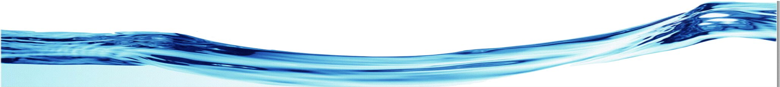
Comparison of Sodium Hypochlorite
ECOAQUA technologies | Tradition methods using sodium (Calcium) hypochlorite
No Disinfection biproducts | >60% DBPs including trihalomethanes
Complete destruction and inhibition of biofilms | No effect on biofilms
Does not cause resistance in microorganisms | Can lead to development of microbial resistance
Non-corrosiveness to metals | Hypochlorites are highly corrosiveness to metals
pH 6.5-7.5 | pH>10
Effectiveness against Giardia, Cryptosporidium, Legionella | Not effective
Safe for environment | Hazardous
Non Toxic | Highly toxic

Slide 11
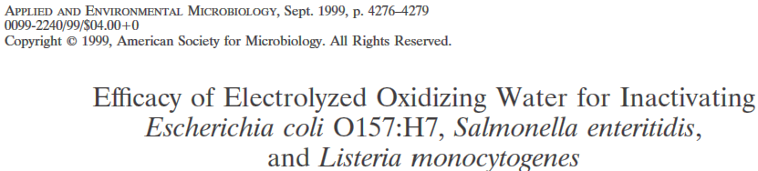
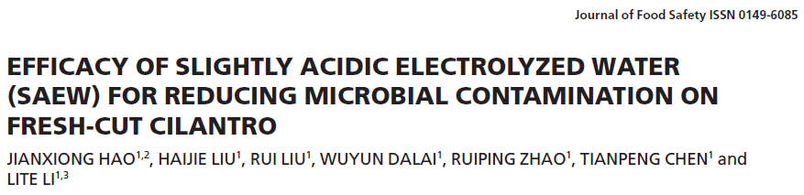
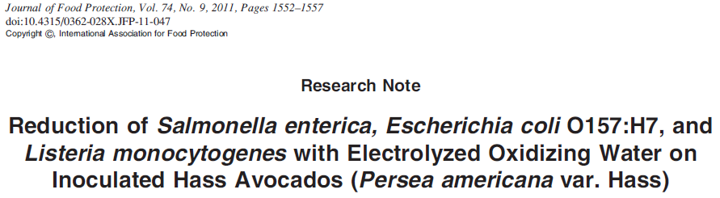
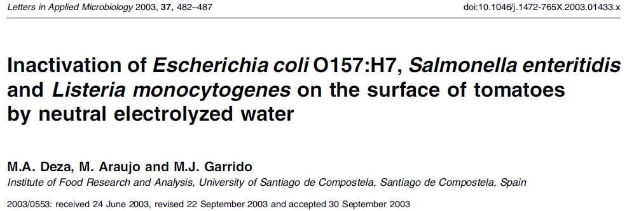

Peer Reviewed Literature on
Electrolyzed Water
Simple elixir called a ‘miracle liquid’
By MARLA DICKERSON
FEB. 23, 2009 12 AM
LOS ANGELES TIMES STAFF WRITER

Slide 12
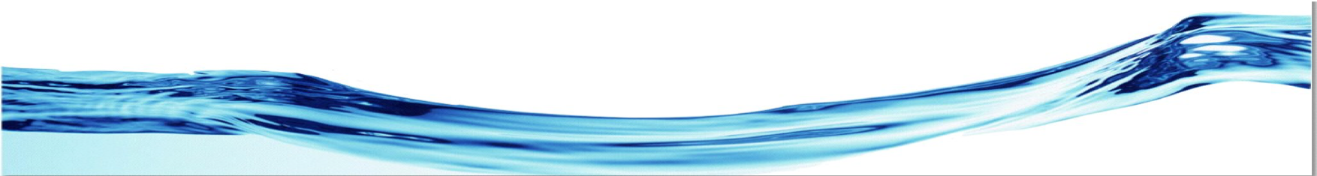
Application of ECOAQUA
In Hospital setup
DESY sanitizer is totally non-corrosive
DESY is stable in solution, it can be applied through many different methods. In addition to direct application through spray bottles and mops, it can also be applied broadly using fogger.
Hospital Sanitation: DESY can be used to sanitize all contact surfaces in the hospital including patient rooms, hospital beds, chairs, medical equipment and instruments, nursing stations, surgery rooms, floors, and bathrooms.
Sanitation of Quarantined wards
Linen sanitation

Slide 13
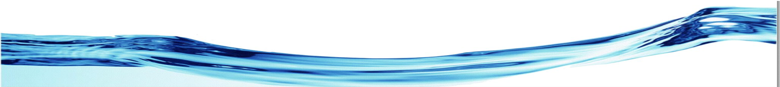
ECOAQUA Certifications
The U.S. Environmental Protection Agency (the “EPA”) approved HOCL disinfecting solution (electrolyzed water or superoxidized water) as a high capacity disinfectant (https://www.cdc.gov/infectioncontrol/pdf/guidelines/disinfection-guidelines-H.pdf)
Is an FDA approved sanitizer that meets 21 CFR 178.1010.
FDA approved under 21 CFR 173.315 for direct contact with processed foods.
FDA approved for several indirect food contact applications under 21 CFR 172.892, 21 CFR175.105,
FDA decision #692 allows for vegetable & fruit produce washing using Electrolyzed Water.
FDA approved for several indirect food contact applications under 21 CFR 176.170 & 21 CFR177.2800.
FDA approved under 21 CFR 7120.1 for spray and water treatment for processing of beef, poultry & pork.
Exempt by the EPA under 40 CFR 180.1054 for washing raw foods that are to be consumed without processing.
Exempt by the EPA under 40 CFR 180.940 provided that the Electrolyzed Water is applied on a semi-permanent or permanent food-contact surface with adequate draining before contact with food.

Slide 14
Thank you for your valuable attention
ASHUTOSH NARANG :9811358731 PRIYA VERMA : 9650013909

