Slide 1
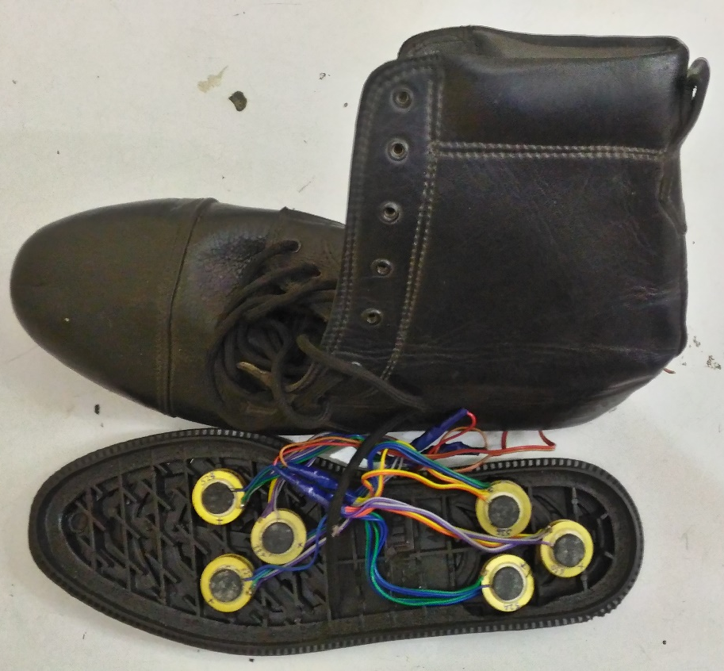
Energy Harvesting Using Piezoelectric Materials

Slide 2
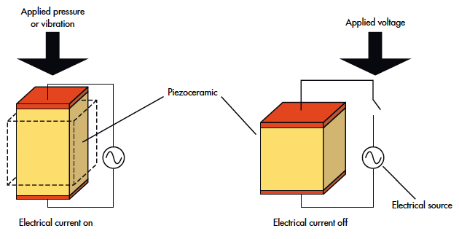
PIEZOELECTRIC MATERIAL
Piezoelectric materials can be used as mechanisms to transform mechanical energy, usually ambient vibration into electrical energy that can be used to power other devices. The practice of harnessing the energy around a system and converting it into usable power is termed power harvesting. By implementing power harvesting devices, portable systems can be developed that do not depend on traditional methods for providing power, such as the battery, which has a limited operating life.

Slide 3
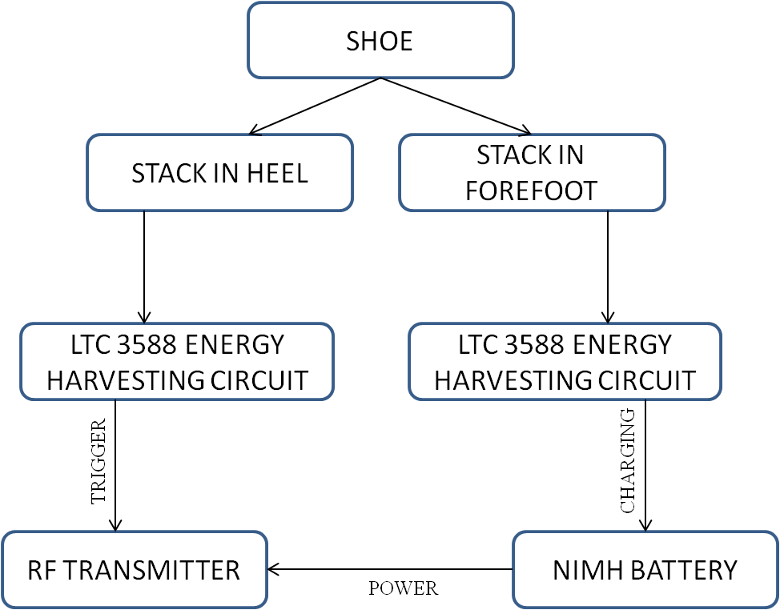
BLOCK DIAGRAM OF SHOE-POWERED TRANSMITTER CUM BATTERY CHARGING MODULE

Slide 4
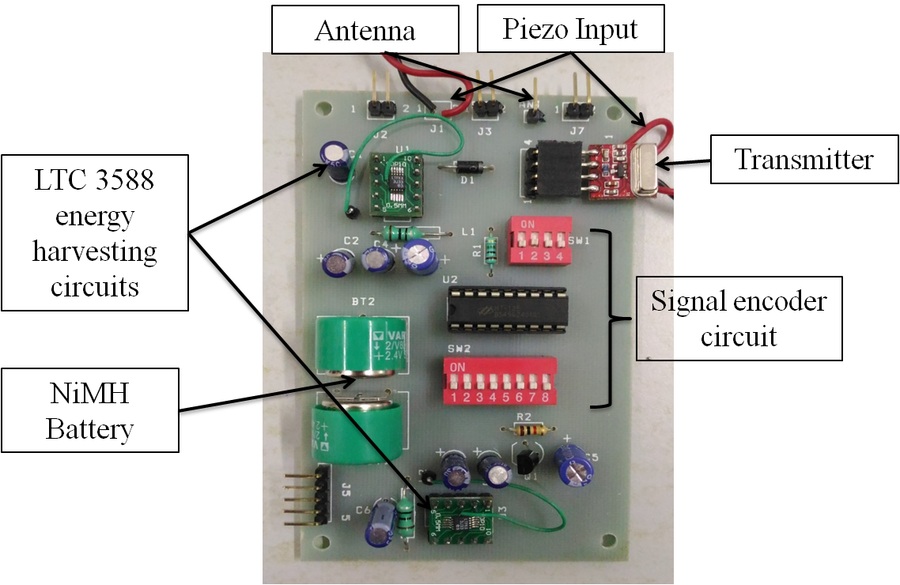
Shoe-powered transmitter circuit

Slide 5
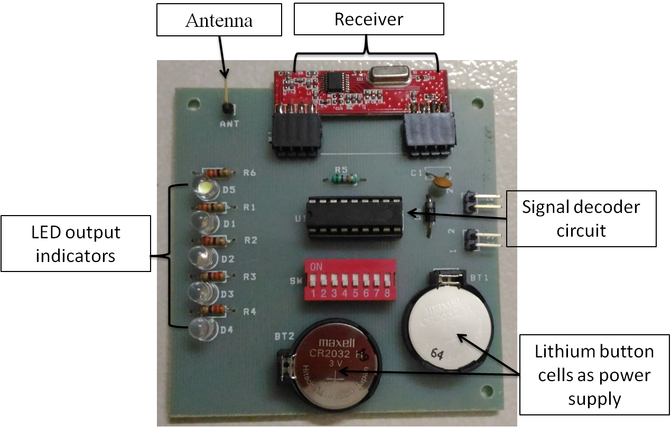
Receiver circuit

Slide 6
SPECIFIC APPLICATION
Retrieving energy from the piezoelectric material embedded in the base of a human shoe.
The weight and pressure exerted by the human while walking, running or standing will create enough energy to charge the battery.
Men in the army patrol wide areas irrespective of the freezing weather or the extremely hot desert climate. They have to guard their country’s border at all times.
This project aims at banking on the energy produced while they are patrolling the border by embedding piezoelectric materials in their shoes
This can be used in cases of emergency, for example: if a soldier gets stuck in snow or an avalanche and he runs out of power to feed his emergency devices to contact his comrades, the energy obtained from the piezoelectric materials incorporated in the shoe will be used to power emergency signaling devices (mobile phones, transceiver, gps system).

Slide 7
DEMONSTRATION
video

