Slide 1
Text Summarization and Classification App
NLP Project (Phase 2)
DSCI-6004-03
By – Manik Malhotra(00803820)

Slide 2
Introduction
Developed an application for document summarization and text classification.
Purpose and Goals: Simplify text analysis tasks for users.
Overview of Technologies Used: Flask, Hugging Face Transformers, spaCy, TextBlob, etc.

Slide 3
Objectives
Text Summarization: Generate concise summaries of input documents.
Text Classification: Categorize documents into predefined classes.
User-Friendly Interface: Provide a simple and intuitive experience.

Slide 4
Technologies Used
Flask (Backend): Micro web framework for building the application.
Hugging Face Transformers
(DistilBERT, BART): Pre-trained models for document summarization and classification.
spaCy (Named Entity Recognition): Library for natural language processing tasks.
TextBlob (Sentiment Analysis): Library for processing textual data.

Slide 5
Architecture
1. Frontend:
User Interface (UI):
Input Section:
Allows users to upload a document or enter text.
Buttons:
"Summarize": Triggers the document summarization process.
"Classify": Triggers the text classification process.
"Clear": Clears the input and output sections.
Output Sections:
"Summary": Displays the generated summary.
"Word Frequency": Shows word frequency analysis.
"Named Entities": Displays entities recognized in the text.
"Sentiment": Presents sentiment analysis (if included).
"Length Information": Shows word and character count.
"Classification Output": Displays the predicted class and probabilities.

Slide 6
Architecture
2. Backend (Flask):
Routes:
Summarize Route (/summarize):
Receives document text from the frontend.
Calls functions for document truncation and summarization.
Performs word frequency analysis and named entity recognition.
Sends the summarized information back to the frontend.
Classify Route (/classify):
Receives document text from the frontend.
Calls the text classification function.
Sends the predicted class and probabilities back to the frontend.
Index Route (/):
Renders the main page (HTML template).

Slide 7
Interactions
Interaction:
1.User Interaction:
User uploads a document or enters text.
Clicks on "Summarize" or "Classify" buttons.
2.Frontend to Backend:
Sends document data to the respective routes (Summarize or Classify) via POST requests.
3.Backend Processing:
Processes the document data, extracts features, and performs analysis.
4.Backend to Frontend:
Sends the results (summary, analysis, classification) back to the frontend.
5.Frontend Update:
Updates the UI with the generated summary and analysis.

Slide 8
Features
Summarization: Condense lengthy texts into shorter summaries.
Word Frequency Analysis: Identify and display frequently occurring words.
Named Entity Recognition: Extract entities (e.g., persons, organizations) from text.
Text Classification: Categorize documents into predefined classes.

Slide 9
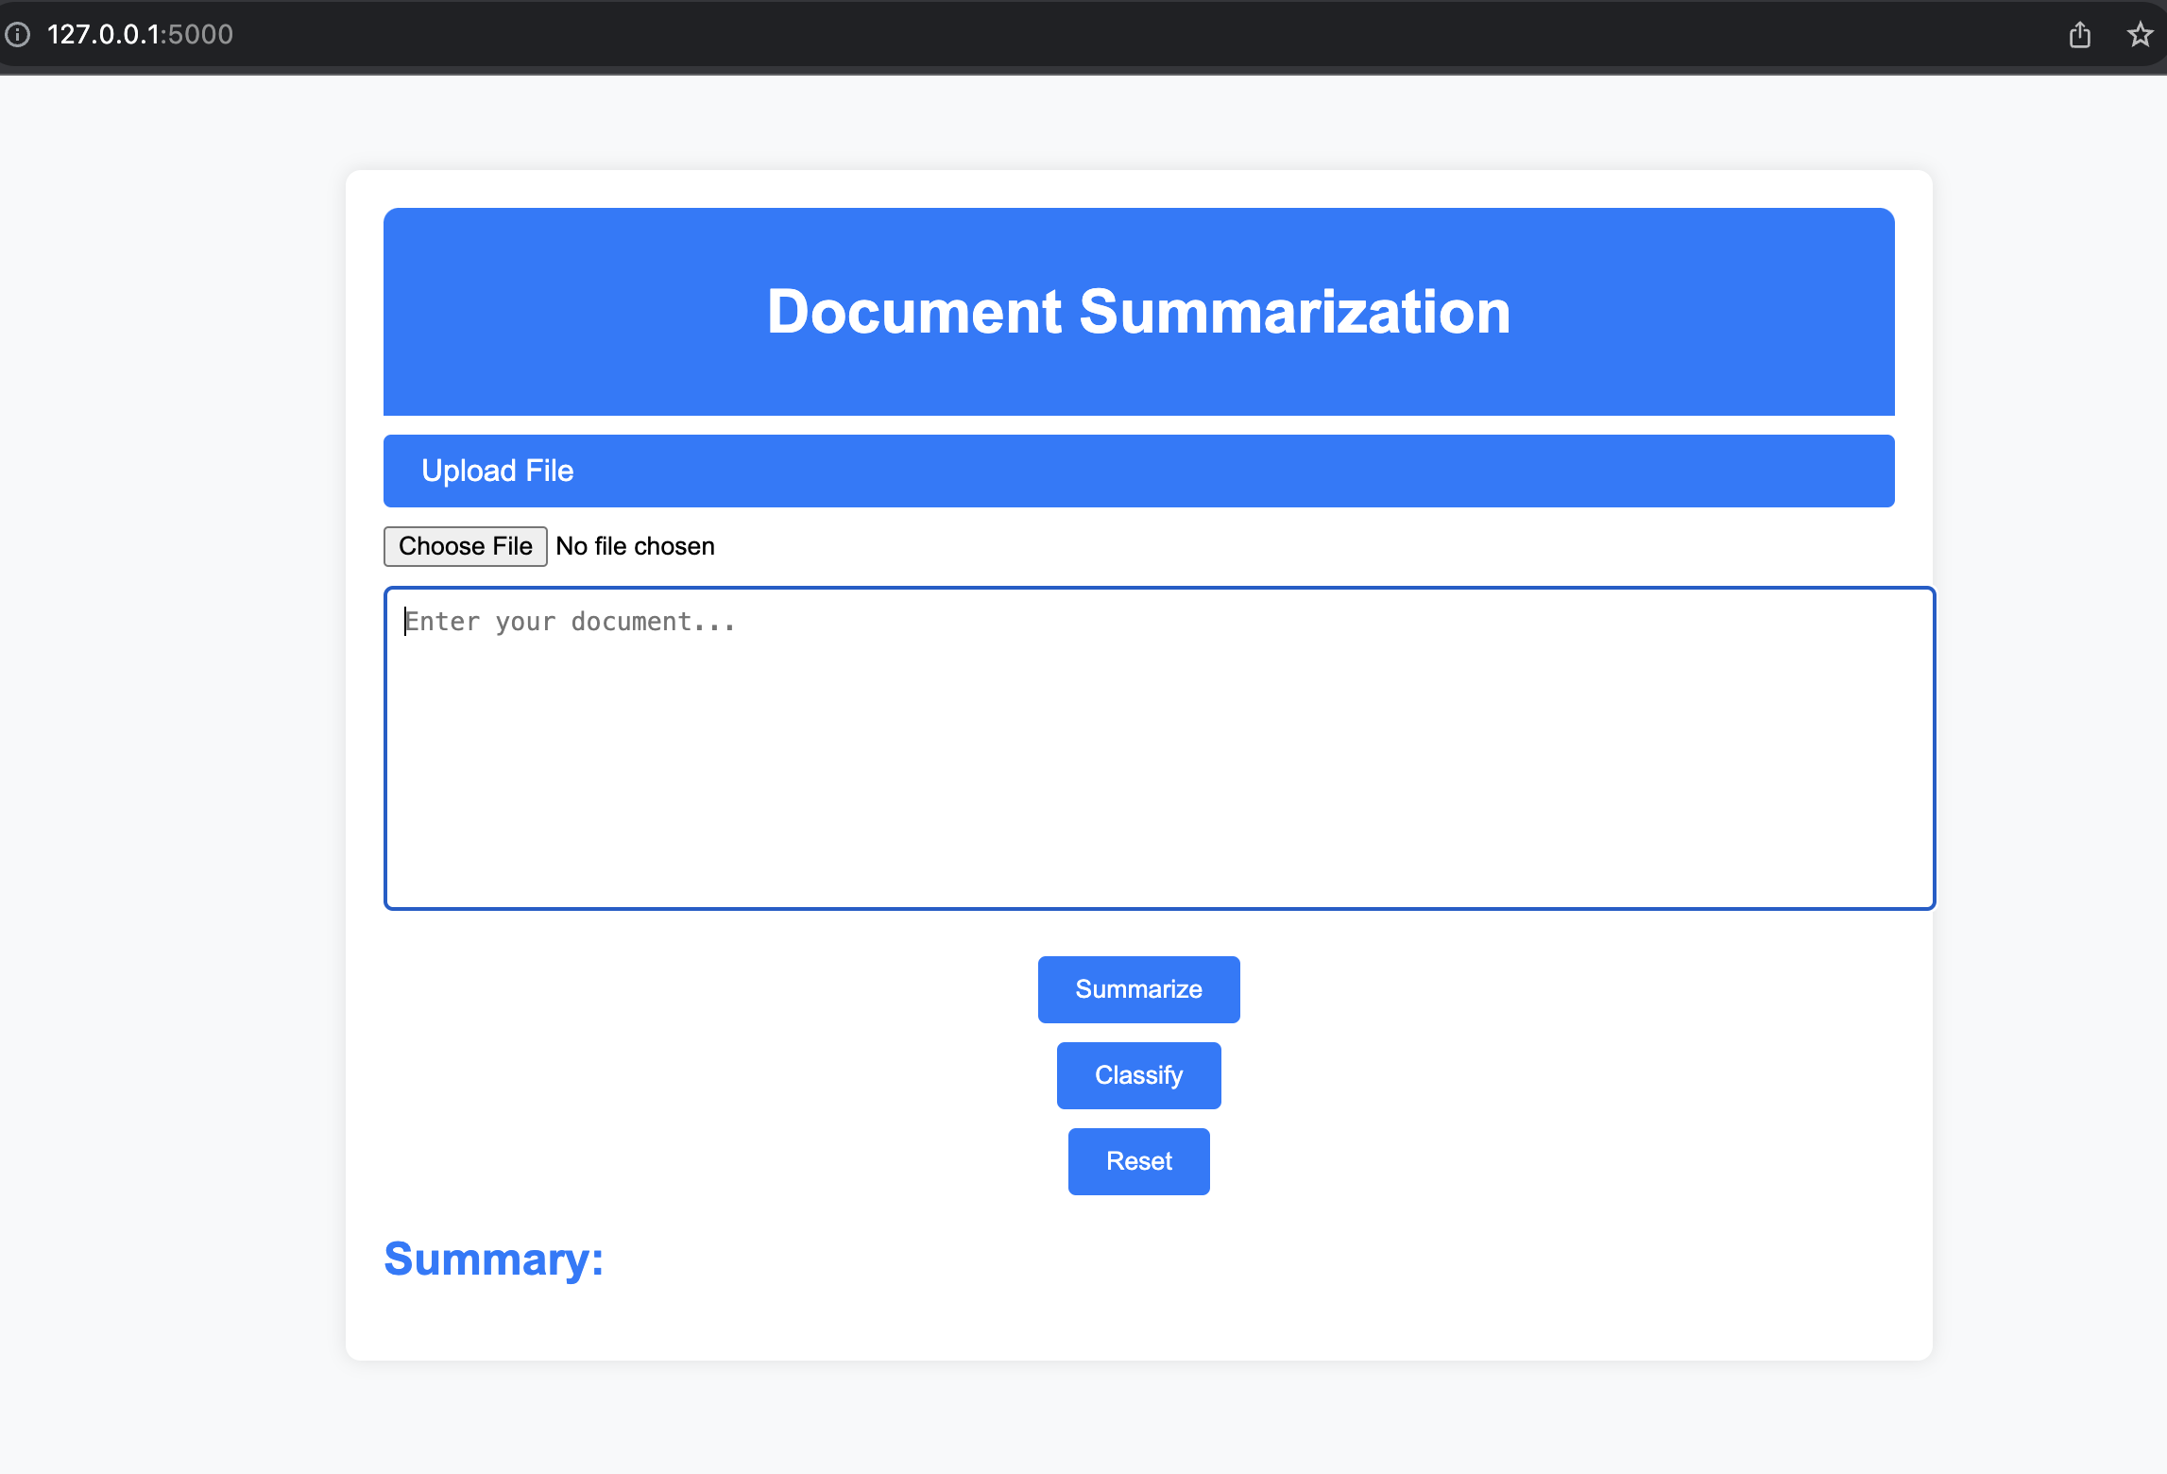
DEMO

Slide 10
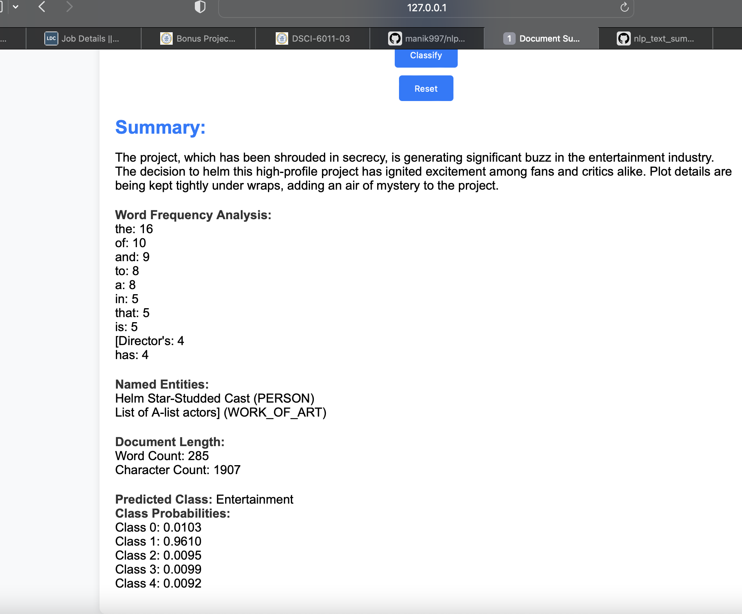
DEMO

Slide 11
Document Summarization
BART leverages a transformer architecture, attention mechanisms, and autoregressive generation to produce high-quality and coherent summaries. Its training objective and length constraints contribute to the model's ability to generate concise and meaningful summaries of input documents. BART leverages a transformer architecture, attention mechanisms, and autoregressive generation to produce high-quality and coherent summaries. Its training objective and length constraints contribute to the model's ability to generate concise and meaningful summaries of input documents.

Slide 12
Text Classification
The fine-tuned DistilBERT model plays a central role in the classification process, leveraging pre-trained contextual embeddings to classify input documents into a specified number of classes (in this case, 4 classes). The integration with the Flask app allows users to obtain classification results by submitting their text through the user interface.
Classes – Politics, Sports, Technology, Entertainment, Others

Slide 13
Challenges and Solutions
Challenges Encountered During Development: Limited Resources, Model Fine-Tuning.
Solutions Implemented: Optimization, Error Handling.

Slide 14
Future Enhancements
Potential Features or Improvements: Multi-Document Summarization, Real-Time Analysis.
Feedback and Contributions Welcome: Encourage users to provide feedback.

Slide 15
Conclusion
The document summarization and classification app successfully leverage cutting-edge NLP models, providing users with efficient summarization and accurate document categorization. While achieving notable success, areas for improvement include processing speed and enhanced user feedback mechanisms. This app also provide valuable features such as word frequency counts, NER, Total words and much more.!!!

Slide 16
References and Resources
https://github.com/manik997/nlp_text_summarization/tree/main

