Slide 1
Android
Besant Technologies
Manikandan selvanathan

Slide 2
Syllabus
Basics of Android
UI Widgets
Activity, Intent & Fragment
Android Menu
Layout Manager
Adapter
Views
Advanced Android
Android Service
Data Storage
SQLite
XML & JSON
Content Provider
Notification
Location
Web services
Firebase
Animation
Multimedia
Speech
Sensor
Google Map
Graphics
Release Management

Slide 3
Basics of Android
What is Android?
Why Android?
Features of Android
Categories of Android applications
History of Android
Architecture
Android software stack
Application Sandbox

Slide 4
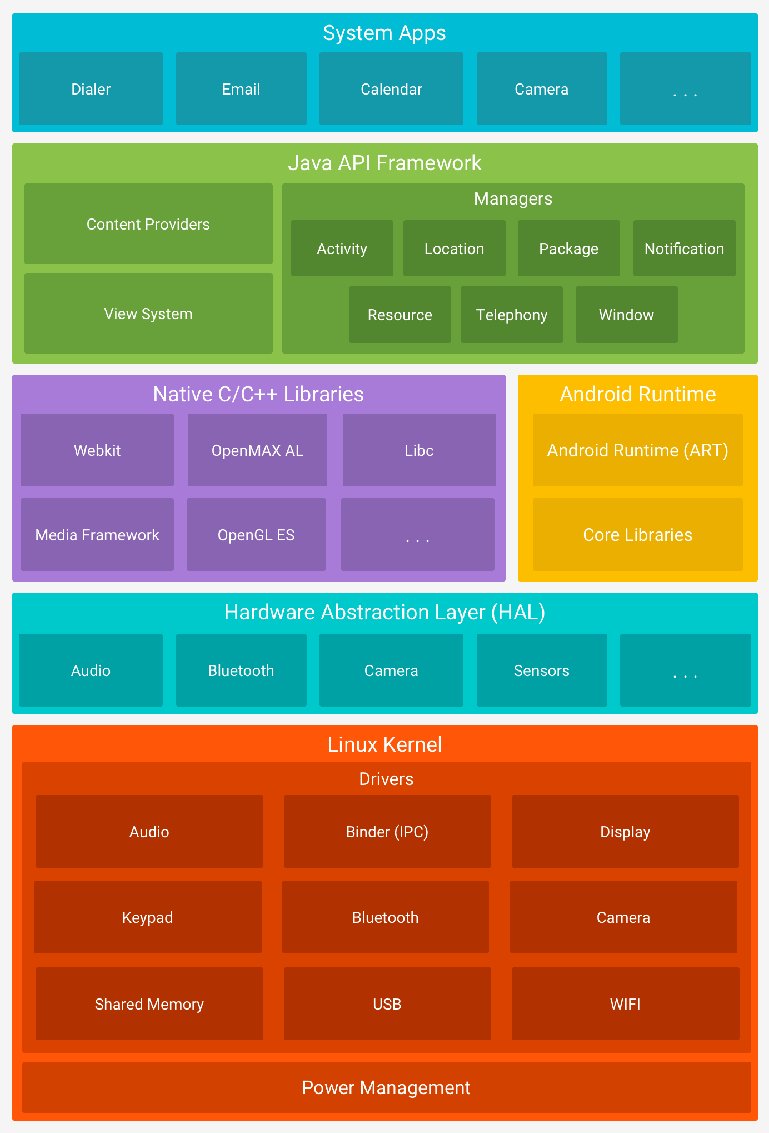
Android Stack

Slide 5
Application Sandbox
Multiple application at the same time
Assign unique User Id to each application and separate process.
Cannot interact with other system apps.

Slide 6
Android Studio
Installation
https://developer.android.com/studio/
First App

Slide 7
Types of Activities
Splash Activity – Entry point
<intent-filter> <action android:name="android.intent.action.MAIN" /> <category android:name="android.intent.category.LAUNCHER" /> </intent-filter>
No history Activity
android:noHistory="true“

Slide 8
Android stack
Back Stack

Slide 9
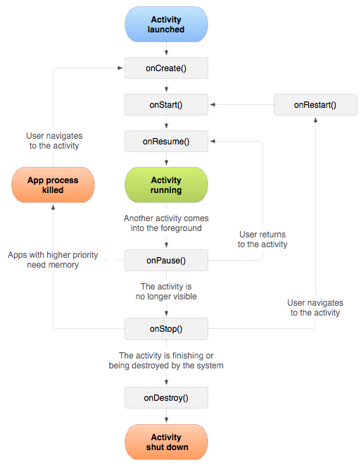
Activity Life Cycle
onCreate()
onStart()
onResume()
onPause()
onStop()
onDestroy()
onRestart()

Slide 10
Intents
Types of Intents
Explicit Intent
Intent i = new Intent(FirstActivity.this, SecondActivity.class);
startActivity(i);
Implicit Intent
Intent email = new Intent(Intent.ACTION_SEND, Uri.parse("mailto:")); email.putExtra(Intent.EXTRA_EMAIL, recipients); email.putExtra(Intent.EXTRA_SUBJECT, subject.getText().toString()); email.putExtra(Intent.EXTRA_TEXT, body.getText().toString()); startActivity(Intent.createChooser(email, "Choose an email client from..."));

Slide 11
Layout
Linear Layout
Relative Layout
Table Layout
Absolute Layout(Deprecated)
Frame Layout
List View
Grid View

Slide 12
Layout Attributes
android:id
android:layout_width
android:layout_height
android:layout_marginTop
android:layout_marginBottom
android:layout_marginLeft
android:layout_marginRight
android:layout_gravity
android:layout_weight
android:gravity
android:layout_x
android:layout_y
android:paddingLeft
android:paddingRight
android:paddingTop
android:paddingBottom

Slide 13
LinearLayout
Android LinearLayout is a view group that aligns all children in either vertically or horizontally.
android:orientation

Slide 14
RelativeLayout
Android RelativeLayout enables you to specify how child views are positioned relative to each other. The position of each view can be specified as relative to sibling elements or relative to the parent.
android:layout_above
android:layout_alignBottom
android:layout_alignLeft
android:layout_alignParentBottom
android:layout_alignParentEnd
android:layout_alignParentLeft
android:layout_alignParentRight
android:layout_alignParentStart
android:layout_alignParentTop
android:layout_alignRight
android:layout_alignStart
android:layout_alignTop
android:layout_below
android:layout_centerHorizontal
android:layout_centerInParent
android:layout_centerVertical
android:layout_toEndOf
android:layout_toLeftOf
android:layout_toRightOf
android:layout_toStartOf

Slide 15
TableLayout
Android TableLayout going to be arranged groups of views into rows and columns.
<TableRow> </TableRow>
android:layout_column

Slide 16
ListView
A flexible view for providing a limited window into a large data set.
implementation 'com.android.support:recyclerview-v7:28.0.0
LinearLayoutManager

