Slide 1

INTRODUCTION TO WEB DEVELOPMENT
Manikandan.V
Reg:24524u18051

Slide 2

Web development
Web development is the comprehensive process of creating and maintaining websites and web applications that are accessible over the internet. This field encompasses a wide range of tasks, from the initial design and layout to the coding, content creation, and functionality implementation.

Slide 3

INTRODUCTION OF HTML
HTML, or HyperText Markup Language, is the standard markup language used to create web pages and web applications. It provides the fundamental structure for content displayed on the World Wide Web.

Slide 4
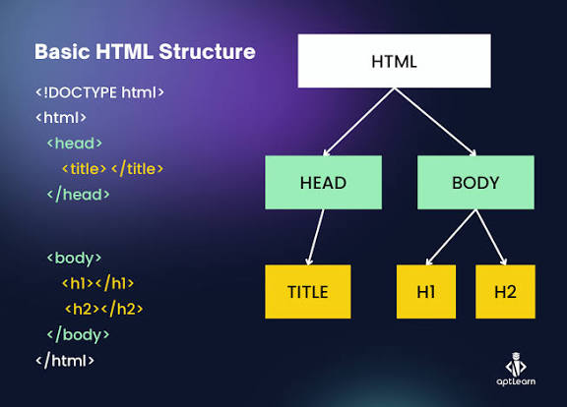
Syntax:

Slide 5
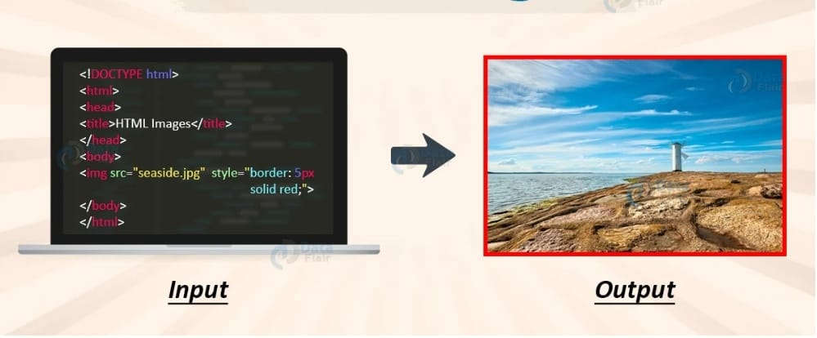
Example:

Slide 6
INTRODUCTION OF CSS
CSS, or Cascading Style Sheets, is a stylesheet language used to describe the presentation of a document written in a markup language, most commonly HTML. It is a fundamental technology of the World Wide Web, working alongside HTML and JavaScript to create web pages.

Slide 7
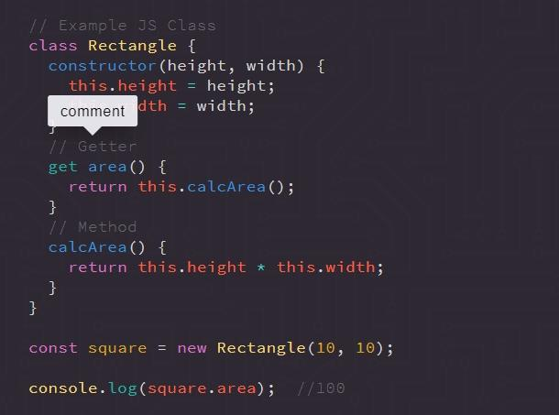
syntax:

Slide 8
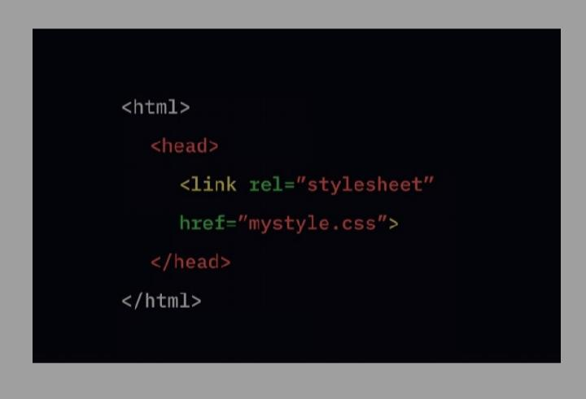
Example:

Slide 9
Introduction of Java script:
JavaScript is a high-level, dynamically typed programming language primarily known for bringing interactivity to web pages. It is one of the three core technologies of the World Wide Web, alongside HTML (for structuring content) and CSS (for styling).
JavaScript is essential for modern web development, allowing the creation of rich, engaging, and responsive user experiences. Its versatility and widespread adoption make it a fundamental skill for web developers and a powerful tool for various software development needs.

Slide 10
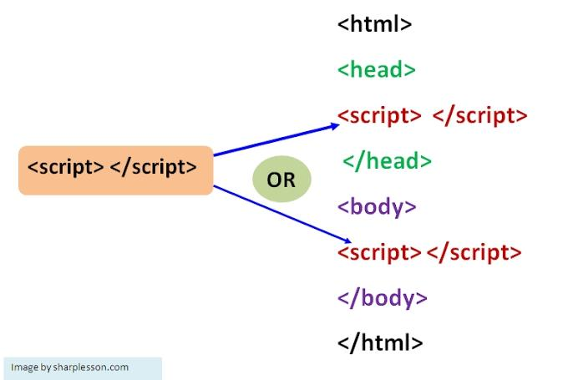
Syntax:

Slide 11
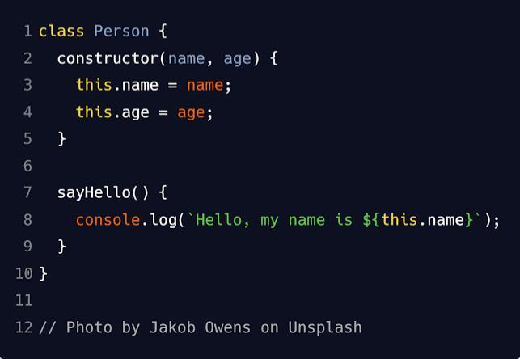
Examples:

Slide 12
Html tags:
HTML tags are keywords enclosed in angle brackets (< >) that structure content on web pages, providing instructions to browsers on how to display text, images, links, and other media. Most tags are paired, consisting of an opening tag (e.g., <p>) and a closing tag with a forward slash (e.g., </p>), though some, like <img>, are self-closing. Tags can also have attributes within the opening tag, such as href in an <a> tag to specify a link’s URL, which offer additional context or guidance to the browser.

Slide 13
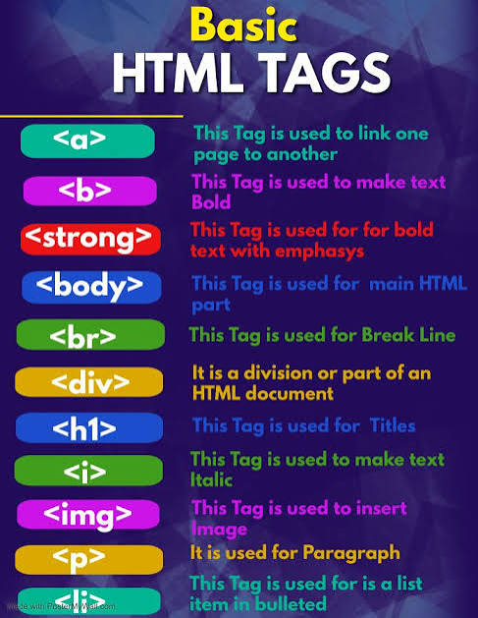
Html tags:

Slide 14
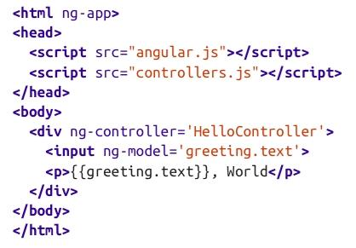
Example and syntax:

Slide 15
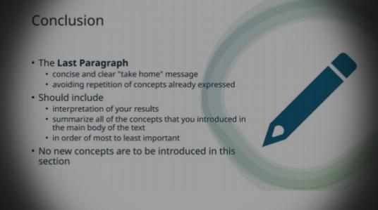
Conclusion:

Slide 16
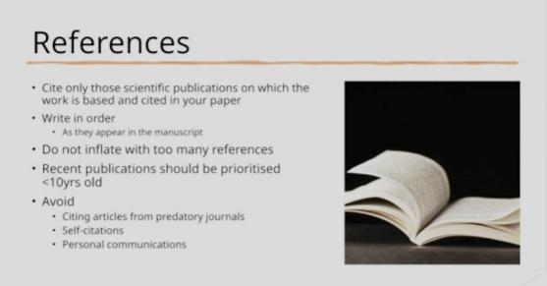
Refference:

