Slide 1
Clinical Insights Assistant — GenAI POC
LangGraph · OpenAI · Databricks
A GenAI-powered assistant for clinical insight generation.

Slide 2
Solution Overview
- Automated doctor feedback summarization
- Cohort-level analysis
- Issue + non-compliance detection
- Dosage what-if simulation
- Agentic reasoning via LangGraph
- Real-time visual agent flow

Slide 3
Architecture at a Glance
- LangGraph agent framework
- Four specialized AI tools
- Memory checkpointing
- OpenAI LLMs
- Databricks Community Edition

Slide 4
How It Works
1. Query parsed into tokens
2. Intent extracted
3. Routing to appropriate tool
4. Tool performs analysis
5. Output aggregated
6. Visual flow displayed

Slide 5
Tool Routing Logic
Intent Keywords → Tool Mapping
adverse / issues / non-compliance → issue_detection
cohort / compare / difference → cohort_comparison
simulate / dosage / what-if → scenario_simulation
Everything else → genai_summary

Slide 6
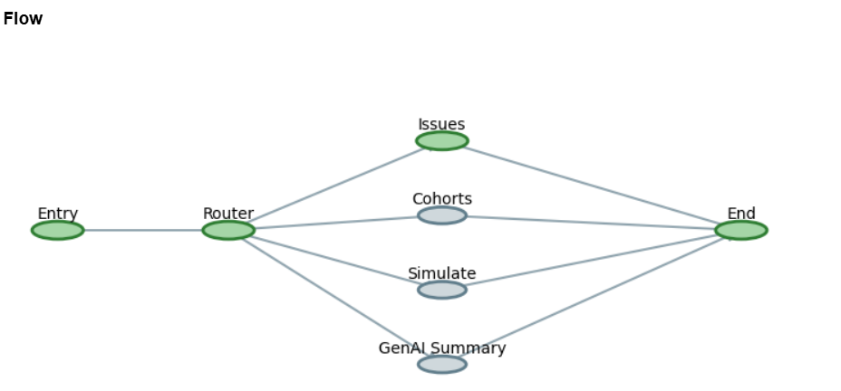
Graph nodes

Slide 7
Agentic Reasoning
- Node-based LangGraph execution
- Memory checkpointing
- Dynamic routing
- LangSmith traces for auditability

Slide 8
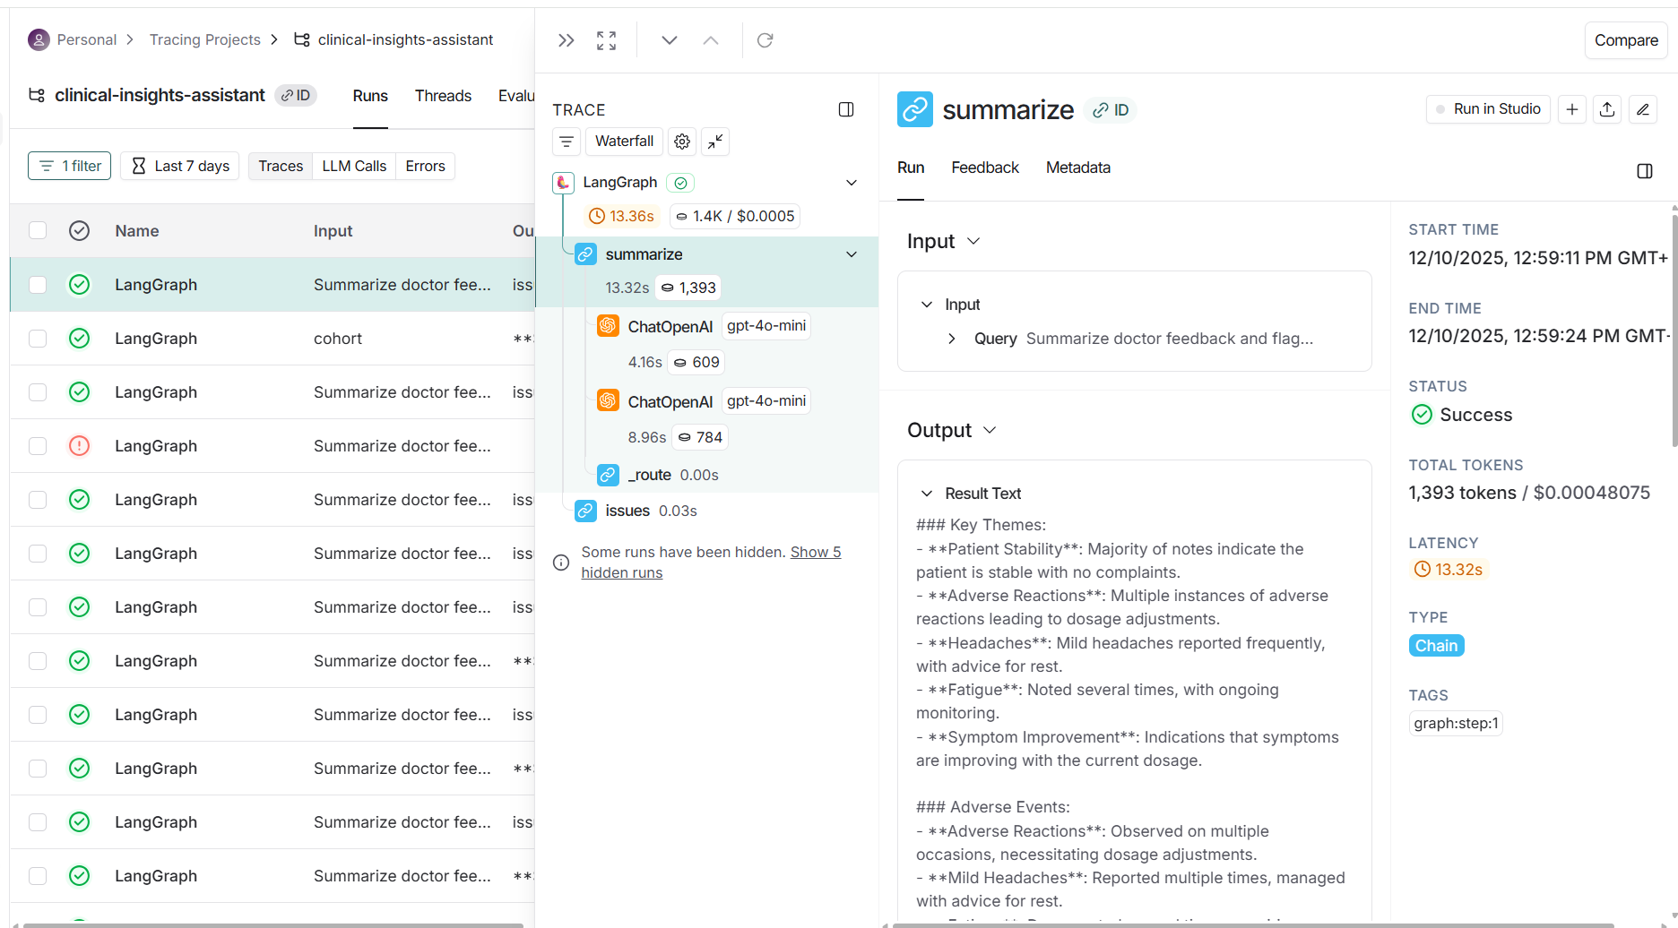
LangSmith Traceability

Slide 9
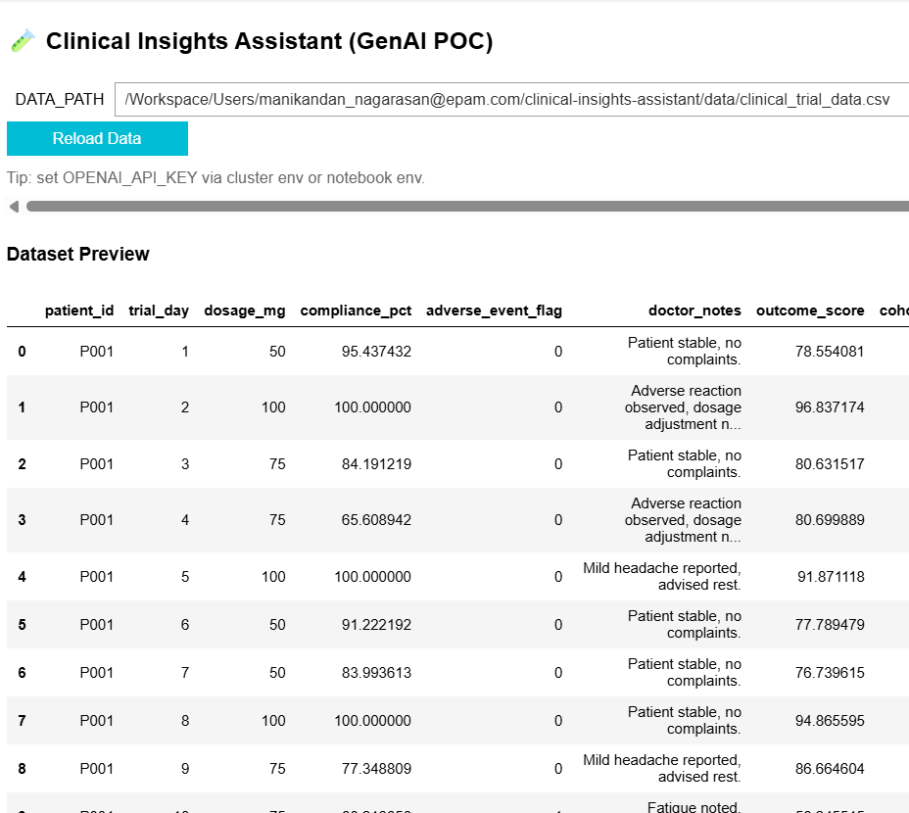
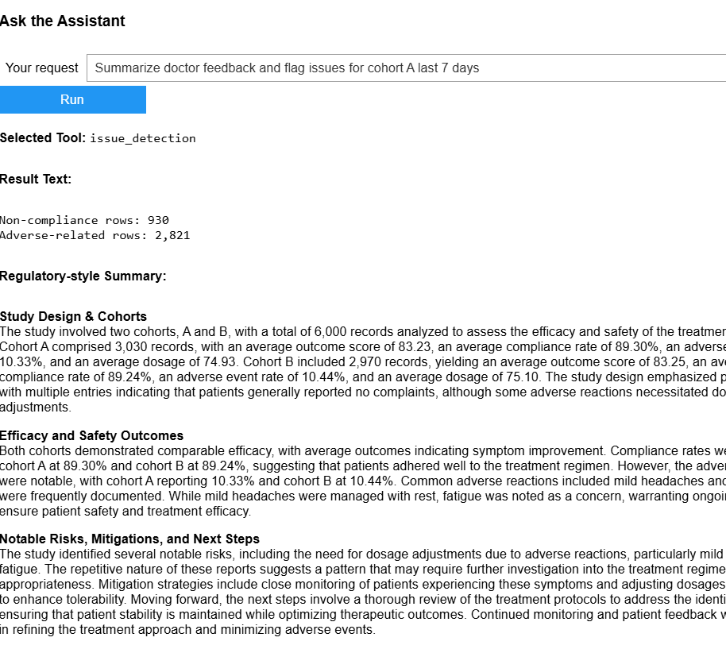
UI uses ipywidgets + Plotly

Slide 10
Conclusion
GenAI-enabled clinical insight automation using LangGraph,
specialized tools, and OpenAI LLMs.
Enhances decision-making and streamlines medical workflows.
Git path : https://github.com/manikandan991/GenAi/tree/main/clinical-insights-assistant
Google Colab: https://colab.research.google.com/drive/1GyqOpZ9v77o47XhKgMuxx9c00KW-63d8?usp=sharing

