Slide 1

ITMD 525 – Data Mining Final project
Credit Card Transaction Categorization using Text Analytics
Team Members:
Anusha Bondili – A20356204
Manikandan Ganesh – A20355226
Jay Thakker – A20359548

Slide 2
Table of Contents
Introduction
Objectives & Applications
Snapshot of dataset
Challenges & Approach
Implementation
Analysis
Demo
Results

Slide 3
1. Introduction
Text Analytics a.k.a. Text Mining refers to the process of deriving high-quality information from text.
Text Mining usually involves parsing of input text data to find out meaningful patterns and interpreting those patterns as a form of an output.
Areas where text mining is implemented is Text Categorization, Sentiment Analysis, Text Clustering, Document Summarizing and many more.
In this project, we have used text mining for Categorization of Credit Card Transactions.

Slide 4
2. Objectives & Applications
Objectives
Carry out text mining on transaction description to identify word patterns belonging to different categories
Using the text patterns, bucket the credit card transaction data in 38 different categories.
Applications
A user would be able to view their spending in an understandable format.
A bank would be able to analyze the expenses in every category and come up with different credit card offers or cash back rewards system.

Slide 5
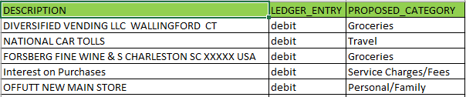
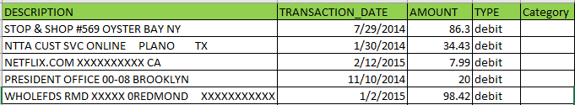
3. Snapshot of the dataset
Creditdata_Category
CreditCard_Actual
Train Dataset
Observations: 501,449.
Categories assigned manually.
Test Dataset
Observations: 500,001.
Using the train dataset, assign the categories.

Slide 6
4. Challenges & Approach
Challenges
Tackle parts of speech present in transaction description to identify patterns
Inconsistent data having spelling mistakes
We have “Other Expenses” as a category which contains transactions that do not fall under any of the major categories.
Identical terms falling under different categories

Slide 7
4. Challenges & Approach
Approach
We extract only NOUNS from every transaction description and eliminate different parts of speech, locations, English stop words, zip codes and abbreviations.
Miscellaneous nouns present in the same transaction description of the training data set are associated with the category to form different rules.
The transaction description of the test dataset is parsed against these rules to predict the category of the transactions present in the test data.
To associate a transaction to a specific category, probability of the associated rule to each category is calculated and the category with the highest probability value is predicted as the associated transaction.

Slide 8
5. Implementation
Text Mining module of SAS Enterprise Miner is used to create a transformation to achieve this objective.
Different nodes of this module used in the system are:
File Import – Import the file (.xlsx/.sas7bdat)
Text Parsing – Extract nouns and eliminate other parts of speech
Text Filter – Weigh the terms using Mutual Information and TF.IDF
Text Rule Builder – Build rules to identify different text patterns
Score Node – Generates a score for transaction w.r.t. every category

Slide 9
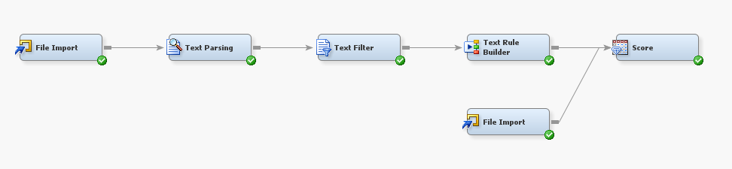
5. Implementation
The transformation created using these components is below:
Train Data
Test Data

Slide 10
5. Implementation
To achieve highest accuracy, we split the train data in 2 parts (80% train – 20% test).
Eliminate all transactions that fall under “Other Expenses” category.
Document Term Matrix is formed by assigning Mutual Information weights for each term associated with documents.

Slide 11
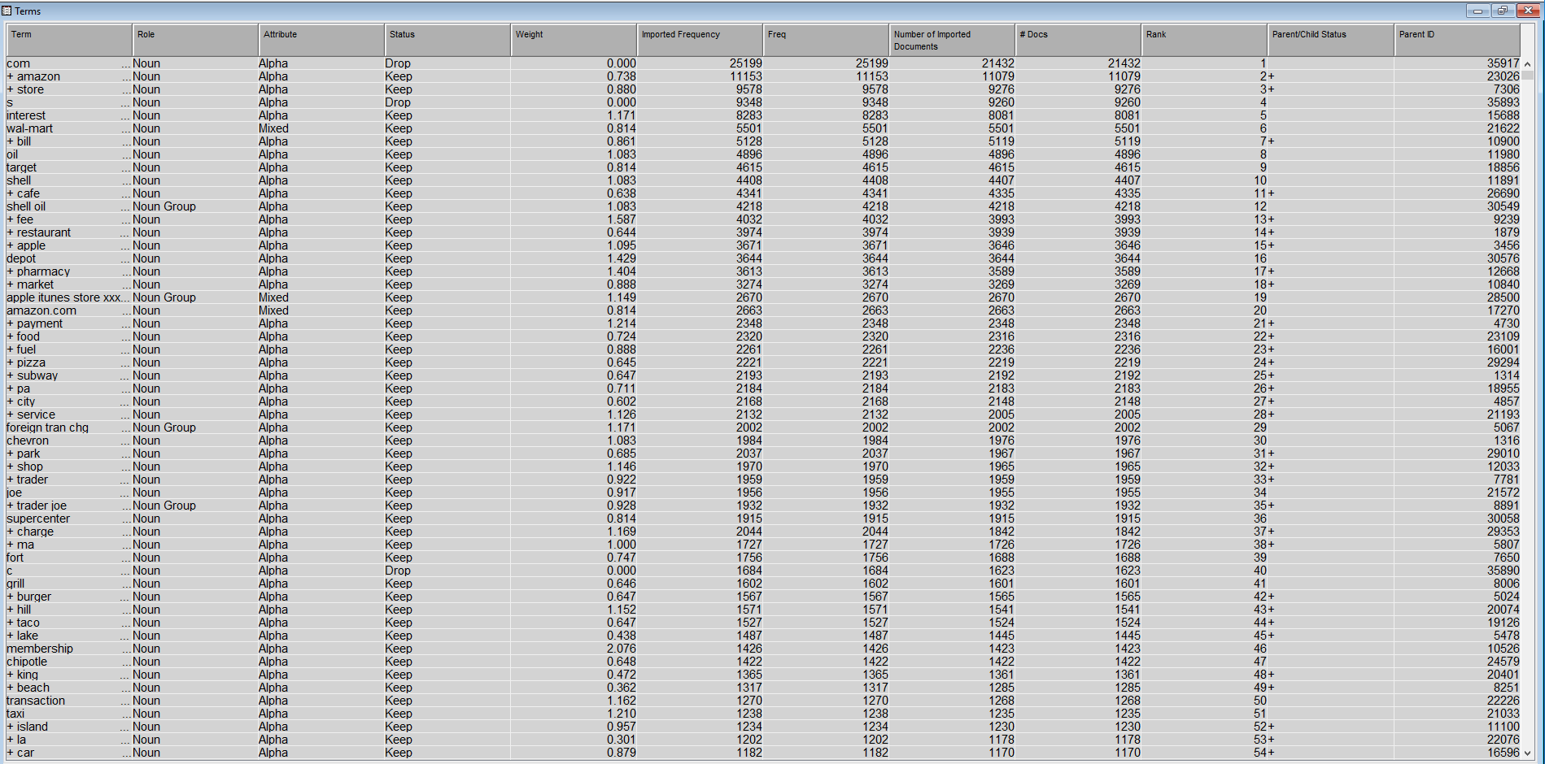

Slide 12
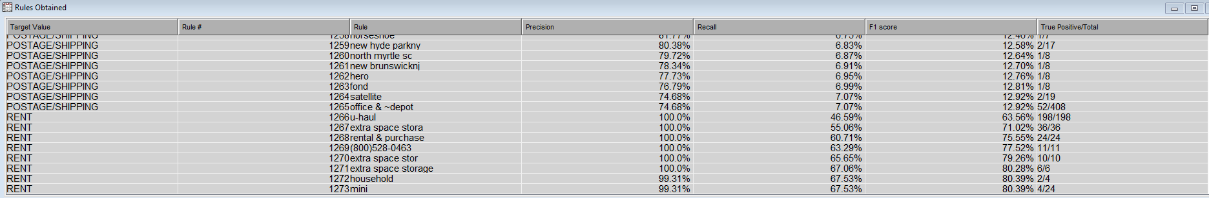
5. Implementation

Slide 13



6. analysis
Accuracy is determined using the following parameters:
Generalization Error – Determines the predicted probability for rules on untrained data
Purity of rules – Higher values result in fewer, purer rules. Lower values cover more instances
Exhaustiveness – Controls the number of terms formed as a conjunction with the existing rule using AND (&) operator

Slide 14
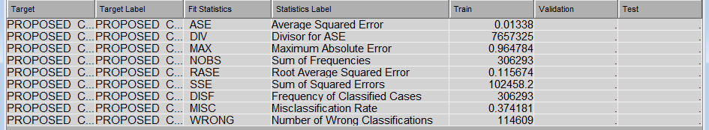
6. analysis
Configuration #1
Generalization Error | Purity of Rules | Exhaustiveness
Medium | Medium | Low

Slide 15
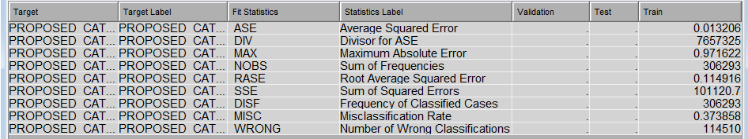
6. analysis
Configuration #2
Generalization Error | Purity of Rules | Exhaustiveness
Very Low | Low | Low

Slide 16
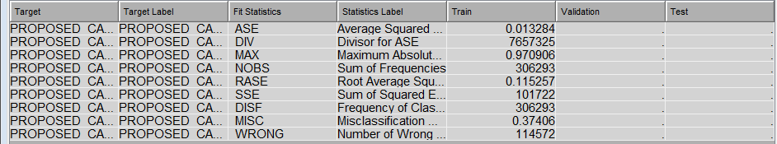
6. analysis
Configuration #3
Generalization Error | Purity of Rules | Exhaustiveness
Very Low | Medium | Low

Slide 17
DEMO

Slide 19

Questions

