Slide 1
Keypad Based Product Counting and Automatic Batch Packing System with Station Sensing using LPC2129
LPC2129
ARM7 MCU
ARM7 based embedded system | Two IR sensors, keypad, LCD and DC motor conveyor

Slide 2
Abstract
An LPC2129 (ARM7) microcontroller, two IR sensors and a keypad count products on a conveyor belt driven by a DC motor. The operator sets the batch quantity on the keypad and presses start. When the batch is complete the motor stops and the LCD shows the final count. If a counted product never reaches the packing station, the system reports a belt fault.
2
IR sensors: count and station check
1
Keypad to set batch quantity
0
Manual counting errors

Slide 3
Objectives
1
Automate counting
2
Set batch size
Count products on the belt with an external interrupt, not by hand.
Let the operator enter the batch quantity through the keypad.
3
Detect belt faults
4
Indicate status
Spot a missing, fallen or blocked product at the packing station.
Show count on the LCD, with buzzer and red / green LEDs.

Slide 4
Hardware Components
LPC2129
4x4 Keypad
IR Sensor 1
IR Sensor 2
ARM7 main controller
Batch quantity and START
Counts at belt start
Checks packing station
16x2 LCD
DC Motor
Motor Driver
Buzzer + LEDs
Count and fault message
Drives the conveyor
L293D or relay stage
Red running, green done

Slide 5
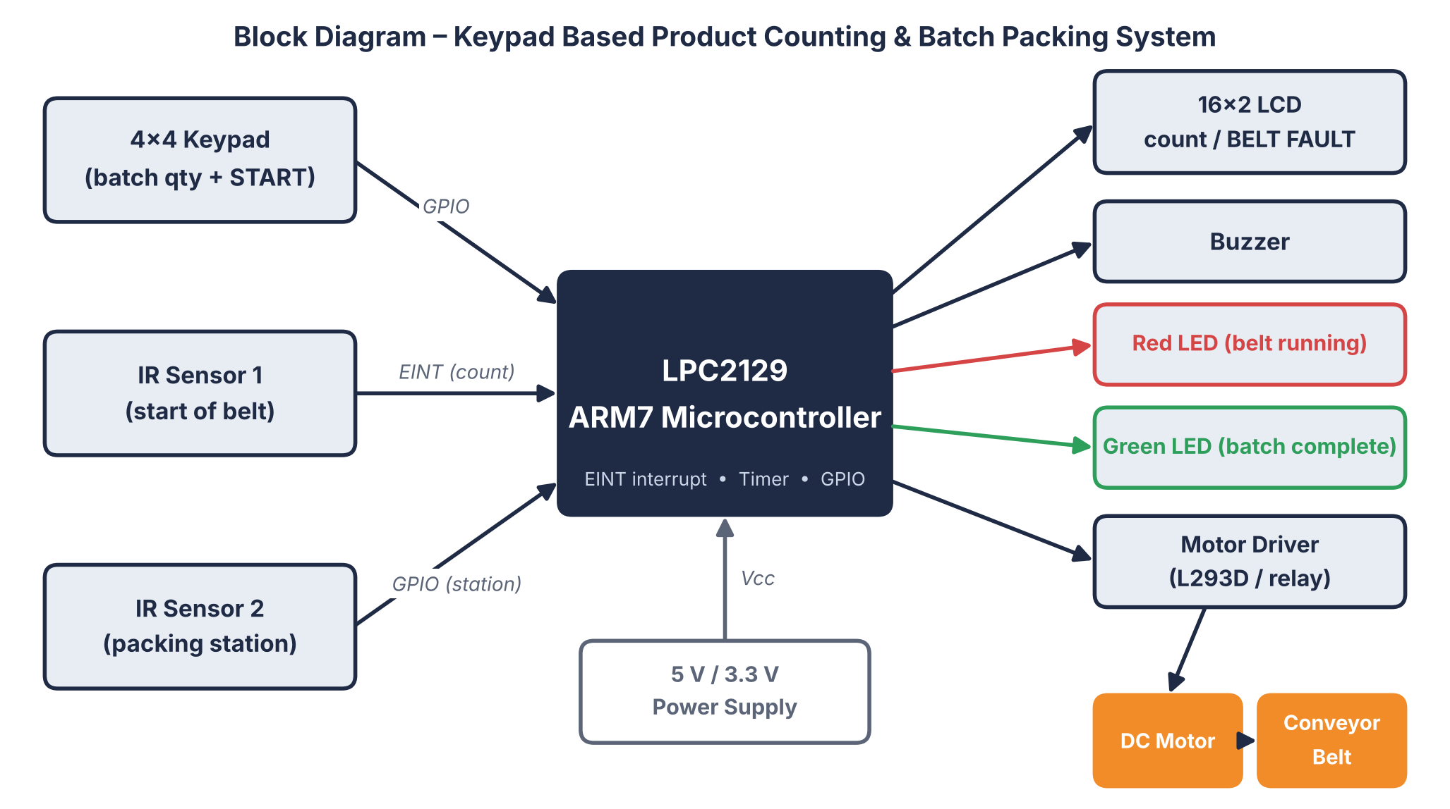
Block Diagram

Slide 6
Working Principle
1
Operator enters the batch quantity on the keypad and presses START.
2
Motor starts the conveyor and the red LED glows.
3
IR sensor 1 at belt start raises an interrupt and the count increases.
4
IR sensor 2 at the packing station confirms each product arrived.
5
No detection within the set time: motor stops, LCD shows BELT FAULT.
6
Count equals batch: motor stops, buzzer beeps, green LED glows, LCD shows final count.

Slide 7
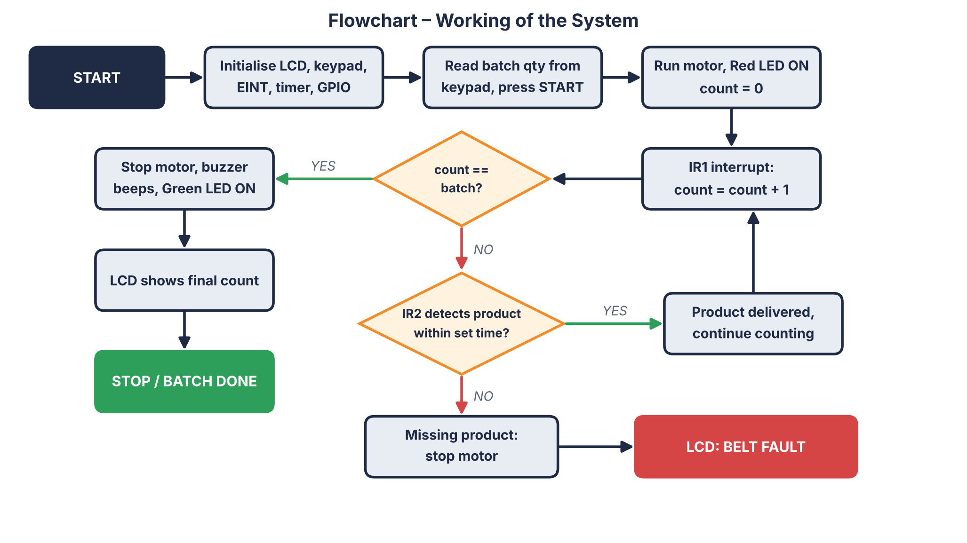
Flowchart

Slide 8
System Output Indications
Condition | Motor | LCD | LED | Buzzer
Belt running | ON | Live count | Red | Off
Batch complete | OFF | Final count | Green | Beeps
Missing product | OFF | BELT FAULT | Red off | Off
Fault logic: IR1 counted a product, but IR2 did not see it at the packing station within the set time.

Slide 9
Advantages and Applications
Advantages
Applications
Removes manual counting errors
Detects fallen or blocked products
Low cost, simple ARM7 design
Clear LCD, LED and buzzer feedback
Packaging lines
Bottling and carton filling
Production line batch counting
Warehouse conveyors

Slide 10
Conclusion
The LPC2129 based system counts products accurately using an interrupt driven IR sensor.
A second IR sensor at the packing station catches missing products and raises a BELT FAULT.
It lowers manual counting errors and suits packaging and production lines.
Thank you

