Slide 1

SMART INDIA HACKATHON 2026
TITLE PAGE
Problem Statement ID – SIH26133
Problem Statement Title – Accessibility and Quality of public healthcare services, particularly in rural and underserved areas .
Theme – Medtech / Biotech / Healthtech
PS Category - Software
Team ID -
Team Name (Registered on portal) – 6_Rays

Slide 2
Jeeva Setu - Connecting patients, health workers & doctors
6_RAYS
Proposed solution :
A digital health platform that transforms periodic rural health-survey measurements into unified longitudinal patient records, enabling continuous health-trend monitoring and informed clinical follow-up.
Detailed Proposed Solution
Unique Patient ID connects all health records across visits.
Mobile platform captures BP, SpO₂, HR, glucose, Hb, temperature & RR.
Records are stored locally and synchronized when connectivity returns.
Authorized doctors access history and visualized trends.
How It Addresses the Problem
Converts isolated survey readings into a continuous patient health history.
Enables doctors to compare current and previous readings.
Reduces dependence on paper records and continuous internet.
Helps identify changes in health trajectory for clinical follow-up.
Innovation & Uniqueness
Longitudinal tracking instead of one-time health surveys.
Offline-to-online synchronization for low-connectivity regions.
Multi-parameter, patient-centric health profile.
Device-agnostic & scalable architecture.

Slide 3
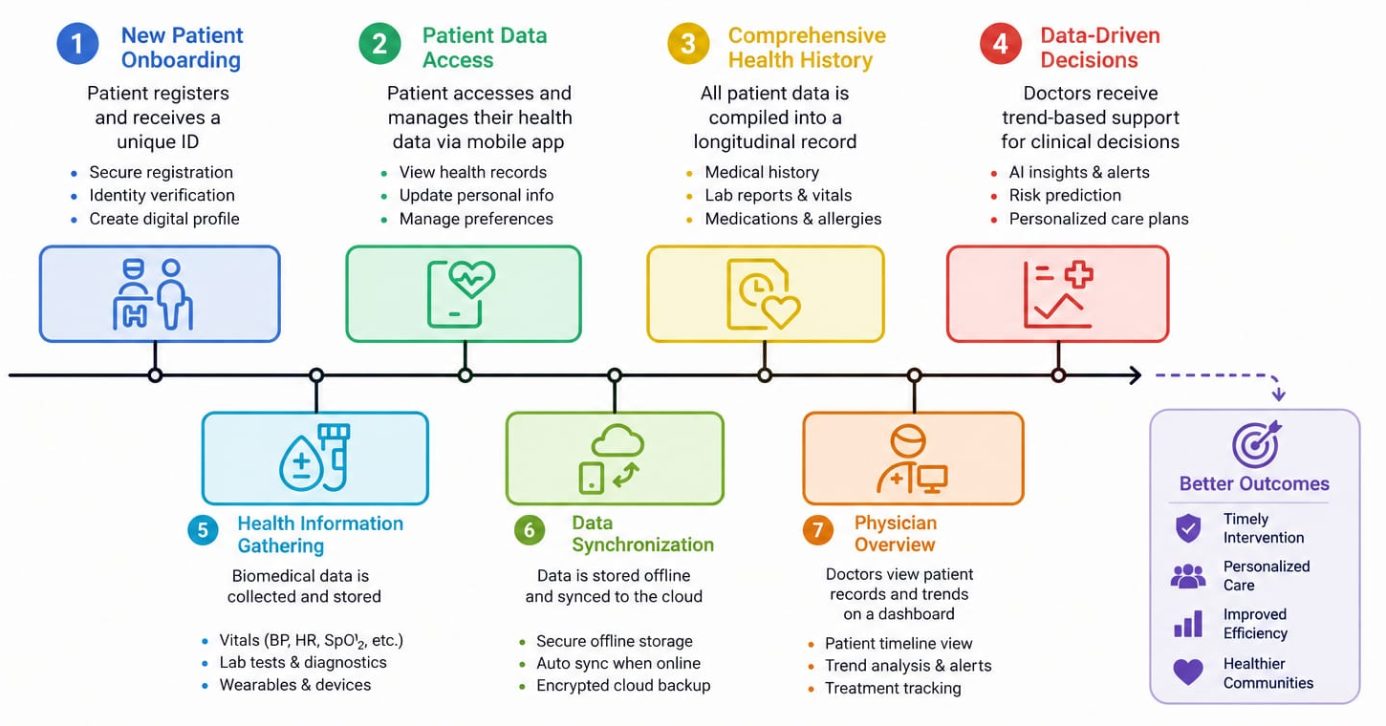
TECHNICAL APPROACH
6_RAYS
Frontend: Mobile/web interface developed using VS Code.
Backend: Python FastAPI for APIs
Database: SQLite for offline storage with a central database for synchronized records.
Data Synchronization: Offline records are securely synchronized with the central server when connectivity is available.
Authentication & Security: Secure login with role-based access for health workers and doctors.
Health Analytics: Patient history and parameter trends are visualized to support clinical follow-up.

Slide 4
FEASIBILITY AND VIABILITY
6_RAYS
CHALLENGES / RISKS
Low Connectivity – Unreliable internet in rural areas
Data Accuracy – Manual entry/device variation
Device Compatibility – Different biomedical devices
Privacy & Security – Sensitive patient information
User Adoption – Training and usability
FEASIBILITY
Existing Technology – Uses smartphones, databases & portable medical devices
Low Infrastructure – Minimal additional hardware required
Scalable Architecture – Village → PHC → District
Prototype Feasible – Can initially use simulated/device data
Easy Deployment – Mobile-based health-worker workflow
MITIGATION STRATEGIES
Offline-First Architecture – Local storage with automatic sync
Validation & Range Checks – Prevent invalid readings
Device-Agnostic Design – Standard APIs + manual entry fallback
Encryption + Role-Based Access
Simple UI + Regional Language Support

Slide 5
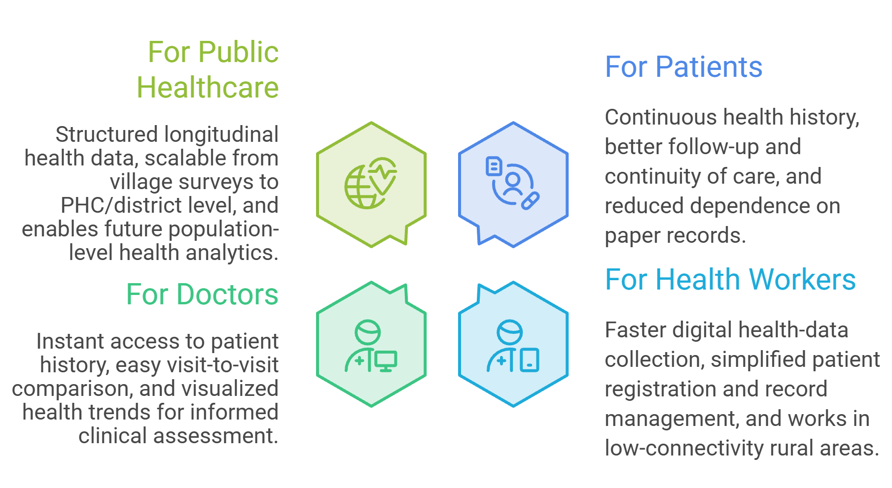
IMPACT AND BENEFITS
6_RAYS

Slide 6
RESEARCH AND REFERENCES
6_RAYS
Ensuring Access to Quality Health Care in Vulnerable Communities — Bhatt - et al., — Academic Medicine (2018).
Disparities in Healthcare Access: Addressing Systemic Barriers in Urban and Rural Communities — Afni —et al ., Journal of Health Literacy and Qualitative Research (2023).
Availability and Accessibility of Primary Care for the Remote, Rural, and Poor Population of Indonesia — Wenang et al., — Frontiers in Public Health (2021).
Improving Health and Health Care in Rural Communities: A Position Paper From the American College of Physicians — Serchen et al., — Annals of Internal Medicine (2025)
Access to health services and health inequalities in remote and rural areasObehi O Osadolor et al., 2022
Janaki Medical College Journal of Medical Science 10 (2), 70-74
6. Healthcare managerial challenges in rural and underserved areas: A Review Oloruntoba Babawarun et al., 2024 World Journal of Biology Pharmacy and Health Sciences 17 (2), 323-330

Slide 7
IMPORTANT INSTRUCTIONS
Please ensure below pointers are met while submitting the Idea PPT:
Kindly keep the maximum slides limit up to six (6). ( Including the title slide)
Try to avoid paragraphs and post your idea in points /diagrams / Infographics /pictures
Keep your explanation precise and easy to understand
Idea should be unique and novel.
You can only use provided template for making the PPT without changing the idea details pointers (mentioned in previous slides).
You need to save the file in PDF and upload the same on portal. No PPT, Word Doc or any other format will be supported.
Note - You can delete this slide (Important Pointers) when you upload the details of your idea on SIH portal.

