Slide 1

Automated Machine Learning (AutoML)Pipeline Web Application
Mini Project Phase -1
Team Members:
1. Balaganesh S - 22619129
2. Madhuragul M - 22619110
3. Manikandan G - 22619111
4. Jeeva K P- 22619142
Guide: Mrs. M. Bhanumathi
Designation: Assistant professor
Dept: Computer science engineering

Slide 2
ABSTRACT:
This project presents an interactive web application built with Streamlit, designed to automate the machine learning pipeline. The application allows users to upload datasets, perform data analysis (DA), visualize data distributions and correlations, and clean data with various preprocessing techniques. The system supports feature engineering through techniques like Principal Component Analysis (PCA) and data balancing methods (e.g., oversampling, undersampling.) Users can choose from a range of machine learning models, including classification, regression, and clustering algorithms. Supported models include Logistic Regression, Random Forest, XGBoost, CatBoost, Support Vector.

Slide 3
OVERVIEW:
Our web application automates essential machine learning tasks through a user-friendly interface. The pipeline supports:
Dataset upload and analysis.
Data visualization for insights.
Automated data cleaning and preprocessing.
Training of classification regression and classification models(depending upon the task).
Model evaluation with performance metrics.
Model download for external deployment. This tool is ideal for those looking to explore machine learning without deep technical expertise, making ML accessible and efficient for diverse users.

Slide 4
PROBLEM STATEMENT:
PROBLEM STATEMENT:
The process of building machine learning models is often complex and resource-intensive, requiring a deep understanding of data preprocessing, feature engineering, model selection, and parameter tuning. For individuals and organizations with limited expertise, these challenges can become significant barriers. As a result, many miss out on the benefits of machine learning, especially in cases where rapid model development is needed to derive actionable insights from data.

Slide 5
SOLLUTION:
SOLUTION:
Our solution is a web application (AutoML) is a user-friendly web platform that automates the machine learning pipeline. Users can upload CSV datasets, visualize data, and clean it by handling missing values, duplicates, and applying techniques like oversampling and undersampling.
The platform supports automated model training for classification, regression, and clustering using algorithms like Random Forest, XGBoost, CatBoost, and KMeans.
It provides performance metrics (accuracy, precision, F1 score, etc.) for easy comparison.
Once trained, models can be downloaded for deployment, making it accessible for users with minimal ML expertise to build and integrate models efficiently.

Slide 6
OBJECTIVES:
User-Friendly ML: Provide a straightforward interface for building ML models.
Empower Non-Experts: Offer a seamless ML experience that minimizes technical barriers, supporting users in making data-driven decisions effectively.
Automate ML Pipeline: Automatically handle data preprocessing, model training, and evaluation.
Enable Model Download: Allow users to easily export trained models for use in their own applications.

Slide 7
KEY FEATURES:
Upload Your Dataset Users can securely upload their datasets to start the ML pipeline.
View a Summary of Your Dataset Get a quick overview of dataset structure, including column details, missing values, and statistics.
Visualize Correlation Matrix and Values Distribution Generate visualizations to understand relationships between features and the distribution of values, aiding feature selection and data understanding.
Clean Your Data Automatic handling of missing values, duplicate rows, and data inconsistencies to prepare data for analysis.
Apply Data Preprocessing Techniques Standardize or normalize data and apply transformations, ensuring consistency and model readiness.
Train Regression/Classification Models Select from popular regression or classification models, and let the app handle model training and optimization.
Evaluate Your Trained Models Receive detailed performance metrics like accuracy, precision, recall, and F1 scores to understand model effectiveness.
Download Your Models Export trained models as files, ready for integration into other applications or further analysis.

Slide 8
LITERATURE SURVEY:
Overview of AutoML Development Automated Machine Learning has rapidly evolved, with research focused on making machine learning accessible to non-experts. Key developments include:
Automated Data Preprocessing: Techniques to handle missing values, outliers, and data transformations automatically.
Model Selection: Algorithms that efficiently select the best models from a predefined set, reducing manual effort.
Key Studies:
Feurer et al. (2019) on automating preprocessing and model selection in AutoML frameworks.
Kotthoff et al. (2021) examining AutoML’s effectiveness in various industry applications.

Slide 9
LITERATURE SURVEY:
Advances in AutoML Model Selection Selecting the right model for a dataset is crucial in machine learning. Recent advancements focus on:
Meta-Learning Approaches: Systems that learn from past model performance to predict the best model for new tasks.
Ensemble Methods: AutoML frameworks are integrating ensemble techniques to combine multiple models for improved performance.
Key Studies:
Vanschoren et al. (2020): Meta-learning for AutoML and its potential in recommending optimal models.
Thornton et al. (2021): Evaluation of ensemble techniques within AutoML pipelines to improve predictive accuracy.

Slide 10
LITERATURE SURVEY:
Automated Hyperparameter Optimization Hyperparameter tuning is essential to model performance, but it is computationally expensive. Advances include:
Bayesian Optimization: A probabilistic model to find optimal parameters with fewer evaluations.
Genetic Algorithms: Evolutionary algorithms that simulate natural selection to optimize parameters.
Automated Hyperband: A technique that accelerates the tuning process by focusing on promising configurations early on.
Key Studies:
Bergstra et al. (2021) on Bayesian optimization for efficient hyperparameter search.
Li et al. (2022) on Hyperband for hyperparameter tuning, reducing computational time.

Slide 11
LITERATURE SURVEY:
AutoML in Model Evaluation and Interpretation Model interpretability is critical for ensuring that AutoML is trusted in high-stakes applications. Research in this area includes:
SHAP and LIME: Techniques integrated into AutoML pipelines to explain model decisions.
Performance Metrics Selection: Automatically choosing evaluation metrics based on the data and task type (classification, regression).
Key Studies:
Ribeiro et al. (2021) on integrating LIME in AutoML frameworks for model interpretability.
Lundberg et al. (2022) on the use of SHAP values to enhance model transparency in automated pipelines.

Slide 12
LITERATURE SURVEY:
Real-World Applications and Future Directions AutoML has been applied in various sectors, including healthcare, finance, and e-commerce, where quick, accurate models are necessary. Ongoing research explores:
AutoML in Healthcare: Automating diagnosis prediction models to assist clinicians.
Finance and E-commerce: Utilizing AutoML for fraud detection, customer segmentation, and personalized marketing.
Future Directions: Integration of deep learning models, reinforcement learning, and improvements in computational efficiency.
Key Studies:
Lee et al. (2023) on AutoML for disease prediction in healthcare.
Wang and Zhang (2022) on using AutoML in financial fraud detection.

Slide 13
PROPOSED SOLLUTION:
Our application automates the following machine learning tasks:
Data Analysis: Users upload their data and receive a detailed summary.
Visualization: Correlation and distribution plots aid in identifying trends and relationships in data.
Preprocessing: Automated steps for cleaning and transforming data, supporting model performance.
Model Training: A range of algorithms are available for regression and classification tasks.
Evaluation and Download: Users receive model performance metrics and can download models for future use.

Slide 14
TECH USED:
Frontend: Streamlit
Streamlit Framework: Streamlit is used as the primary interface framework, allowing for the creation of interactive, real-time dashboards without extensive frontend coding. This enables users to:
Upload and display datasets.
Interact with different components such as buttons, sliders, and dropdowns for selecting preprocessing and model options.
View visualizations and evaluation metrics in an intuitive format.
Advantages: Streamlit’s simplicity and Python-native approach make it ideal for machine learning applications that require rapid prototyping and real-time interactivity.

Slide 15
TECH USED:
Backend: Python with ML Libraries
Python: The core programming language for backend development. Its extensive library ecosystem supports machine learning, data processing, and model evaluation with efficiency.
Machine Learning Libraries:
Scikit-learn: Essential for implementing classic ML models (e.g., Logistic Regression, KNN) and preprocessing methods (e.g., PCA, data encoding).
XGBoost: Known for its high performance in gradient boosting tasks, XGBoost is used for training classification and regression models with better accuracy and speed.
CatBoost: A library optimized for categorical data, allowing the application to handle mixed data types effectively.
Imbalanced-learn: This library includes tools like RandomOverSampler and SMOTEENN to handle imbalanced datasets, which is crucial for improving the quality of model predictions.

Slide 16
TECH USED:
Data Processing and Visualization: Pandas, Plotly, and NumPy
Pandas: Provides data manipulation capabilities, enabling operations such as reading data, handling missing values, and reshaping datasets. Used extensively for data preprocessing and transformation tasks.
NumPy: Supports numerical computations, especially matrix operations for feature engineering, PCA, and dataset balancing, enhancing computational efficiency.
Plotly: Plotly Express and Graph Objects are used for interactive visualizations, allowing users to explore correlations, distributions, and model evaluation metrics visually. This enhances the interpretability of data insights.

Slide 17
TECH USED:
Model Persistence: Pickle and NumPy:
Pickle: Enables model serialization, allowing users to download trained models as .pkl files. This makes the models portable, so they can be used in other applications without retraining.
Implementation: After training, each model is serialized with Pickle and provided as a downloadable file. This feature supports easy integration into other ML pipelines or deployment environments.

Slide 18
TECH USED:
Machine Learning Model Options
Classification Algorithms: Logistic Regression, Random Forest, XGBoost, CatBoost, SVM, and KNN. These models cover a wide range of applications, from linear classification to complex, non-linear tasks.
Regression Algorithms: Linear Regression, Random Forest Regressor, XGBoost Regressor, CatBoost Regressor, and SVR. These models are optimized for predicting continuous values in various types of datasets.
Clustering Algorithms: K-Means and Hierarchical Clustering for unsupervised tasks, enabling the application to group data into clusters without predefined labels.

Slide 19
TECH USED:
Model Evaluation Metrics
Classification Metrics: Accuracy, Precision, Recall, F1 Score, and Confusion Matrix to provide detailed performance insights for each classification model.
Regression Metrics: Mean Absolute Error (MAE), Root Mean Squared Error (RMSE), and R2 Score are calculated to assess regression model performance, helping users interpret prediction accuracy and error.
Clustering Metrics: Silhouette Score is used for clustering algorithms to assess clusters.

Slide 20
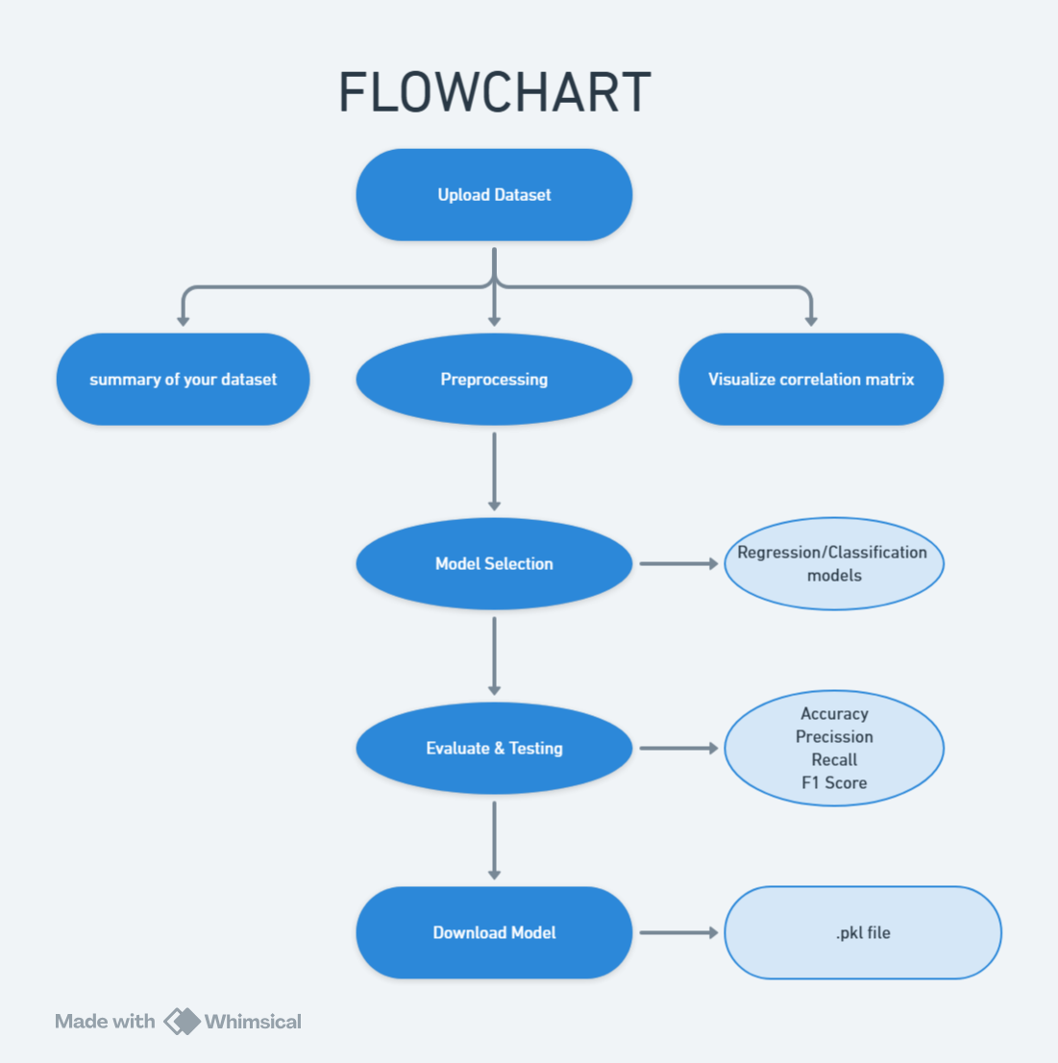

Slide 21
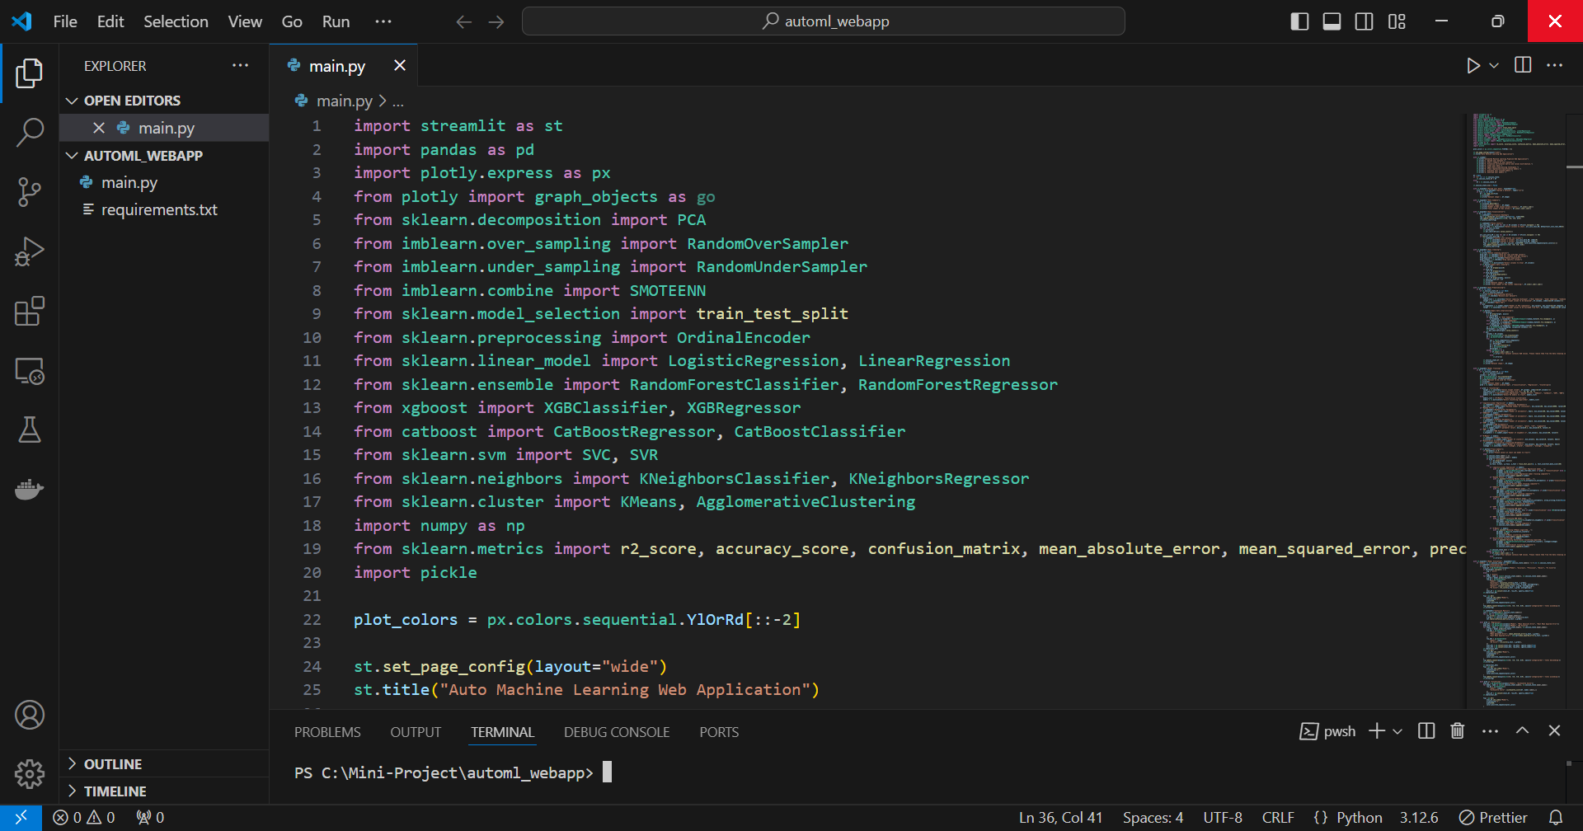
CODING (SCREENSHOT)

Slide 22
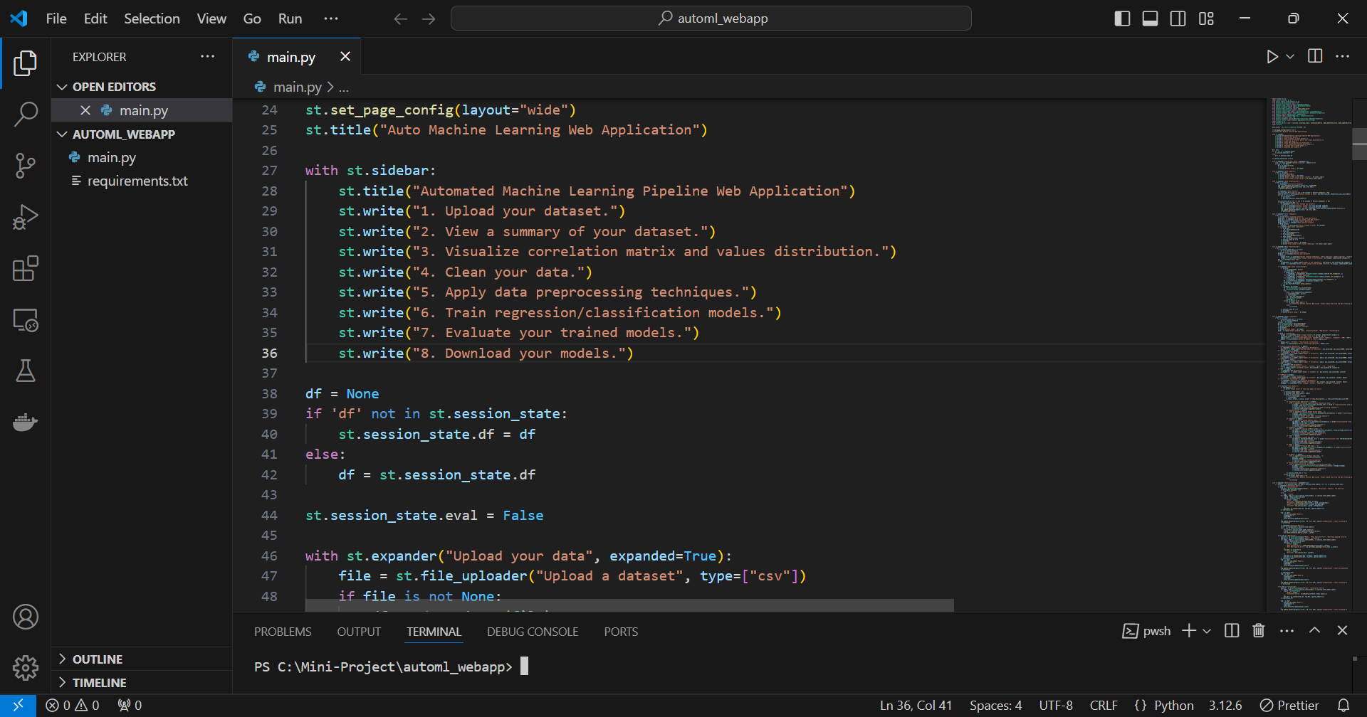
CODING (SCREENSHOT)

Slide 23
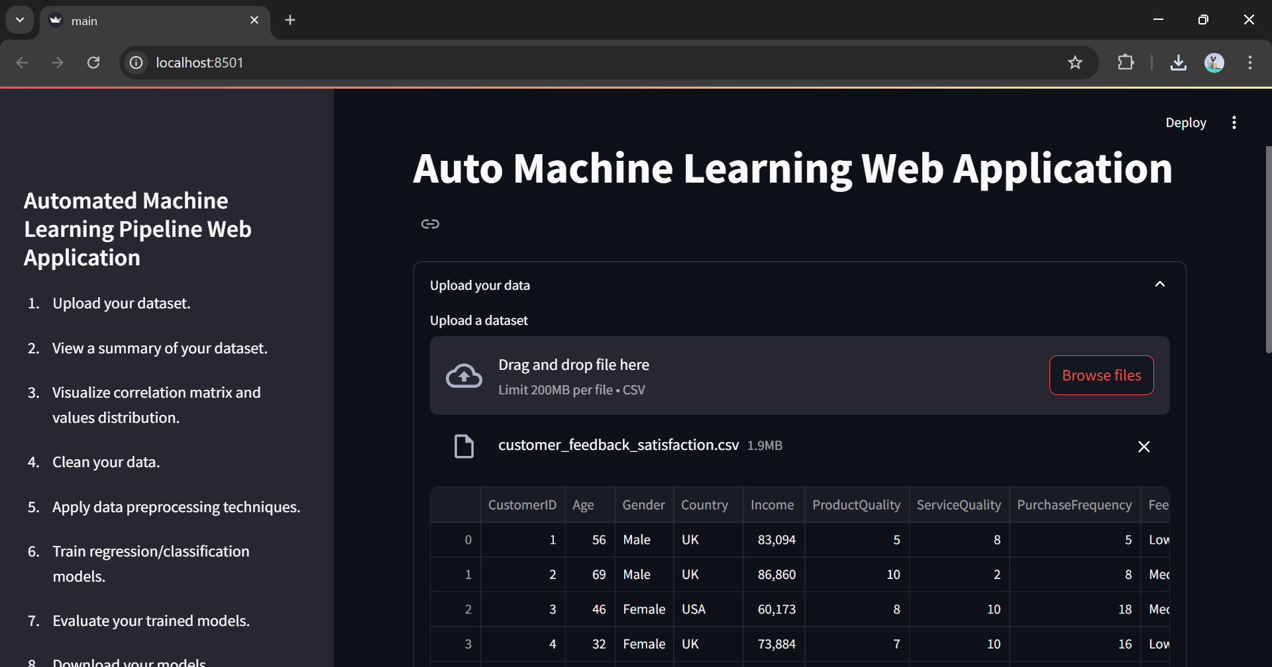
OUTPUT (SCREENSHOT)

Slide 24
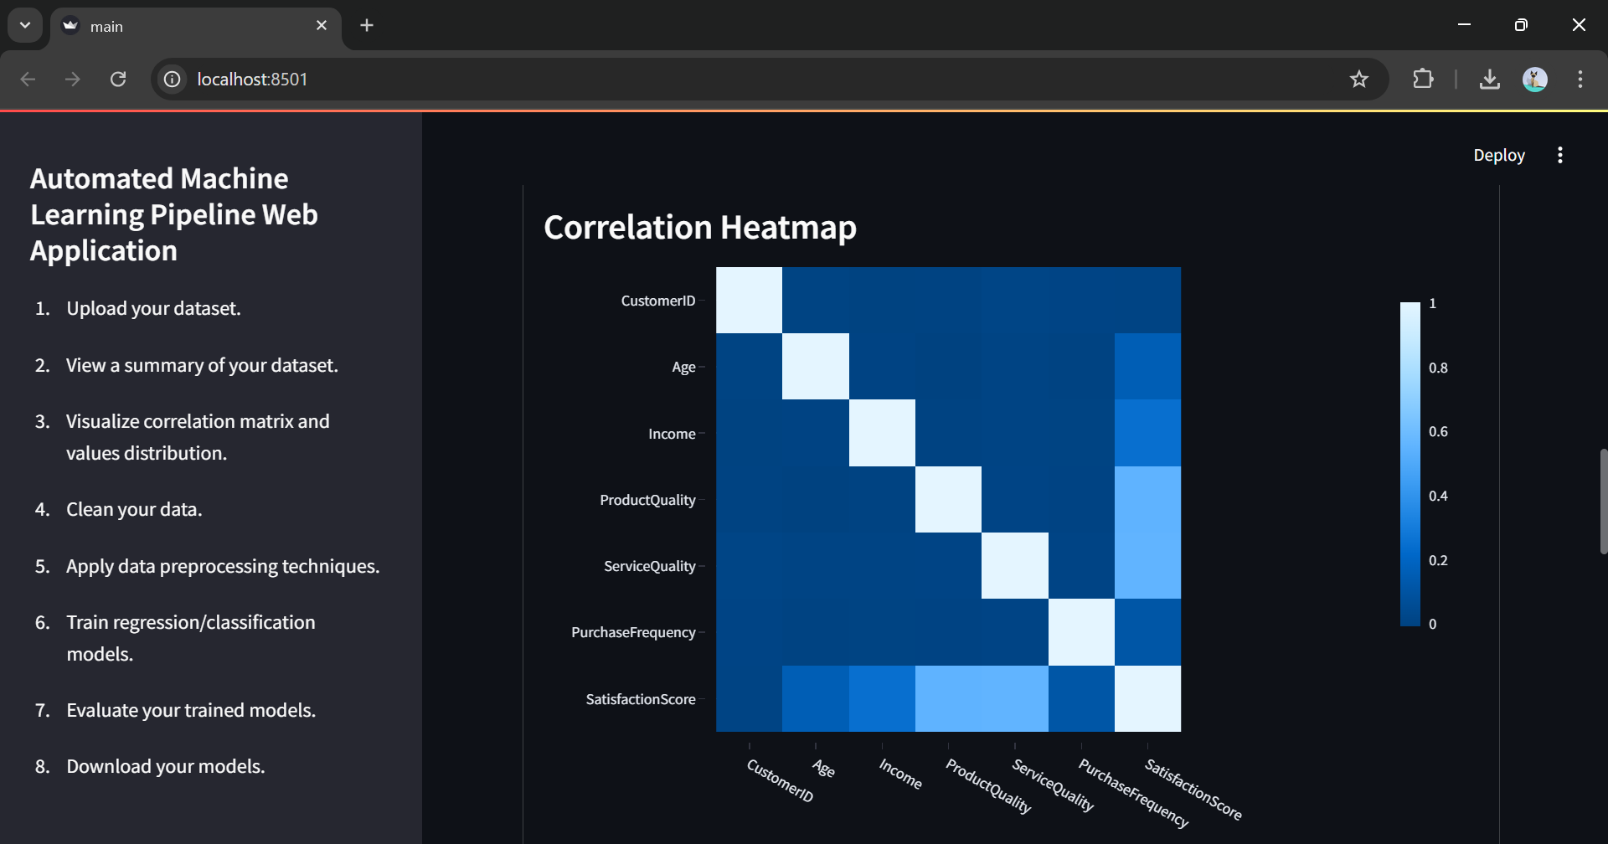
OUTPUT (SCREENSHOT)

Slide 25
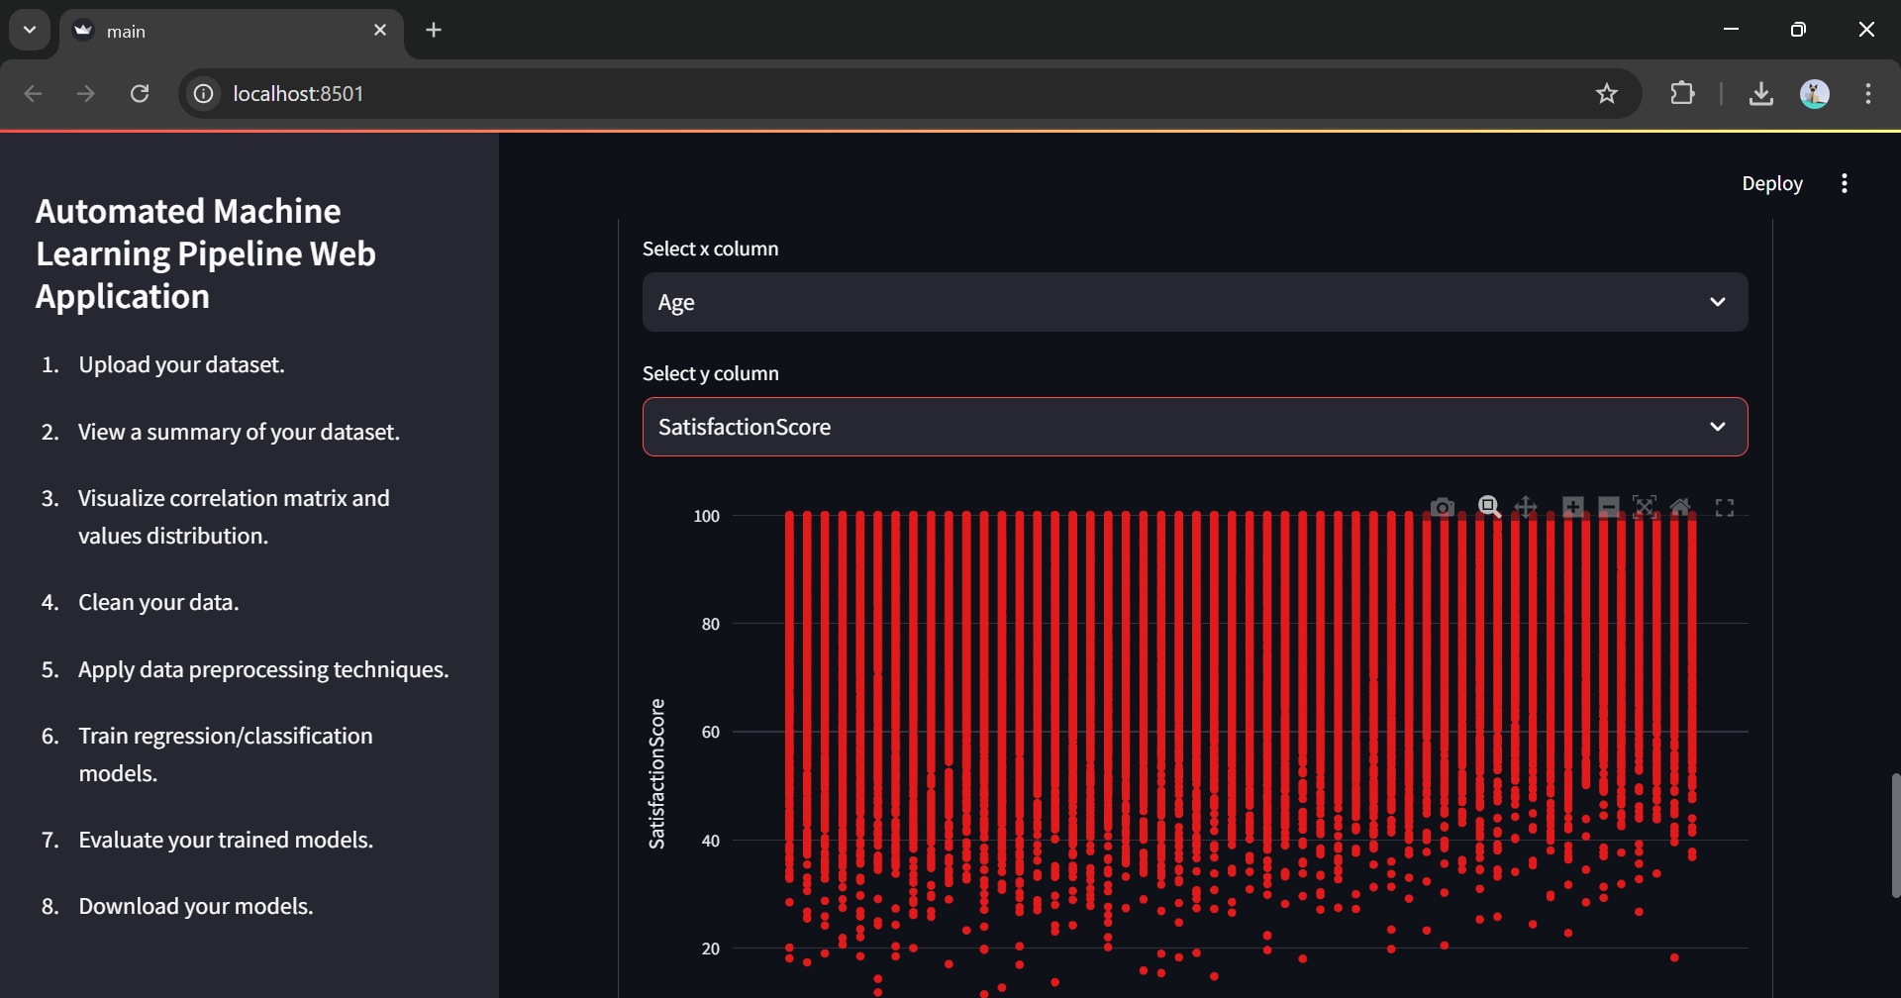
OUTPUT (SCREENSHOT)

Slide 26
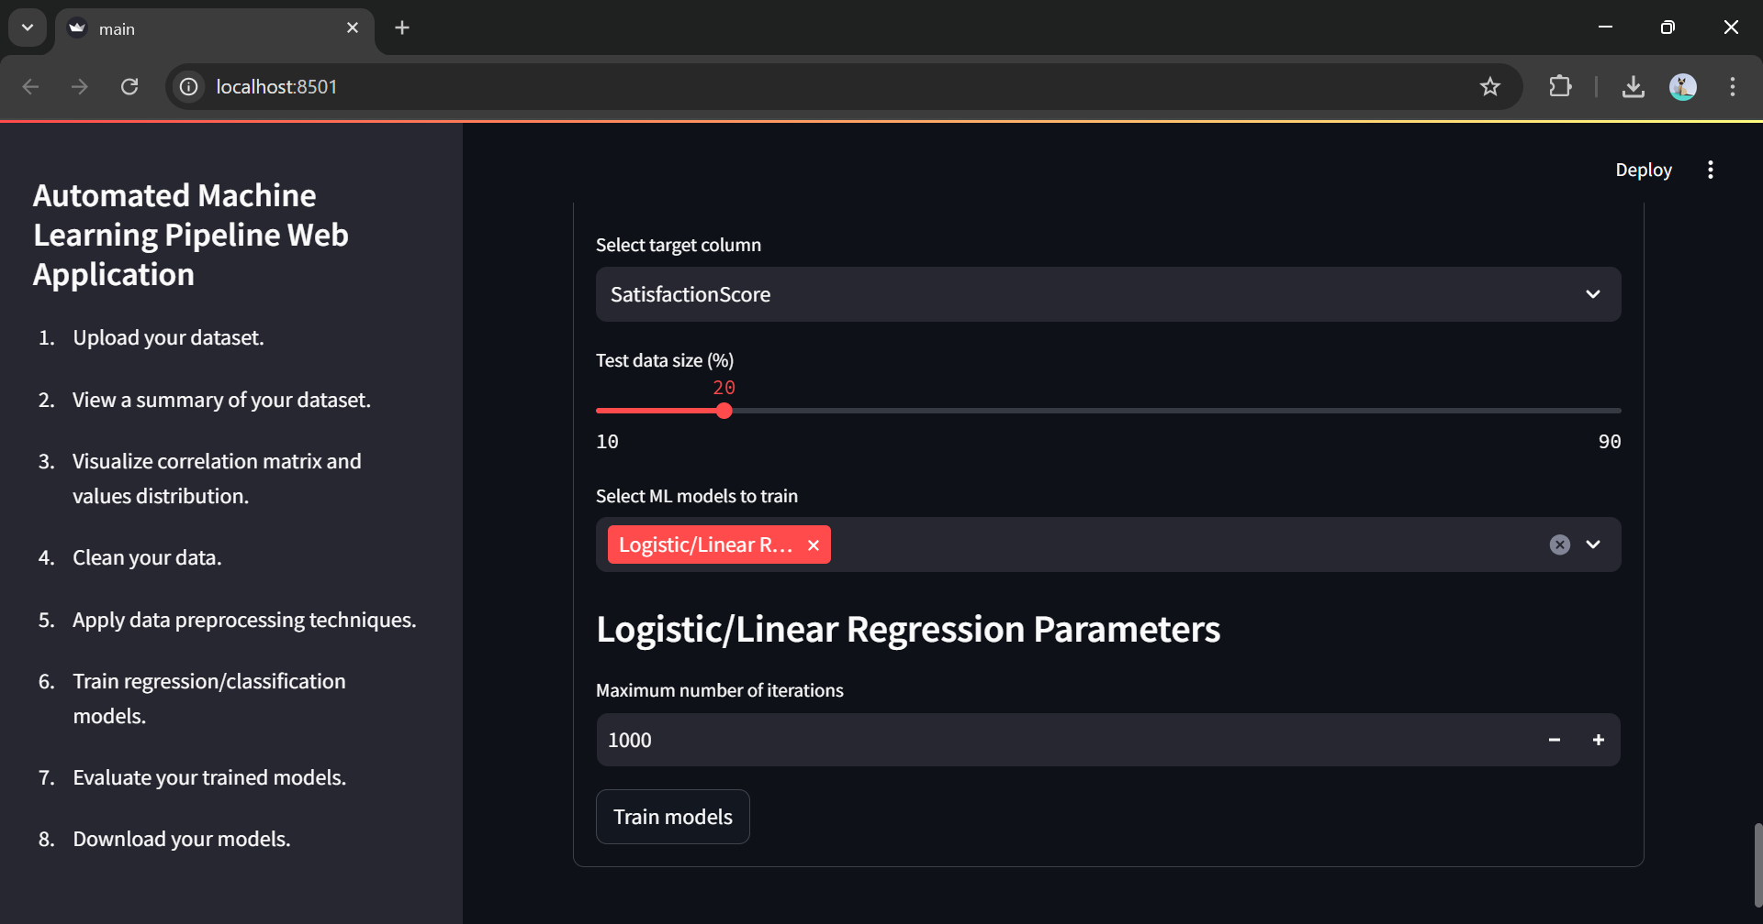
OUTPUT (SCREENSHOT)

Slide 27
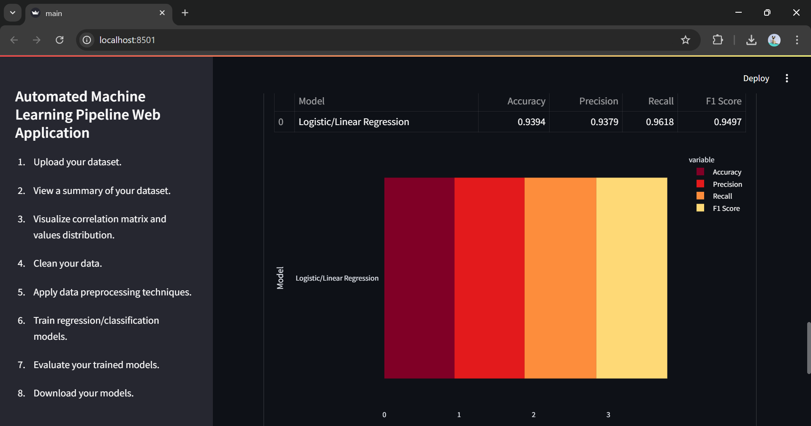
OUTPUT (SCREENSHOT)

Slide 28
CONCLUSION
This project demonstrates the capabilities of AutoML to simplify complex ML workflows, making machine learning accessible to a wider audience. The web application provides an end-to-end ML solution that automates data processing, model training, evaluation, and deployment. Future improvements could include support for advanced algorithms, additional evaluation metrics, and integration with cloud storage for scalability.

Slide 29
REFERENCE
Feurer, et al. (2019). “Automated Machine Learning: Methods, Systems, Challenges.” Journal of Machine Learning Research [1]
Kotthoff, et al. (2021). “Survey on AutoML Applications in Industry.” AI Review Journal. [2]
Vanschoren, et al. (2020). “Meta-Learning for Automated Model Selection.” Data Mining and Knowledge Discovery. [3]
Thornton et al. (2021). “Evaluating Ensemble Methods in AutoML Pipelines.” Advances in Neural Information Processing Systems. [4]
Bergstra, et al(2021). “Making a Science of Model Search: Hyperparameter Optimization in Machine Learning.” Proceedings of Machine Learning Research. [5]
Jamieson, et al. (2022). “Efficient Hyperparameter Optimization by Hyperband.” International Conference on Learning Representations. [6]
M. T., Singh, et al. (2021). “Why Should I Trust You? Explaining the Predictions of Any Classifier.” Proceedings of the 22nd ACM SIGKDD International Conference on Knowledge Discovery and Data Mining. [7]
Lundberg, et al. (2022). “A Unified Approach to Interpreting Model Predictions.” Advances in Neural Information Processing Systems. [8]
Park, et al. (2023). “Automated Machine Learning for Predictive Healthcare Applications.” Journal of Healthcare Informatics Research. [9]
Wang Q, et al (2022). “AutoML in Financial Fraud Detection: A Review.” International Journal of Financial Studies. [10]

