Slide 1

Automated Machine Learning (AutoML)Pipeline Web Application
Mini Project Phase -1
Team Members:
1. Balaganesh S - 22619129
2. Madhuragul M - 22619110
3. Manikandan G - 22619111
4. Jeeva K P- 22619142
Guide: Mrs. M. Bhanumathi
Designation: Assistant professor
Dept: Computer science engineering

Slide 2
ABSTRACT:
The AutoML Web Application simplifies the process of developing, evaluating, and deploying machine learning models for users with minimal technical expertise. It addresses barriers faced by non-experts, who typically struggle with data preprocessing, model selection, and evaluation. This platform allows users to upload datasets, preprocess data, choose ML algorithms, evaluate models, and download trained models—all without programming skills. Built with Streamlit, Python, and libraries like Scikit-learn, XGBoost, and CatBoost, it supports tasks such as classification, regression and clustering. The application automates data cleaning, feature engineering, and parameter tuning, making ML accessible to a broader audience. Future enhancements could include cloud support and deep learning integration, further expanding access to machine learning.

Slide 3
OVERVIEW:
Our web application automates essential machine learning tasks through a user-friendly interface. The pipeline supports:
Dataset upload and analysis.
Data visualization for insights.
Automated data cleaning and preprocessing.
Training of classification, regression and classification models(depending upon the task).
Model evaluation with performance metrics.
Model download for external deployment.
This tool is ideal for those looking to explore machine learning without deep technical expertise, making ML accessible and efficient for diverse users.

Slide 4
PROBLEM STATEMENT:
The process of building machine learning models is often complex and resource-intensive, requiring a deep understanding of data preprocessing, feature engineering, model selection, and parameter tuning. For individuals and organizations with limited expertise, these challenges can become significant barriers. As a result, many miss out on the benefits of machine learning, especially in cases where rapid model development is needed to derive actionable insights from data.

Slide 5
SOLUTION:
Our solution is a web application (AutoML) is a user-friendly web platform that automates the machine learning pipeline. Users can upload CSV datasets, visualize data, and clean it by handling missing values, duplicates, and applying techniques like oversampling and undersampling.
The platform supports automated model training for classification, regression, and clustering using algorithms like Random Forest, XGBoost, CatBoost.
It provides performance metrics (accuracy, precision, F1 score, etc.) for easy comparison.
Once trained, models can be downloaded for deployment, making it accessible for users with minimal ML expertise to build and integrate models efficiently.

Slide 6
Existing AutoML Technologies:
Google AutoML
Features: Uses Google’s cloud infrastructure to provide automated model training and deployment, supporting image, text, and tabular data.
Limitations:
Requires a Google Cloud account and can be costly for users with limited budgets.
Complexity in setup and requires some familiarity with cloud services.
Limited support for non-cloud environments.

Slide 7
Existing AutoML Technologies:
H2O.ai (H2O AutoML)
Features: Open-source platform that automates the ML pipeline, supporting classification and regression with powerful algorithms.
Limitations:
Has a steep learning curve, especially for beginners.
Primarily used by tech-savvy users, requiring a basic understanding of H2O Flow.
Heavier computational requirements.

Slide 8
Existing AutoML Technologies:
DataRobot
Features: Enterprise-level platform that automates model development and deployment with strong analytics capabilities.
Limitations:
High cost, making it less accessible to small businesses or individual users.
Primarily targets enterprise users, not beginners or small-scale projects.

Slide 9
How Our AutoML Application Could Be Different and Useful:
User-Friendly, No-Code Interface
Differentiator: Unlike many existing platforms that require some coding knowledge, Our application focuses on a fully no-code experience using a clean UI interface. This will make it accessible to non-technical users, enabling them to easily build and deploy models without programming expertise.

Slide 10
How Our AutoML Application Could Be Different and Useful:
Lower Cost and Greater Accessibility
Differentiator: By keeping your platform open-source and focusing on local deployments, you can provide a cost-effective solution for small businesses, researchers, and individual users who cannot afford expensive AutoML solutions.

Slide 11
How Our AutoML Application Could Be Different and Useful:
Future Scalability & Customization
Differentiator: Your application can plan for future enhancements, such as integrating cloud-based storage, support for deep learning models, and more advanced visualization tools. This ensures scalability and flexibility as user needs evolve.

Slide 12
OBJECTIVES:
User-Friendly ML: Provide a straightforward interface for building ML models.
Empower Non-Experts: Offer a seamless ML experience that minimizes technical barriers, supporting users in making data-driven decisions effectively.
Automate ML Pipeline: Automatically handle data preprocessing, model training, and evaluation.
Enable Model Download: Allow users to easily export trained models for use in their own applications.

Slide 13
LITERATURE SURVEY:
Overview of AutoML Development Automated Machine Learning has rapidly evolved, with research focused on making machine learning accessible to non-experts. Key developments include:
Automated Data Preprocessing: Techniques to handle missing values, outliers, and data transformations automatically.
Model Selection: Algorithms that efficiently select the best models from a predefined set, reducing manual effort.
Key Studies:
Feurer et al. (2019) on automating preprocessing and model selection in AutoML frameworks.
Kotthoff et al. (2021) examining AutoML’s effectiveness in various industry applications.

Slide 14
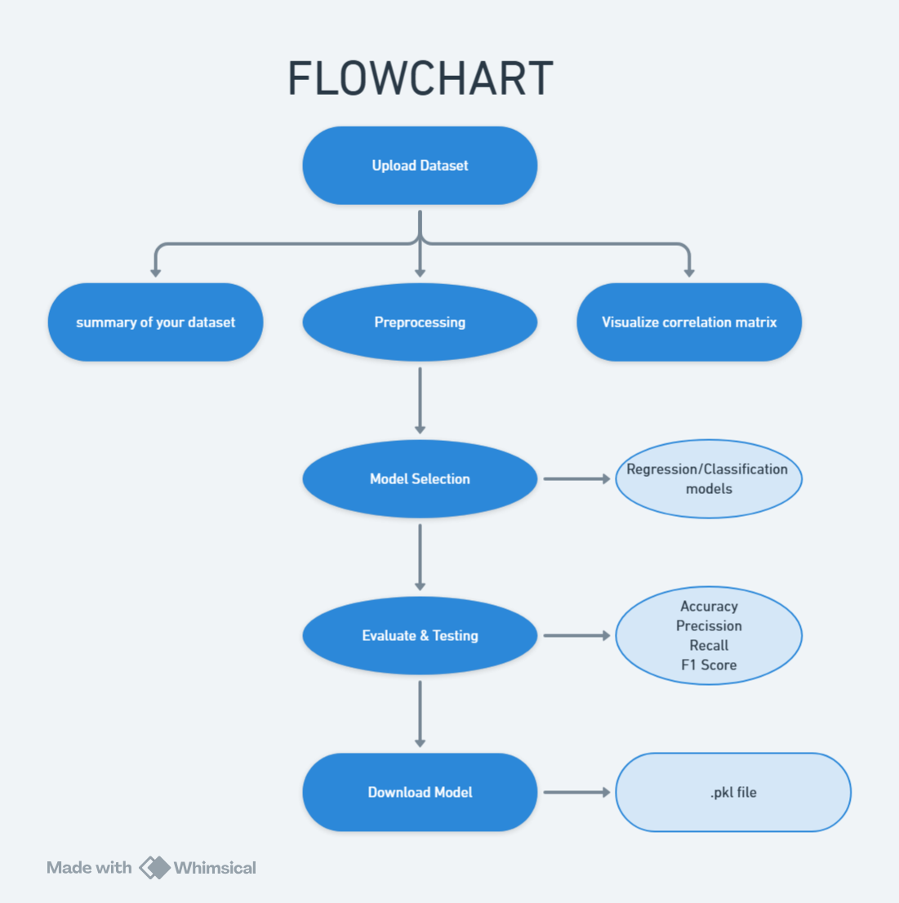

Slide 15
TECH USED:
Frontend(User Interface): Streamlit
Streamlit Framework: Streamlit is used as the primary interface framework, allowing for the creation of interactive, real-time dashboards without extensive frontend coding. This enables users to:
Upload and display datasets.
Interact with different components such as buttons, sliders, and dropdowns for selecting preprocessing and model options.
View visualizations and evaluation metrics in an intuitive format.
Advantages: Streamlit’s simplicity and Python-native approach make it ideal for machine learning applications that require rapid prototyping and real-time interactivity.

Slide 16
TECH USED:
Backend: Python with ML Libraries
Python: The core programming language for backend development. Its extensive library ecosystem supports machine learning, data processing, and model evaluation with efficiency.
Machine Learning Libraries:
Scikit-learn: Essential for implementing classic ML models (e.g., Logistic Regression, KNN) and preprocessing methods (e.g., PCA, data encoding).
XGBoost: Known for its high performance in gradient boosting tasks, XGBoost is used for training classification and regression models with better accuracy and speed.
CatBoost: A library optimized for categorical data, allowing the application to handle mixed data types effectively.
Imbalanced-learn: This library includes tools like RandomOverSampler and SMOTEENN to handle imbalanced datasets, which is crucial for improving the quality of model predictions.

Slide 17
TECH USED:
Data Processing and Visualization: Pandas, Plotly, and NumPy
Pandas: Provides data manipulation capabilities, enabling operations such as reading data, handling missing values, and reshaping datasets. Used extensively for data preprocessing and transformation tasks.
NumPy: Supports numerical computations, especially matrix operations for feature engineering, PCA, and dataset balancing, enhancing computational efficiency.
Plotly: Plotly Express and Graph Objects are used for interactive visualizations, allowing users to explore correlations, distributions, and model evaluation metrics visually. This enhances the interpretability of data insights.

Slide 18
TECH USED:
Model Persistence: Pickle and NumPy:
Pickle: Enables model serialization, allowing users to download trained models as .pkl files. This makes the models portable, so they can be used in other applications without retraining.
Implementation: After training, each model is serialized with Pickle and provided as a downloadable file. This feature supports easy integration into other ML pipelines or deployment environments.

Slide 19
TECH USED:
Machine Learning Model Options
Classification Algorithms: Logistic Regression, Random Forest, XGBoost, CatBoost, SVM, and KNN. These models cover a wide range of applications, from linear classification to complex, non-linear tasks.
Regression Algorithms: Linear Regression, Random Forest Regressor, XGBoost Regressor, CatBoost Regressor. These models are optimized for predicting continuous values in various types of datasets.
Clustering Algorithms: K-Means and Hierarchical Clustering for unsupervised tasks, enabling the application to group data into clusters without predefined labels.

Slide 20
TECH USED:
Model Evaluation Metrics
Classification Metrics: Accuracy, Precision, Recall and F1 Score to provide detailed performance insights for each classification model.
Regression Metrics: Mean Absolute Error (MAE), Root Mean Squared Error (RMSE), and R2 Score are calculated to assess regression model performance, helping users interpret prediction accuracy and error.
Clustering Metrics: Silhouette Score is used for clustering algorithms to assess the clusters.

Slide 21
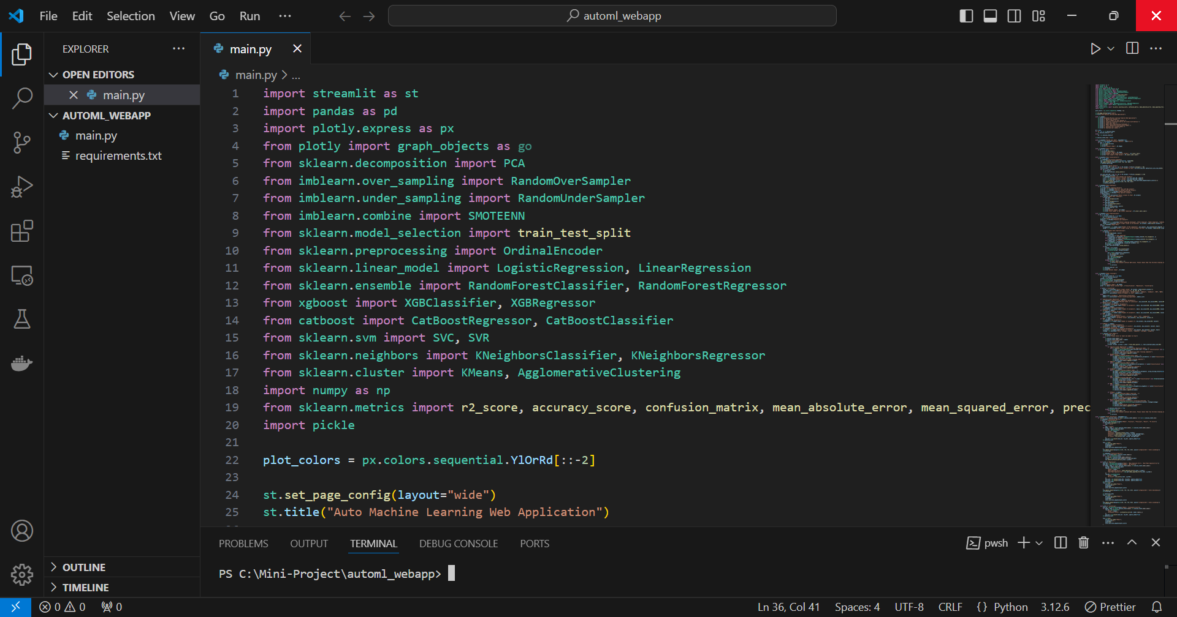
CODING (SCREENSHOT)

Slide 22
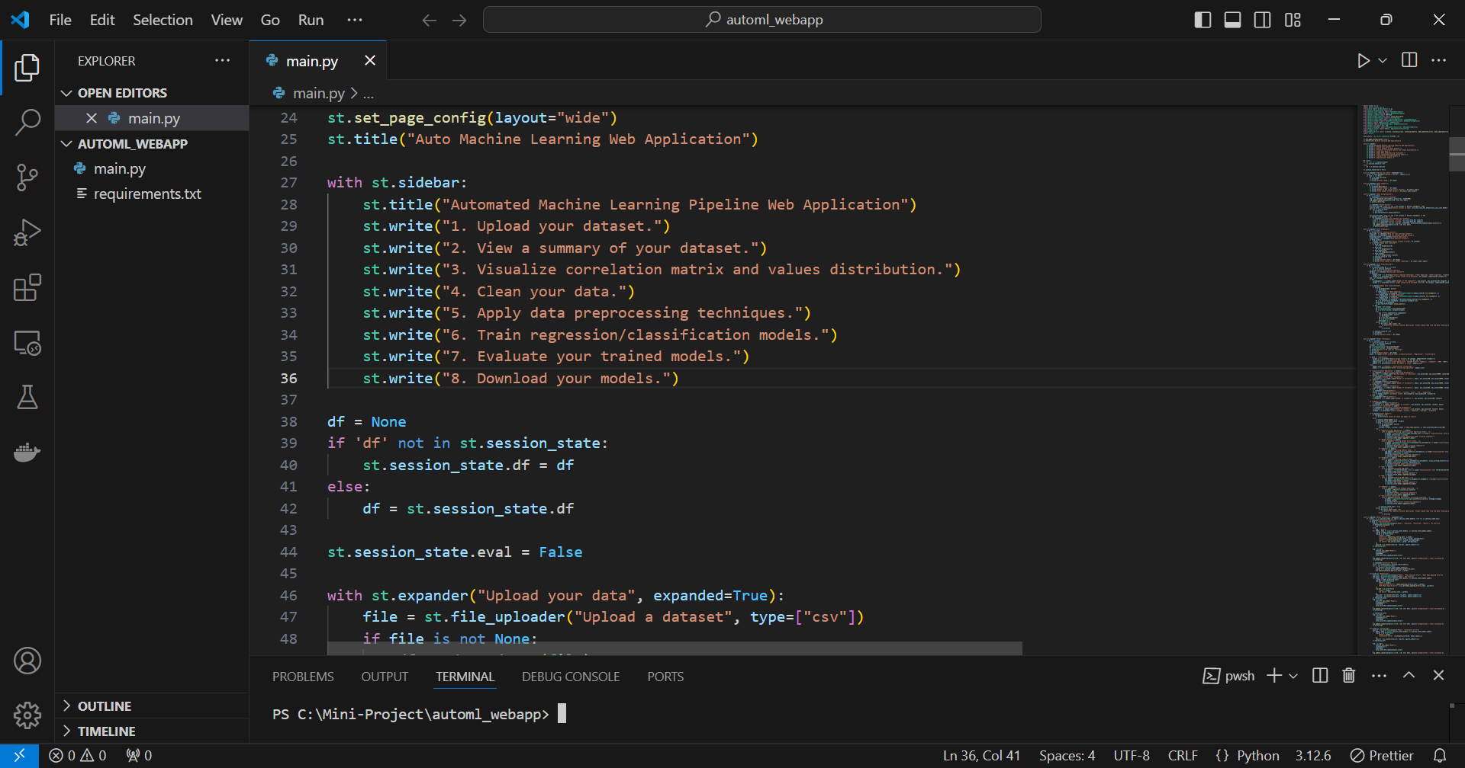
CODING (SCREENSHOT)

Slide 23
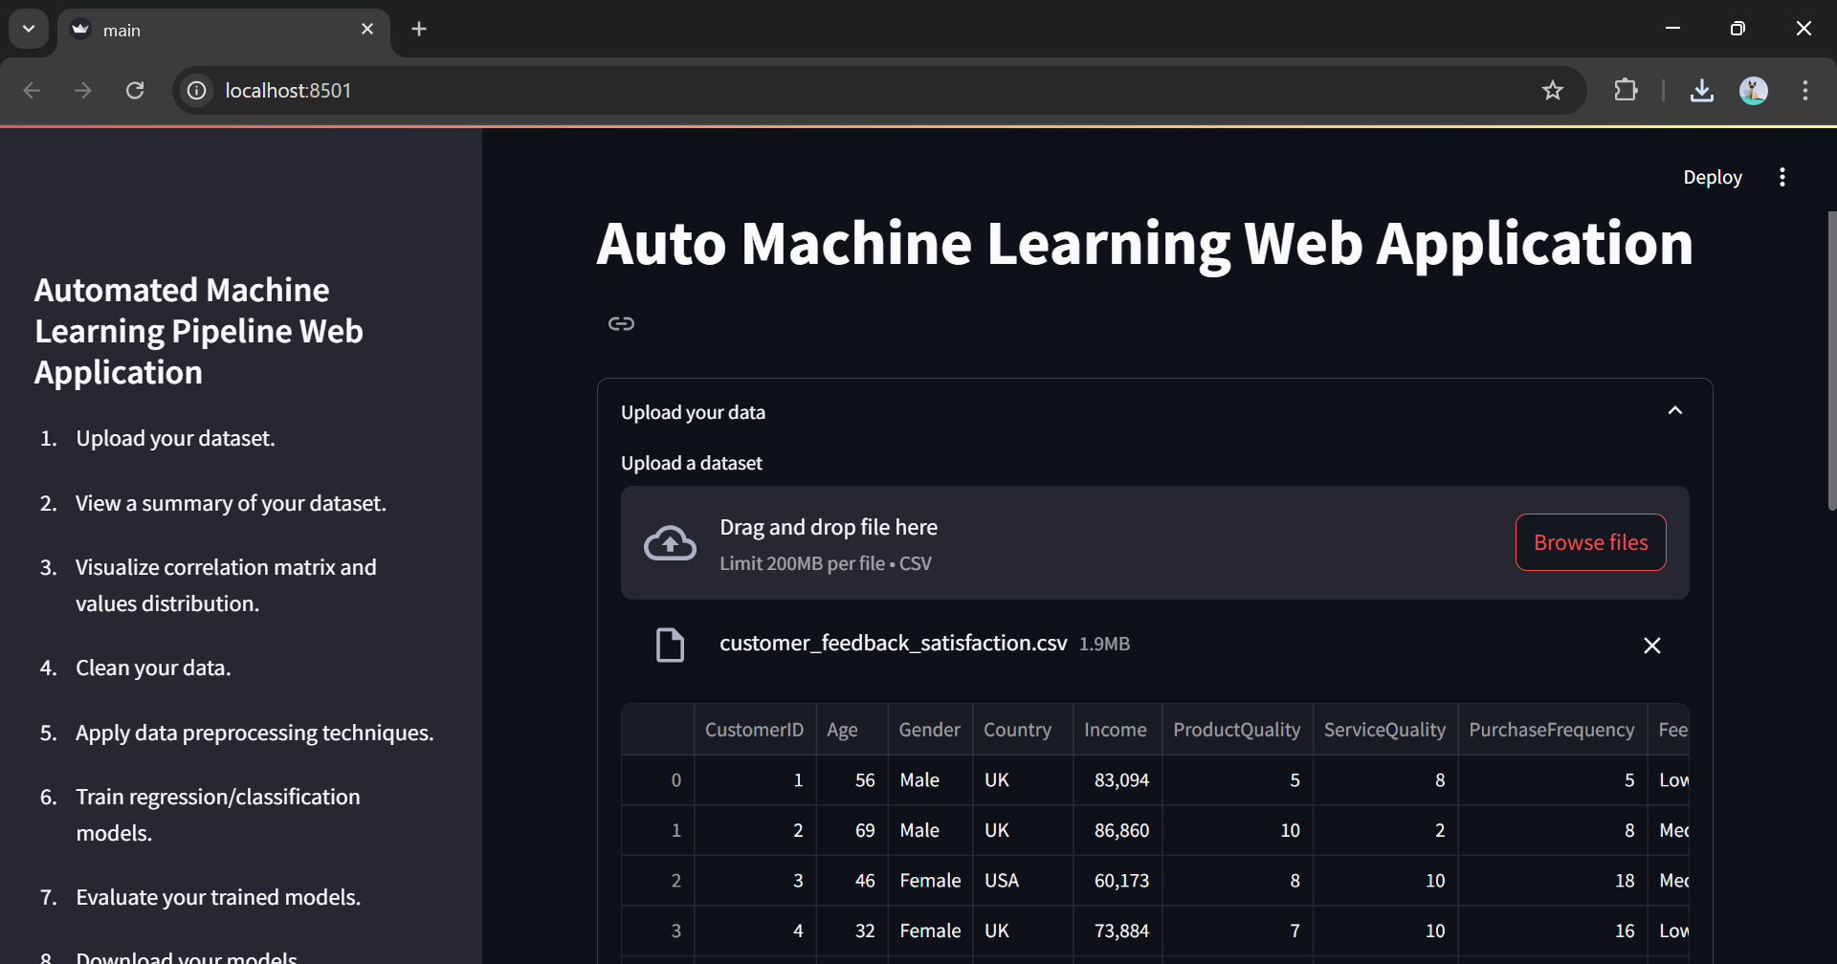
OUTPUT (SCREENSHOT)

Slide 24
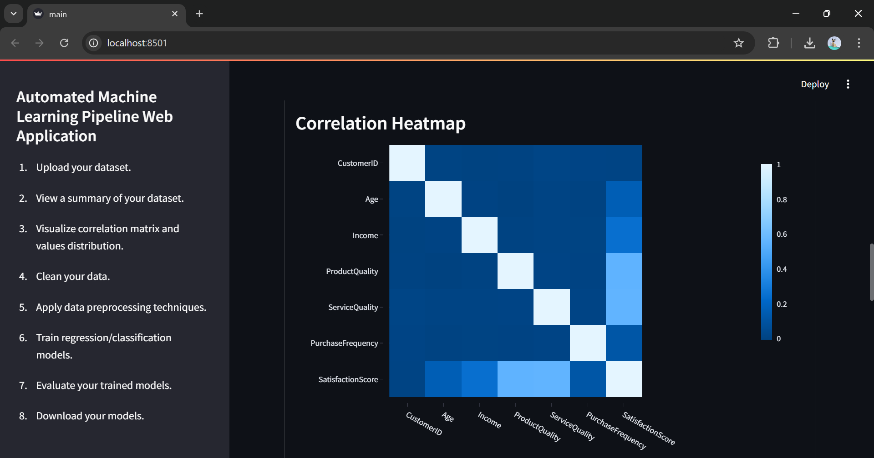
OUTPUT (SCREENSHOT)

Slide 25
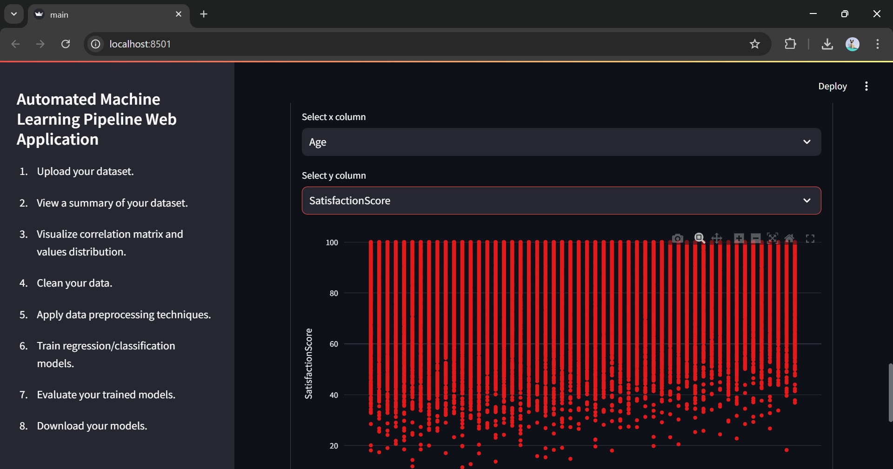
OUTPUT (SCREENSHOT)

Slide 26
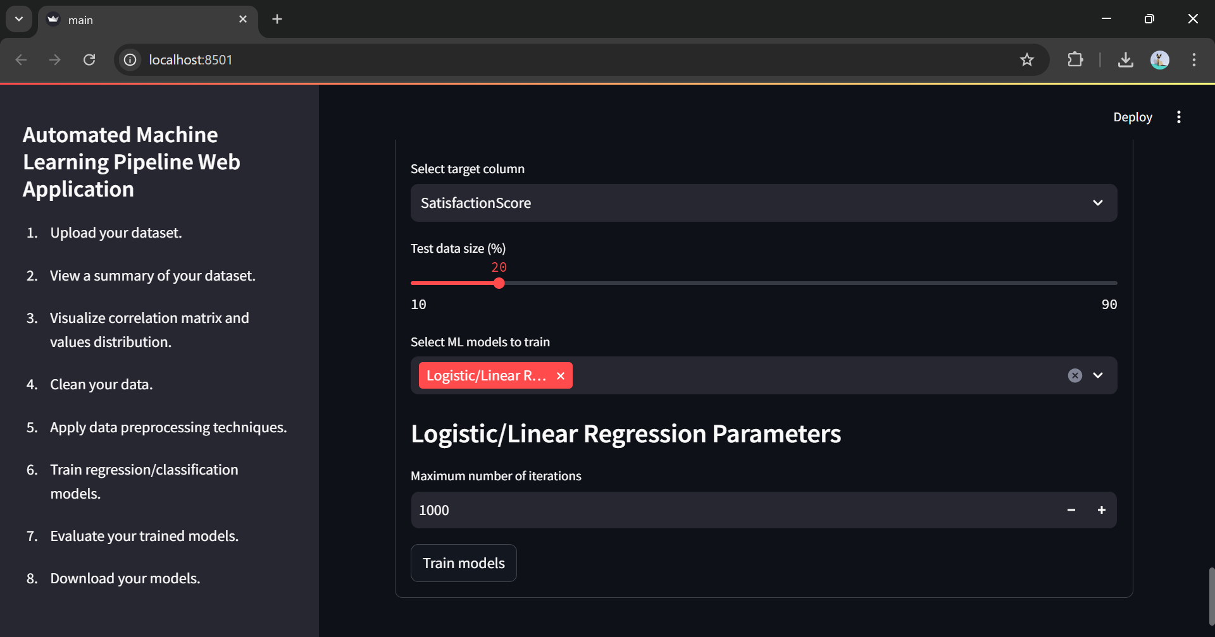
OUTPUT (SCREENSHOT)

Slide 27
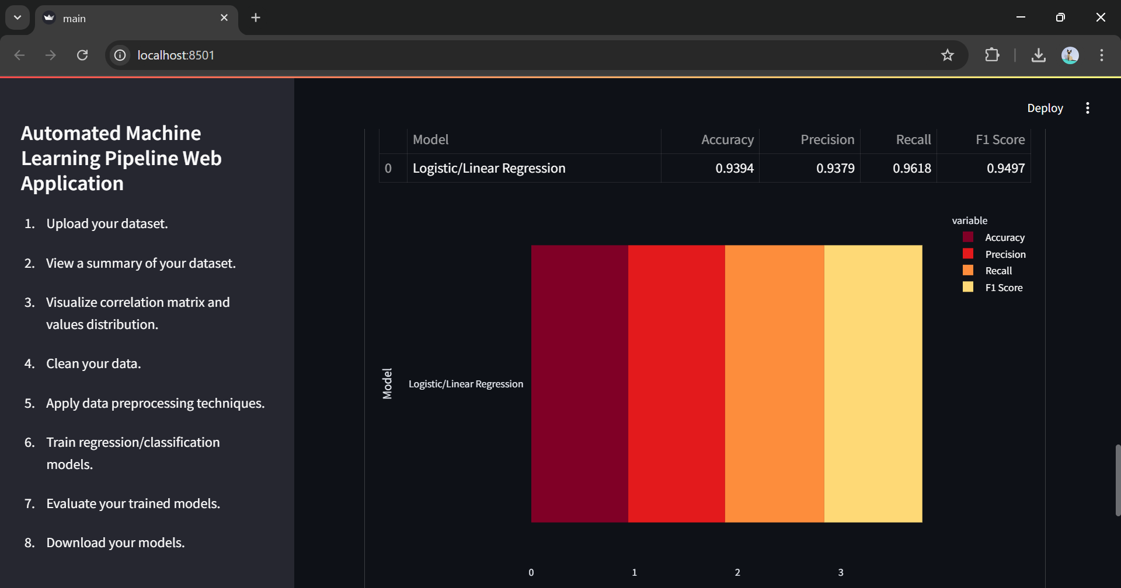
OUTPUT (SCREENSHOT)

Slide 28
CONCLUSION
This project demonstrates the capabilities of AutoML to simplify complex ML workflows, making machine learning accessible to a wider audience. The web application provides an end-to-end ML solution that automates data processing, model training, evaluation, and deployment. Future improvements could include support for advanced algorithms, additional evaluation metrics, and integration with cloud storage for scalability.

Slide 29
REFERENCE
Feurer, et al. (2019). “Automated Machine Learning: Methods, Systems, Challenges.” Journal of Machine Learning Research [1]
Kotthoff, et al. (2021). “Survey on AutoML Applications in Industry.” AI Review Journal. [2]
Vanschoren, et al. (2020). “Meta-Learning for Automated Model Selection.” Data Mining and Knowledge Discovery. [3]
Thornton et al. (2021). “Evaluating Ensemble Methods in AutoML Pipelines.” Advances in Neural Information Processing Systems. [4]
Bergstra, et al(2021). “Making a Science of Model Search: Hyperparameter Optimization in Machine Learning.” Proceedings of Machine Learning Research. [5]
Jamieson, et al. (2022). “Efficient Hyperparameter Optimization by Hyperband.” International Conference on Learning Representations. [6]
M. T., Singh, et al. (2021). “Why Should I Trust You? Explaining the Predictions of Any Classifier.” Proceedings of the 22nd ACM SIGKDD International Conference on Knowledge Discovery and Data Mining. [7]
Lundberg, et al. (2022). “A Unified Approach to Interpreting Model Predictions.” Advances in Neural Information Processing Systems. [8]
Park, et al. (2023). “Automated Machine Learning for Predictive Healthcare Applications.” Journal of Healthcare Informatics Research. [9]
Wang Q, et al (2022). “AutoML in Financial Fraud Detection: A Review.” International Journal of Financial Studies. [10]

