Slide 1
Node.js

Slide 2
Introduction

Slide 3
What is Node.js?
Node.js is an open-source, cross-platform JavaScript runtime environment
Open source - source code is publicly available for sharing and modification
Cross platform - Available on Mac, Windows and Linux
JavaScript runtime environment - ?

Slide 4
Why learn Node.js?
Build end-to-end JavaScript applications
A number of major companies like LinkedIn, Netflix, PayPal have all migrated from other backend technologies to Node.js
Full stack development is one of the most sought out skill sets by companies
Huge community support

Slide 5
Course Structure
Terms and concepts to understand
Modules (User defined)
Built-in modules
Node.js internals
npm - Node package manager
CLI tool
Misc

Slide 6
Prerequisites
Modern JavaScript
JavaScript fundamentals crash course
Advanced JavaScript crash course
ES2015 topics

Slide 7
ECMAScript

Slide 8
Going back in time...
In 1993, the first web browser with a user interface called Mosaic was released
In 1994, the lead developers of Mosaic founded a company called Netscape and released a more polished browser called Netscape Navigator
Web pages could only be static and there was no interactivity after a page was loaded
In 1995, Netscape created a new scripting language called JavaScript
The name was purely for marketing purpose as Java was the hot new language back then

Slide 9
The advent of Microsoft
In 1995, Microsoft debuted their browser Internet Explorer
Microsoft realized that JavaScript fundamentally changed the user experience of the web and wanted the same for internet explorer
But there was no specification for them to follow
In 1996, Microsoft reverse-engineered the Navigator interpreter to create its own scripting language called JScript
The differences made it difficult for developers to make their websites work well in both browsers
"Best viewed in Netscape” and “Best viewed in Internet Explorer" badges became common

Slide 10
ECMA International
In Nov 1996, Netscape submitted JavaScript to ECMA International
It is an industry association dedicated to the standardization of information and communication systems
Netscape wanted a standard specification that all browser vendors could conform to as it would help keep other implementations consistent across browsers
For each new specification ECMA provides a standard specification and a committee
In case of JavaScript, the standard is called ECMA-262 and the committee that works on ECMA-262 is called Technical Committee 39 (TC39)

Slide 11
ECMA International contd.
ECMA however decided to use the term "ECMAScript" to talk about the official language
The reason for this is because Oracle (who acquired Microsystems) owns the trademark for the term "JavaScript"
ECMAScript refers to the standard language whereas JavaScript is what we use in practice and builds on top of ECMAScript

Slide 12
ECMAScript versions
1997 - ECMAScript 1
1998 - ECMAScript 2
1999 - ECMAScript 3
ECMAScript 4 never released
2009 - ECMAScript 5
2015 - ECMAScript 2015 (ES6)
One version every year since 2015

Slide 13
ECMAScript Summary
ECMA-262 is the language specification
ECMAScript is the language that implements ECMA-262
JavaScript is basically ECMAScript at its core but builds on top of that

Slide 14
Chrome's V8 Engine

Slide 15
JavaScript Engine
JavaScript code we write cannot be understood by the computer
A JavaScript engine is a program that converts javascript code that developers write into machine code that allows a computer to perform specific tasks
JavaScript engines are typically developed by web browser vendors
V8 - Open-source JavaScript Engine developed by Google for Chrome
SpiderMonkey - The JavaScript Engine powering Mozilla Firefox
JavaScriptCore - Open-source JavaScript Engine developed by Apple for Safari
Chakra - A JavaScript Engine for the original Microsoft Edge (The latest version of edge uses V8)

Slide 16
Chrome's V8 Engine
V8 is Google's open source JavaScript engine.
V8 implements ECMAScript as specified in ECMA-262.
V8 is written in C++ and is used in Google Chrome, the open source browser from Google.
V8 can run standalone, or can be embedded into any C++ application.

Slide 17
Chrome's V8 Engine & Node.js
Chrome's V8 engine by Google sits at the core of Node.js
By embedding V8 into your own C++ application, you can write C++ code that gets executed when a user writes JavaScript code
You can add new features to JavaScript itself
Since C++ is great for lower level operations like file handling, database connections and network operations, by embedding V8 into your own C++ program, you have the power to add all of that functionality in JavaScript
The C++ program we're talking about is Node.js*
(* Node.js is a lot more than just a C++ program)

Slide 18
Chrome's V8 Engine Summary
A JavaScript engine is a program that executes JavaScript code
In 2008, Google created its own JavaScript engine called V8
V8 is written in C++ and can be used independently or can be embedded into other C++ programs
That allows you to write your own C++ programs which can do everything that V8 can do and more
Your C++ program can run ECMAScript and additional features that you choose incorporate
For example, features that are available in C++ but not available with JavaScript

Slide 19
JavaScript Runtime

Slide 20
JavaScript Runtime
JavaScript runtime is an environment which provides all the necessary components in order to use and run a JavaScript program
Every browser has a JavaScript Engine
A JavaScript Engine is one component in the JavaScript Runtime
What else does the JavaScript Runtime consist of?

Slide 21
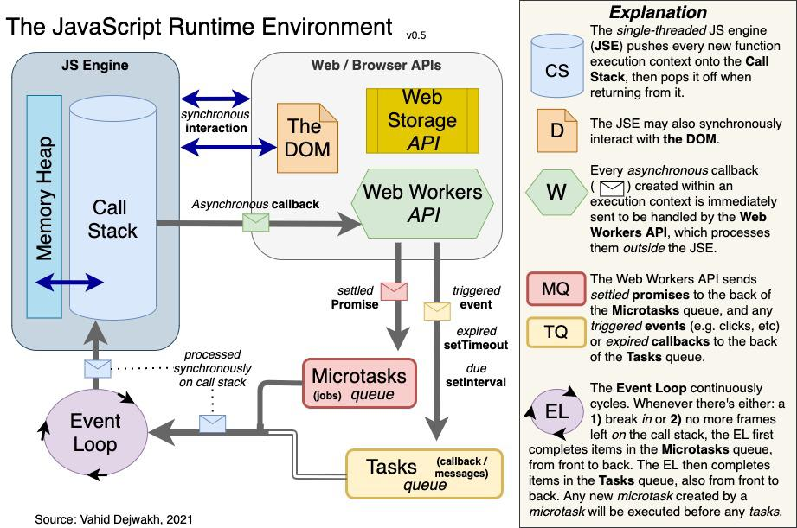

Slide 22
What is Node.js?

Slide 23
Node.js is an open-source, cross-platform JavaScript runtime environment
Open source - source code is publicly available for sharing and modification
Cross platform - available on Mac, Windows and Linux
JavaScript runtime environment - provides all the necessary components in order to use and run a JavaScript program outside the browser

Slide 24
What can you build with Node.js?
Traditional websites
Backend services like APIs
Real-time applications
Streaming services
CLI tools
Multiplayer games
Node.js allows you to build complex and powerful applications

Slide 25
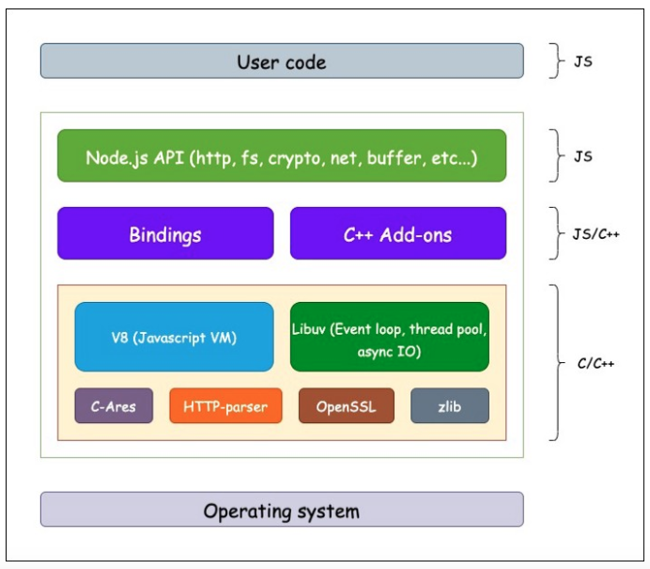

Slide 26
Node.js Summary
Node.js is an open-source, cross-platform JavaScript runtime environment
It is not a language, it is not a framework
Capable of executing JavaScript code outside a browser
It can execute not only the standard ECMAScript language but also new features that are made available through C++ bindings using the V8 engine
It consists of C++ files which form the core features and JavaScript files which expose common utilities and some of the C++ features for easier consumption

Slide 27
Browser vs Node.js
In the browser, most of the time what you are doing is interacting with the DOM, or other Web Platform APIs like Cookies.
You don't have the document, window and all the other objects that are provided by the browser.
In the browser, we don't have all the nice APIs that Node.js provides through its modules. For example the filesystem access functionality.
With Node.js, you control the environment.
With a browser, you are at the mercy of what the users choose

Slide 28
Section Summary
ECMAScript
Chrome's V8 engine
JavaScript runtime
Node.js visually and through code
Hello world program
Browser vs Node.js

