Slide 1
SAKILA DVD- RENTAL STORE
Presented by Manikanta

Slide 2
Sakila DVD rental store- Overview
The Sakila DVD Rental Store is a sample database to represent fictional movie rental business
It was created by Mike Hillyer for learning and demonstrating database concepts
It mainly deals with the management of a movie rental business
Managing information about films and managing available copies in inventory
To break it down, Sakila simulates how a movie rental company operates using a relational database

Slide 3
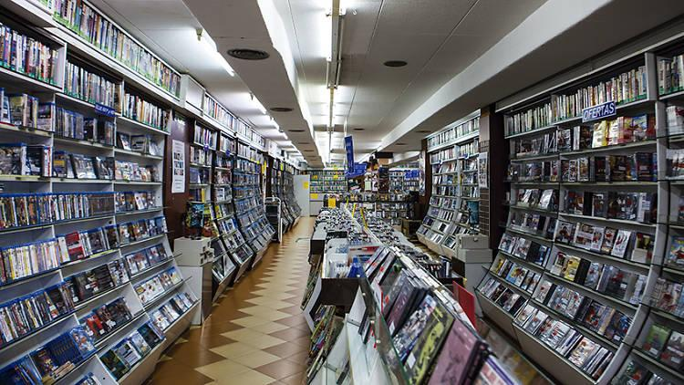

DATASET INTRODUCTION
Category
Film
Film text
Language
Actor
Flim actor
Store
Inventory
Rental
Staff
Payment
A central inventory table links films, film actor, stores and rentals to perform complex queries.

Slide 4

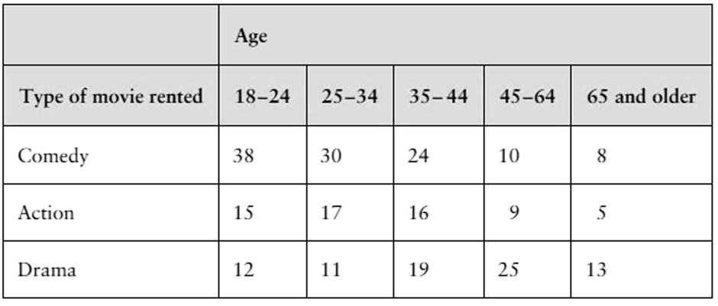
Dataset introduction
Dataset Includes :
Customers
Address
City
Country

Slide 5
Handling Errors
Apply NOT NULL, PRIMARY KEY, FOREIGN KEY, UNIQUE It ensures invalid data is not inserted
Use transactions for safe operations, this Helps undo changes if an error occurs
Validate data before inserting like Check the data type, range, and format by ensuring the payment amount is not negative
Avoid duplicate entries by using UNIQUE constraints or checks before insert
Logging and debugging helps in identifying issues in queries or data also, records troubleshooting

Slide 6
Null Values
Identify NULL values by Using IS NULL and IS NOT NULL
Replace NULL values by Using COALESCE() or IFNULL()
Use DEFAULT in table definition to avoid NULLs
Use UPDATE to fill NULL fields with valid data
Remove rows where NULL data is not useful
Prevent NULL values during data insertion
Use functions to avoid incorrect results in aggregations

Slide 7
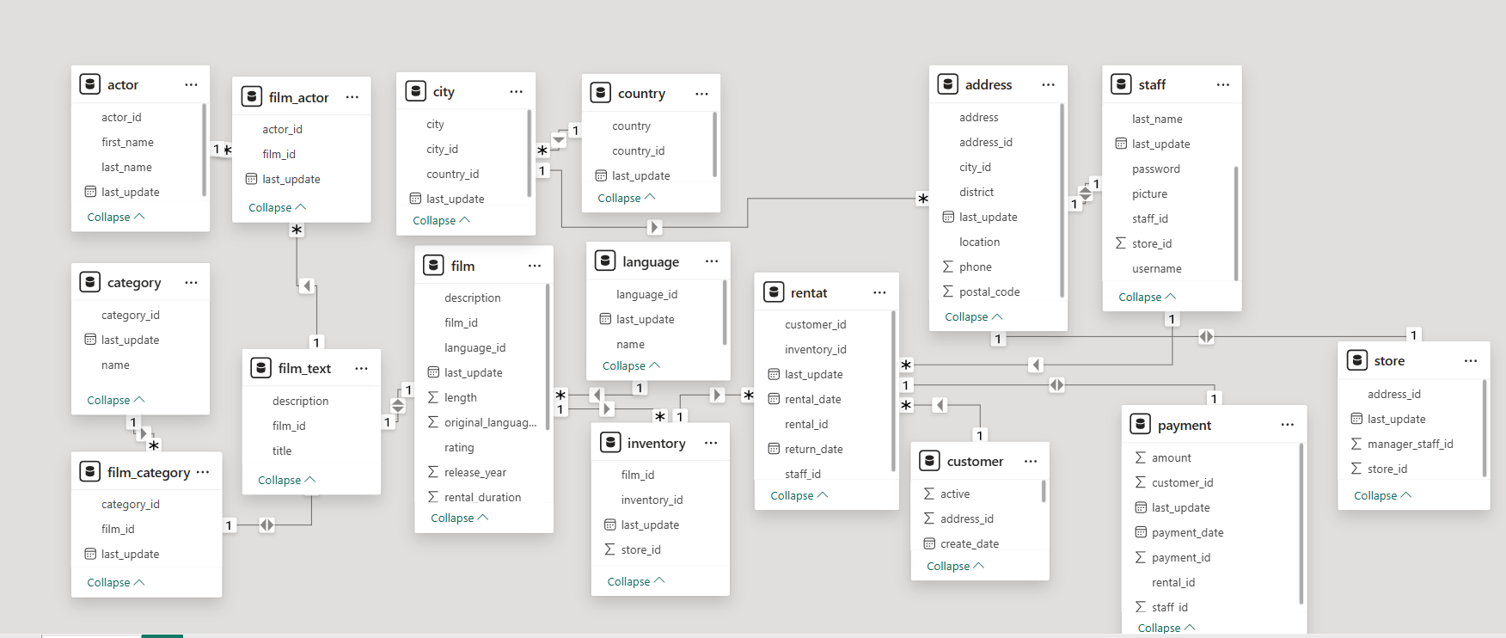
ER Diagram

Slide 8
EDA INSIGHTS
Content Insights
Platform has structured catalog and massive potential growth in Indian market
Actor Insights
Actors appear across multiple actors (reusable talent)
Films have multiple actors (resemble casting)
Inventory insights
Inventory reflects expected demand
More copies = higher anticipated popularity
Customer insights
Strong base for retention analysis and marketing campaigns
Geographical insights
You can map customer distribution and regional demand this enables geo targeted marketing
Store and operations Analysis
Inventory is distributed across the stores
Simple but effective multi-store model

Slide 9
Power BI Questions
How does the sales revenue vary by month?
What is the distribution of sales by payment method?
Which customer segments generate the highest sales?
What is the distribution of films by rental duration?
How does the inventory vary by film rating?
What is the breakdown of film categories in the inventory?
What is the distribution of staff by employment duration?
How does the store performance vary by location?
What is the average rental duration by staff member?
What is the distribution of customers across different cities?
How does the rental revenue vary by country?
Which locations have the highest and lowest customer ratings?
What is the distribution of films by language?
Which film categories have the highest rental rates?
How does the average rental duration vary by film category?

Slide 10
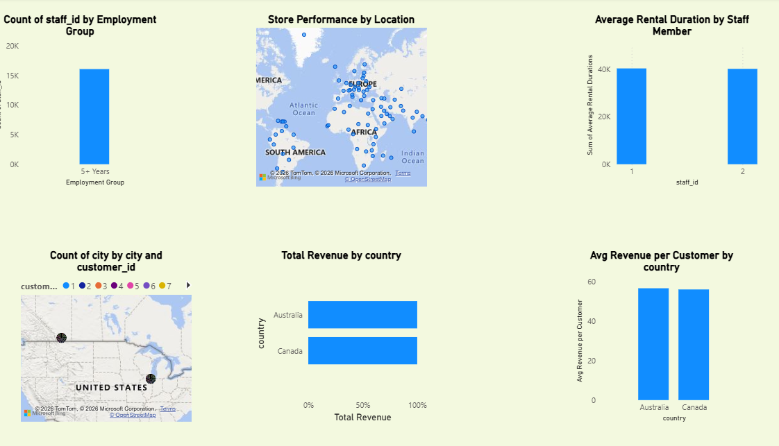

Slide 11
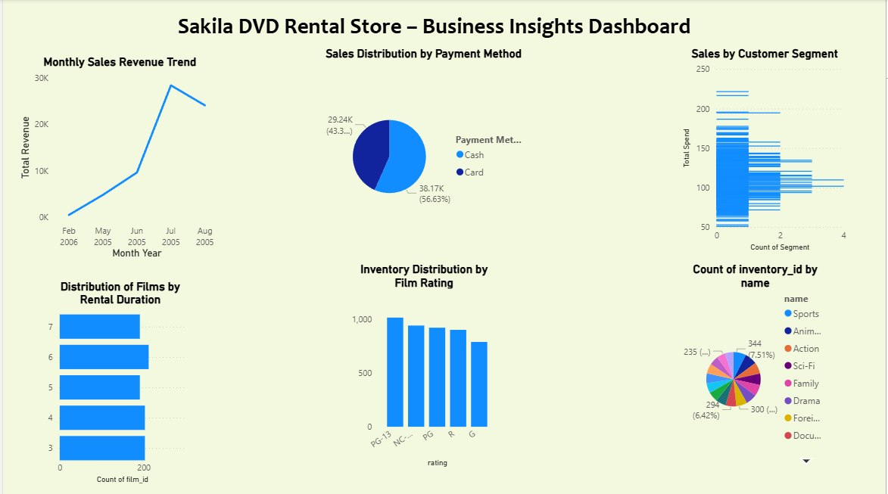
Comprehending market trends

Slide 12
SUMMARY AND SUGGESTIONS
Understanding the data structure and relationships
Writing SQL queries to extract useful insights
Performing data cleaning (handling NULL values, ensuring consistency)
Analyzing customer behavior, rental trends, and revenue
Using joins, aggregations, and filtering to generate reports

