Slide 1
WattWise
See where your electricity goes, and which change to make first.
Built by Manikanta, 3rd year EEE, Bonam Venkata Chalamyya Engineering College
Build with AI: Code for Communities | Sustainability
Notes:
WattWise is a home and hostel energy audit with an AI-written action plan.

Slide 2
Most people cannot see what drives their bill
A monthly bill is one number. It does not show that the AC, water heater and always-on chargers may use most of it.
Generic tips like "use LEDs" ignore what is actually in your home.
Higher use means higher bills and higher CO₂, since the grid still runs largely on fossil fuels.
Notes:
Lead with the gap: people have a bill, not a breakdown.

Slide 3
WattWise turns your appliance list into a plan
Audit
Simulate
Plan with Gemini
Enter count, watts and hours. See daily kWh, monthly bill, yearly CO₂ and the solar size needed.
Tick swaps like BLDC fans, LED lighting and inverter AC. Savings update instantly.
Gemini ranks the three changes that save the most and explains why in plain language.
Notes:
Three steps: see it, test changes, get a ranked plan.

Slide 4
How it works
Browser
Flask on Cloud Run
Gemini API
Static page with the audit calculator
→
Validates input, keeps the API key server-side
→
Returns a ranked plan as JSON
Stack: Python, Flask, google-genai SDK, Docker, Google Cloud Run
Notes:
The key never reaches the browser. Model name is set by environment variable.

Slide 5
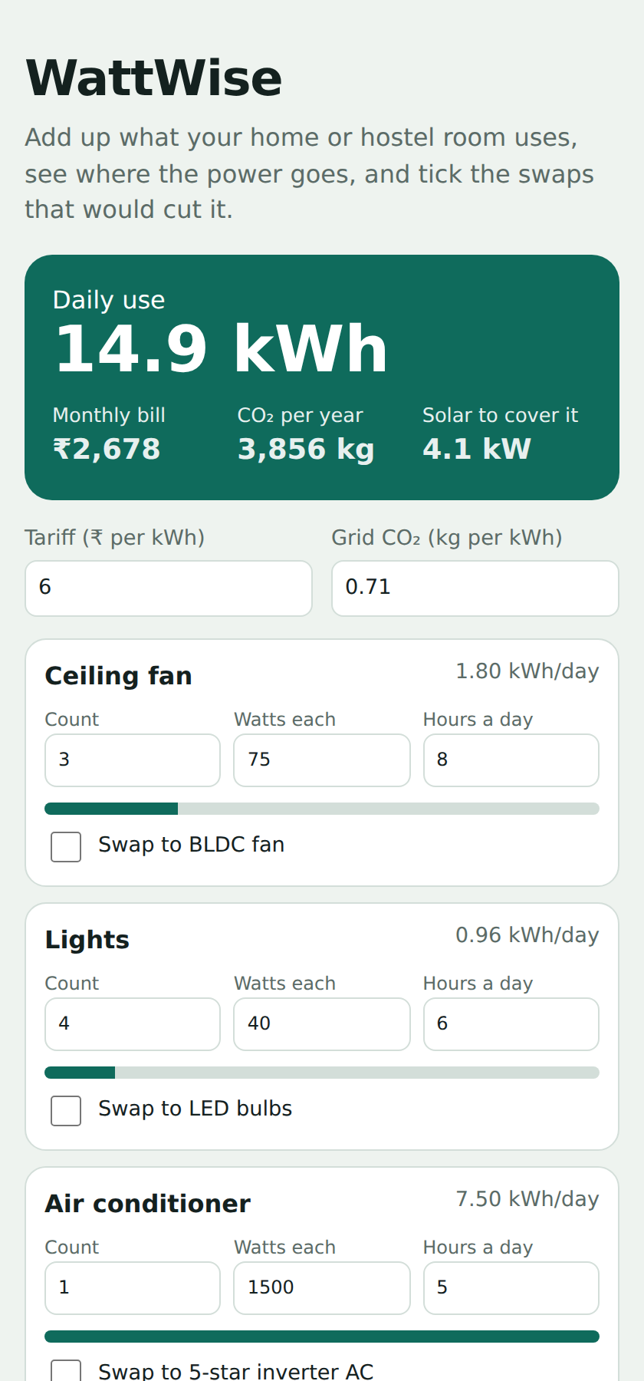
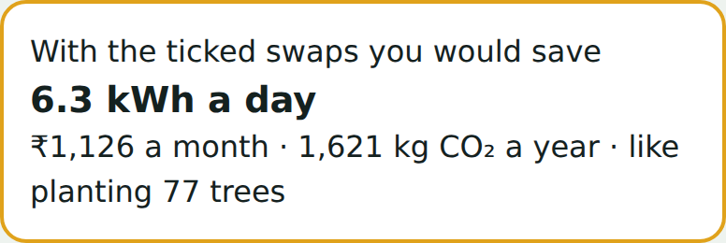
The app in use
Left: the audit for the sample home, 14.9 kWh a day and a ₹2,678 monthly bill. Right: savings after ticking every swap.
Notes:
Screenshots of the working app with default sample values.

Slide 6
The Gemini call
resp = client.models.generate_content(
model=MODEL,
contents=json.dumps(payload),
config=types.GenerateContentConfig(
system_instruction=SYSTEM,
response_mime_type="application/json",
temperature=0.3,
),
)
return jsonify(json.loads(resp.text))
main.py: validates input, asks Gemini for a JSON plan, returns it to the browser. Full code and README are in the GitHub repo.
Notes:
The API key is read from the environment on the server.

Slide 7
What a typical home could save
6.3 kWh
₹1,126
1,621 kg
saved per day, from 14.9 to 8.6
saved per month at ₹6 per kWh
CO₂ avoided per year, about 77 trees
Sample home: 3 fans, 4 lights, 1 AC, fridge, TV, laptop, water heater, 3 chargers, with every swap applied. Assumes 0.71 kg CO₂ per kWh and 21 kg absorbed per tree a year.
Notes:
These are modelled estimates from default values, not measured results.

Slide 8
What comes next
Read a photo of the electricity bill with Gemini and fill the audit automatically
State-wise tariffs and grid emission factors
Hostel and campus mode to compare rooms and blocks
Pilot with a small group of households to check the savings against real bills
Notes:
Close with the pilot: real bills are the proof.

Slide 9
About the builder
Manikanta
3rd year student, Electrical and Electronics Engineering, Bonam Venkata Chalamyya Engineering College, Odalarevu
Chose energy efficiency because it is where electrical engineering meets everyday household cost and emissions
Built WattWise with Python, Flask and the Gemini API
GitHub: github.com/manikanta09tech/wattwise
Notes:
Add your email here.

