Slide 1

Music Store Analysis Using SQL
Giri Sai Manikanta Dara

Slide 2
Questions Raised :
Q1: Who is the senior most employee based on job title?
Q2: Which countries have the most Invoices? only top 5 countries
Q3: What are top 3 values of total invoice?
Q4: Which city has the best customers? We would like to throw a promotional Music Festival in the city we made the most money. Write a query that returns one city that has the highest sum of invoice totals. Return both the city name & sum of all invoice totals
Q5: Who are the top 5 best customer? The customer who has spent the most money will be declared the best customer. Write a query that returns the person who has spent the most money.
Q6: Write query to return the email, first name, last name, & Genre of all Rock Music listeners. Return your list ordered alphabetically by email starting with A.
Q7: Let's invite the artists who have written the most rock music in our dataset. Write a query that returns the Artist name and total track count of the top 5 rock bands.
Q8: Return all the track names that have a song length longer than the average song length. Return the Name and Milliseconds for each track. Order by the song length with the longest songs listed first.
Q9: Find how much amount spent by each customer on artists? Write a query to return customer name, artist name and total spent?
Q10: We want to find out the most popular music Genre for each country. We determine the most popular genre as the genre with the highest amount of purchases. Write a query that returns each country along with the top Genre. For countries where the maximum number of purchases is shared return all Genres.
Q11: Write a query that determines the customer that has spent the most on music for each country. Write a query that returns the country along with the top customer and how much they spent. For countries where the top amount spent is shared, provide all customers who spent this amount.
@manikanta1801

Slide 3
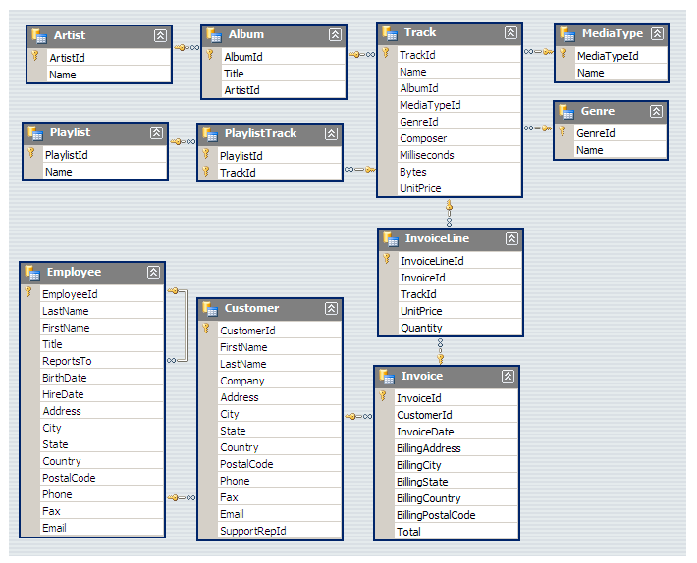
Schema:
@manikanta1801

Slide 4
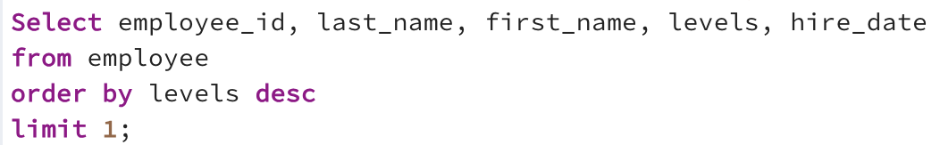
Q1: Who is the senior most employee based on job title
Query:
Data Output:
@manikanta1801

Slide 5
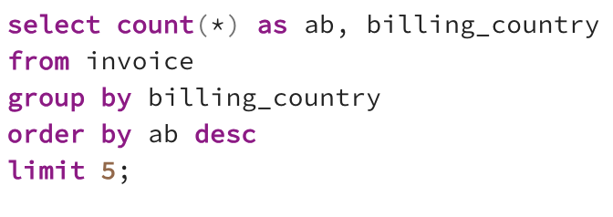
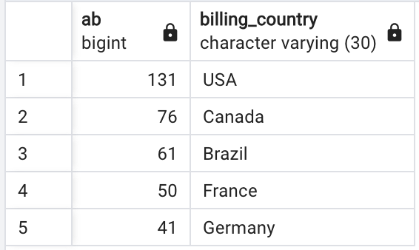
Q2: Which countries have the most Invoices? only top 5 countries
Query:
Data Output:
@manikanta1801

Slide 6
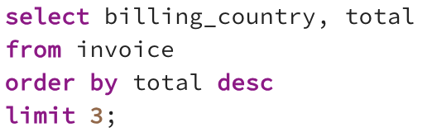
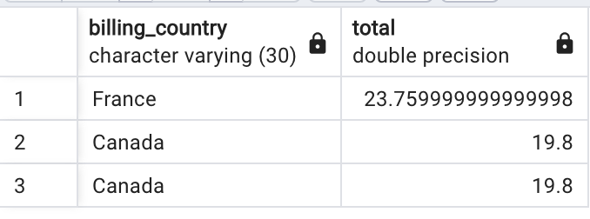
Q3: What are top 3 values of total invoice?
Query:
Data Output:
@manikanta1801

Slide 7
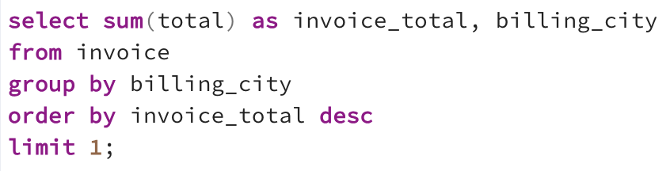
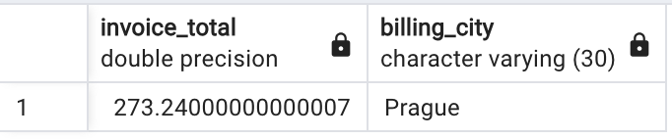
Q4: Which city has the best customers? We would like to throw a promotional Music Festival in the city we made the most money. Write a query that returns one city that has the highest sum of invoice totals. Return both the city name & sum of all invoice totals
Query:
Data Output:
@manikanta1801

Slide 8
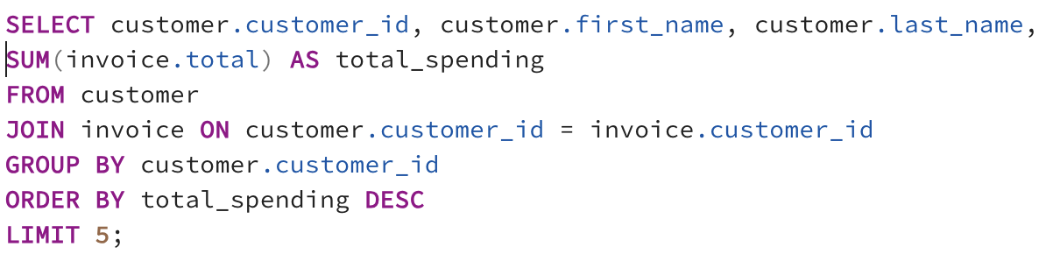
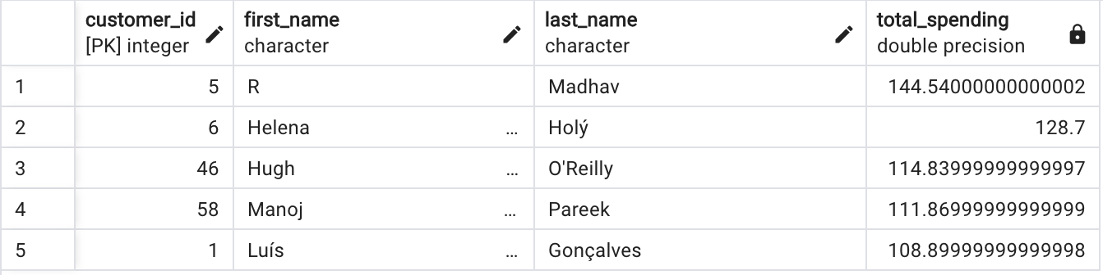
Q5: Who are the top 5 best customer? The customer who has spent the most money will be declared the best customer. Write a query that returns the person who has spent the most money.
Query:
Data Output:
@manikanta1801

Slide 9
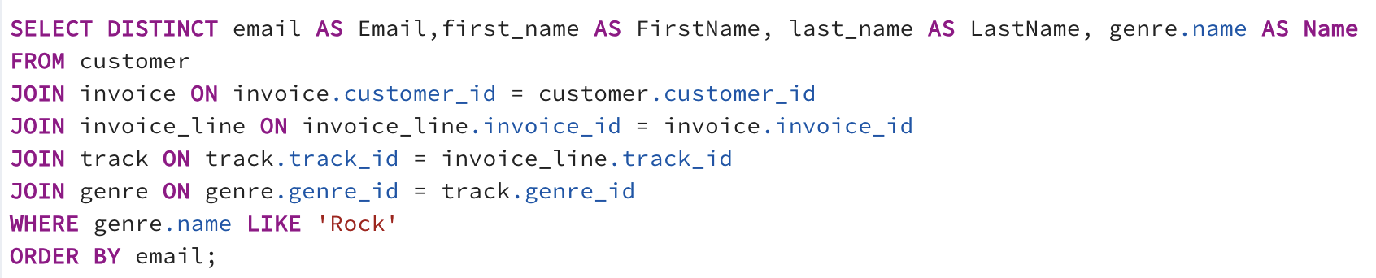
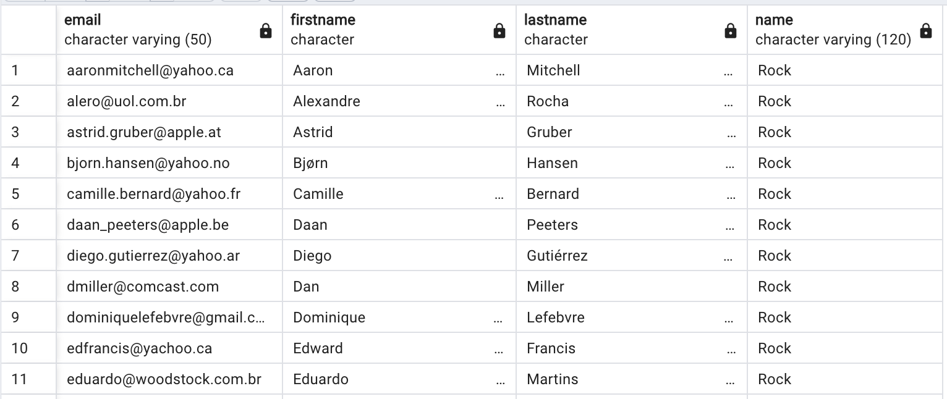
Q6: Write query to return the email, first name, last name, & Genre of all Rock Music listeners. Return your list ordered alphabetically by email starting with A.
Query:
Data Output:
@manikanta1801

Slide 10
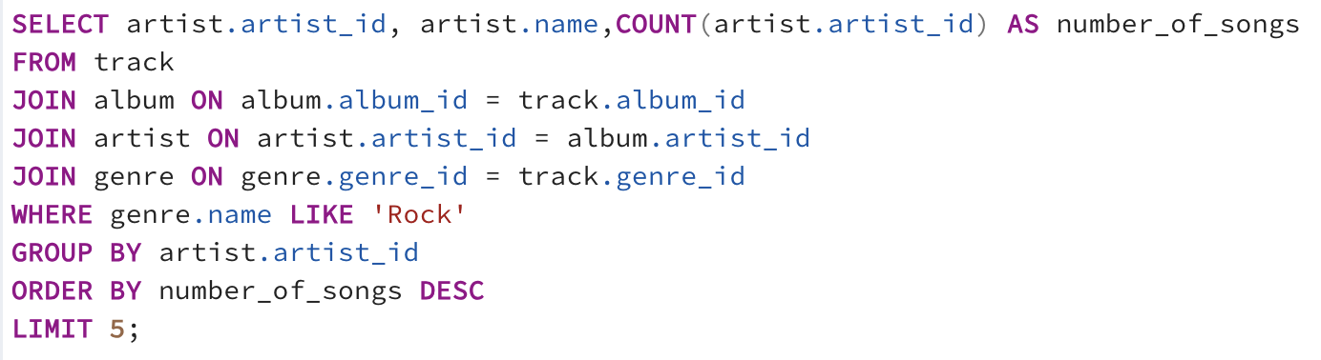
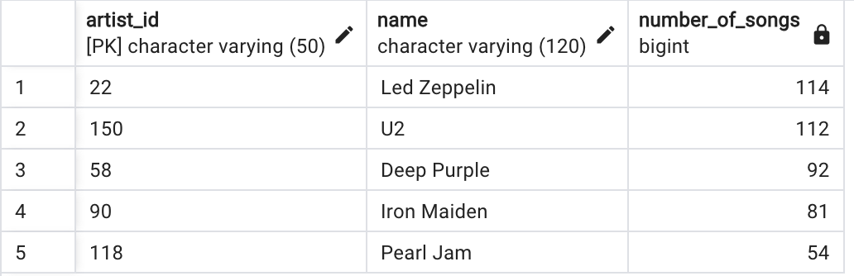
Q7: Let's invite the artists who have written the most rock music in our dataset. Write a query that returns the Artist name and total track count of the top 5 rock bands.
Query:
Data Output:
@manikanta1801

Slide 11
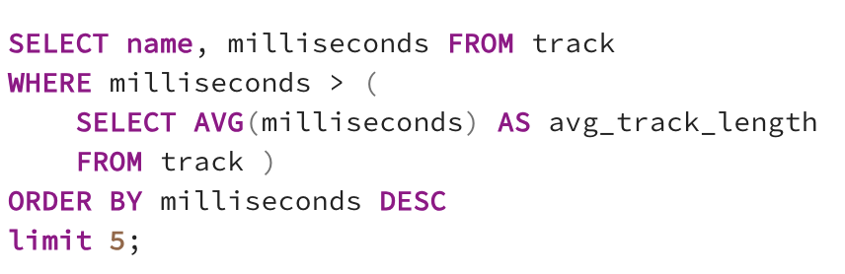
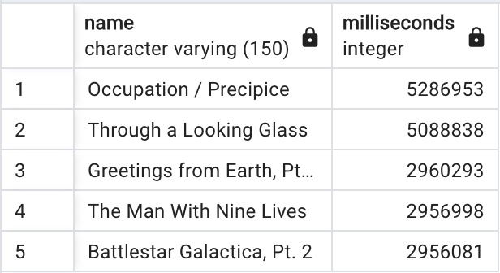
Q8: Return all the track names that have a song length longer than the average song length. Return the Name and Milliseconds for each track. Order by the song length with the longest songs listed first.
Query:
Data Output:
@manikanta1801

Slide 12
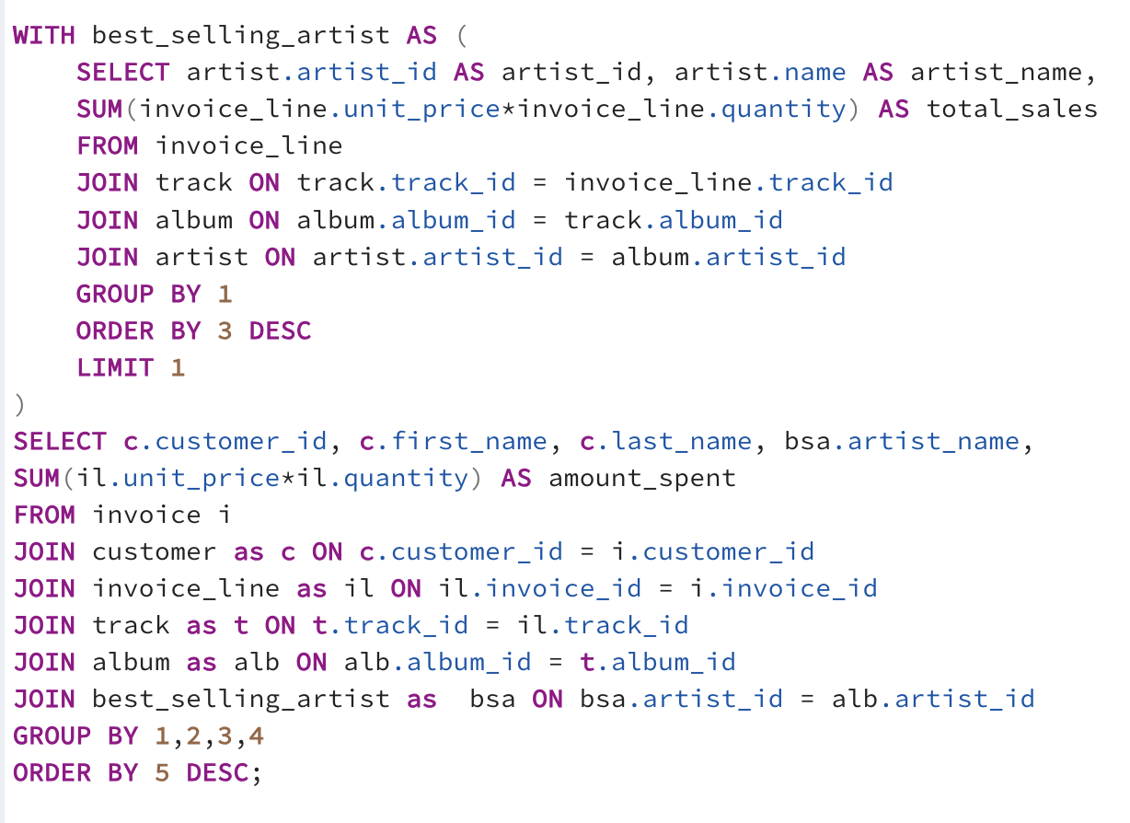
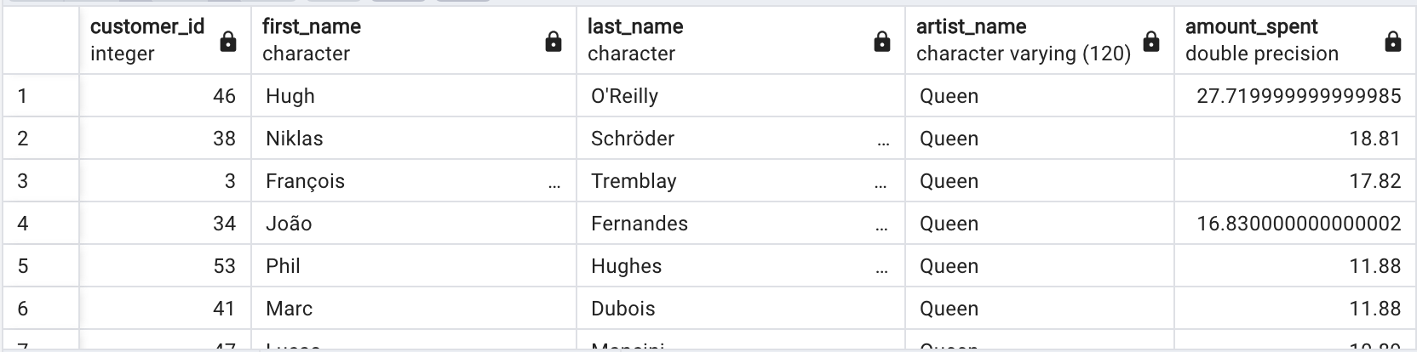
Q9: Find how much amount spent by each customer on artists? Write a query to return customer name, artist name and total spent
Query:
Data Output:
To solve the problem, first, identify the top-earning artist by joining the `Invoice_Line`, `Track`, `Album`, and `Artist` tables, then calculate total earnings for each artist by summing `Unit_Price * Quantity` and selecting the artist with the highest earnings. Next, find the customer who spent the most on this artist by joining the `Invoice_Line`, `Invoice`, `Track`, `Album`, `Artist`, and `Customer` tables, filtering for the identified artist, calculating total spending per customer by summing `Unit_Price * Quantity`, and selecting the customer with the highest spending on this artist.

Slide 13
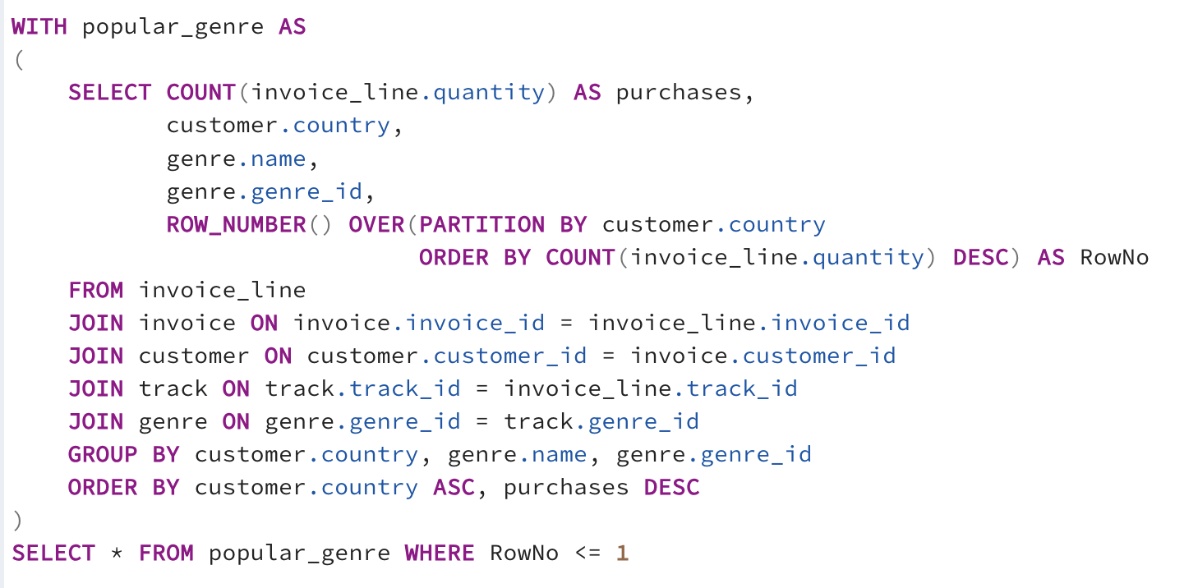
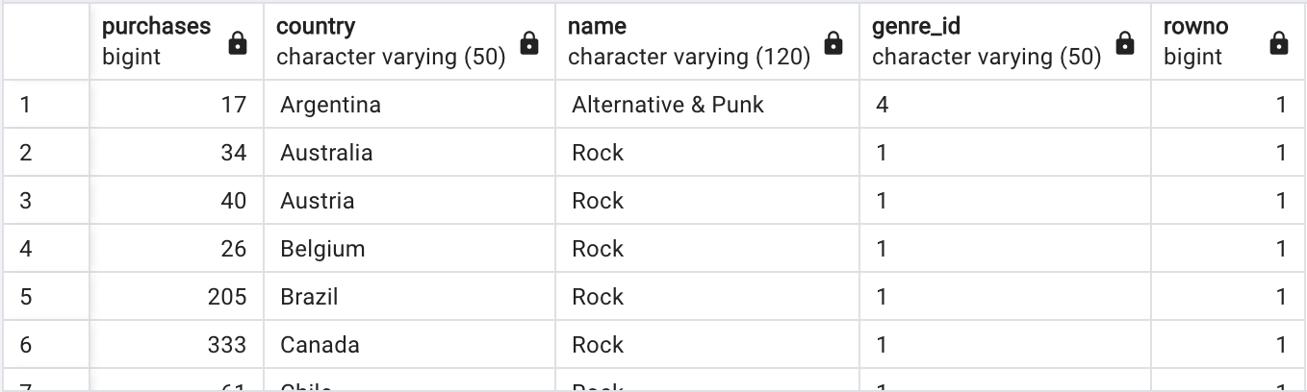
Q10: We want to find out the most popular music Genre for each country. We determine the most popular genre as the genre with the highest amount of purchases. Write a query that returns each country along with the top Genre. For countries where the maximum number of purchases is shared return all Genres.
Query:
Data Output:
@manikanta1801

Slide 14
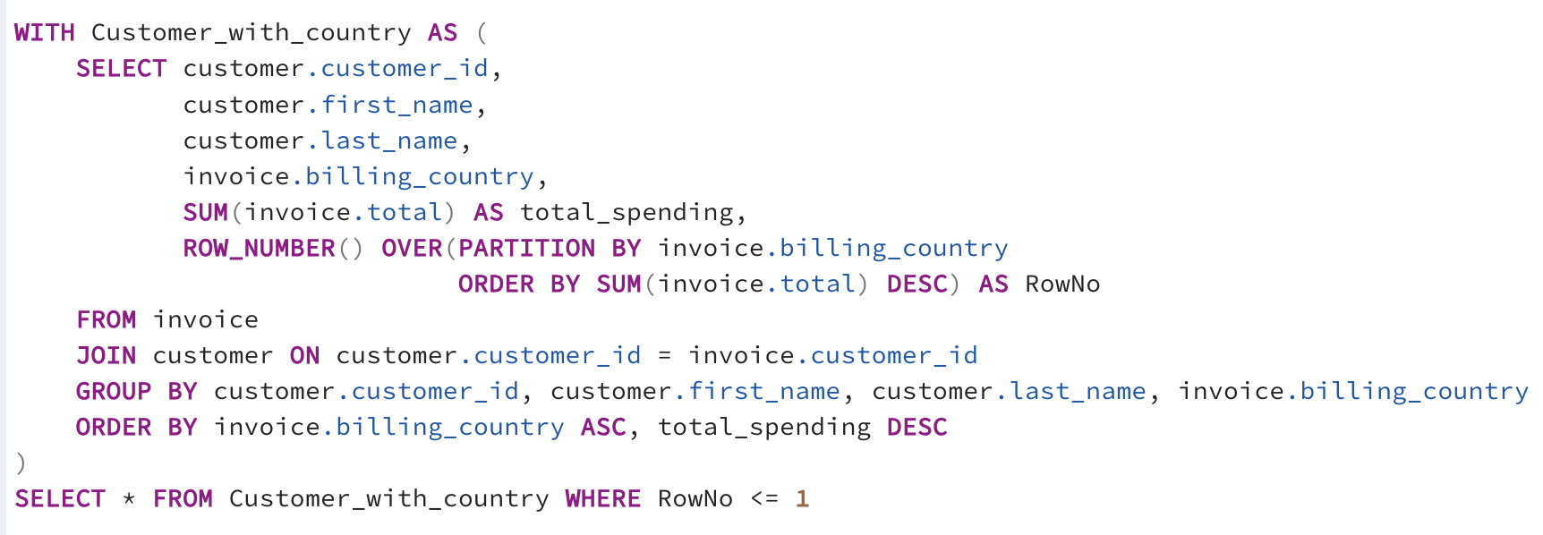
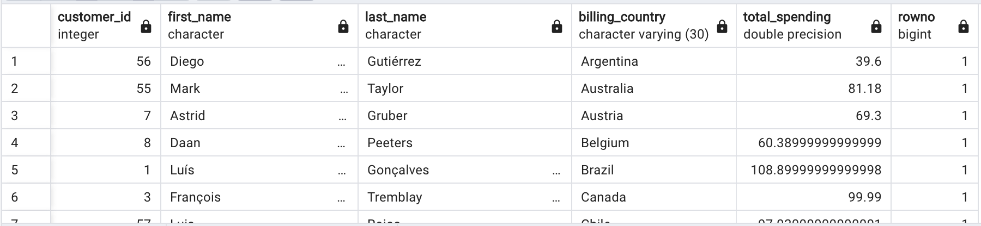
Q11: Write a query that determines the customer that has spent the most on music for each country. Write a query that returns the country along with the top customer and how much they spent. For countries where the top amount spent is shared, provide all customers who spent this amount.
Query:
Data Output:
@manikanta1801

Slide 15


Thank You
Giri Sai Manikanta Dara
@manikanta1801
daragirisaimanikanta.netlify.app

