Slide 1

College Event Registration, Volunteer Allocation & Participation Management System
A secure, scalable platform with real-time analytics — transforming how colleges plan, coordinate, and evaluate campus events.
FINAL YEAR ENGINEERING PROJECT
VISAKA MANIKANTA
324129512062

Slide 2

THE CHALLENGE
Why Traditional Event Management Falls Short
Current Pain Points
Manual registration: Paper forms and spreadsheets create errors, duplicates, and data loss
Inefficient volunteer allocation: No structured matching of skills, availability, and event needs
Poor attendance tracking: No real-time visibility into participation or no-shows
Fragmented coordination: Organisers lack a centralised view of schedules and responsibilities
No actionable insights: Historical data is inaccessible, preventing continuous improvement

Slide 3
PROJECT OBJECTIVES
What This System Sets Out to Achieve
Automate Registration
Optimise Volunteer Allocation
Eliminate manual entry with a digital, error-free registration process for students and volunteers
Intelligently match volunteers to events based on skills, availability, and role requirements
Monitor Attendance in Real Time
Deliver Actionable Insights
Track participation live with digital check-in and automated status updates
Provide administrators with live dashboards and reports for data-driven decisions

Slide 4
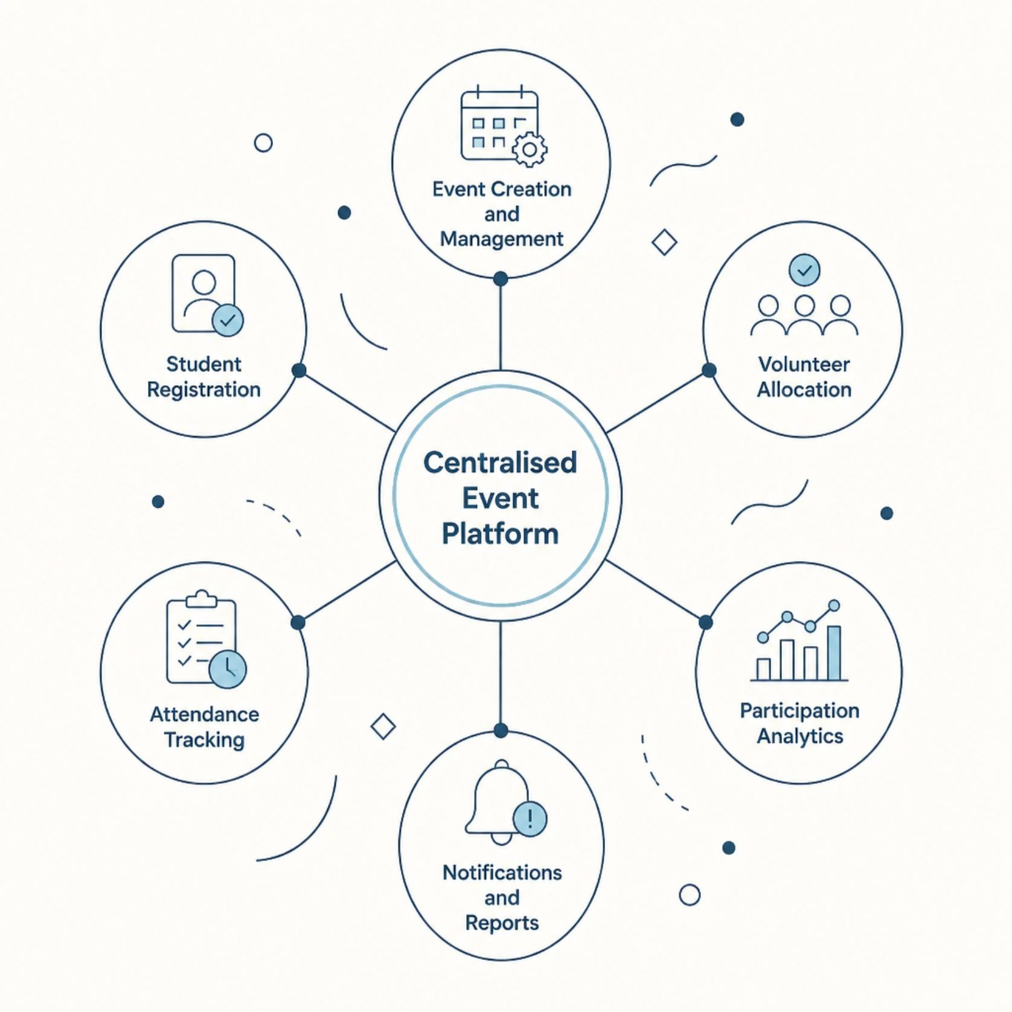
THE SOLUTION
A Centralised Platform for Modern Campus Events
Proposed System Overview
A unified web platform automating the full event lifecycle — from creation and registration to volunteer assignment, attendance tracking, and analytics.
Intuitive interfaces for students, volunteers, and administrators
Automated confirmations and real-time notifications
Role-based access control and secure data management
Scalable architecture for growing event volumes

Slide 5
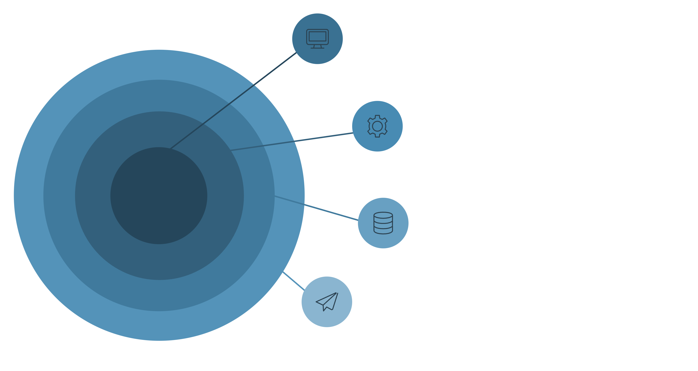
ARCHITECTURE & WORKFLOW
System Architecture & End-to-End Workflow
Presentation
Student, Volunteer portals, Admin dashboard.
Application
Event, Registration, Allocation, Attendance, Analytics.
Data
MySQL database and file storage.
External
Email gateway and SMS notifications.
The platform follows a three-tier architecture separating presentation, application, and data layers — ensuring modularity, security, and scalability across all user roles.

Slide 6



USER ROLES
Who Uses the System — and How
Students
Volunteers
Administrators
Browse events, register, receive confirmations, and track personal participation history
Apply for roles, view assigned responsibilities, check in on event day, and log hours
Create events, assign volunteers, monitor attendance, and access real-time performance dashboards

Slide 7
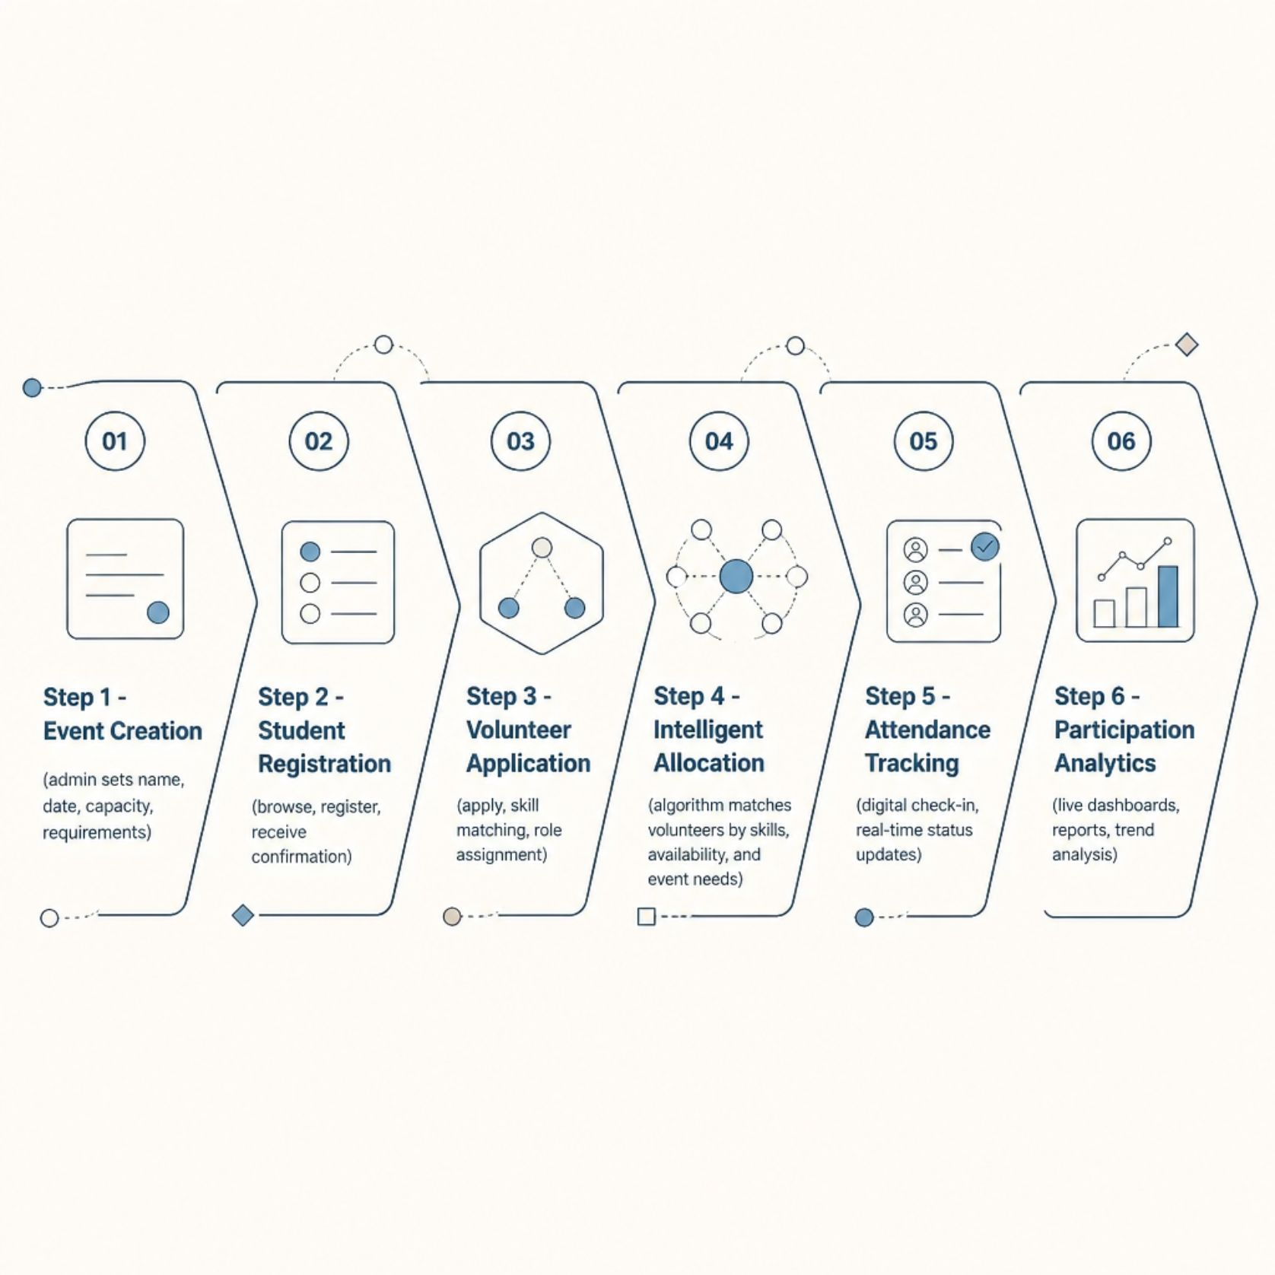
CORE MODULES
Key System Functions in Detail
Intelligent Volunteer Allocation
The allocation engine matches volunteers to events by evaluating skills, prior experience, availability, and event-specific requirements — reducing manual effort and improving role fit.
Notifications & Confirmations
Automated email and in-app alerts keep all stakeholders informed at every stage — from registration confirmation to event reminders and post-event summaries.

Slide 8
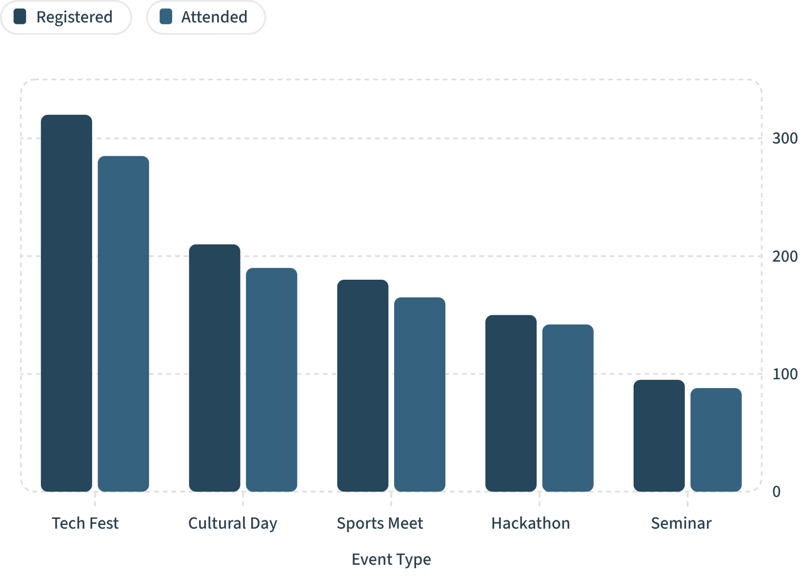

ANALYTICS & REPORTING
Real-Time Analytics & Live Dashboards
What Administrators Can Monitor
Registration trends across events and time periods
Attendance rates and no-show patterns
Volunteer utilisation and role coverage
Event-wise participation breakdowns
Historical comparisons and engagement scores
All dashboards update in real time, enabling on-the-spot decisions during live events.

Slide 9
TECHNOLOGY & SECURITY
Built on a Modern, Secure Technology Stack
Technology Stack
Security & Privacy
Role-based access control (RBAC) across all user tiers
Encrypted data in transit (TLS) and at rest (AES-256)
Input validation and sanitisation to prevent injection attacks
Session management with secure token-based authentication
GDPR-aligned data handling and audit logging
Frontend
Backend
React.js / Angular — responsive, mobile-friendly UI
Node.js / Spring Boot — RESTful API architecture
Database
DevOps
MySQL / PostgreSQL — relational data with full indexing
Docker, CI/CD pipelines, cloud-ready deployment

Slide 10
OUTCOMES & ROADMAP
Expected Impact & the Path Forward
Key Benefits
Future Enhancements
Up to 70% reduction in manual administrative effort
Near-zero registration errors through automated validation
Improved volunteer satisfaction via intelligent role matching
Live visibility into event performance for all stakeholders
Scalable to support hundreds of concurrent events
Mobile application with offline check-in capability
AI-driven recommendations for event suggestions and volunteer matching
Integration with university SIS and calendar systems
Predictive analytics for attendance forecasting and capacity planning

