Slide 1


Slide 2
DNS :
A Domain Name System (DNS) turns domain names into IP addresses, which allow browsers to get to websites and other internet resources
Cache DNS
Primary DNS
Secondary DNS
Forwarder
AD Integrated
IP confirguration and Flush DNS

Slide 3


Slide 4
DHCP :
Dynamic Host Configuration Protocol (DHCP) is a network protocol that is used to configure network devices to communicate on an IP network.
Lease duration
Subnet mask
Benefits of DHCP

Slide 5
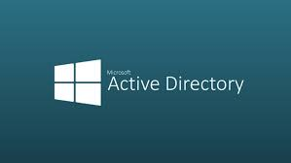

Slide 6
Active Directory (AD):
Active Directory (AD) is a database and set of services that connect users with the network resources they need to get their work done. The database (or directory) contains critical information about your environment, including what users and computers there are and who's allowed to do what.
Uses
Compute
Group Policy
Group & OU

Slide 7
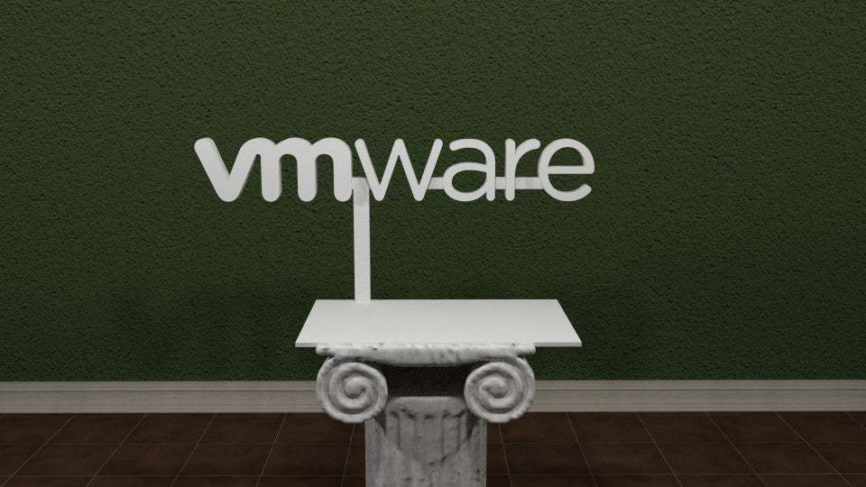

Slide 8
VM WARE :
Virtualization software creates an abstraction layer over computer hardware that allows the hardware elements of a single computer— processors, memory, storage, and more— to be divided into multiple virtual computers, commonly called virtual machines (VMs).
VMDK
Vertus
Tivoli-IBM

Slide 9
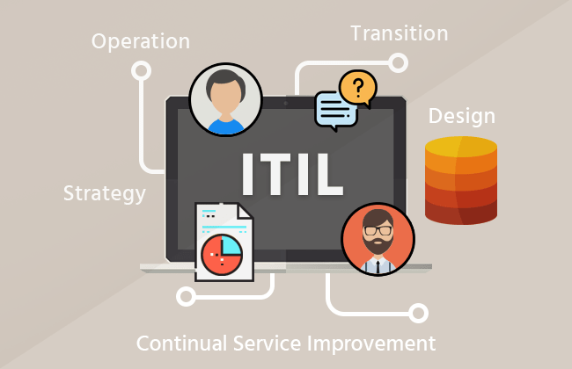

Slide 10
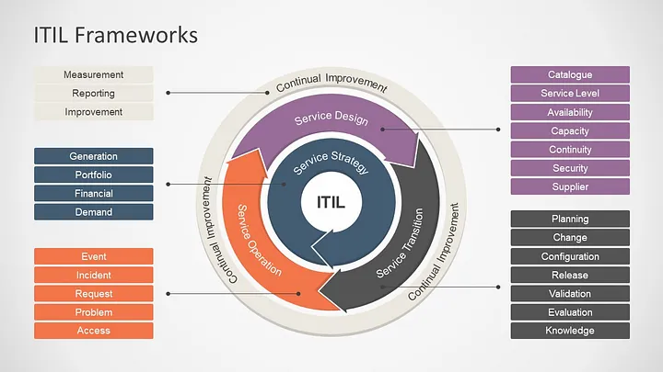

Slide 11
Thank You

