Slide 1
Capstone Project - The Battle of Neighborhoods (Week 2)
Prepared by
MANIKANTA CHITTIPROLU

Slide 2
INTRODUCTION:
The purpose of this Capstone Project is to help people in exploring better facilities around their neighborhood.
Lots of people are migrating to various states of Spain and needed lots of research for good housing prices and reputated schools for their children

Slide 3
OBJECTIVE:
This project is for those people who are looking for better neighborhoods. For ease of accessing to Cafe, School, Super market, medical shops, grocery shops, mall, theatre, hospital, like minded people, etc.
It will help people to get awareness of the area and neighborhood before moving to a new city, state, country or place for their work or to start a new fresh life

Slide 4
SOLUTION:
Sorted list of house in terms of housing prices in a ascending or descending order
Sorted list of Restaurants ,grocery stores, schools and cafe in terms of location, fees, rating and reviews

Slide 5
METHODOLOGY:
To compare the similarities of two cities, we decided to explore neighborhoods, segment them, and group them into clusters .
To be able to do that, we need to cluster data which is a form of unsupervised machine learning: k-means clustering algorithm.

Slide 6
LIBRARIES USED:
Matplotlib
Scikit
Pandas
Numpy
Geocoder
Folium

Slide 7
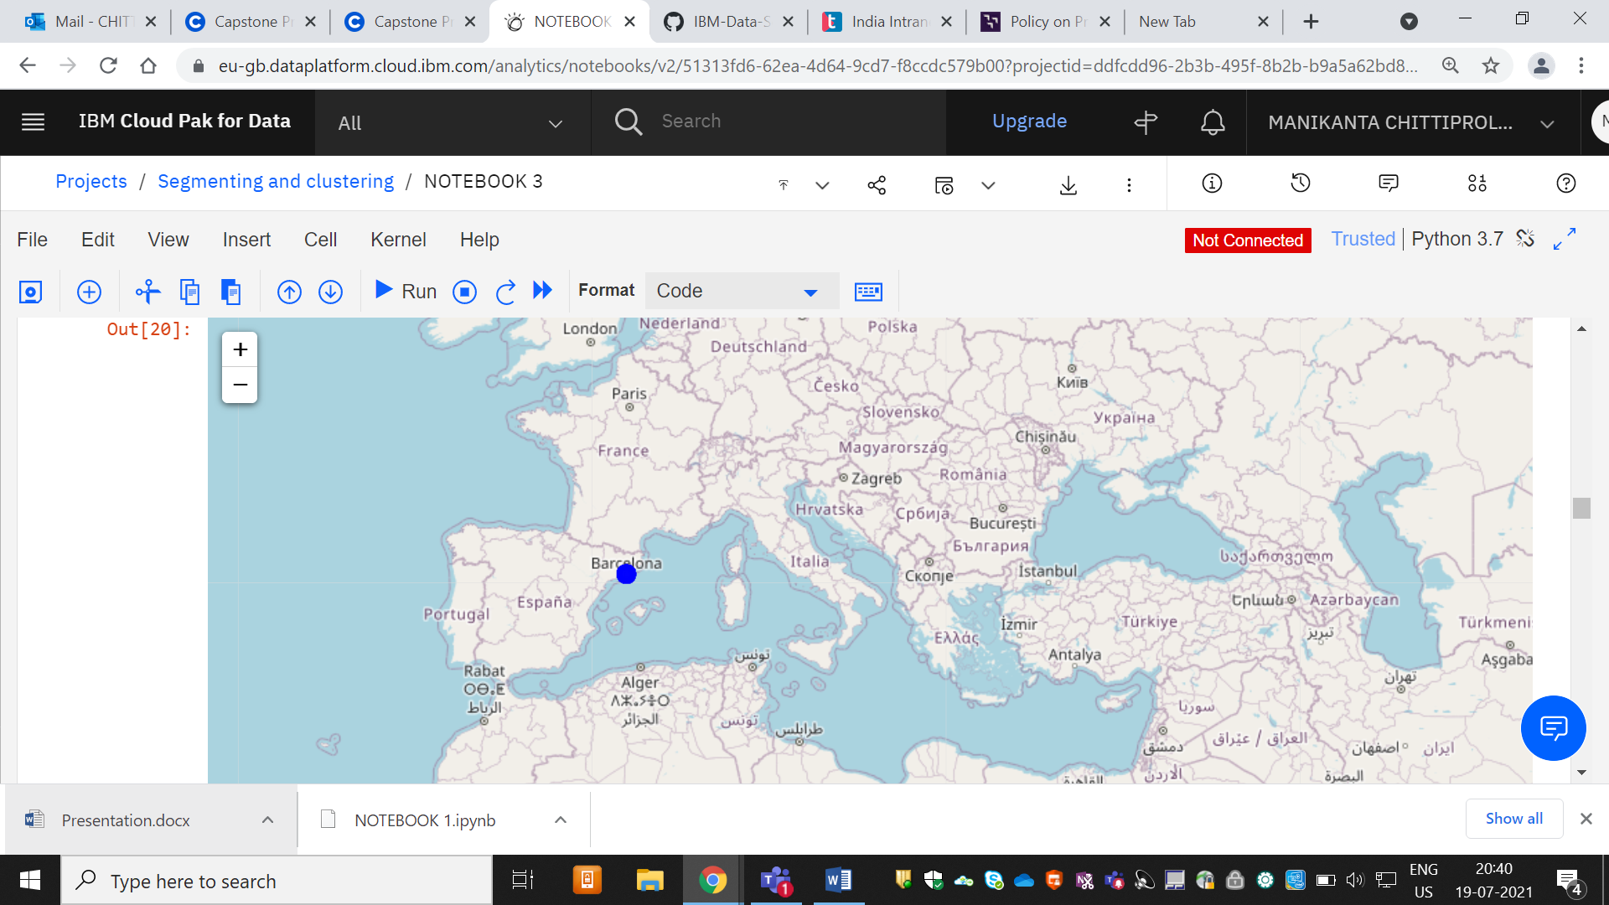
RESULTS:
FIG: City map of Barcelona

Slide 8
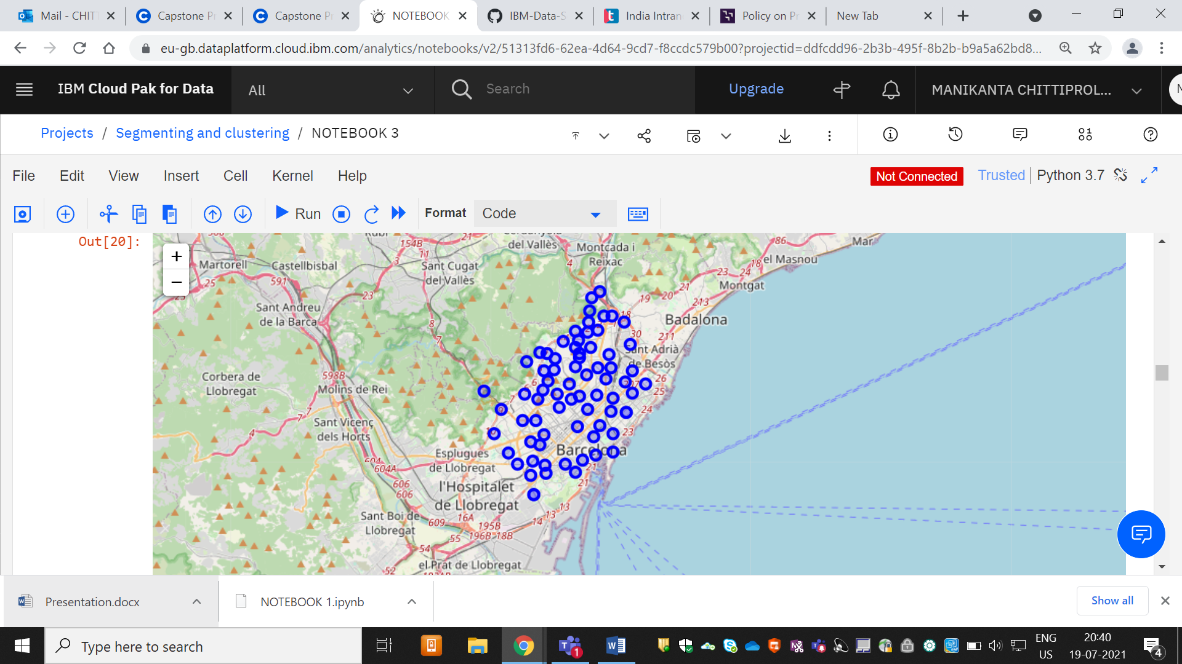
FIG: clusters formed in the Barcelona city

Slide 9
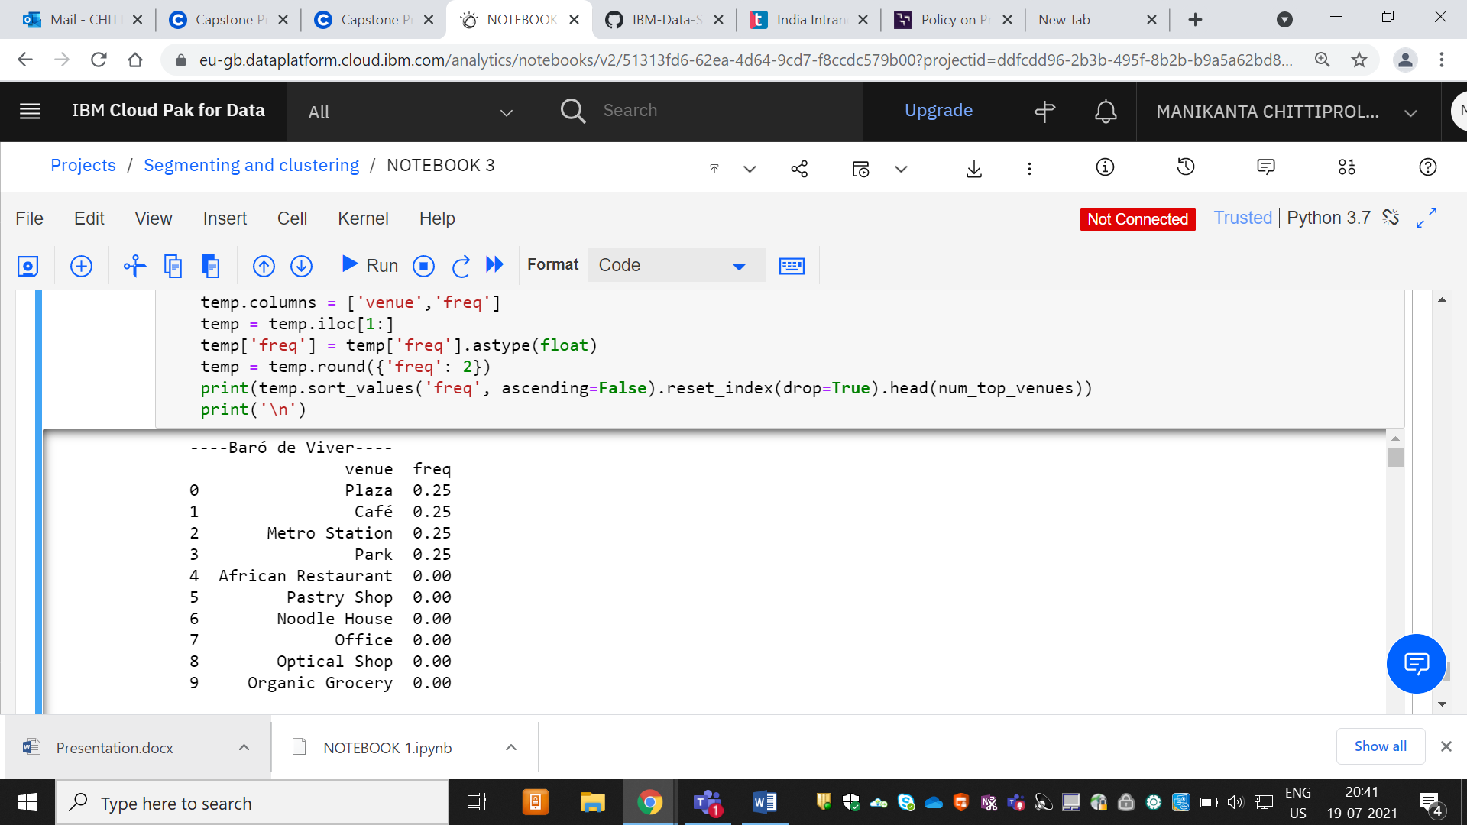
FIG: Venues in the neighbourhood of Barcelona with frequency

Slide 10
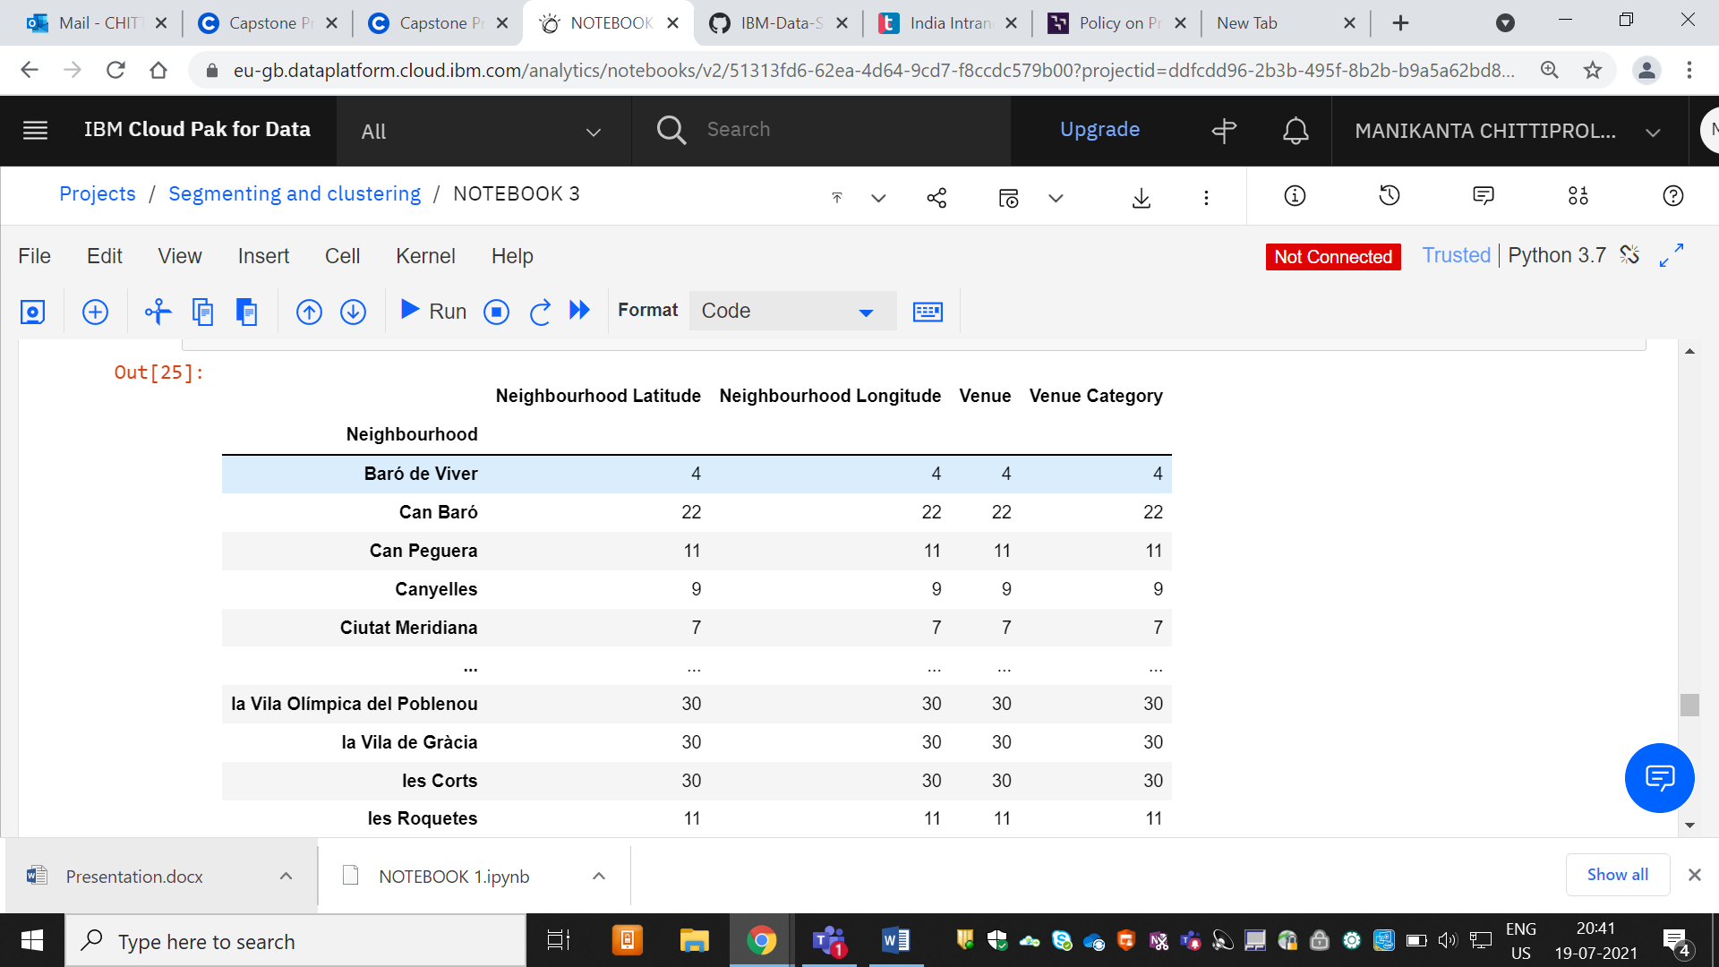
FIG: Venues in Barcelona with Latitudes and Longitudes grouped by category using K-means clustering

Slide 11
DISCUSSION:
Problem Which Tried to Solve:
The major purpose of this project, is to suggest a better neighborhood in a new city for the person who are shiffting there. Social presence in society in terms of like minded people. Connectivity to the restaurants, grocery stores and cafes and other daily needs things nearby.

Slide 12
CONCLUSION:
I feel rewarded with the efforts and believe this course with all the topics covered is well worthy of appreciation. This project has shown me a practical application to resolve a real situation that has impacting personal and financial impact using Data Science tools. The mapping with Folium is a very powerful technique to consolidate information and make the analysis and decision better with confidence

