Slide 1
YVI DWAN · EXECUTIVE RISK INTELLIGENCE
Executive Cyber Risk Command Center
R&D → Implementation → Production-readiness
Risk → Impact → Decision → Action → Closed Loop
Data-backed MVP · PostgreSQL · Fastify · React · Sample dataset verified

Slide 2
Agenda
From problem framing to a demonstrable MVP
Discovery & design
Build & readiness
• Problem & product principle
• Source materials consumed
• Reference vs implemented UI
• Architecture & data model
• Sample data & KPI derivation
• Executive journeys & decisions
• Security / tenancy
• What shipped + test evidence
• Limitations & next phase
• How to run locally
YVI DWAN · Executive Cyber Risk Command Center · 2/20

Slide 3
The problem
CXOs have many technical dashboards — not one business-context command view
• Domain tools (SOC, IAM, CSPM, VAPT, compliance…) produce signals in isolation
• Board packs are assembled manually, late, and in technical language
• Executives need residual risk, financial exposure, compliance, and decisions in one place
• Success metric: time-to-executive-insight measured in seconds, not hours
YVI DWAN · Executive Cyber Risk Command Center · 3/20

Slide 4
Product principle
ECC is an aggregation layer above 12 YVI domain solutions — not a replacement
• Risk → Impact → Decision → Action → Closed Loop
• Ingest / normalize / correlate domain signals into executive language
• Translate findings into financial & compliance impact
• Escalate only what exceeds executive tolerance into a decision queue
• Record actions immutably and feed closed-loop reporting
YVI DWAN · Executive Cyber Risk Command Center · 4/20

Slide 5
Source materials (authoritative)
Implementation followed supplied contracts — not invented models
• HTML mockup + preview.jpg — visual / information-architecture baseline
• High-Level Flow PDF — end-to-end product stages
• Database ERD PDF + cyber_command_center_schema.sql — domain model & RLS intent
• CyberCommandCenter_Sample_Data.xlsx — synthetic multi-tenant dataset to import
• Prior repo demo (5-domain hardcoded SPA) treated as superseded prototype
YVI DWAN · Executive Cyber Risk Command Center · 5/20

Slide 6
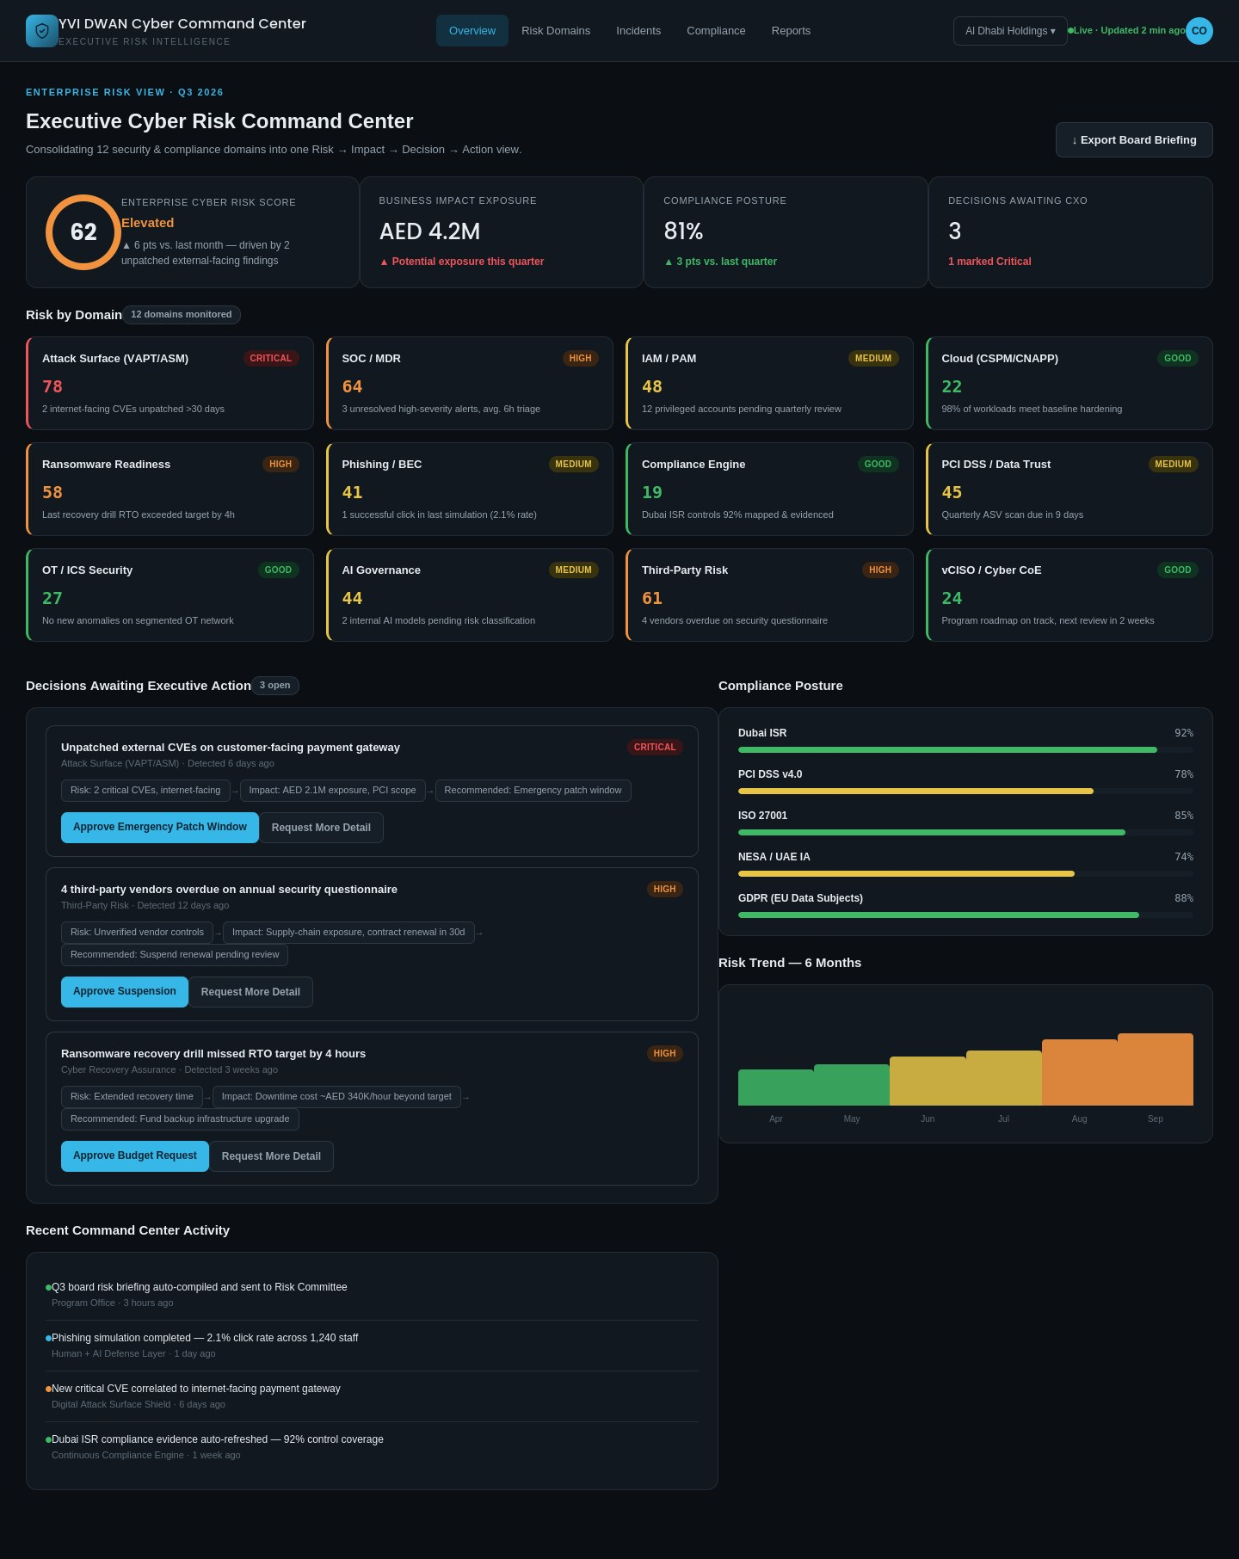
Reference UI baseline
Static HTML / preview — visual target, not hardcoded production values
Note: mockup KPIs (e.g. score 62) differ from sample DB (Al Dhabi ≈ 42.83).
YVI DWAN · Executive Cyber Risk Command Center · 6/20

Slide 7
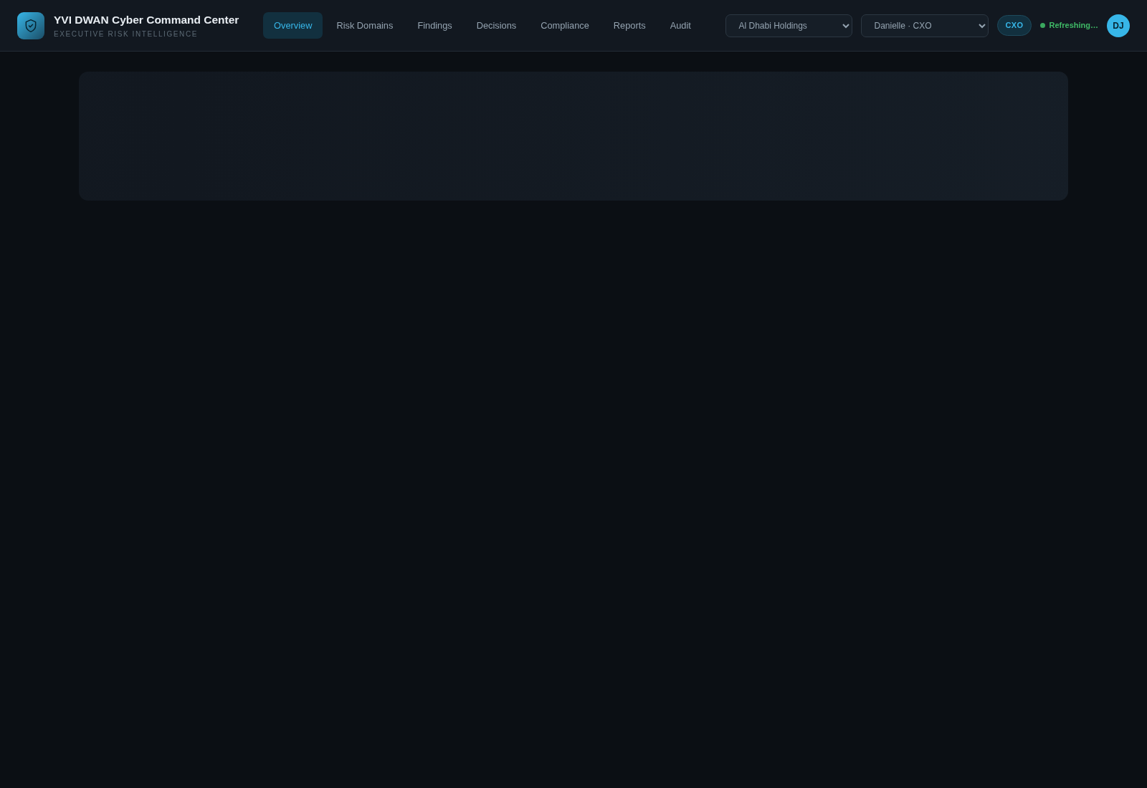
Implemented Command Center
Data-backed Overview — KPIs computed from PostgreSQL for the selected organization
Decisions Awaiting Executive Action is the primary CXO interaction (inline Approve / Request Info).
YVI DWAN · Executive Cyber Risk Command Center · 7/20

Slide 8
Architecture (smallest viable)
Reuse existing React/Vite app; add Postgres + Fastify aggregation API
• PostgreSQL 16 via Docker Compose (host port 5433)
• Idempotent Excel → DB importer + FK validation report
• Fastify /api/ecc/* with org-scoped aggregation (overview endpoint)
• React UI: Overview, Domains, Findings, Decisions, Compliance, Reports, Audit
• Demo auth headers X-Org-Id / X-User-Id (SSO deferred)
• Explicitly deferred: microservices, K8s, WebSockets, FAIR, live external feeds
YVI DWAN · Executive Cyber Risk Command Center · 8/20

Slide 9
Data model (schema-faithful)
15 tables · multi-tenant org_id · Risk→Impact→Decision linkage
• Tenancy: organizations, users (cxo / board / program_office / analyst / auditor)
• Domains: risk_domains (12), org_domain_subscriptions
• Scores: domain_risk_snapshots, enterprise_risk_score_snapshots
• Evidence: risk_findings → business_impact_assessments → executive_decisions
• Closed loop: decision_action_log, command_center_activity, generated_reports, audit_log
• Compliance: compliance_frameworks + org_compliance_status
YVI DWAN · Executive Cyber Risk Command Center · 9/20

Slide 10
Sample dataset (imported)
Workbook mapped 1:1 to schema — validation PASSED after reload
Entity | Rows | Notes
organizations | 5 | Incl. Al Dhabi, Falcon, Burj, Meridian, Zayed
risk_domains | 12 | Full YVI portfolio taxonomy
domain_risk_snapshots | 360 | 6 months × 12 × 5
enterprise snapshots | 30 | Trend source
findings / impacts | 15 / 15 | Linked AED exposure
executive_decisions | 15 | Awaiting varies by org
compliance status | 50 | 5 frameworks × orgs/snapshots
activity / reports | 34 / 10 | Closed-loop artifacts
YVI DWAN · Executive Cyber Risk Command Center · 10/20

Slide 11
KPI calculation model
Server-side only — no hardcoded HTML prototype numbers in the UI
KPI | Source | Rule
Enterprise risk score | enterprise_risk_score_snapshots | Latest snapshot + MoM delta
Business impact exposure | business_impact_assessments | Sum AED for open findings
Compliance posture | org_compliance_status | Avg latest coverage %
Decisions awaiting CXO | executive_decisions | status = awaiting_decision ONLY
Risk by domain | domain_risk_snapshots | Latest per subscribed domain
Risk trend | enterprise snapshots | Chronological score series
YVI DWAN · Executive Cyber Risk Command Center · 11/20

Slide 12
Executive journeys (MVP)
Designed for <30s posture comprehension and actionable follow-through
• J1 CXO opens Overview → score, trend, exposure, compliance, awaiting queue
• J2 Domain card → score history, findings, linked decisions, exposure rollup
• J3 Finding → financial / downtime / BU / compliance scope → linked decision
• J4 Approve or Request More Information inline → action log + activity + audit
• Org switcher: Al Dhabi (0 awaiting, valid empty) · Falcon (2 awaiting, demo path)
YVI DWAN · Executive Cyber Risk Command Center · 12/20

Slide 13
Decision workflow
Immutable history · explicit statuses · overview matches KPI
• States: awaiting_decision · info_requested · approved · declined · closed
• Overview KPI & queue count only awaiting_decision (info_requested excluded)
• Primary overview actions: Approve (from recommended_action) + Request More Information
• Every mutation writes decision_action_log + audit_log + command_center_activity
• RBAC: CXO approve/decline · CXO/Program Office request-info/close · others read
• Duplicate submission guarded in UI (busy lock) + terminal-state 409 on API
YVI DWAN · Executive Cyber Risk Command Center · 13/20

Slide 14
Security & tenancy
Frontend hiding is not isolation — API enforces organization context
• All tenant routes require validated X-Org-Id + X-User-Id membership
• Findings, decisions, compliance, reports, audit filtered by org_id
• Cross-org decision read/mutate returns 404; analyst approve returns 403
• Domain UUIDs are shared catalog; findings/snapshots remain org-scoped (tested)
• Schema includes RLS policies; MVP app role still bypasses RLS — next-phase hardening
• Demo auth is intentional for workshops — not a production IdP
YVI DWAN · Executive Cyber Risk Command Center · 14/20

Slide 15
What we shipped
MUST-HAVE flow complete · production-readiness pass applied
Core product
Hardening
• DB + sample import/validation
• Aggregation APIs + overview
• Domains / findings / decisions
• Inline CXO decision actions
• Compliance · reports · audit
• Org switch + role-visible UI
• RIDA chain on overview cards
• Honest polled freshness label
• Domain drill-down enrichment
• Empty/error/loading states
• Tenant isolation tests
• Typecheck + production build
YVI DWAN · Executive Cyber Risk Command Center · 15/20

Slide 16
Test evidence
Gates executed during R&D and hardening
• Sample import validation — row counts + FK checks PASSED
• Overview golden tests (Al Dhabi KPIs · Falcon queue ≡ KPI) PASSED
• Security tests (finding isolation · report scoping · approve/audit) PASSED
• E2E Risk→Impact→Decision→Action script PASSED
• Frontend TypeScript build (tsc + vite build) PASSED
YVI DWAN · Executive Cyber Risk Command Center · 16/20

Slide 17
Known limitations
Explicit so stakeholders do not confuse MVP with production enterprise ops
• Header demo auth — not SSO / MFA
• DB owner connection bypasses Postgres RLS (API filters active today)
• No live domain feed adapters yet (workbook is the source)
• Sample compliance_scope_impact often null — UI shows when present
• Board briefing is Markdown from live aggregates (PDF later)
• Al Dhabi sample has zero awaiting decisions — use Falcon for action demo
YVI DWAN · Executive Cyber Risk Command Center · 17/20

Slide 18
Recommended next phase
Stay on current architecture — deepen trust, feeds, and board packaging
• Phase A: SSO + connect as ccc_app with app.current_org_id RLS enforced
• Phase B: Wire 1–3 live domain feeds into findings/snapshots
• Phase C: Per-org risk appetite config (replace env default 50)
• Phase D: Decision aging / SLA + PDF board briefing
• Phase E: Playwright UI smoke (org switch + approve path)
• Do not add FAIR Monte Carlo, WebSockets, or microservices unless required
YVI DWAN · Executive Cyber Risk Command Center · 18/20

Slide 19
How to run locally
Workshop / demo path
• docker compose up -d # Postgres on localhost:5433
• .venv-ecc/bin/python db/import_sample_data.py --reset && validate_import.py
• cd server && npm run dev # API :4000
• cd web && npm run dev # UI :5173 (proxies /api)
• Switch org to Falcon National Bank to exercise awaiting CXO decisions
• Docs: docs/ecc-*.md · checklist · production-readiness
YVI DWAN · Executive Cyber Risk Command Center · 19/20

Slide 20
One command view for cyber risk —
in business language, with decisions that close the loop.
Questions · pilot scoping · feed mapping workshop
YVI DWAN · Executive Cyber Risk Command Center · 20/20

