Slide 1
STRATEGY DESIGN PATTERN
Sravan Appana(3)
Architha Mukka(30)
Vikesh Padarthi(39)
Manikanta Maddula(24)

Slide 2
STRATEGY DESIGN PATTERN
The strategy pattern enables an algorithm’s behaviour to be selected at run time.
In the strategy pattern, behaviours are defined as separate interfaces and specific classes that implement these interfaces. This allows better decoupling between the behaviour and the class that uses the behaviour.
Strategy pattern define a family of algorithms.
The strategy pattern encapsulates using interfaces and make them interchangeable.
The strategy pattern algorithm varies independently from clients that use it.

Slide 3
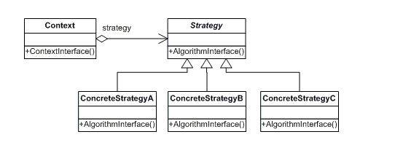
CLASS DIAGRAM FOR STRATEGY DESIGN PATTERN
The classes and objects participating in this pattern are:
Strategy-declares an interface common to all supported algorithms. Context uses this interface to call the algorithm defined by a Concrete Strategy
Concrete Strategy-implements the algorithm using the Strategy interface
Context -is configured with a Concrete Strategy object maintains a reference to a Strategy object may define an interface that lets Strategy access its data.

Slide 4
BENEFITS OF STRATEGY DESIGN PATTERN:
Strategy pattern reduces long list of conditionals.
Strategy avoids duplicate code.
Strategy pattern keep changing of classes by forcing other classes to change.
Strategy pattern can hide complicated/secret code from the user.
Hierarchies of Strategy classes can be used to define a family of algorithms or behaviours for contexts to reuse.
Strategy enables the clients to choose the required algorithm, without using a "switch" statement or a series of "if-else" statements.
Using encapsulation the algorithm separately, new algorithms complying with the same interface can be easily introduced.

Slide 5
DISADVANTAGES OF STRATEGY DESIGN PATTERN:
Strategy pattern increases the number of objects in an application.
A client must understand how Strategies differ to be able to select the right strategy.
The application configures the Context with the required Strategy object. Therefore, the application needs to create and maintain two objects in place of one.
Since, the Strategy object is created by the application in most cases; the Context has no control on lifetime of the Strategy object. However, the Context can make a local copy of the Strategy object. But, this increases the memory requirement and has performance impact.

Slide 6
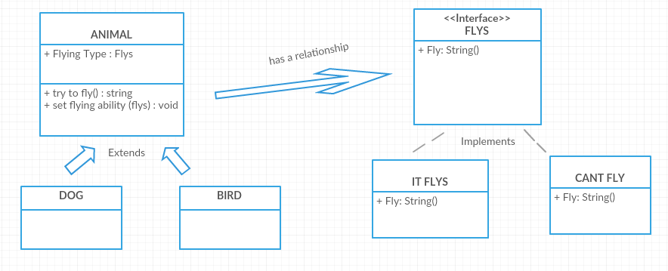
CLASS DIAGRAM FOR STRATEGY DESIGN PATTERN OF AN ATM SYSTEM

Slide 7
STRATEGY DESIGN PATTERN
List of Java Classes :
Animal.java
Dog.java
Bird.java
Flys.java
AnimalPlay.java

Slide 8
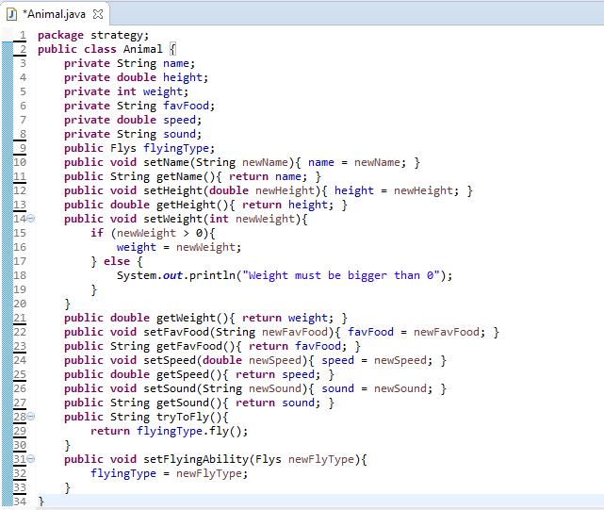

Slide 9
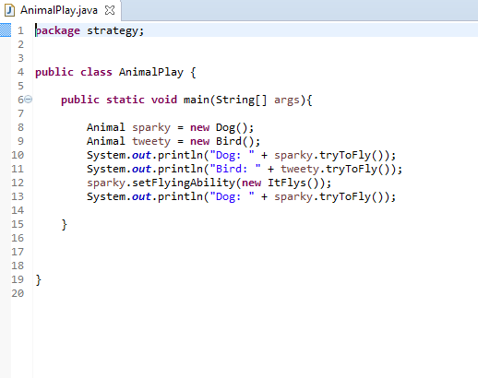

Slide 10
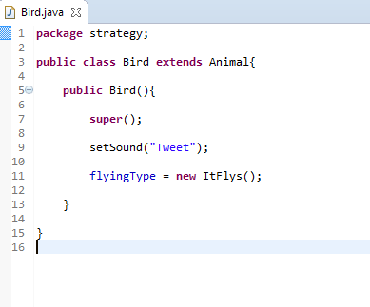

Slide 11
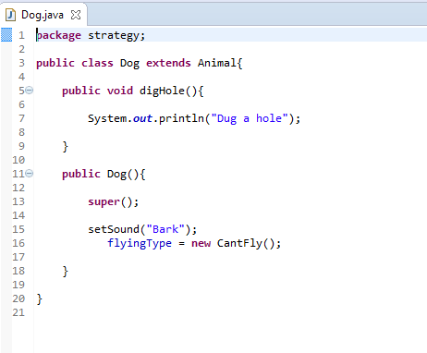

Slide 12
